Slide 1
Section 8.2
Area of a Surface of Revolution

Slide 2
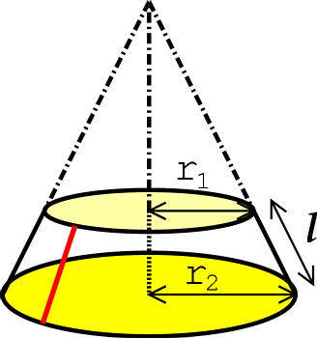
THE AREA OF A FRUSTUM
The area of the frustum of a cone is given by
$$A=2π\left(\frac{r_{1}+r_{2}}{2}\right)⋅ℓ \\ =2π\left(average radius\right)⋅\left(length\right)$$

Slide 3
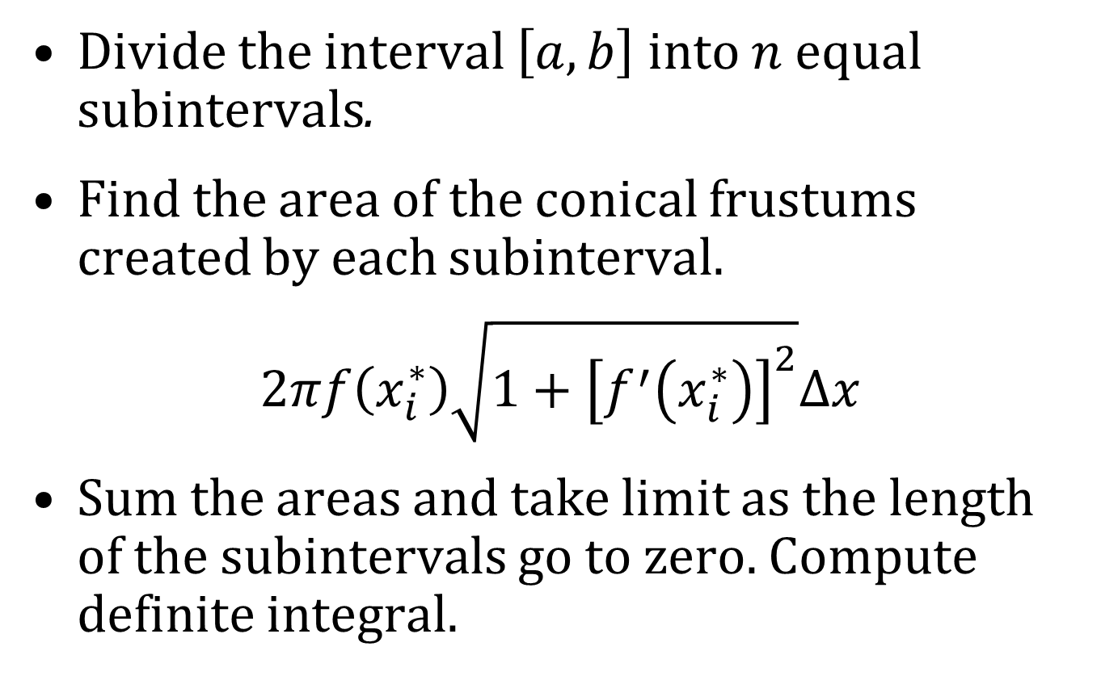
FINDING THE SURFACE AREA OF A SOLID OF REVOLUTION
Divide the interval $\left[a,b\right]$ into $n$ equal subintervals.
Find the area of the conical frustums created by each subinterval.
$$2πf\left(x_{i}^{∗}\right)\sqrt{1+{\left[f^{′}\left(x_{i}^{∗}\right)\right]}^{2}}Δx$$
Sum the areas and take limit as the length of the subintervals go to zero. Compute definite integral.

Slide 4
REVOLUTION ABOUT THE x-AXIS
Let f be positive and have a continuous derivative. The surface area of the surface obtained by rotating the curve $y=f\left(x\right), a≤x≤b$, about the $x$-axis is
$$S=\int_{a}^{b}{2πf\left(x\right)\sqrt{1+{\left[f^{′}\left(x\right)\right]}^{2}}dx} \\ =\int_{a}^{b}{2πf\left(x\right)\sqrt{1+{\left(\frac{dy}{dx}\right)}^{2}}dx}$$
If the curve is $x=g\left(y\right), c≤y≤d$, then
$$S=\int_{c}^{d}{2πy\sqrt{1+{\left(\frac{dx}{dy}\right)}^{2}}dy}$$
NOTE: For both cases, $S=∫2πy ds=2π∫y ds$

Slide 5
REVOLUTION ABOUT THE y-AXIS
For rotation about the $y$-axis, the surface area formula is
$$S=∫2π x ds$$
where
$$ds=\sqrt{1+{\left(\frac{dy}{dx}\right)}^{2}}dx \\ =\sqrt{1+{\left(\frac{dx}{dy}\right)}^{2}}dy$$

