Slide 1
Section 8.1
Arc Length

Slide 2
FINDING THE LENGTH OF A PLANE CURVE
Divide the interval $\left[a, b\right]$ into $n$ equal subintervals.
Find the length of the straight line segments in each subinterval using the distance formula.
$\sqrt{1+{\left[f^{′}\left(x_{i}^{∗}\right)\right]}^{2}}Δx$
Sum the lengths and take limit as the length of the subintervals go to zero. Compute definite integral.

Slide 3
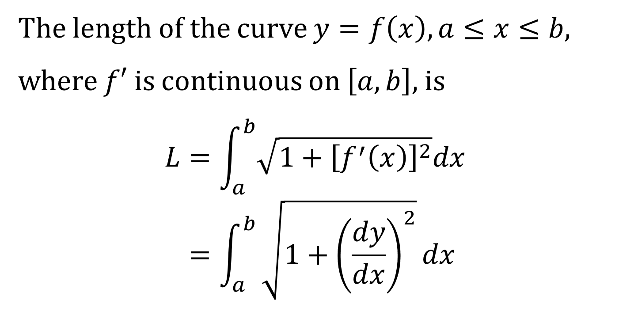
THE ARC LENGTH FORMULA
The length of the curve $y=f\left(x\right), a≤x≤b$,
where $f′$ is continuous on $\left[a,b\right]$, is
$$L=\int_{a}^{b}{\sqrt{1+{\left[f^{′}\left(x\right)\right]}^{2}}dx} \\ =\int_{a}^{b}{\sqrt{1+{\left(\frac{dy}{dx}\right)}^{2}}dx}$$

Slide 4
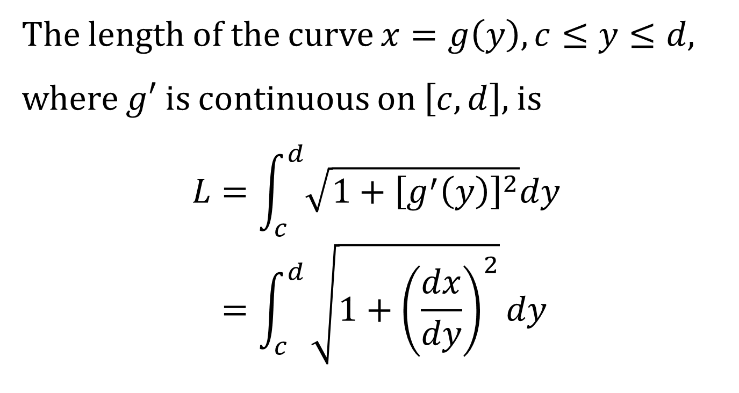
ANOTHER ARC LENGTH FORMULA
The length of the curve $x=g\left(y\right), c≤y≤d$,
where $g′$ is continuous on $\left[c,d\right]$, is
$$L=\int_{c}^{d}{\sqrt{1+{\left[g^{′}\left(y\right)\right]}^{2}}dy} \\ =\int_{c}^{d}{\sqrt{1+{\left(\frac{dx}{dy}\right)}^{2}}dy}$$

Slide 5
THE ARC LENGTH FUNCTION
Definition: Let C be a smooth curve with equation:
$$y=f\left(x\right), a≤x≤b.$$
The arc length function, $s\left(x\right)$, the distance along the curve $C$ from the initial point $P_{0}\left(a, f\left(a\right)\right)$ to the point $Q\left(x, f\left(x\right)\right)$, is defined by
$$s\left(x\right)=\int_{a}^{x}{\sqrt{1+{\left[f^{′}\left(t\right)\right]}^{2}}dt}$$

Slide 6
THE DIFFERENTIAL OF ARC LENGTH
The differential of the arc length is
$$ds=\sqrt{1+{\left(\frac{dy}{dx}\right)}^{2}}dx \\ =\sqrt{1+{\left(\frac{dx}{dy}\right)}^{2}}dy$$
Thus, the arc length is the integral of the differential $ds$.
$$L=∫ds$$

