Slide 1
Section 7.8
Improper Integrals

Slide 2
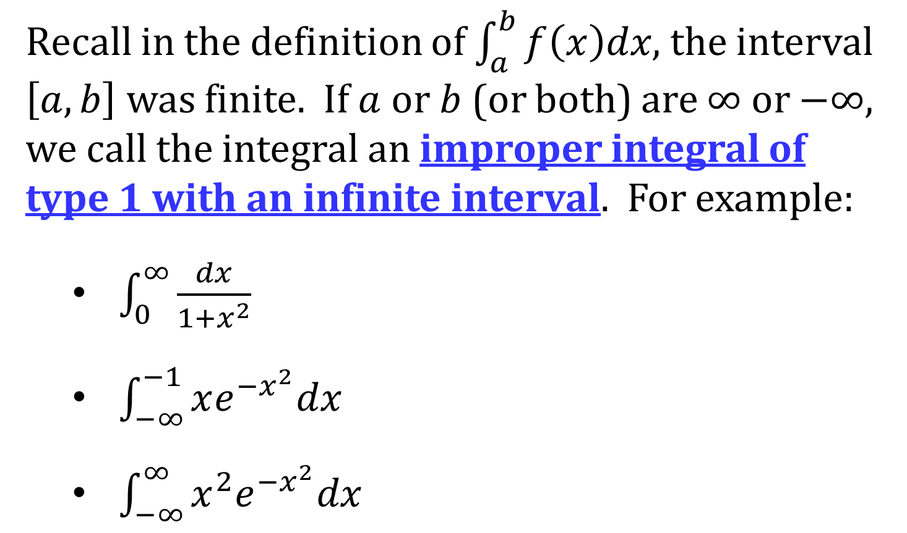
IMPROPER INTEGRALS OF TYPE 1: INFINITE INTERVALS
Recall in the definition of $\int_{a}^{b}{f\left(x\right)dx}$, the interval $\left[a,b\right]$ was finite. If $a$ or $b$ (or both) are $∞$ or $−∞$, we call the integral an improper integral of type 1 with an infinite interval. For example:
$\int_{0}^{∞}{\frac{dx}{1+x^{2}}}$
$\int_{−∞}^{−1}{xe^{−x^{2}}dx}$
$\int_{−∞}^{∞}{x^{2}e^{−x^{2}}dx}$

Slide 3
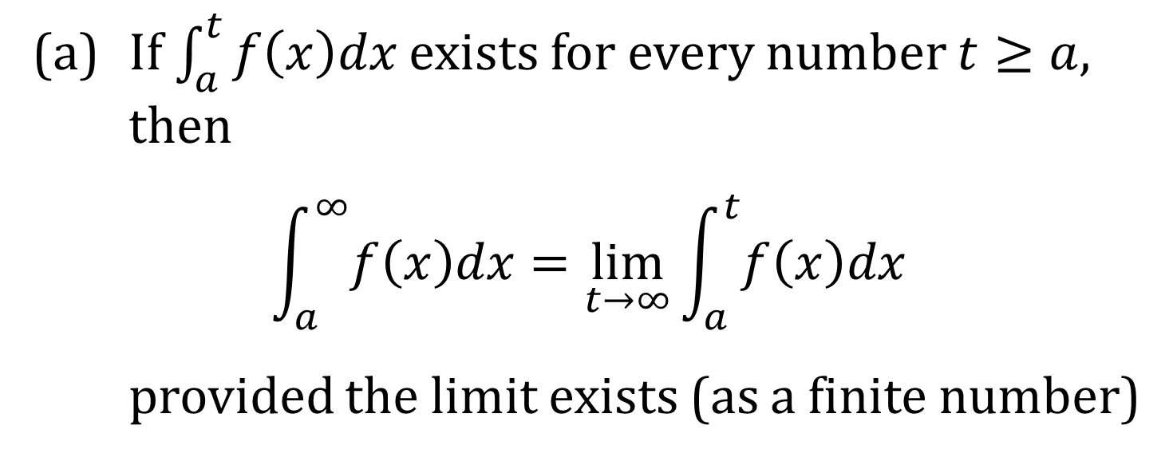
DEFINITION OF TYPE 1 IMPROPER INTEGRALS
(a) If $\int_{a}^{t}{f\left(x\right)dx}$ exists for every number $t≥a$, then
$$\int_{a}^{∞}{f\left(x\right)dx}=\lim_{t→∞}{\int_{a}^{t}{f\left(x\right)dx}}$$
provided the limit exists (as a finite number)

Slide 4
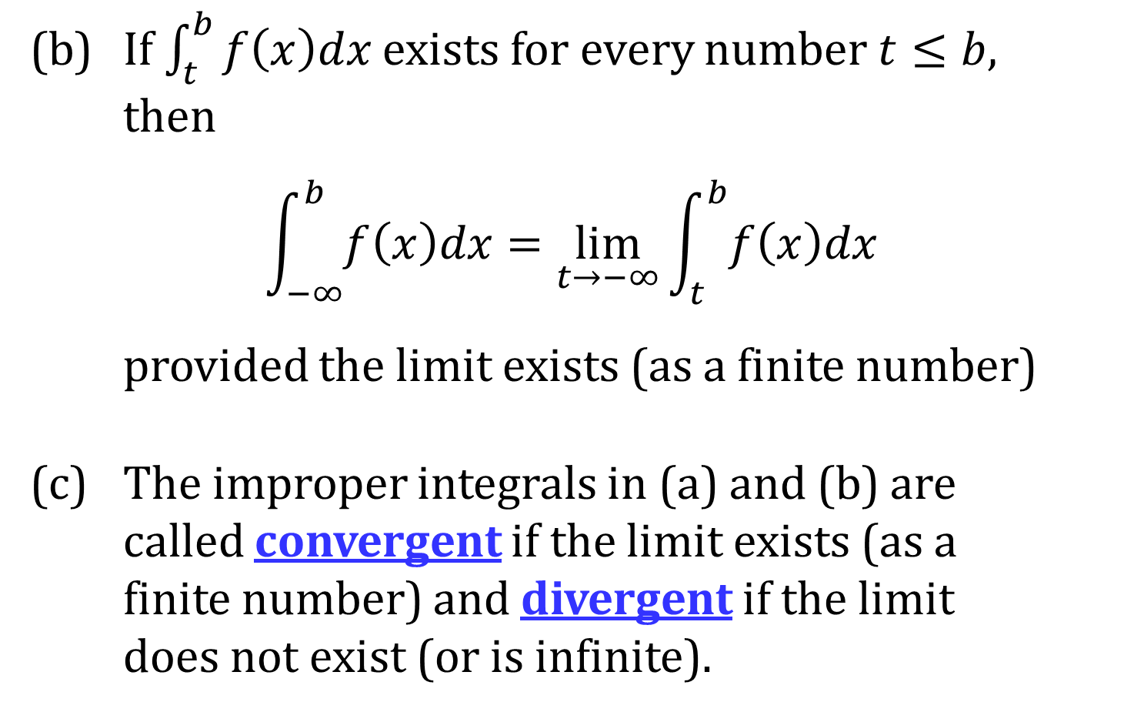
DEFINITION (CONTINUED)
(b) If $\int_{t}^{b}{f\left(x\right)dx}$ exists for every number $t≤b$, then
$$\int_{−∞}^{b}{f\left(x\right)dx}=\lim_{t→−∞}{\int_{t}^{b}{f\left(x\right)dx}}$$
provided the limit exists (as a finite number)
(c) The improper integrals in (a) and (b) are called convergent if the limit exists (as a finite number) and divergent if the limit does not exist (or is infinite).

Slide 5
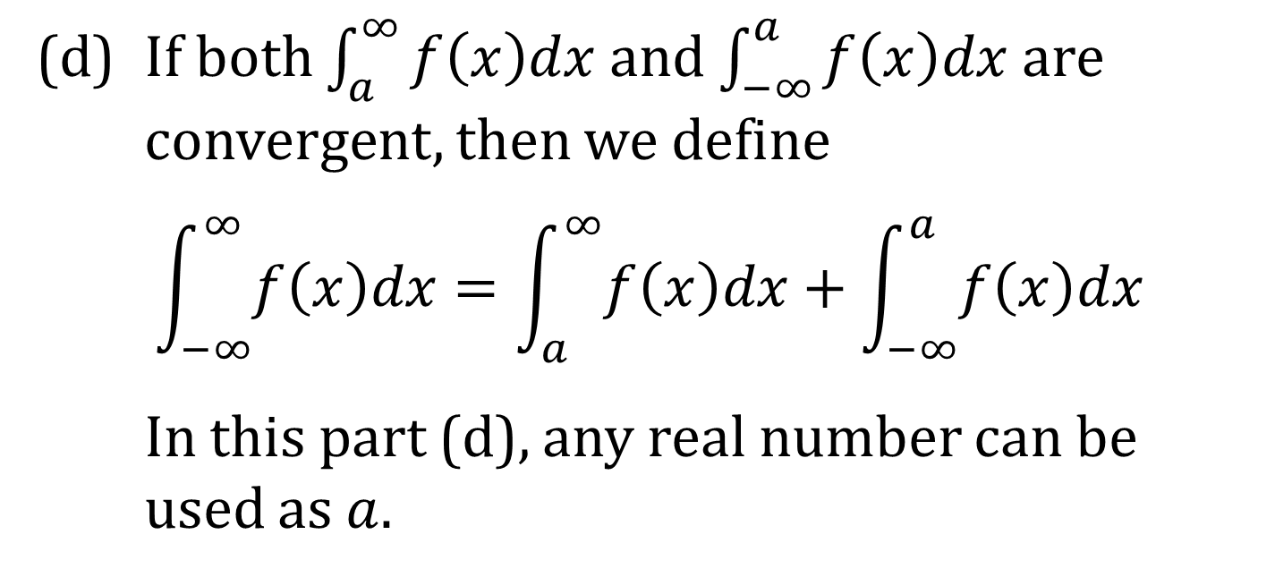
DEFINITION (CONCLUDED)
(d) If both $\int_{a}^{∞}{f\left(x\right)dx}$ and $\int_{−∞}^{a}{f\left(x\right)dx}$ are convergent, then we define
$$\int_{−∞}^{∞}{f\left(x\right)dx}=\int_{a}^{∞}{f\left(x\right)dx}+\int_{−∞}^{a}{f\left(x\right)dx}$$
In this part (d), any real number can be used as $a$.

Slide 6
THEOREM
$\int_{1}^{∞}{\frac{1}{x^{p}}dx}$ is convergent if $p>1$ and divergent
if $p≤1$.

Slide 7
IMPROPER INTEGRALS OF TYPE 2: DISCONTINUOUS INTEGRANDS
Recall in the definition of $\int_{a}^{b}{f\left(x\right)dx}$, the functions f was bounded on $\left[a,b\right]$. If f is not bounded on $\left[a,b\right]$ (that is, has an $x$-value, $a≤x≤b$, where the limit is $∞$ or $−∞$, we call the integral an improper integral of type 2 with discontinuous integrand. For example:
$$\int_{0}^{1}{\frac{dx}{x^{2}}}, \int_{−2}^{0}{\frac{dx}{x^{2}}}, \int_{−2}^{1}{\frac{dx}{x^{2}}}$$

Slide 8
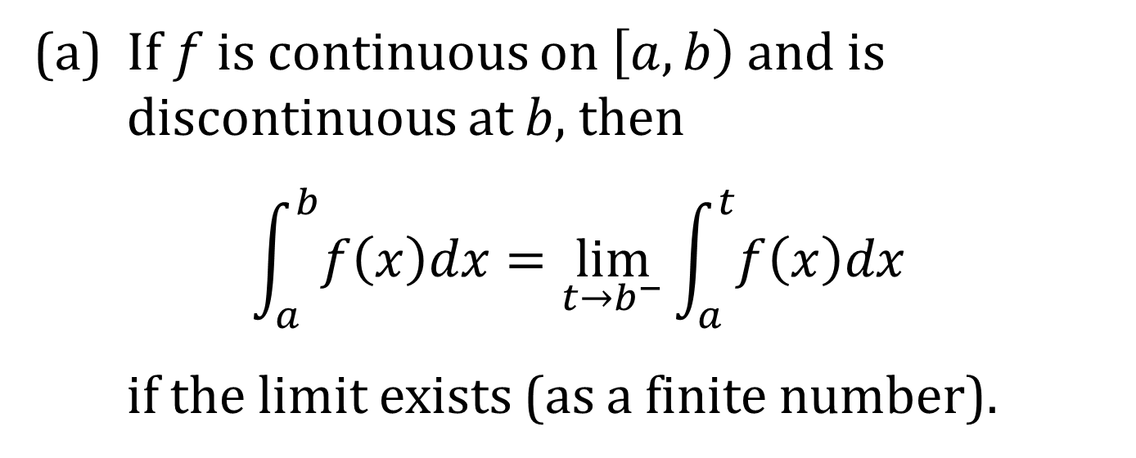
DEFINITION OF AN IMPROPER INTEGRAL OF TYPE 2
(a) If $f$ is continuous on $\left[a,b\right)$ and is discontinuous at $b$, then
$$\int_{a}^{b}{f\left(x\right)dx}=\lim_{t→b^{−}}{\int_{a}^{t}{f\left(x\right)dx}}$$
if the limit exists (as a finite number).

Slide 9
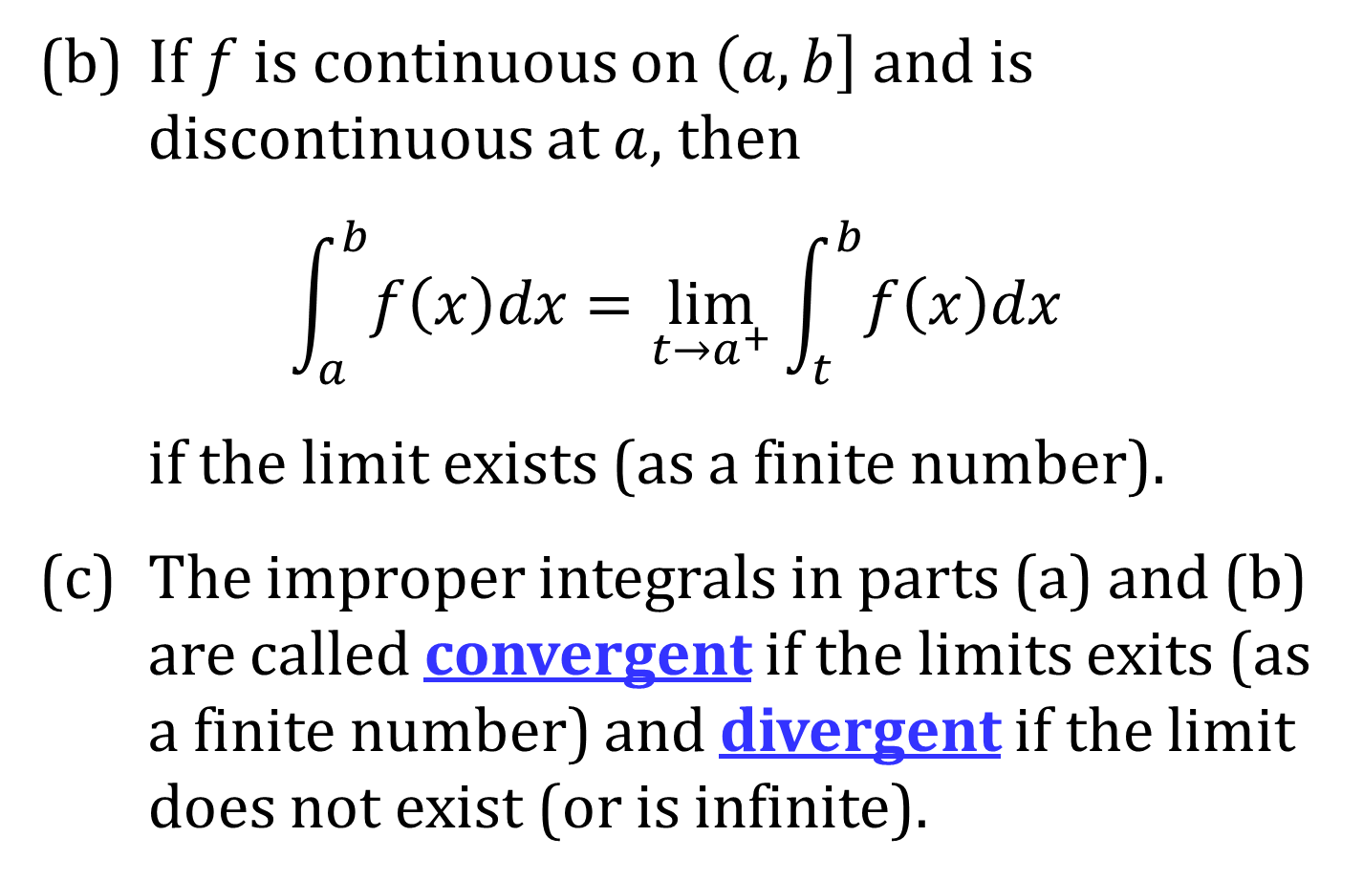
DEFINITION (CONTINUED)
(b) If $f$ is continuous on $\left(a,b\right]$ and is discontinuous at $a$, then
$$\int_{a}^{b}{f\left(x\right)dx}=\lim_{t→a^{+}}{\int_{t}^{b}{f\left(x\right)dx}}$$
if the limit exists (as a finite number).
(c) The improper integrals in parts (a) and (b) are called convergent if the limits exits (as a finite number) and divergent if the limit does not exist (or is infinite).

Slide 10
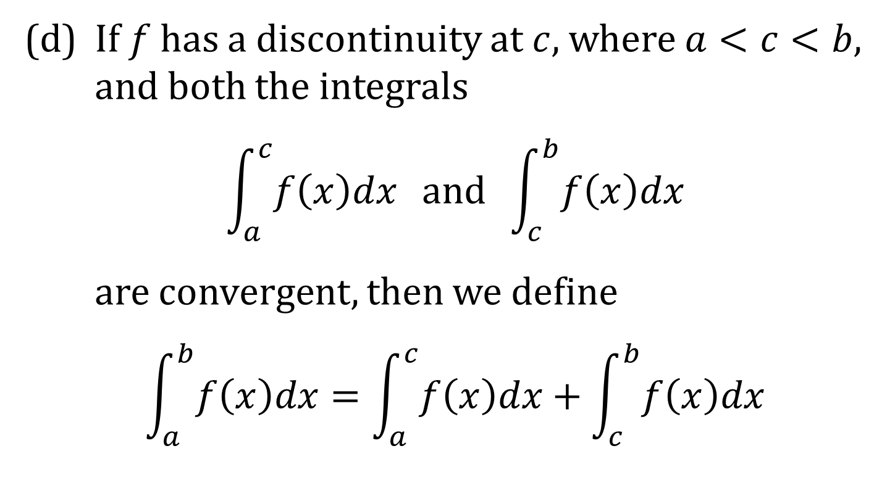
DEFINITION (CONCLUDED)
(d) If $f$ has a discontinuity at $c$, where $a<c<b$, and both the integrals
$$\int_{a}^{c}{f\left(x\right)dx} and \int_{c}^{b}{f\left(x\right)dx}$$
are convergent, then we define
$$\int_{a}^{b}{f\left(x\right)dx}=\int_{a}^{c}{f\left(x\right)dx}+\int_{c}^{b}{f\left(x\right)dx}$$

Slide 11
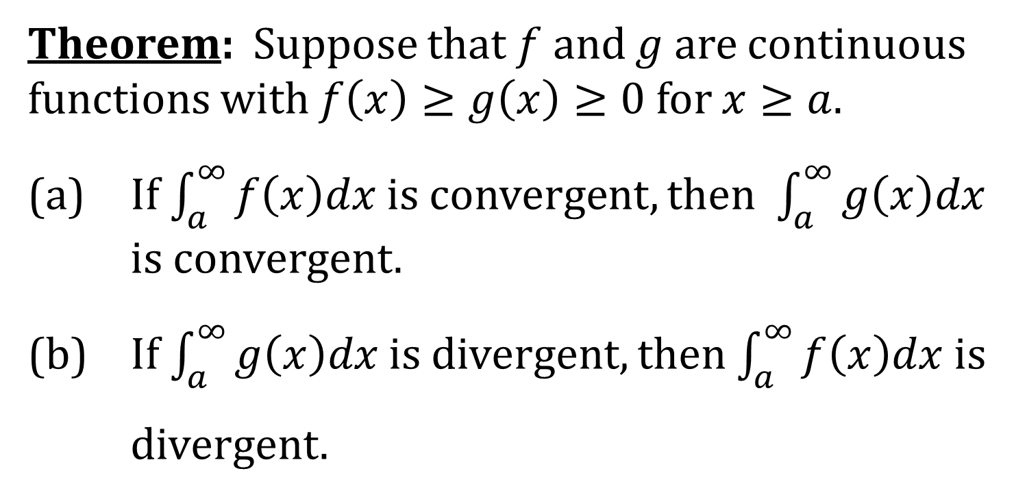
COMPARISON TEST FOR IMPROPER INTEGRALS
Theorem: Suppose that $f$ and $g$ are continuous functions with $f\left(x\right)≥g\left(x\right)≥0$ for $x≥a$.
(a) If $\int_{a}^{∞}{f\left(x\right)dx}$ is convergent, then $\int_{a}^{∞}{g\left(x\right)dx}$ is convergent.
(b) If $\int_{a}^{∞}{g\left(x\right)dx}$ is divergent, then $\int_{a}^{∞}{f\left(x\right)dx}$ is
divergent.

