Slide 1
Section 7.7
Approximate Integration

Slide 2
DIVIDING THE INTERVAL [a, b]
In order to approximate the integral $\int_{a}^{b}{f\left(x\right)dx}$
we must first partition the interval $\left[a, b\right]$ into $n$ equal subintervals of with
$$Δx=\frac{b−a}{n}$$
with endpoints
$$a=x_{0},x_{1},x_{2},…,x_{n−1},x_{n}=b$$
where $x_{i}=a+iΔx$.

Slide 3
THE LEFT AND RIGHT ENDPOINT APPROXIMATIONS
Left Endpoint Approximation:
$$\int_{a}^{b}{f\left(x\right)dx}≈L_{n}=\sum_{i=1}^{n}{f\left(x_{i−1}\right)Δx}$$
Right Endpoint Approximation:
$$\int_{a}^{b}{f\left(x\right)dx}≈R_{n}=\sum_{i=1}^{n}{f\left(x_{i}\right)Δx}$$

Slide 4

THE MIDPOINT RULE
$$\int_{a}^{b}{f\left(x\right)dx}≈M_{n}=Δx\left[f\left({\overline{x}}_{1}\right)+f\left({\overline{x}}_{2}\right)+…+f\left({\overline{x}}_{n}\right)\right]$$
$$Δx=\frac{b−a}{n}$$
where
and
$${\overline{x}}_{i}=\frac{x_{i−1}+x_{i}}{2}=\text{midpoint} \text{of} [x_{i−1},x_{i}]$$

Slide 5
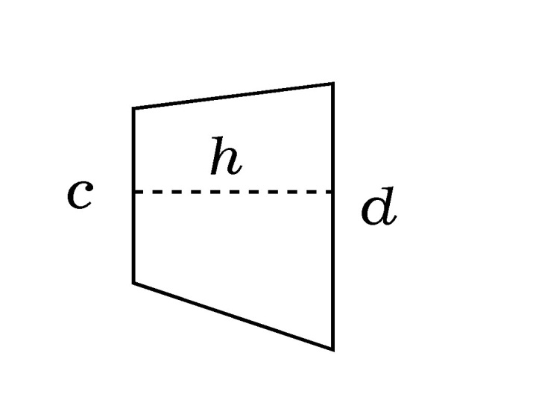
AREA OF A TRAPEZOID
Recall the area of a trapezoid is given by
$$A=h⋅\frac{c+d}{2}=\frac{h}{2}\left(c+d\right)$$

Slide 6
THE TRAPEZOIDAL RULE
$$\int_{a}^{b}{f\left(x\right)dx}≈T_{n}=\frac{Δx}{2}\left[f\left(x_{0}\right)+2f\left(x_{1}\right)+…+2f\left(x_{n−1}\right)+f\left(x_{n}\right)\right]$$
where $Δx=\frac{b−a}{n}$ and $x_{i}=a+iΔx$

Slide 7
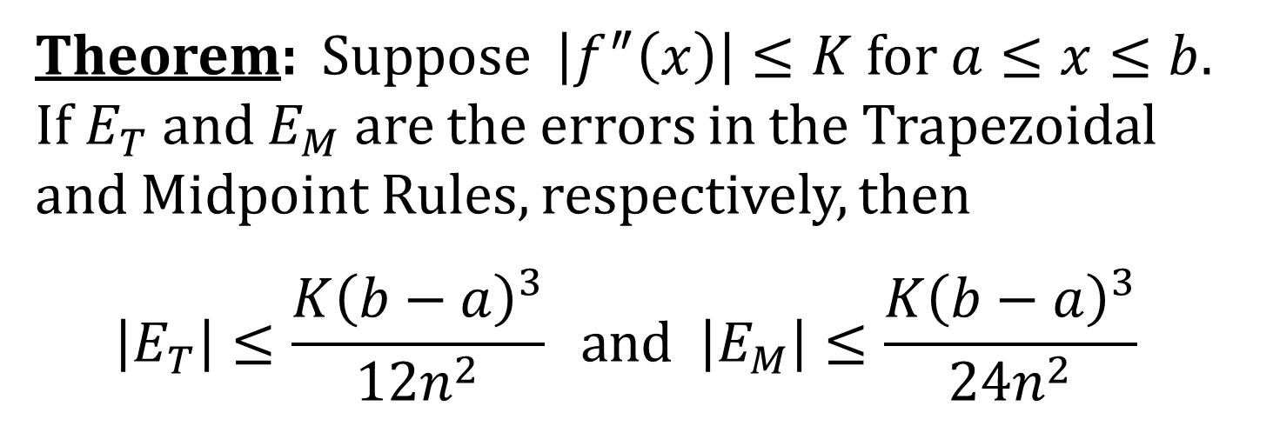
ERROR BOUNDS FOR THE TRAPEZOIDAL AND MIDPOINT RULES
Theorem: Suppose $\left|f^{″}\left(x\right)\right|≤K$ for $a≤x≤b$. If $E_{T}$ and $E_{M}$ are the errors in the Trapezoidal and Midpoint Rules, respectively, then
$$\left|E_{T}\right|≤\frac{K{\left(b−a\right)}^{3}}{12n^{2}} \text{and} \left|E_{M}\right|≤\frac{K{\left(b−a\right)}^{3}}{24n^{2}}$$

Slide 8
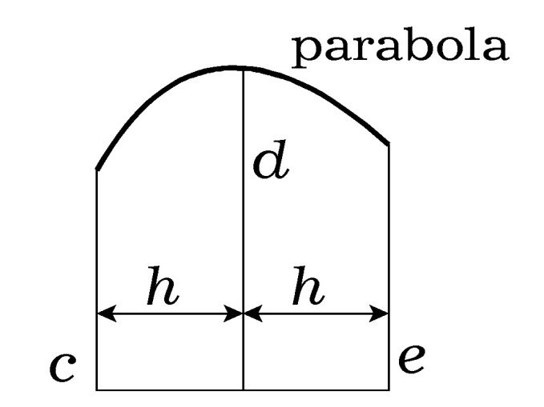
PARABOLIC AREA FORMULA
The area of the geometric figure below is given by
$$A=\frac{h}{3}\left(c+4d+e\right)$$

Slide 9
SIMPSON’S (PARABOLIC) RULE
$$\int_{a}^{b}{f\left(x\right)dx}≈S_{n}=\frac{Δx}{3}\left[f\left(x_{0}\right)+4f\left(x_{1}\right)+2f\left(x_{2}\right)+4f\left(x_{3}\right)+…+2f\left(x_{n−2}\right)+4f\left(x_{n−1}\right)+f\left(x_{n}\right)\right]$$
where $n$ is even and $Δx=\frac{b−a}{n}$.

Slide 10
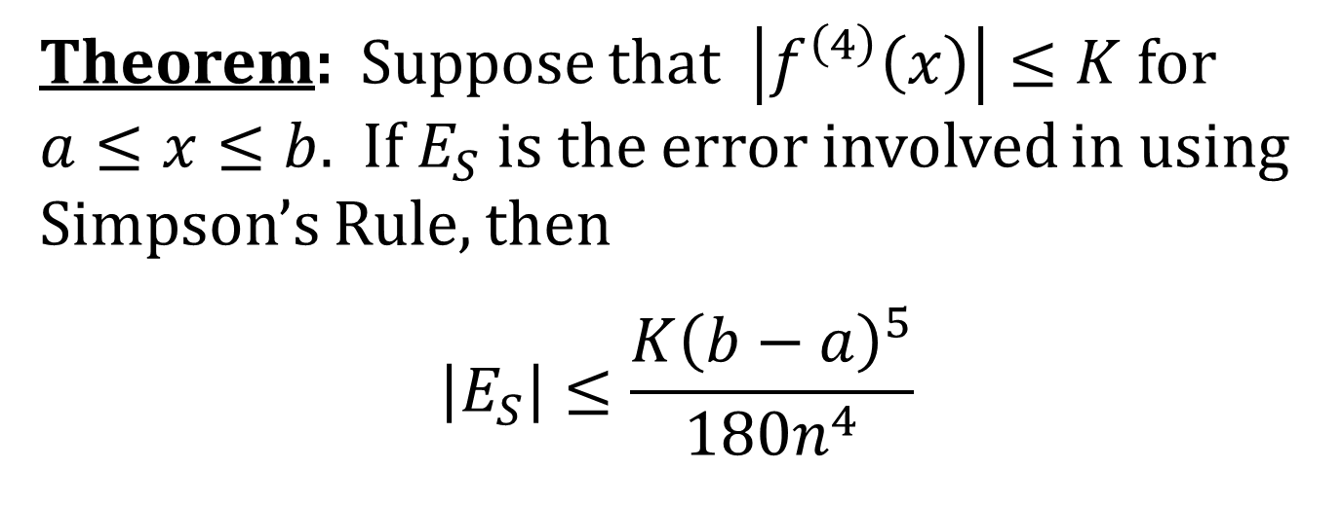
ERROR BOUND FOR SIMPSON’S RULE
Theorem: Suppose that $\left|f^{\left(4\right)}\left(x\right)\right|≤K$ for
$a≤x≤b$. If $E_{S}$ is the error involved in using Simpson’s Rule, then
$$\left|E_{S}\right|≤\frac{K{\left(b−a\right)}^{5}}{180n^{4}}$$

