Slide 1
Section 7.4
Integration of Rational Functions by Partial Fractions

Slide 2
PARTIAL FRACTION DECOMPOSITION
Partial fraction decomposition is the process of breaking a fraction up. It is the inverse operation of getting a common denominator.

Slide 3
PROCEDURE FOR PARTIAL FRACTION DECOMPOSTION
If the rational function is not proper, use long division to convert it to a polynomial and a proper rational function.
Factor the denominator.
Break the fraction into two or more fractions added. Put letters on top for the unknown constants.
Recombine the fractions.
Solve the system of linear equations.

Slide 4
REMARK
For factors that are not linear, the numerators will have the variable as well as unknown constants.

Slide 5
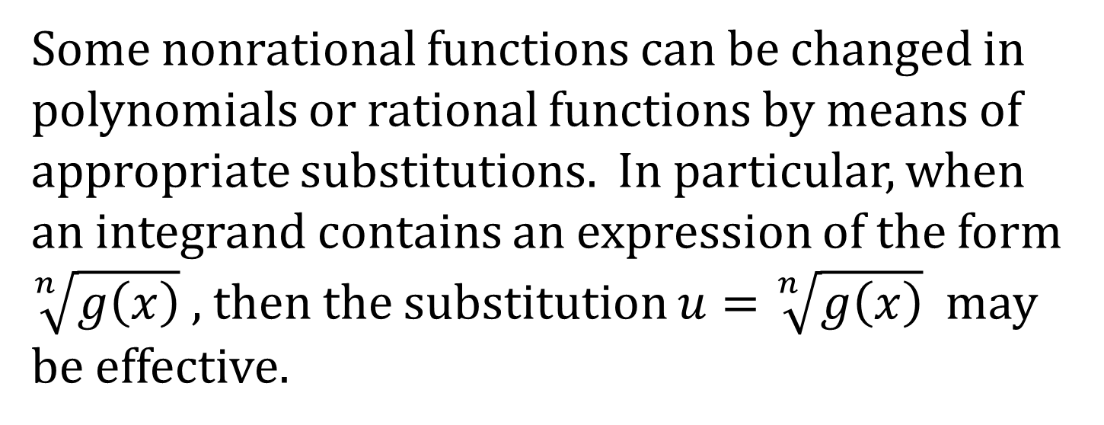
RATIONALIZING SUBSTITUTIONS
Some nonrational functions can be changed in polynomials or rational functions by means of appropriate substitutions. In particular, when an integrand contains an expression of the form $\sqrt[n]{g\left(x\right)}$ , then the substitution $u=\sqrt[n]{g\left(x\right)}$ may be effective.

