Slide 1
Section 7.3
Trigonometric Substitution

Slide 2
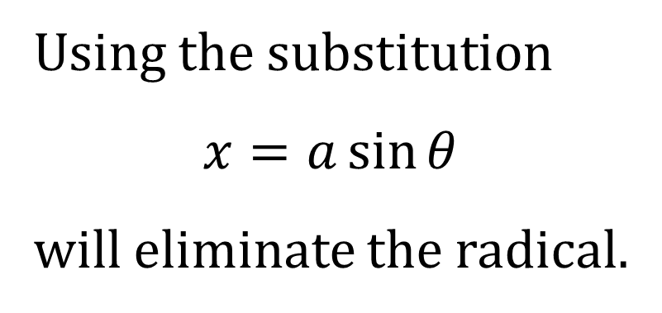
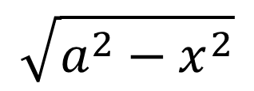
INTEGRALS INVOLVING $$\sqrt{a^{2}−x^{2}}$$
Using the substitution
$$x=a\sin{θ}$$
will eliminate the radical.
$$a$$
$$x$$
$$θ$$
$$\sqrt{a^{2}−x^{2}}$$

Slide 3
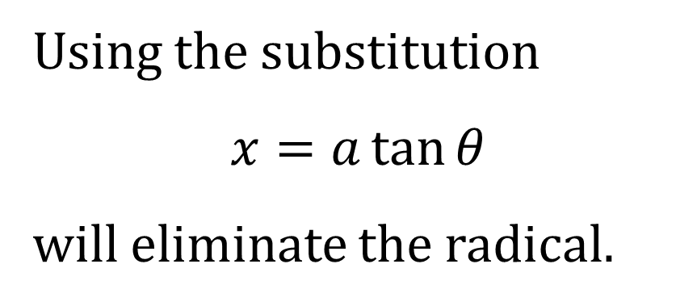

INTEGRALS INVOLVING $$\sqrt{a^{2}+x^{2}}$$
Using the substitution
$$x=a\tan{θ}$$
will eliminate the radical.
$$\sqrt{a^{2}+x^{2}}$$
$$x$$
$$θ$$
$$a$$

Slide 4
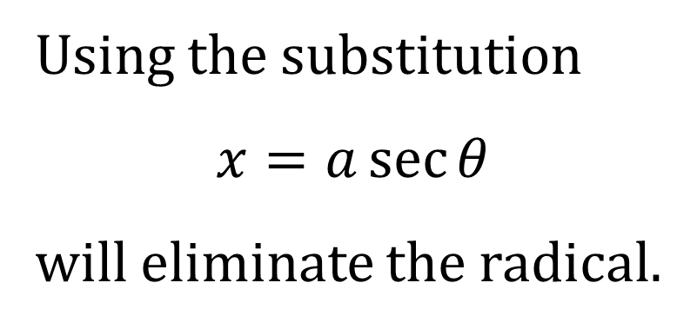
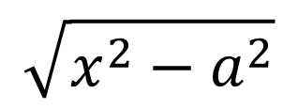
INTEGRALS INVOLVING $$\sqrt{x^{2}−a^{2}}$$
Using the substitution
$$x=a\sec{θ}$$
will eliminate the radical.
$$x$$
$$\sqrt{x^{2}−a^{2}}$$
$$θ$$
$$a$$

