Slide 1
Section 7.2
Trigonometric Integrals

Slide 2
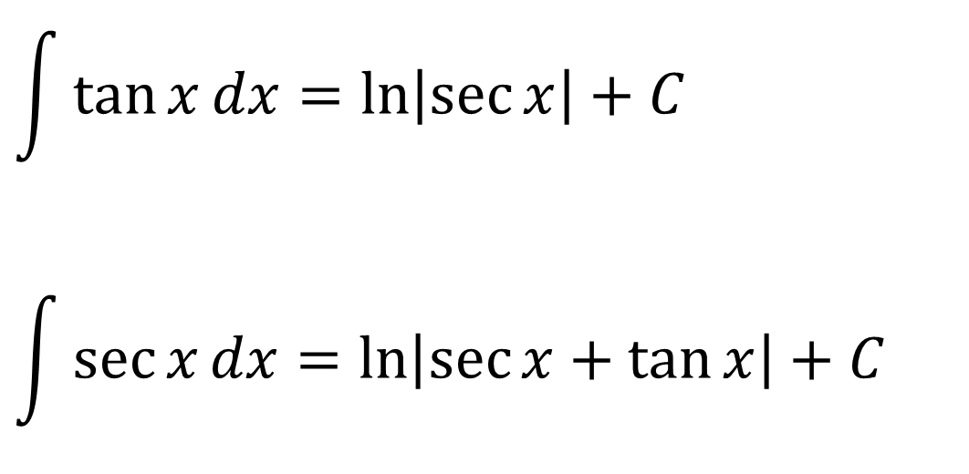
TWO TRIGONOMETRIC INTEGRALS
$$\int{\tan{x}dx}=\ln\left|\sec{x}\right|+C$$
$$\int{\sec{x}dx}=\ln\left|\sec{x}+\tan{x}\right|+C$$

Slide 3
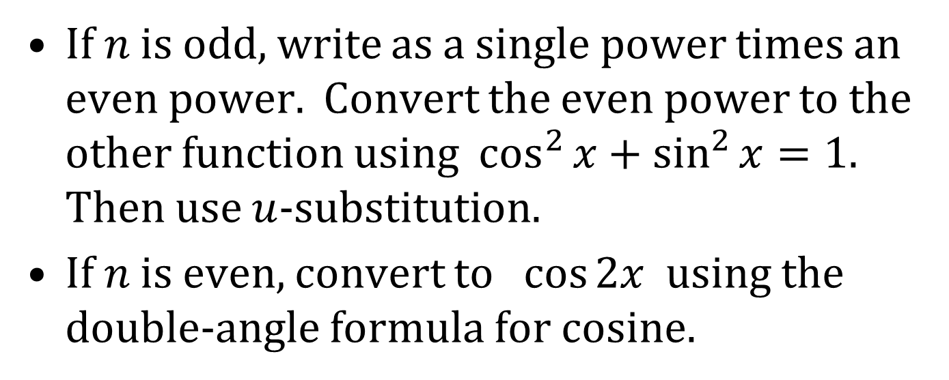
INTEGRALS OF SINE AND COSINE
For $∫\sin^{n}{x}dx, ∫\cos^{n}{x}dx$
If $n$ is odd, write as a single power times an even power. Convert the even power to the other function using $\cos^{2}{x}+\sin^{2}{x}=1$. Then use $u$-substitution.
If $n$ is even, convert to $\cos{2x}$ using the double-angle formula for cosine.

Slide 4
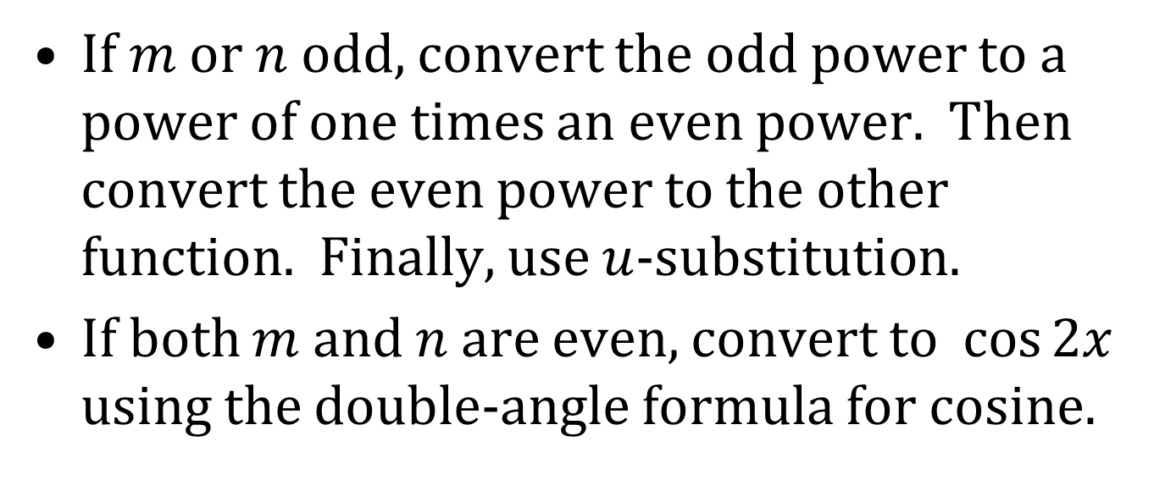
INTEGRALS INVOLVING SINE AND COSINE (CONTINUED)
For $∫\sin^{m}{x}\cos^{n}{x}dx$
If $m$ or $n$ odd, convert the odd power to a power of one times an even power. Then convert the even power to the other function. Finally, use $u$-substitution.
If both $m$ and $n$ are even, convert to $\cos{2x}$ using the double-angle formula for cosine.

Slide 5
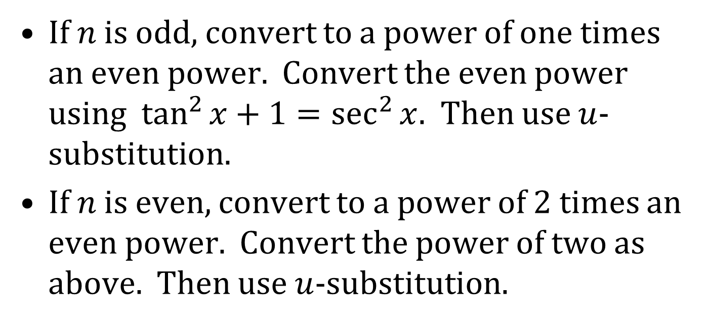
INTEGRALS INVOLVING TANGENT
For $∫\tan^{n}{x}dx$
If $n$ is odd, convert to a power of one times an even power. Convert the even power using $\tan^{2}{x}+1=\sec^{2}{x}$. Then use $u$-substitution.
If $n$ is even, convert to a power of 2 times an even power. Convert the power of two as above. Then use $u$-substitution.

Slide 6
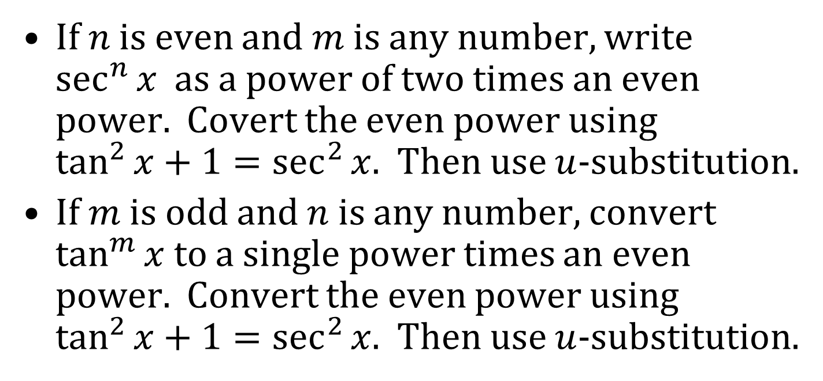
INTEGRALS INVOLVING SECANT AND TANGENT
For $∫\tan^{m}{x}\sec^{n}{x}dx$
If $n$ is even and $m$ is any number, write $\sec^{n}{x}$ as a power of two times an even power. Covert the even power using $\tan^{2}{x}+1=\sec^{2}{x}$. Then use $u$-substitution.
If $m$ is odd and $n$ is any number, convert $\tan^{m}{x}$ to a single power times an even power. Convert the even power using $\tan^{2}{x}+1=\sec^{2}{x}$. Then use $u$-substitution.

Slide 7
INTEGRALS INVOLVING SINE AND COSINE (CONCLUDED)
For
$$\int{\sin\left(mx\right)\cos\left(nx\right)dx} \\ \int{\sin\left(mx\right)\sin\left(nx\right)dx} \\ \int{\cos\left(mx\right)\cos{(nx)}dx}$$
use the trigonometric identities on the bottom of page 524 of the text. Also, integration by parts can be used.

