Slide 1
Section 7.1
Integration by Parts

Slide 2
INTEGRATION BY PARTS
Indefinite Integration by Parts:
$$\int{f\left(x\right)g^{′}\left(x\right)dx}=f\left(x\right)g\left(x\right)−\int{g\left(x\right)f^{′}\left(x\right)dx} \\ \int{u dv}=uv−\int{v du}$$
Definite Integration by Parts:
$$\int_{a}^{b}{f\left(x\right)g^{′}\left(x\right)dx}={\left[f\left(x\right)g\left(x\right)\right]}_{a}^{b}−\int_{a}^{b}{g\left(x\right)f^{′}\left(x\right)dx}$$

Slide 3
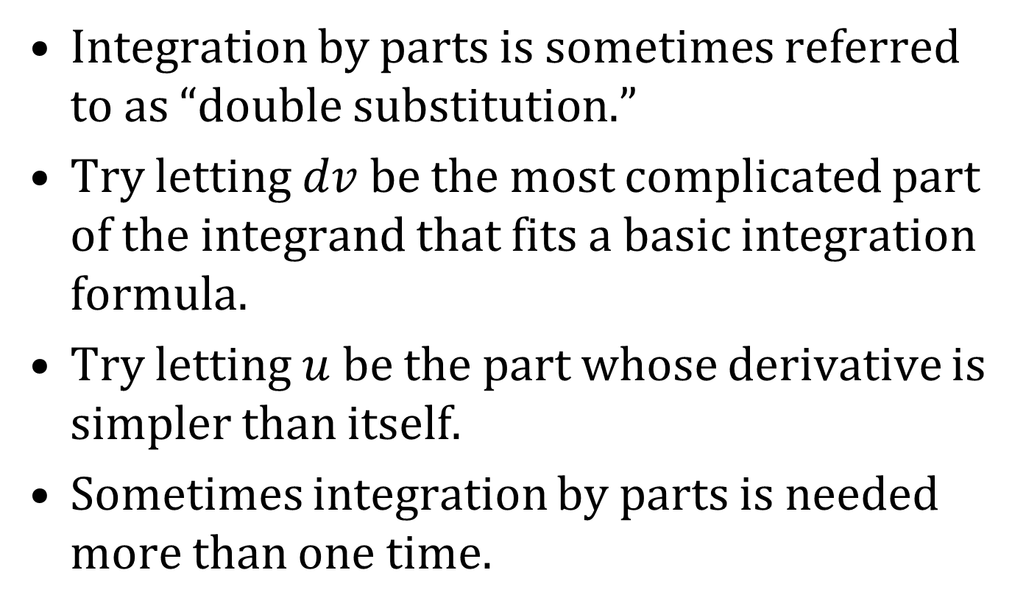
NOTES ON INTEGRATION BY PARTS
Integration by parts is sometimes referred to as “double substitution.”
Try letting $dv$ be the most complicated part of the integrand that fits a basic integration formula.
Try letting $u$ be the part whose derivative is simpler than itself.
Sometimes integration by parts is needed more than one time.

