Slide 1
Section 6.8
Indeterminate Forms and l’Hospital’s Rule

Slide 2
INDETERMINATE FORMS
When working with limits, the following forms are indeterminate in that the value of the limit is not “obvious.”
$$\frac{0}{0},\frac{∞}{∞}, 0⋅∞, ∞−∞, 0^{0}, ∞^{0}, 1^{∞}$$

Slide 3
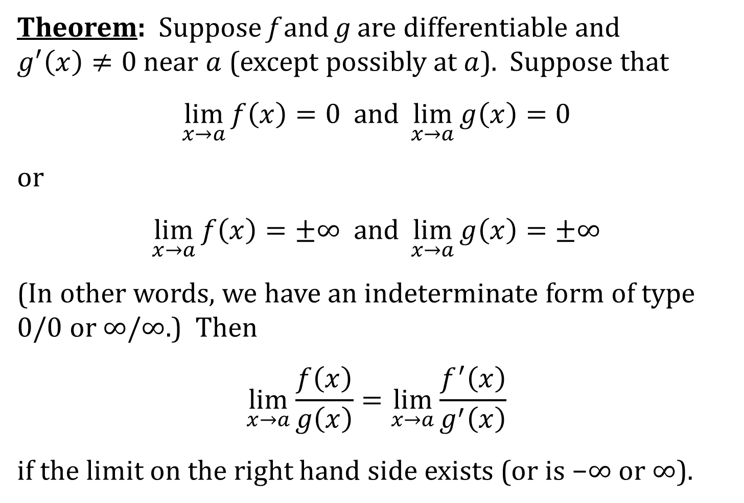
l’HOSPITAL’S RULE
Theorem: Suppose f and g are differentiable and $g^{′}\left(x\right)≠0$ near $a$ (except possibly at $a$). Suppose that
$$\lim_{x→a}{f\left(x\right)}=0 and \lim_{x→a}{g\left(x\right)}=0$$
or
$$\lim_{x→a}{f\left(x\right)}=±∞ and \lim_{x→a}{g\left(x\right)}=±∞$$
(In other words, we have an indeterminate form of type 0/0 or ∞/∞.) Then
$$\lim_{x→a}{\frac{f\left(x\right)}{g\left(x\right)}}=\lim_{x→a}{\frac{f^{′}\left(x\right)}{g^{′}\left(x\right)}}$$
if the limit on the right hand side exists (or is −∞ or ∞).

Slide 4
OTHER INDETERMINATE FORMS
For indeterminate forms of type: ∞ − ∞ and 0 · ∞
Write the product or the difference as a quotient and apply l’Hospital’s Rule
For indeterminate forms of type: 0⁰, ∞⁰, and 1∞
Take the natural logarithm to transform the problem to that of the type 0 · ∞.

Slide 5
NOTE
The following forms are indeterminate: 0/0, ∞/∞, 0 · ∞, ∞ − ∞, 0⁰, ∞⁰, 1∞.
The following forms are determinate; that is, they are NOT indeterminate: 0/∞, ∞/0, ∞ + ∞, ∞ · ∞, 0∞, 1⁰, and ∞∞. These forms do NOT require l’Hospital’s Rule. These forces work together, not against each other.

