Slide 1
Section 6.6
Inverse Trigonometric Functions

Slide 2
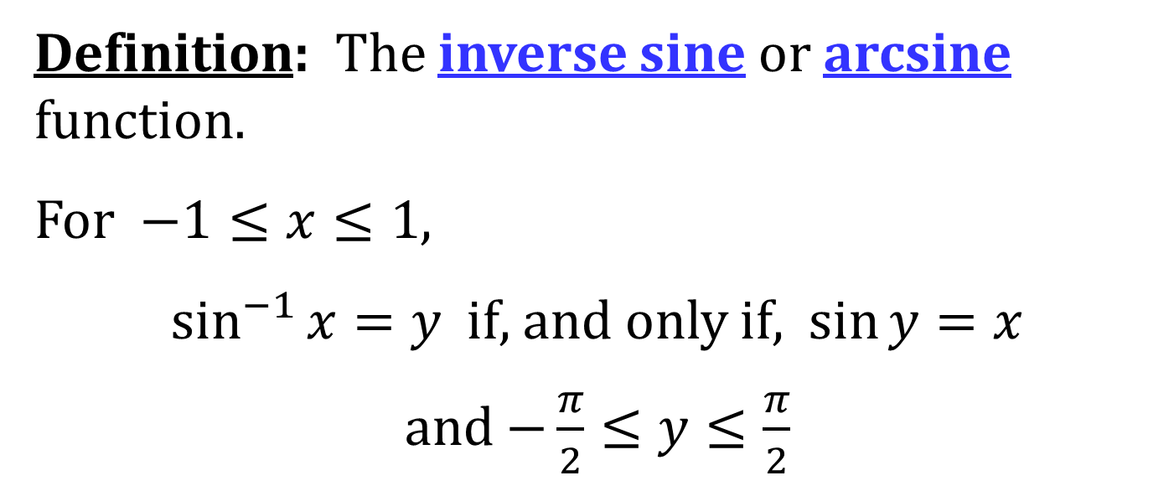
THE INVERSE SINE FUNCTION
Definition: The inverse sine or arcsine function.
For $−1≤x≤1$,
$\sin^{−1}{x}=y$ if, and only if, $\sin{y}=x$
and $−\frac{π}{2}≤y≤\frac{π}{2}$

Slide 3
COMPOSITION OF SINE AND INVERSE SINE
$\sin^{−1}{(\sin{x})}=x$ for $−\frac{π}{2}≤x≤\frac{π}{2}$
$\sin{(\sin^{−1}{x}})=x$ for $−1≤x≤1$

Slide 4
DIFFERENTIATION OF INVERSE SINE
$$\frac{d}{dx}\left(\sin^{−1}{x}\right)=\frac{1}{\sqrt{1−x^{2}}} −1<x<1$$

Slide 5
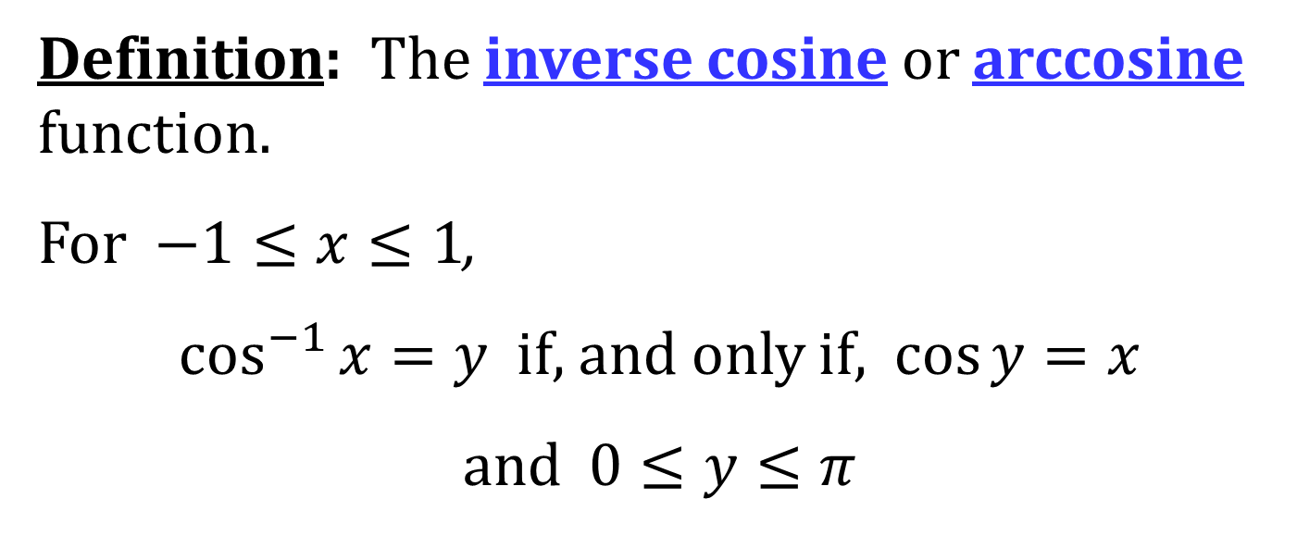
THE INVERSE COSINE FUNCTION
Definition: The inverse cosine or arccosine function.
For $−1≤x≤1$,
$\cos^{−1}{x}=y$ if, and only if, $\cos{y}=x$
and $0≤y≤π$

Slide 6
COMPOSITION OF COSINE AND INVERSE COSINE
$\cos^{−1}{(\cos{x})}=x$ for $0≤x≤π$
$\cos{(\cos^{−1}{x}})=x$ for $−1≤x≤1$

Slide 7
DIFFERENTIATION OF INVERSE COSINE
$$\frac{d}{dx}\left(\cos^{−1}{x}\right)=−\frac{1}{\sqrt{1−x^{2}}} −1<x<1$$

Slide 8
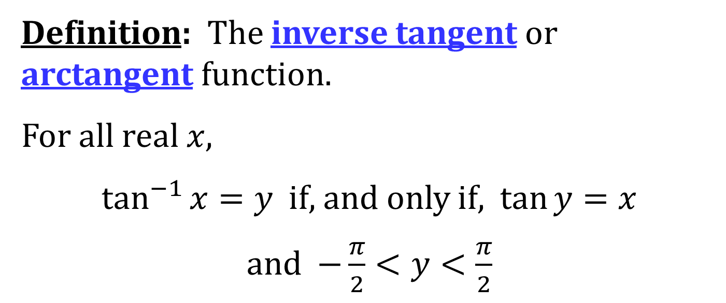
THE INVERSE TANGENT FUNCTION
Definition: The inverse tangent or arctangent function.
For all real $x$,
$\tan^{−1}{x}=y$ if, and only if, $\tan{y}=x$
and $−\frac{π}{2}<y<\frac{π}{2}$

Slide 9
COMPOSITION OF TANGENT AND INVERSE TANGENT
$\tan^{−1}{(\tan{x})}=x$ for $−\frac{π}{2}<x<\frac{π}{2}$
$\tan{(\tan^{−1}{x}})=x$ for all $x$

Slide 10
DIFFERENTIATION OF INVERSE TANGENT
$$\frac{d}{dx}\left(\tan^{−1}{x}\right)=\frac{1}{1+x^{2}}$$

Slide 11
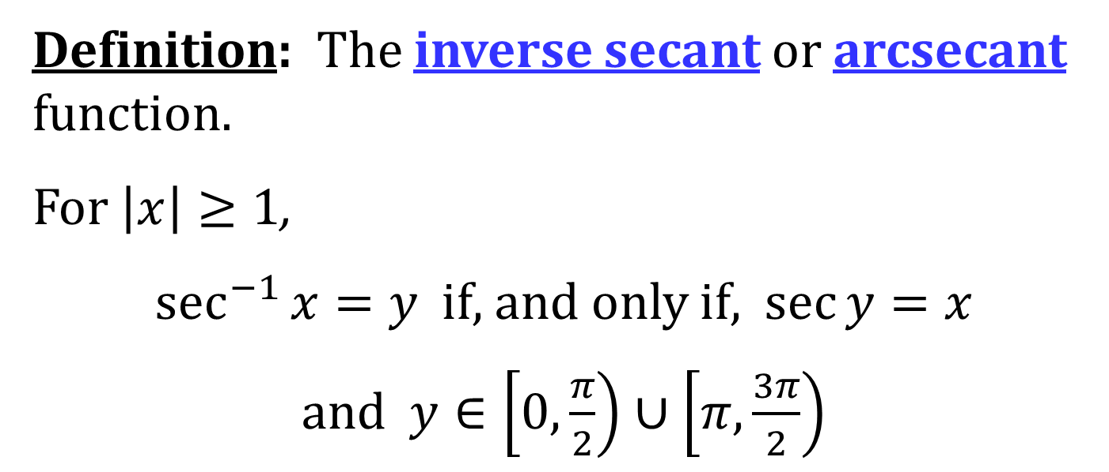
THE INVERSE SECANT FUNCTION
Definition: The inverse secant or arcsecant function.
For $\left|x\right|≥1$,
$\sec^{−1}{x}=y$ if, and only if, $\sec{y}=x$
and $y∈\left[0,\frac{π}{2}\right)∪\left[π,\frac{3π}{2}\right)$

Slide 12
COMPOSITION OF SECANT AND INVERSE SECANT
$\sec^{−1}{(\sec{x})}=x$ for $x∈\left[0,\frac{π}{2}\right)∪\left[π,\frac{3π}{2}\right)$
$\sec\left(\sec^{−1}{x}\right)=x$ for $\left|x\right|≥1$

Slide 13
DIFFERENTIATION OF INVERSE SECANT
$$\frac{d}{dx}\left(\sec^{−1}{x}\right)=\frac{1}{x\sqrt{x^{2}−1}} \left|x\right|>1$$

Slide 14
The definitions for inverse cosecant and inverse cotangent are on page 457 of the text.
The derivatives of inverse cosecant and inverse cotangent are also on page 457 of the text.

Slide 15
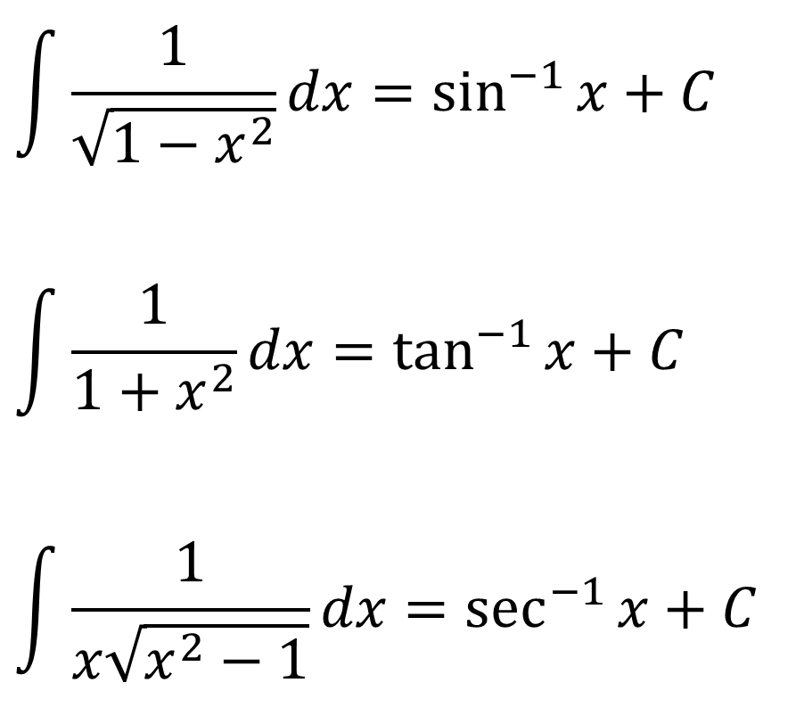
ANTIDERIVATIVE FORMULAS INVOLVING INVERSE TRIG. FUNCTIONS
$$\int{\frac{1}{\sqrt{1−x^{2}}}dx}=\sin^{−1}{x}+C$$
$$\int{\frac{1}{1+x^{2}}dx}=\tan^{−1}{x}+C$$
$$\int{\frac{1}{x\sqrt{x^{2}−1}}dx}=\sec^{−1}{x}+C$$

Slide 16
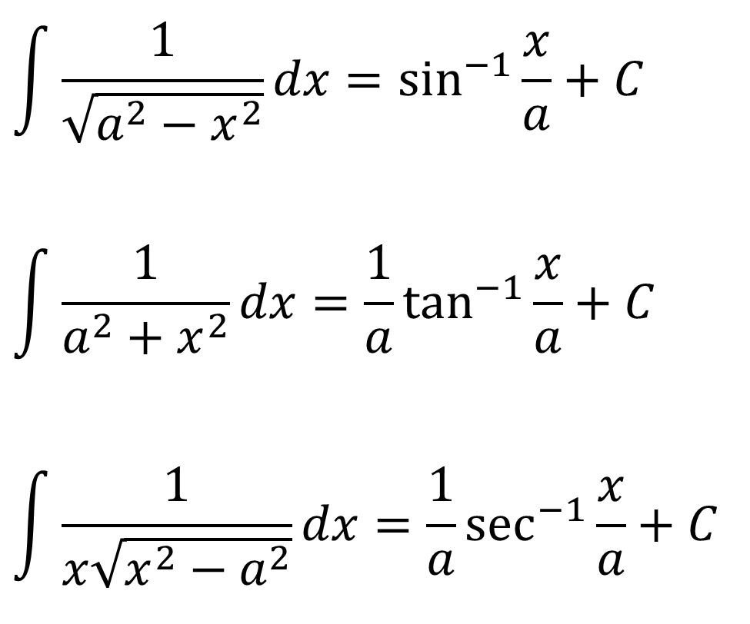
GENERALIZED ANTIDERIVATIVE FORMULAS INVOLVING INVERSE TRIG. FUNCTIONS
$$\int{\frac{1}{\sqrt{a^{2}−x^{2}}}dx}=\sin^{−1}{\frac{x}{a}}+C$$
$$\int{\frac{1}{a^{2}+x^{2}}dx}={\frac{1}{a}tan}^{−1}{\frac{x}{a}}+C$$
$$\int{\frac{1}{x\sqrt{x^{2}−a^{2}}}dx}=\frac{1}{a}\sec^{−1}{\frac{x}{a}}+C$$

