Slide 1
Section 6.4*
General Logarithmic and Exponential Functions

Slide 2
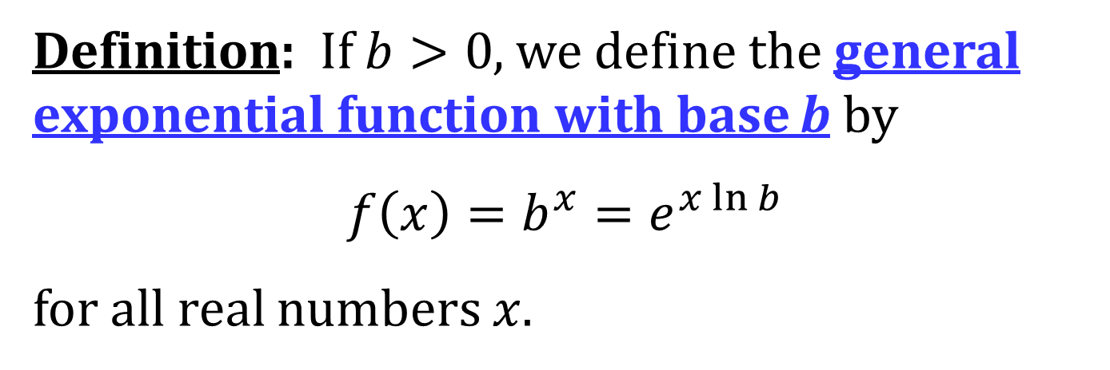
GENERAL EXPONENTIAL FUNCTIONS
Definition: If $b>0$, we define the general exponential function with base b by
$$f\left(x\right)=b^{x}=e^{x\ln{b}}$$
for all real numbers $x$.

Slide 3
NOTES ON f(x) = b^{x}
1. $f\left(x\right)=b^{x}$ is positive for all $x$
2. For any real number $r$, $\ln\left(b^{r}\right)=r\ln{b}$

Slide 4
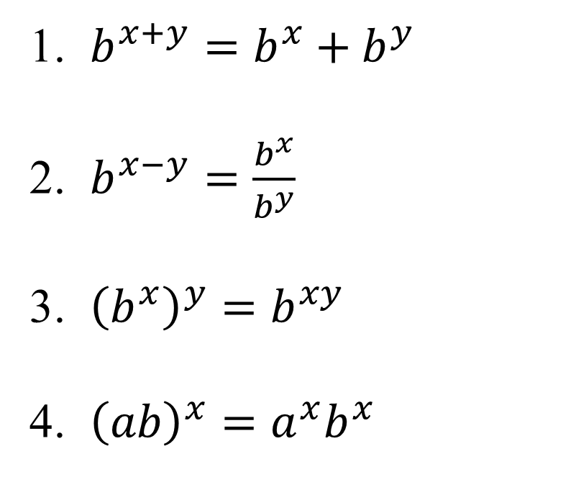
LAWS OF EXPONENTS
If $x$ and $y$ are real numbers and $a, b>0$, then
1. $b^{x+y}=b^{x}+b^{y}$
2. $b^{x−y}=\frac{b^{x}}{b^{y}}$
3. ${\left(b^{x}\right)}^{y}=b^{xy}$
4. ${\left(ab\right)}^{x}=a^{x}b^{x}$

Slide 5
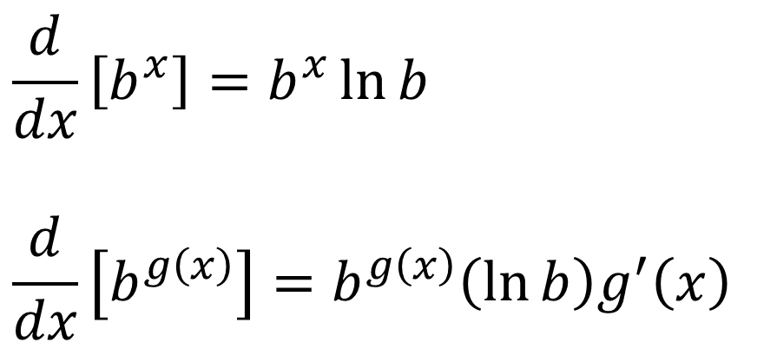
DIFFERENTIATION OF GENERAL EXPONENTIAL FUNCTIONS
$$\frac{d}{dx}\left[b^{x}\right]=b^{x}\ln{b}$$
$$\frac{d}{dx}\left[b^{g\left(x\right)}\right]=b^{g\left(x\right)}\left(\ln{b}\right)g^{′}\left(x\right)$$

Slide 6
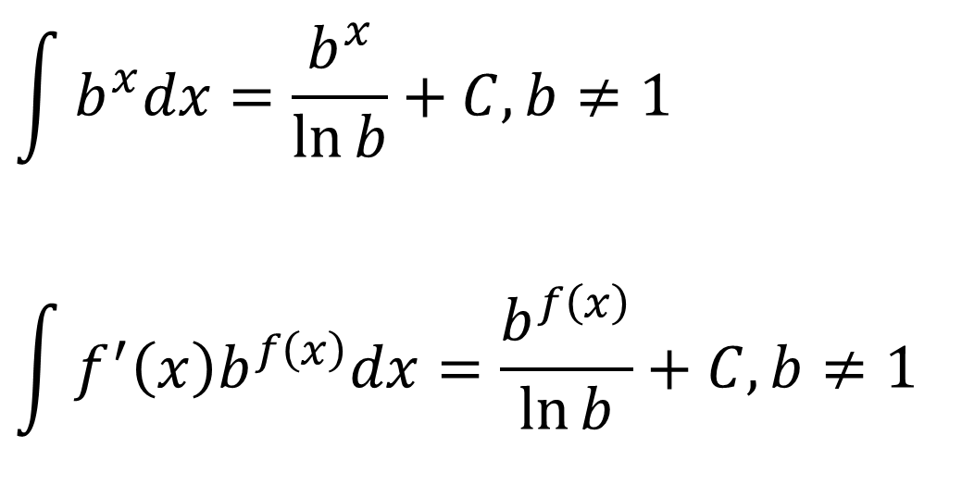
ANTIDERIVATIVES OF GENERAL EXPONENTIAL FUNCTIONS
$$\int{b^{x}dx}=\frac{b^{x}}{\ln{b}}+C, b≠1$$
$$\int{f^{′}\left(x\right)b^{f\left(x\right)}dx}=\frac{b^{f\left(x\right)}}{\ln{b}}+C, b≠1$$

Slide 7
THE GENERAL LOGARITHMIC FUNCTION
Definition: If $b>0$ and $b≠1$, we define the logarithmic function with base b, denoted by log_{b}, to be the inverse of $f\left(x\right){=b}^{x}$. Thus
$\log_{b}{x}=y$ if, and only if, $b^{y}=x$

Slide 8
NOTES ON THE GENERAL LOGARITHMIC FUNCTION
1. $\log_{e}{x}=\ln{x}$
2. $b^{\log_{b}{x}}=x, \log_{b}\left(b^{x}\right)=x$

Slide 9
THE CHANGE OF BASE FORMULA
For any positive number $b$ ($b≠1$), we have
$$\log_{b}{x}=\frac{\ln{x}}{\ln{b}}$$

Slide 10
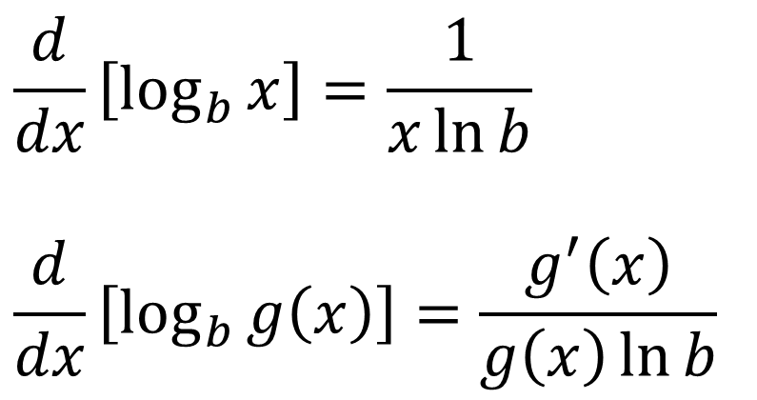
DIFFERENTIATION OF GENERAL LOGARITHMIC FUNCTIONS
$$\frac{d}{dx}\left[\log_{b}{x}\right]=\frac{1}{x\ln{b}}$$
$$\frac{d}{dx}\left[\log_{b}{g\left(x\right)}\right]=\frac{g^{′}\left(x\right)}{g\left(x\right)\ln{b}}$$

Slide 11
THE GENERALIZED VERSION OF THE POWER RULE
Theorem: If $n$ is any real number and $f\left(x\right)=x^{n}$, then
$$f^{′}\left(x\right)=nx^{n−1}$$

Slide 12
THE NUMBER e AS A LIMIT
$$e=\lim_{x→0}{{\left(1+x\right)}^{1/x}}=\lim_{n→∞}{{\left(1+\frac{1}{n}\right)}^{n}}$$

