Slide 1
Section 6.3*
The Natural Exponential Function

Slide 2
THE NATURAL EXPONENTIAL FUNCTION
Definition: The inverse of the one-to-one natural logarithmic function is the natural exponential function defined by
$y=\exp\left(x\right)$ if, and only if, $\ln{y}=x$

Slide 3
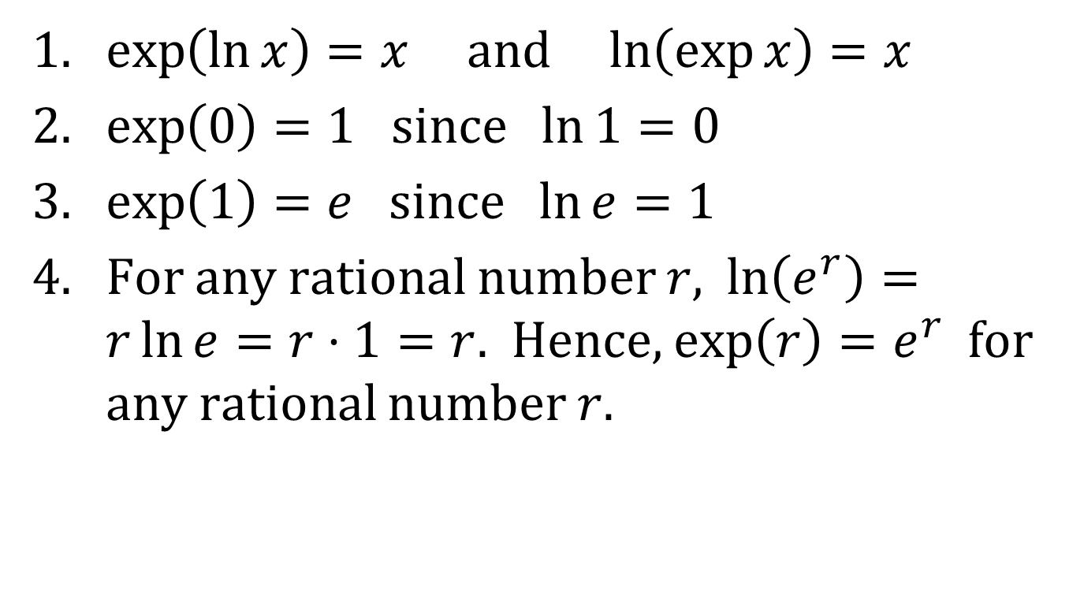
COMMENTS ON THE NATURAL EXPONENTIAL FUNCTION
1. $\exp\left(\ln{x}\right)=x$ and $\ln\left(\exp{x}\right)=x$
2. $\exp\left(0\right)=1$ since $\ln{1}=0$
3. $\exp\left(1\right)=e$ since $\ln{e}=1$
4. For any rational number $r$, $\ln\left(e^{r}\right)=r\ln{e}=r⋅1=r$. Hence, $\exp\left(r\right)=e^{r}$ for any rational number $r$.

Slide 4
DEFINITION
Definition: For all real numbers $x$,
$$e^{x}=\exp\left(x\right)$$

Slide 5
COMMENTS ON e^{x}
1. $e^{x}=y$ if, and only if, $\ln{y}=x$
2. $e^{\ln{x}}=x, x>0$
3. $\ln\left(e^{x}\right)=x$ for all $x$

Slide 6
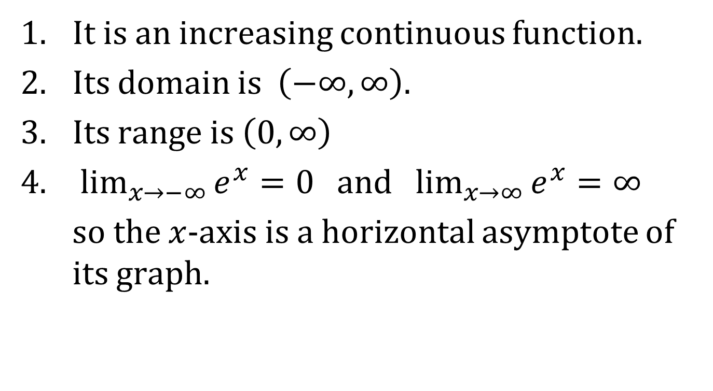
PROPERTIES OF THE NATURAL EXPONENTIAL FUNCTION f(x) = e^{x}
It is an increasing continuous function.
Its domain is $\left(−∞, ∞\right)$.
Its range is $\left(0, ∞\right)$
$\lim_{x→−∞}{e^{x}}=0$ and $\lim_{x→∞}{e^{x}}=∞$
so the $x$-axis is a horizontal asymptote of its graph.

Slide 7
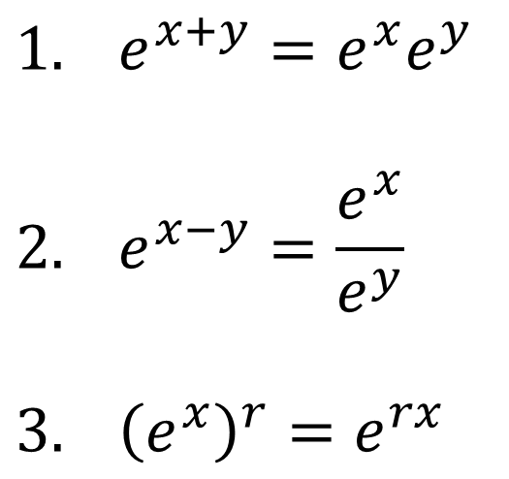
LAWS OF EXPONENTS
If $x$ and $y$ are real numbers and $r$ is rational, then
$$1. e^{x+y}=e^{x}e^{y}$$
$$2. e^{x−y}=\frac{e^{x}}{e^{y}}$$
$$3. {\left(e^{x}\right)}^{r}=e^{rx}$$

Slide 8
DIFFERENTIATION OF e^{x}
$$1. \frac{d}{dx}\left(e^{x}\right)=e^{x}$$
$$2. \frac{d}{dx}\left(e^{u}\right)=e^{u}\frac{du}{dx} or \frac{d}{dx}\left(e^{g\left(x\right)}\right)=e^{g\left(x\right)}⋅g^{′}\left(x\right)$$

Slide 9

ANTIDIFFERENTIATION OF e^{x}
$$1. \int{e^{x}dx}=e^{x}+C$$
$$2. \int{f^{′}\left(x\right)e^{f\left(x\right)}dx}=e^{f\left(x\right)}+C$$

