Slide 1
Section 6.2*
The Natural Logarithmic Function

Slide 2
THE NATURAL LOGARITHMIC FUNCTION
Definition: The natural logarithmic function is the function defined by
$$\ln{x}=\int_{1}^{x}{\frac{1}{t} dt}, x>0$$

Slide 3
THE DERIVATIVE OF THE NATURAL LOGARITHMIC FUNCTION
From the Fundamental Theorem of Calculus, Part 1, we see that
$$\frac{d}{dx}\left(\ln{x}\right)=\frac{1}{x}$$

Slide 4
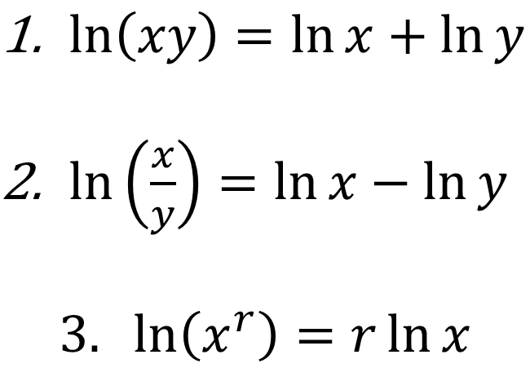
LAWS OF LOGARITHMS
If $x$ and $y$ are positive numbers and r is a rational number, then
$\ln\left(xy\right)=\ln{x}+\ln{y}$
$\ln\left(\frac{x}{y}\right)=\ln{x}−\ln{y}$
$$3. \ln\left(x^{r}\right)=r\ln{x}$$

Slide 5
PROPERTIES OF THE NATURAL LOGARITHMIC FUNCTION
1. $y=\ln{x}$ is an increasing function, since
$$\frac{d}{dx}\left(\ln{x}\right)=\frac{1}{x}>0$$
2. The graph of $y=\ln{x}$is concave downwards, since
$$\frac{d^{2}}{dx^{2}}\left(\ln{x}\right)=−\frac{1}{x^{2}}<0$$

Slide 6
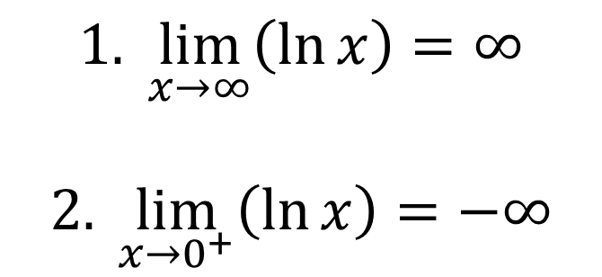
THEOREM
$$1. \lim_{x→∞}\left(\ln{x}\right)=∞$$
$$2. \lim_{x→0^{+}}\left(\ln{x}\right)=−∞$$

Slide 7
THE NUMBER e
Definition: e is the number such that ln e = 1
e ≈ 2.718281828459045 . . .
e ≈ 2.7 1828 1828 45 90 45 . . .

Slide 8
THE DERIVATIVE OF THE NATURAL LOGARITHM AND THE CHAIN RULE
$$\frac{d}{dx}\left[\ln{g\left(x\right)}\right]=\frac{g^{′}\left(x\right)}{g\left(x\right)}$$

Slide 9
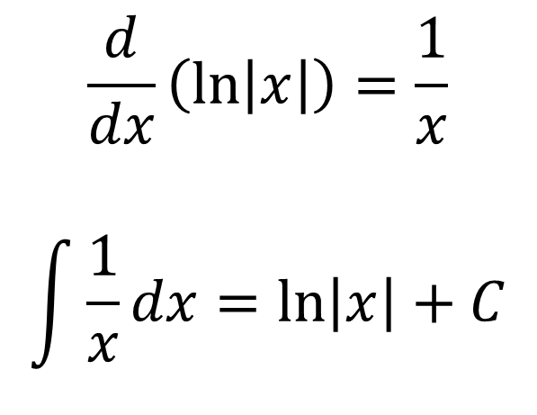
ANTIDERIVATIVES INVOLVING THE NATURAL LOGARITHM
Theorem:
$$\frac{d}{dx}\left(\ln\left|x\right|\right)=\frac{1}{x}$$
$$\int{\frac{1}{x}}dx=\ln\left|x\right|+C$$

Slide 10
ANTIDERIVATIVES OF SOME TRIGONOMETRIC FUNCTIONS
$$\int{\tan{x}} dx=\ln\left|\sec{x}\right|+C$$
$$\int{\cot{x}dx}=\ln{|\sin{x}|}+C=−\ln\left|\csc{x}\right|+C$$
$$\int{\sec{x}dx}=\ln\left|\sec{x}+\tan{x}\right|+C$$
$$\int{\csc{x}dx}=\ln{|\csc{x}−\cot{x}|}+C$$

Slide 11
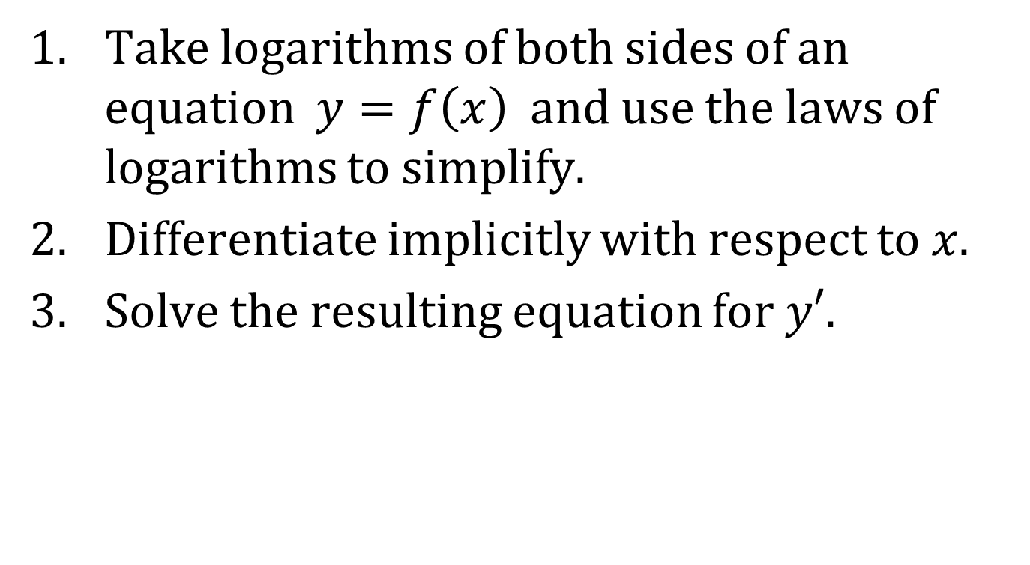
LOGARITHMIC DIFFERENTIATION
Take logarithms of both sides of an equation $y=f\left(x\right)$ and use the laws of logarithms to simplify.
Differentiate implicitly with respect to $x$.
Solve the resulting equation for $y′$.

