Slide 1
Section 6.1
Inverse Functions

Slide 2
ONE-TO-ONE FUNCTIONS
Definition: A function $f$ is called one-to-one (or 1-1) if it never takes the same value twice; that is,
$f\left(x_{1}\right)≠f\left(x_{2}\right)$ whenever $x_{1}≠x_{2}$

Slide 3
THE HORIZONTAL LINE TEST
A function is one-to-one if and only if no horizontal line intersects the graph more than once.

Slide 4
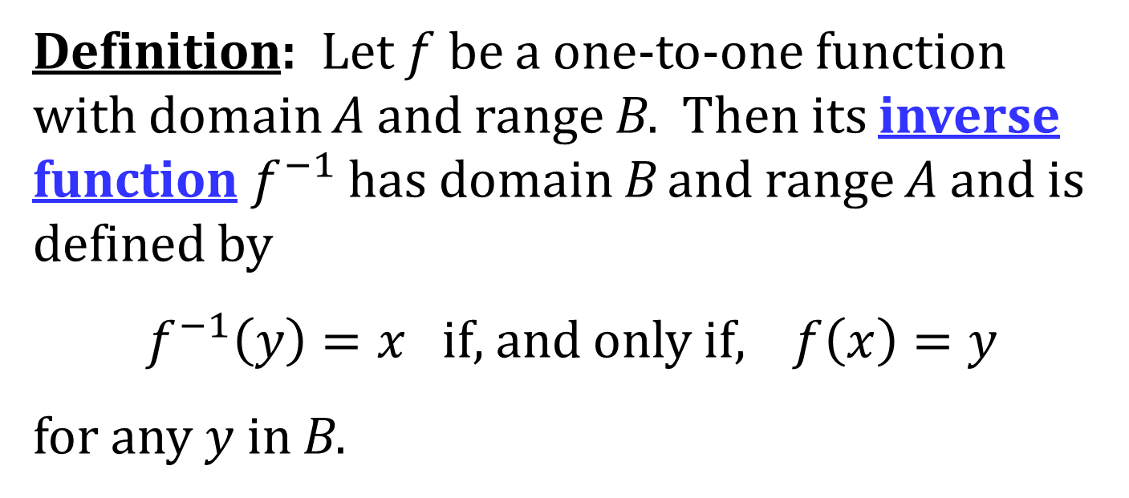
INVERSE FUNCTION
Definition: Let $f$ be a one-to-one function with domain A and range B. Then its inverse function $f^{−1}$ has domain B and range A and is defined by
$f^{−1}\left(y\right)=x$ if, and only if, $f\left(x\right)=y$
for any $y$ in B.

Slide 5
COMMENTS ON INVERSE FUNCTIONS
$f^{−1}\left(f\left(x\right)\right)=x$ for every $x$ in A.
$f\left(f^{−1}\left(x\right)\right)=x$ for every $x$ in B.
domain of $f^{−1}$ = range of $f$
range of $f^{−1}$ = domain of $f$
Do NOT mistake $f^{−1}$ for an exponent. $f^{−1}\left(x\right)$ does NOT mean $\frac{1}{f\left(x\right)}$.

Slide 6
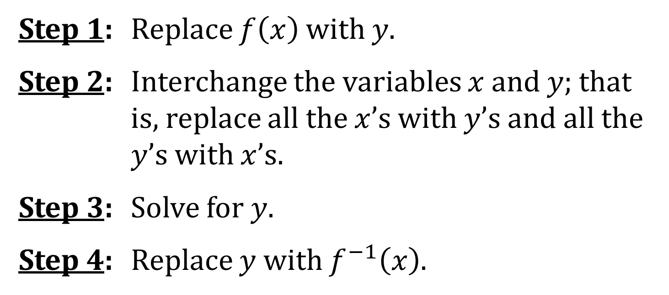
FINDING THE FORMULA FOR AN INVERSE FUNCTION
To find the formula for the inverse function of a one-to-one function:
Step 1: Replace $f\left(x\right)$ with $y$.
Step 2: Interchange the variables $x$ and $y$; that is, replace all the $x$’s with $y$’s and all the $y$’s with $x$’s.
Step 3: Solve for $y$.
Step 4: Replace $y$ with $f^{−1}\left(x\right)$.

Slide 7
THE GRAPH OF AN INVERSE FUNCTION
The graph of $f^{−1}$ is obtained by reflecting the graph of $f$ about the line $y=x$.

Slide 8
INVERSE FUNCTIONS AND CONTINUITY
Theorem: If f is a one-to-one continuous function defined on an interval, then its inverse function is also continuous.

Slide 9
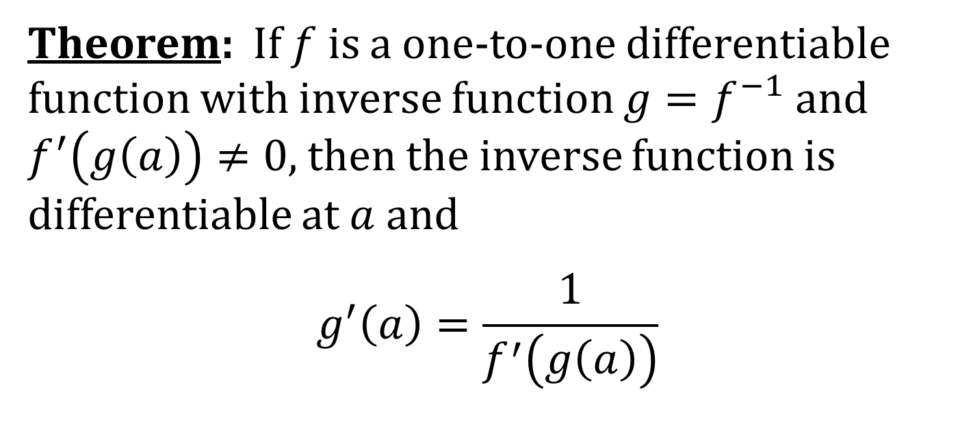
INVERSE FUNCTIONS AND DIFFERENTIABILITY
Theorem: If $f$ is a one-to-one differentiable function with inverse function $g=f^{−1}$ and $f^{′}\left(g\left(a\right)\right)≠0$, then the inverse function is differentiable at $a$ and
$$g^{′}\left(a\right)=\frac{1}{f^{′}\left(g\left(a\right)\right)}$$
$${\left(f^{−1}\right)}^{′}\left(a\right)=\frac{1}{f^{′}\left(f^{−1}\left(a\right)\right)}$$
Alternatively,

