Slide 1
Section 11.11
Applications of Taylor Polynomials

Slide 2
TAYLOR POLYNOMIAL OF ORDER n
The Taylor polynomial of order n based at a, $T_{n}\left(x\right)$, for the function f is the n^{th} partial sum of the Taylor series at $a$ for f. Thus,
$$T_{n}\left(x\right)=f\left(a\right)+f^{′}\left(a\right)\left(x−a\right)+\frac{f^{′′}\left(a\right)}{2!}{\left(x−a\right)}^{2}+…+\frac{f^{\left(n\right)}\left(a\right)}{n!}{\left(x−a\right)}^{n}$$

Slide 3
MACLAURIN POLYNOMIALS
When $a=0$ in the Taylor Polynomial of order $n$, we call it the Maclaurin polynomial of order n. That is, the Maclaurin polynomial of order $n$ is the n^{th} partial sum of the Maclaurin series for a function f.
$$T_{n}\left(x\right)=f\left(0\right)+f^{′}\left(0\right)x+\frac{f^{′′}\left(0\right)}{2!}x^{2}+…+\frac{f^{\left(n\right)}\left(0\right)}{n!}x^{n}$$

Slide 4
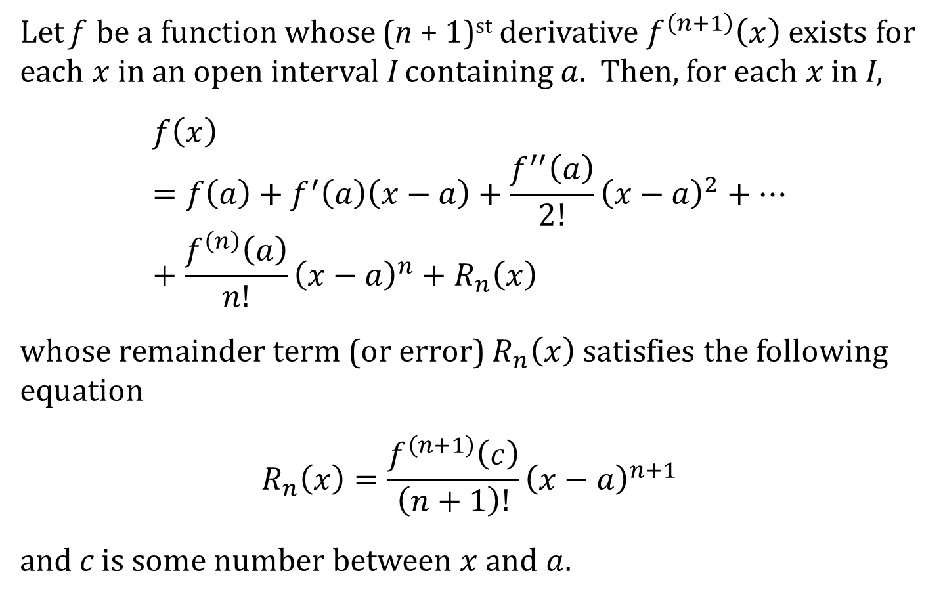
TAYLOR’S THEOREM WITH REMAINDER
Let f be a function whose (n + 1)^{st} derivative $f^{\left(n+1\right)}\left(x\right)$ exists for each $x$ in an open interval I containing $a$. Then, for each $x$ in I,
$$f\left(x\right)=f\left(a\right)+f^{′}\left(a\right)\left(x−a\right)+\frac{f^{′′}\left(a\right)}{2!}{\left(x−a\right)}^{2}+…+\frac{f^{\left(n\right)}\left(a\right)}{n!}{\left(x−a\right)}^{n}+R_{n}\left(x\right)$$
whose remainder term (or error) $R_{n}\left(x\right)$ satisfies the following equation
$$R_{n}\left(x\right)=\frac{f^{\left(n+1\right)}\left(c\right)}{\left(n+1\right)!}{\left(x−a\right)}^{n+1}$$
and c is some number between $x$ and $a$.

Slide 5
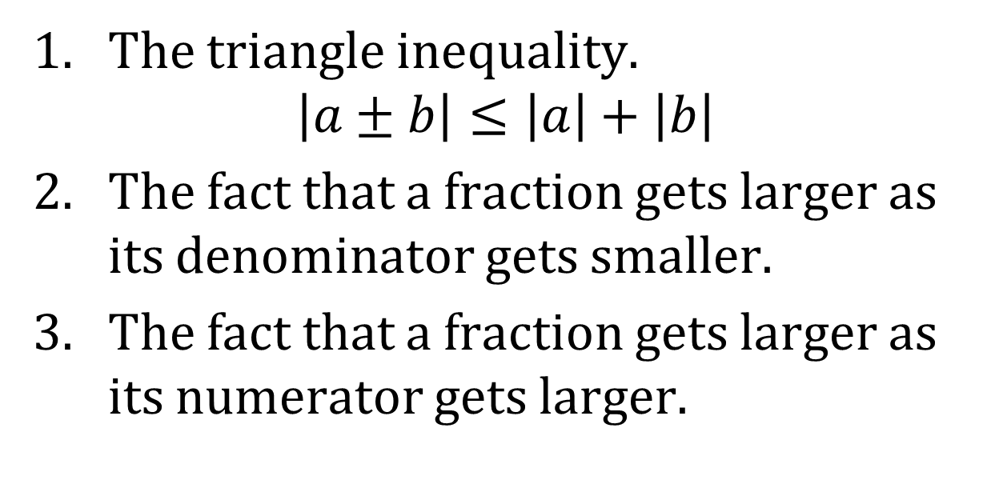
USEFUL TOOLS FOR BOUNDING |R_{n}(x)|
It is usually impossible to get an exact value for $R_{n}\left(x\right)$. So, we usually bound $\left|R_{n}\left(x\right)\right|$. Our primary tools are:
1. The triangle inequality.
$$\left|a±b\right|≤\left|a\right|+\left|b\right|$$
2. The fact that a fraction gets larger as its denominator gets smaller.
3. The fact that a fraction gets larger as its numerator gets larger.

