Slide 1
Section 10.4
Areas and Lengths in Polar Coordinates

Slide 2
FINDING POINT OF INTERSECTION OF POLAR EQUATIONS
Sketch the graphs of the polar equations.
Solve the systems of simultaneous equations.
Check to see if the pole is included.

Slide 3
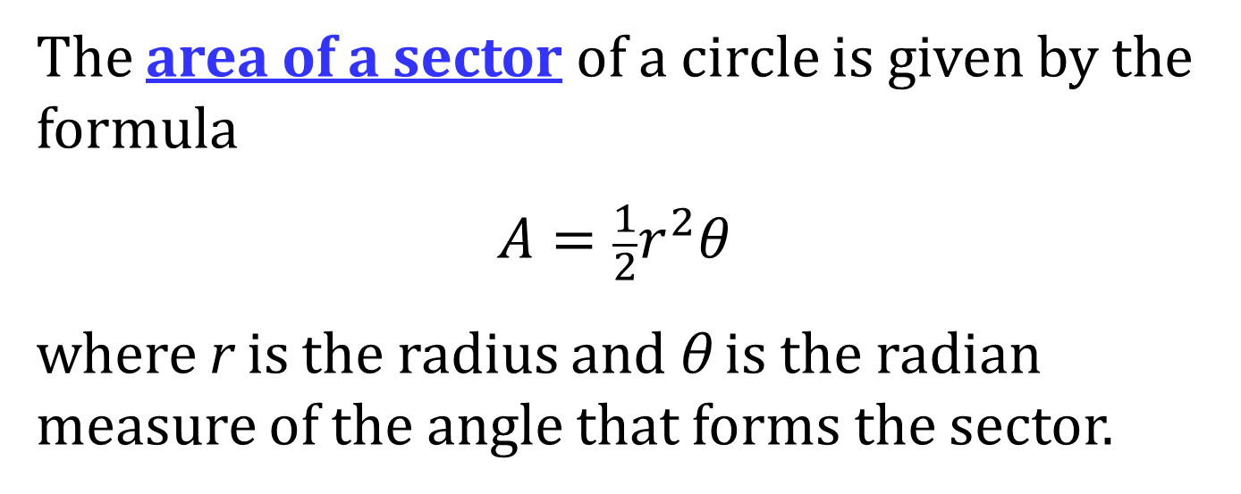
AREA OF A SECTOR
The area of a sector of a circle is given by the formula
$$A=\frac{1}{2}r^{2}θ$$
where r is the radius and θ is the radian measure of the angle that forms the sector.

Slide 4
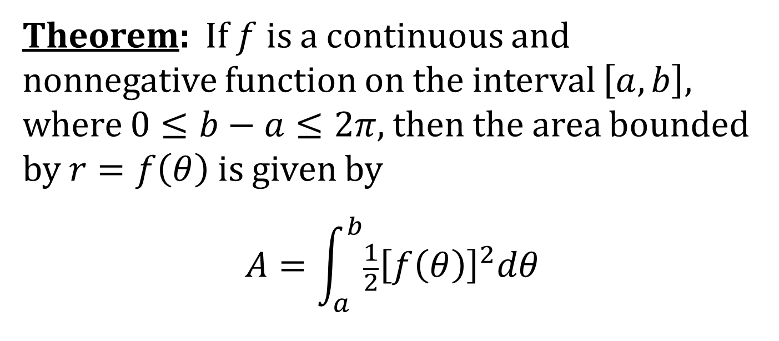
FINDING THE AREA OF A REGION IN POLAR COORDINATES
Theorem: If $f$ is a continuous and nonnegative function on the interval $\left[a,b\right]$, where $0≤b−a≤2π$, then the area bounded by $r=f\left(θ\right)$ is given by
$$A=\int_{a}^{b}{\frac{1}{2}{\left[f\left(θ\right)\right]}^{2}dθ}$$

Slide 5
PROCEDURE FOR FINDING AREA IN POLAR COORDINATES
Sketch the graph(s)
If needed, find the points of intersection.
Set up the integral(s).
Evaluate the integral(s).

Slide 6
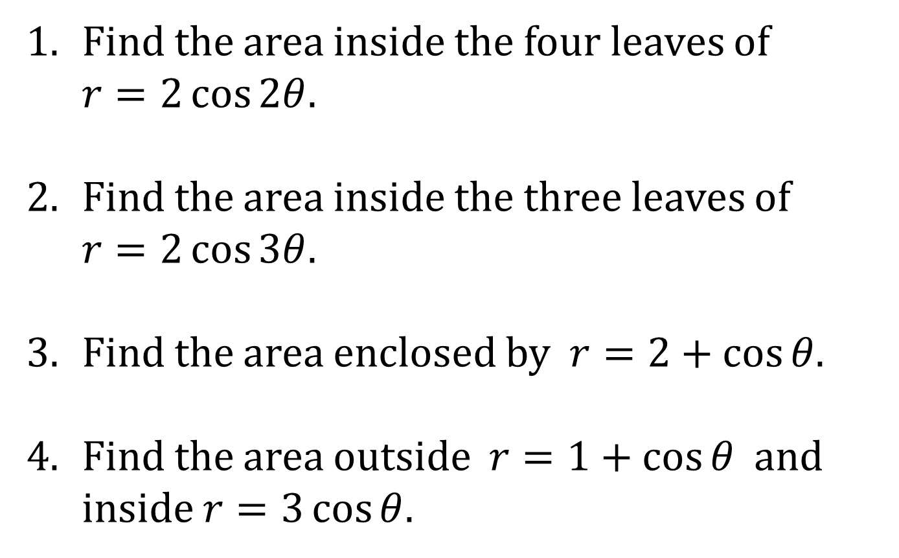
EXAMPLES
1. Find the area inside the four leaves of
$r=2\cos{2θ}$.
2. Find the area inside the three leaves of
$r=2\cos{3θ}$.
3. Find the area enclosed by $r=2+\cos{θ}$.
4. Find the area outside $r=1+\cos{θ}$ and inside $r=3\cos{θ}$.

Slide 7
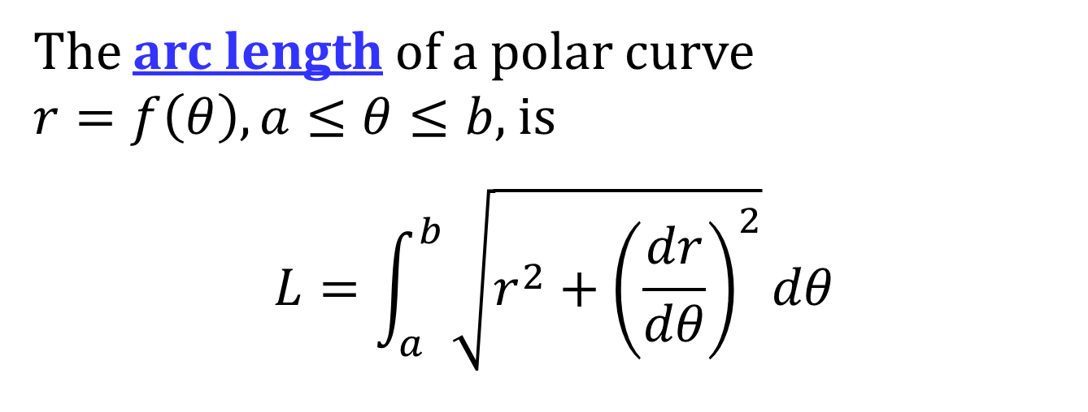
ARC LENGTH IN POLAR COORDINATES
The arc length of a polar curve
$r=f\left(θ\right), a≤θ≤b$, is
$$L=\int_{a}^{b}{\sqrt{r^{2}+{\left(\frac{dr}{dθ}\right)}^{2}}dθ}$$

