Slide 1
Section 10.3
Polar Coordinates

Slide 2
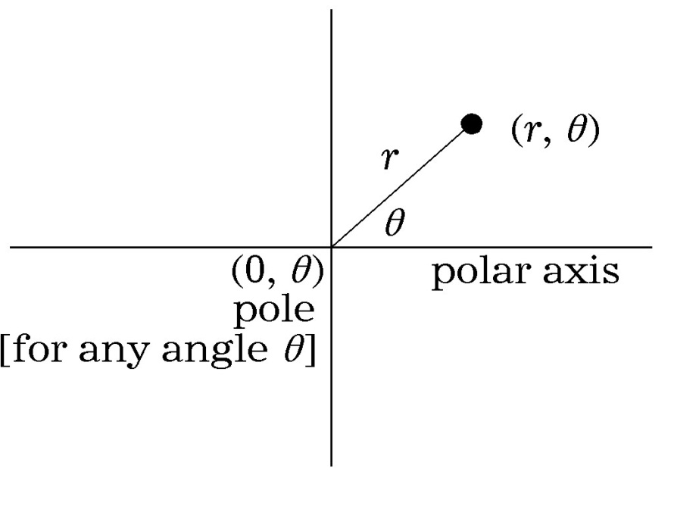
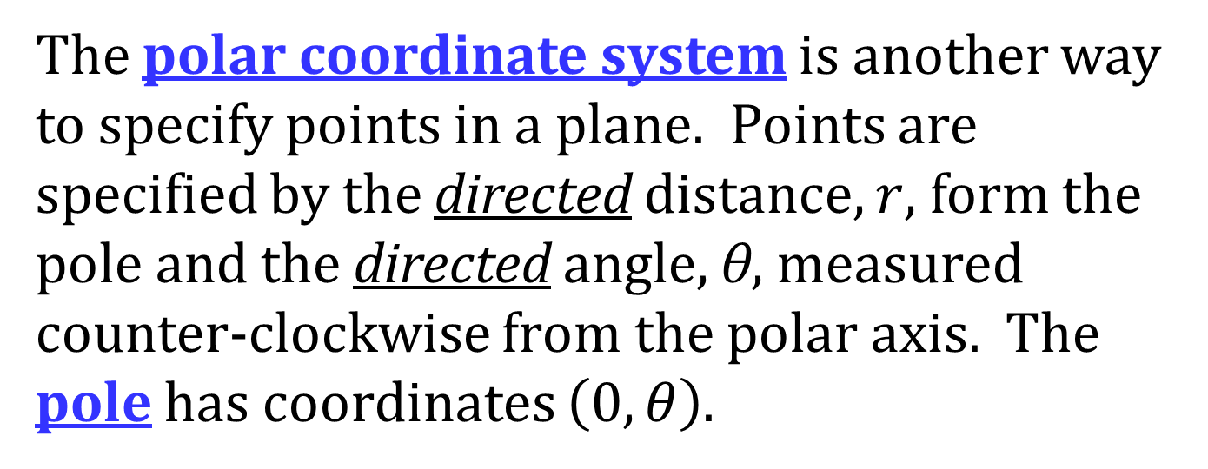
POLAR COORDINATES
The polar coordinate system is another way to specify points in a plane. Points are specified by the directed distance, $r$, form the pole and the directed angle, θ, measured counter-clockwise from the polar axis. The pole has coordinates $\left(0, θ\right)$.

Slide 3
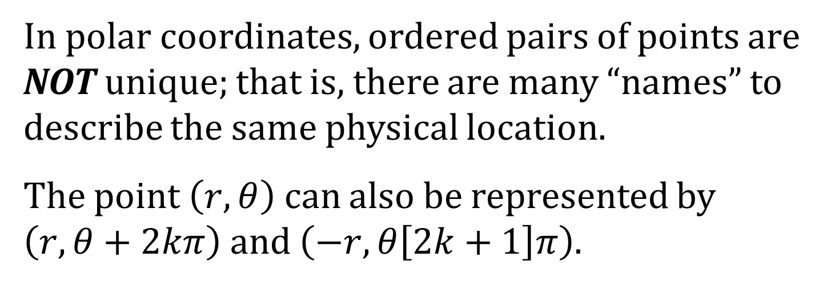
UNIQUESNESS OF POLAR COORDINATES
In polar coordinates, ordered pairs of points are NOT unique; that is, there are many “names” to describe the same physical location.
The point $\left(r,θ\right)$ can also be represented by $\left(r, θ+2kπ\right)$ and $\left(−r, θ\left[2k+1\right]π\right)$.

Slide 4
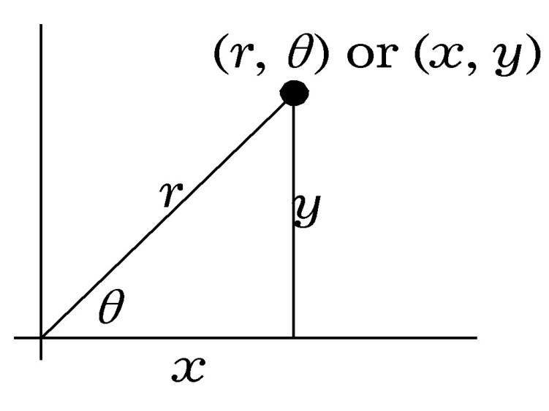
CONVERTING BETWEEN RECTANGULAR AND POLAR COORDINATES
Polar coordinates to rectangular coordinates
Rectangular coordinates to polar coordinates
$$x=r\cos{θ}; y=r\sin{θ}$$
$$r^{2}=x^{2}+y^{2}; \tan{θ}=\frac{y}{x}$$

Slide 5
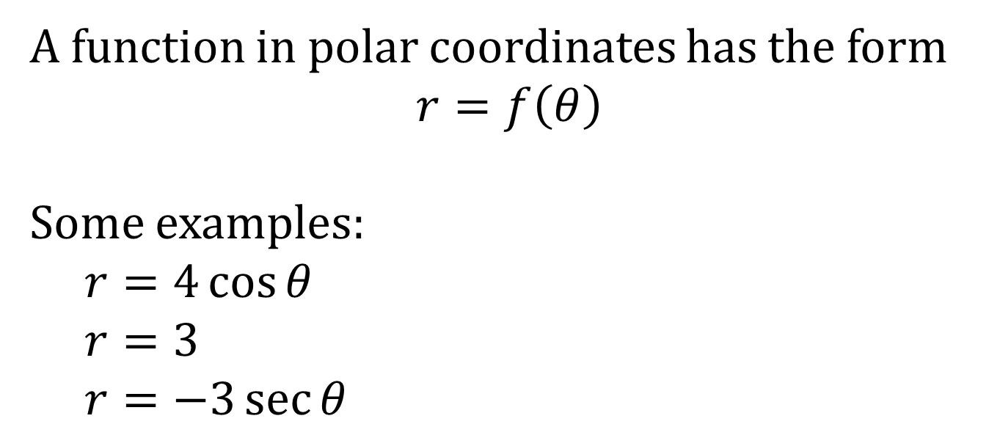
FUNCTIONS IN POLAR COORDINATES
A function in polar coordinates has the form
$$r=f\left(θ\right)$$
Some examples:
$r=4\cos{θ}$
$r=3$
$r=−3\sec{θ}$

Slide 6
POLAR EQUATIONS TO RECTANGULAR EQUATIONS
NOTE: $r=\sqrt{x^{2}+y^{2}}$
To convert polar equations into rectangular equations use:
$$\cos{θ}=\frac{x}{\sqrt{x^{2}+y^{2}}}; \sin{θ}=\frac{y}{\sqrt{x^{2}+y^{2}}}; r^{2}=x^{2}+y^{2}$$

Slide 7
RECTANGULAR EQUATIONS TO POLAR EQUATIONS
NOTE: $r=\sqrt{x^{2}+y^{2}}$
To convert rectangular equations to polar equations use:
$$x=r\cos{θ} r^{2}=x^{2}+y^{2} \\ y=r\sin{θ} \tan{θ}=\frac{y}{x}$$

Slide 8
HORIZONTAL AND VERTICAL LINES
The graph of $r\sin{θ}=a$ is a horizontal line $a$ units above the pole if $a$ is positive and $\left|a\right|$ units below the pole if $a$ is negative.
The graph of $r\cos{θ=a}$ is a vertical line $a$ units to the right of the pole if $a$ is positive and $\left|a\right|$ units to the left of the pole if $a$ is negative.

Slide 9
POLAR EQUATIONS OF CIRCLES
The equation $r=a$ is a circle of radius |a| centered at the pole.
The equation $r=a\cos{θ}$ is a circle of radius $\left|\frac{a}{2}\right|$, passing through the pole, and with center on $θ=0$ or $θ=π$.
The equation $r=a\sin{θ}$ is a circle of radius $\left|\frac{a}{2}\right|$, passing through the pole, and with center on $θ=\frac{π}{2}$ or $θ=\frac{3π}{2}$.

Slide 10
ROSE CURVES
The equations
$$r=b\sin\left(aθ\right)$$
$$r=b\cos\left(aθ\right)$$
both have graphs that are called rose curves.
The rose curve has 2a leaves (petals) if $a$ is an even number.
The rose curve has a leaves (petals) if $a$ is an odd number.
The leaves (petals) have length b.
To graph rose curves pick multiples of $\left(\frac{π}{2}\right)⋅\left(\frac{1}{a}\right)$

Slide 11
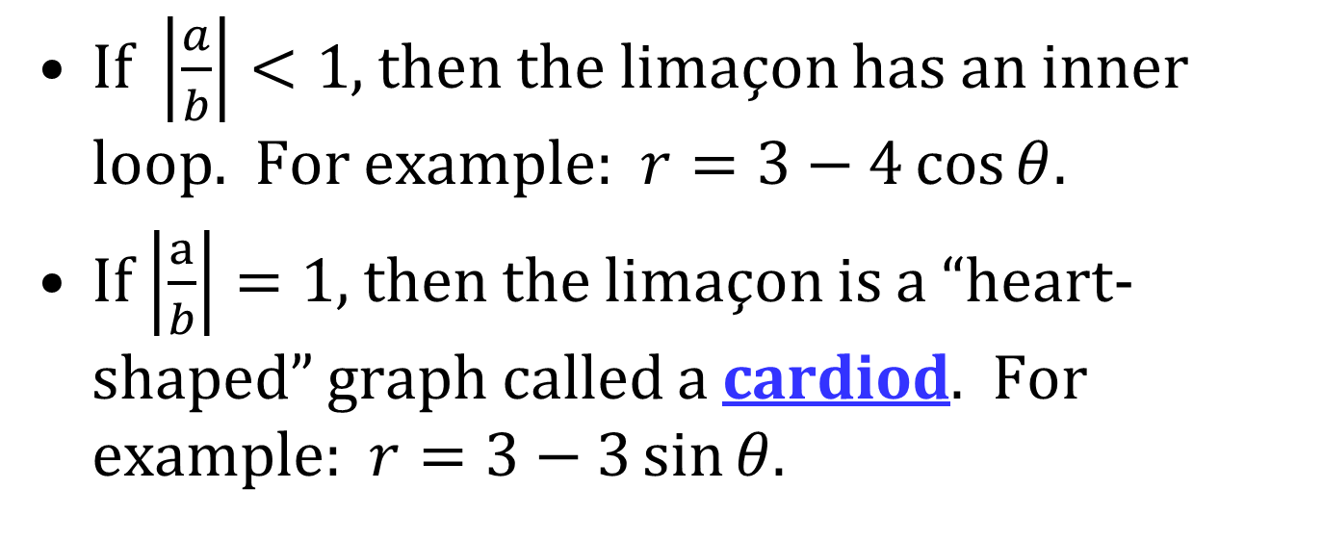
LIMAÇONS
The graphs of the equations
$$r=a±b\sin{θ}$$
$$r=a±b\cos{θ}$$
are called limaçons.
If $\left|\frac{a}{b}\right|<1$, then the limaçon has an inner loop. For example: $r=3−4\cos{θ}$.
If $\left|\frac{a}{b}\right|=1$, then the limaçon is a “heart-shaped” graph called a cardiod. For example: $r=3−3\sin{θ}$.

Slide 12
LIMAÇONS (CONTINUED)
If $1<\left|\frac{a}{b}\right|<2$, then the limaçon is dimpled. For example: $r=3+2\cos{θ}$.
If $\left|\frac{a}{b}\right|≥2$, then the limaçon is convex. For example: $r=3+\sin{θ}$.

Slide 13
TANGENTS TO POLAR CURVES
Given a polar curve $r=f\left(θ\right)$, the Cartesian coordinates of a point on the curve are:
$$x=r\cos{θ}=f\left(θ\right)\cos{θ}$$
$$y=r\sin{θ}=f\left(θ\right)\sin{θ}$$
Hence,
$$\frac{dy}{dx}=\frac{\frac{dy}{dθ}}{\frac{dx}{dθ}}=\frac{\frac{dr}{dθ}\sin{θ}+r\cos{θ}}{\frac{dr}{dθ}\cos{θ}−r\sin{θ}}$$

