Slide 1
Prosocial behavior
Chapter 13

Slide 2
What is Prosocial Behavior?
Prosocial Behavior
Any act performed with the goal of benefiting another person
Altruism
The desire to help another person even if it involves a cost to the helper and where there is not any expectation of personal gain

Slide 3
Why do people choose to help?
Evolutionary Psychology Explanation
The attempt to explain social behavior in terms of genetic factors that evolved over time according to the principles of natural selection.
Any gene that furthers survival and increases the probability of producing offspring likely to be passed on
Genes that lower chances of survival and reduce the chances of producing offspring less likely to be passed on

Slide 4
Why do people choose to help?
SOCIAL NORMS
Adaptive for individuals to learn social norms from other members of a society (Simon, 1990)
Norm of Reciprocity
The expectation that helping others will increase the likelihood that they will help us in the future.

Slide 5
Why do people choose to help?
Social exchange theory
In relationships with others, try to maximize the ratio of social rewards to social costs
Helping can be rewarding in a number of ways:
Increase likelihood of future help (reciprocity)
Someone will help us when we need it
Relief of another’s distress
Gain rewards
Social approval
Increased feelings of self-worth

Slide 6
Why do people choose to help?
Potential Costs of Helping
Physical danger
Risk of experiencing pain
Risk of embarrassment
Time costs
Social exchange theory argues that true altruism does not exist
People help when the benefits outweigh the costs

Slide 7
Why do people choose to help?
Empathy-Altruism Hypothesis
The idea that when we feel empathy for a person, we will attempt to help that person purely for altruistic reasons, regardless of what we have to gain
Empathy
The ability to put oneself in the shoes of another person and to experience events and emotions (e.g., joy and sadness) the way that person experiences them (as if you were experiencing them yourself)

Slide 8
Summary of Theories on Motives for Helping
Biological/Genetic (Evolutionary psychology)
Learned Social Norms
Social exchange theory
Maximize rewards, minimize costs
Empathy-altruism hypothesis
Powerful feelings of empathy and compassion → selfless giving

Slide 9
Helping & Personal Characteristics
Personality
Gender
Group Membership
Mood

Slide 10
Helping & Personal Characteristics
Altruistic Personality: the qualities that cause an individual to help others in a wide variety of situations.
Studies of both children and adults indicate that people with high scores on personality tests of altruism are not much more likely to help than those with lower scores.

Slide 11
Helping & Gender
Consider two scenarios:
In one, someone stops to change a tire for a stranded motorist or offers to fix a leaky faucet.
In the other, someone is involved in a long-term helping relationship, such as assisting a disabled neighbor with chores around the house.
Are men or women more likely to help in each situation?
Men, in the first example and women in the second. While women are often believed to be more helpful than men, it seems to depend upon the type of help required and whether it is more associated with the male or female gender stereotype.

Slide 12
Helping & Group Membership
People in all cultures are more likely to help anyone they define as a member of their in-group (the group with which an individual identifies as a member) than those they perceive in out-groups (any group with which an individual does not identify)
When will we help in-group and out-group members?
In-group: Help when we feel empathy
Out-group: Help when it furthers own self-interests

Slide 13
Helping and Mood
Feel good-Do good hypothesis
When people are in a good mood, they are more helpful in a variety of ways!
Results of a study testing this:
84% of people who found coins researcher left in mall pay phone helped a man pick up papers in one study.
Only 4% of those who did not find coins helped.

Slide 14
Helping and Mood
Feel good – Do good Why?
Being in a good mood can increase helping for these reasons:
Good moods make us look on the bright side of life.
Helping others can prolong our good mood.
Good moods increase self-attention (Remember, that makes us compare ourselves to our own moral standards.)

Slide 15
Helping and Mood
Feeling guilty clearly leads to an increase in helping, probably because people believe that good deeds cancel out bad deeds (penance).
Sadness can also lead to an increase in helping, under some conditions.
When sad, people are motivated to do things that make them feel better. Helping others lets them:
Forget their own problems
Feel useful and capable of solving a problem
Compare their plight to someone else in trouble

Slide 16
Situational Determinants of Helping
Number of people in the immediate environment
Research using a man apparently in distress showed that in small towns, half the people who walked by stopped and offered to help. In large cities, only 15% of passersby stopped to help.
When opportunity for helping arises, matters more whether the incident occurs in a rural or urban area than where the witnesses grew up.

Slide 17
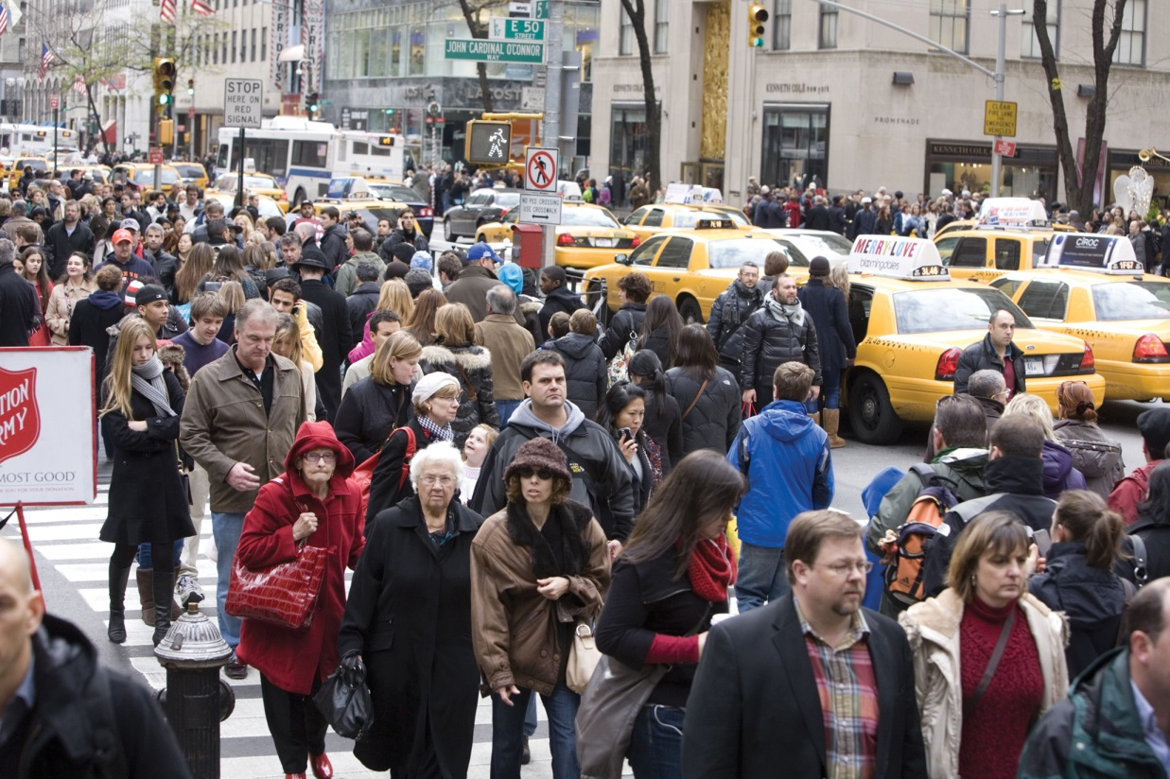
People are less helpful in big cities than in small towns, not because of a difference in values, but because the stress of urban life causes them to keep to themselves. Source: (left): John Lund/Drew Kelly/Sam Diephuis/Glow Images, Inc.; (right): David Grossman/Alamy

Slide 18
Urban Overload Hypothesis
People living in cities are constantly being bombarded with stimulation and they keep to themselves to avoid being overwhelmed by it.
if you put urban dwellers in a calmer, less stimulating environment, they would be as likely as anyone else to reach out to others
Research Supports the hypothesis

Slide 19
Residential Mobility
It is not only where you live that matters, but how often you have moved from one place to another.
People who have lived for a long time in one place more likely to engage in pro-social behaviors that help community.
Living for a long time in one place leads to:
Greater attachment to the community
More inter-dependence with neighbors
Greater concern with one's reputation in the community

Slide 20
The Bystander Effect
Kitty Genovese's prolonged murder
38 witnesses failed to call police.
Bibb Latané and John Darley (1970) considered why no one helped.
The greater the number of bystanders who observe an emergency, the less likely any one is to help.
This is known as the bystander effect.

Slide 21
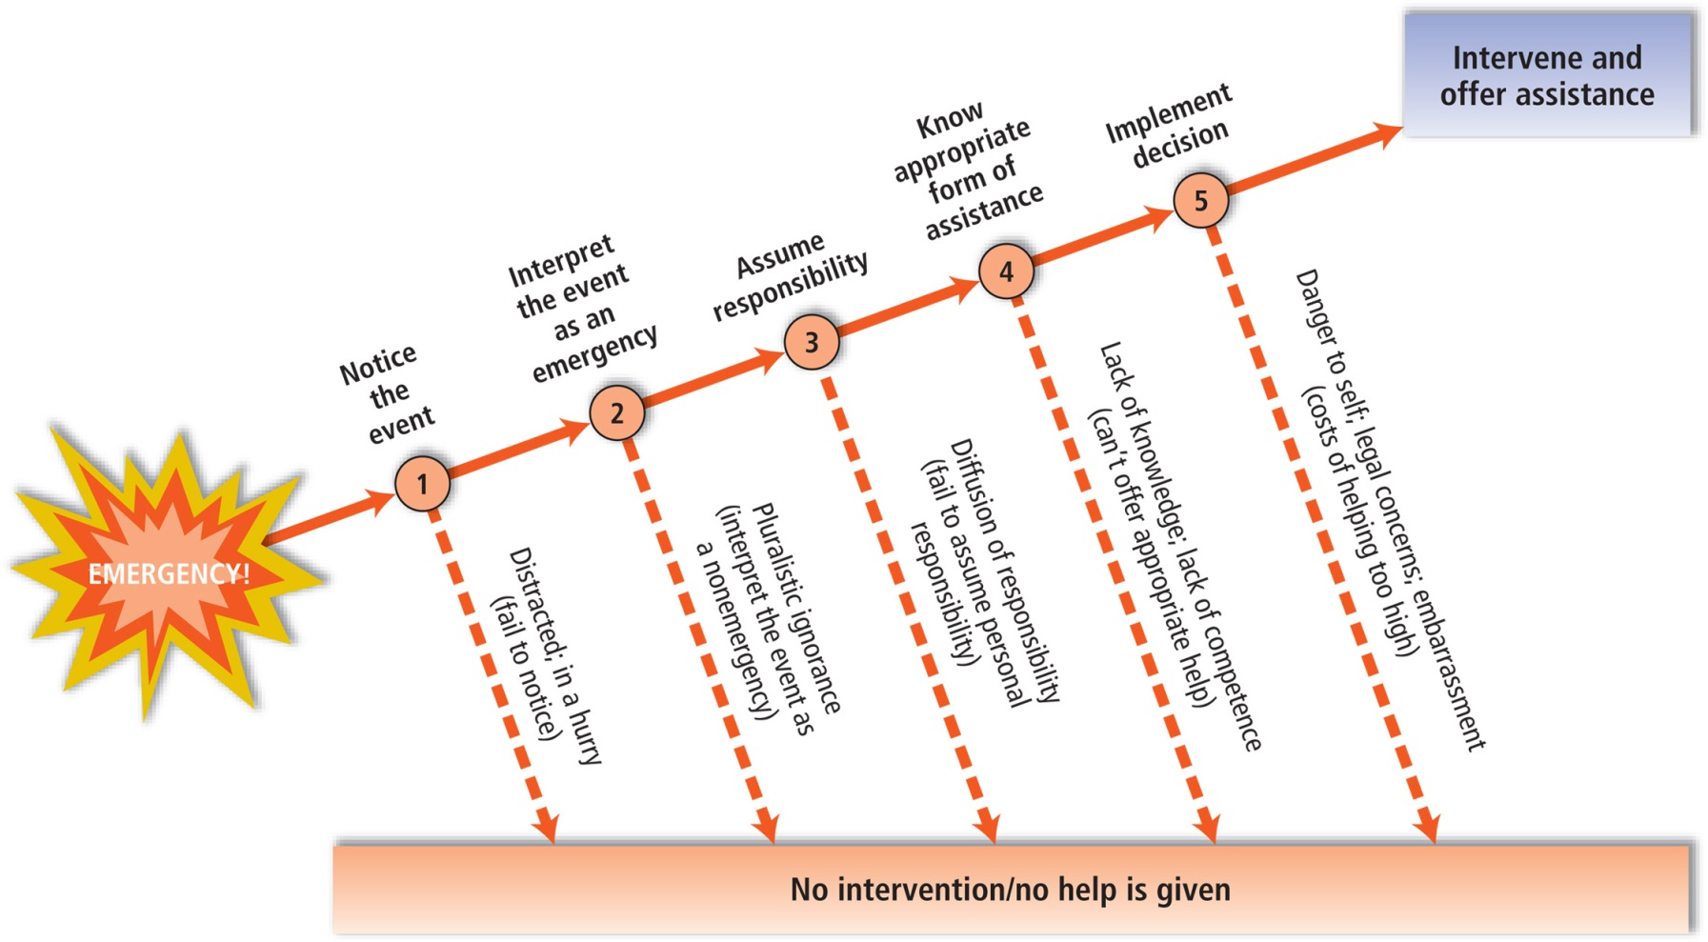
Figure 11.4 Bystander Intervention Decision Tree: Five Steps to Helping in an Emergency Latan. and Darley (1970) showed that people go through five decision-making steps before they help someone in an emergency. If bystanders fail to take any one of the five steps, they will not help. Each step is outlined here, along with the possible reasons why people decide not to intervene. (Adapted from Latan. & Darley, 1970)
Notes:
Why is it that people are less likely to help when others are present? Latané and Darley (1970) developed a step-by-step description of how people decide whether to intervene in an emergency. Part of this description is an explanation of how the number of bystanders can make a difference.

Slide 22
Bystander Effect
Diffusion of Responsibility
The phenomenon whereby each bystander’s sense of responsibility to help decreases as the number of witnesses increases.

