Slide 1
Chapter 1 Psychology as a Science
Overview

Slide 2
What is Psychology?
Psychology Is the Scientific Study of Mental Processes and Behavior

Slide 3
What is Psychology?
The term psychology comes from the Greek words psyche, meaning “mind” or “soul” and logos, meaning “study.”

Slide 4
Origins of Psychology
Philosophy & Physiology
Interactive Dualism (The mind-body problem)
Rene Descartes
Psychology decided to become a science

Slide 5
History of Psychology
Socrates (469 – 399 B.C.) & Plato
Mind is separable from body
Knowledge is innate
(used logic)

Slide 6
History of Psychology
Aristotle (335 B.C.) (used observation)
Knowledge is not innate, comes from experience
The mind is inseparable from the body
The heart is the seat of mental processes

Slide 7
History of Psychology
Rene Descartes (1595 – 1650 A. D.)
Interactive dualism or the “mind-body problem”

Slide 8
History of Psychology
John Locke (1632 – 1704 A.D.)
The mind at birth is a blank slate (tabula rasa) on which experience writes.

Slide 9
History of Psychology
Wilhelm Wundt – 1879
“birth of psychology”
Laboratory in Leipzig, Germany
Studied simple reaction time

Slide 10
Early Pioneers
Wilhelm Wundt (1832–1920) is associated with structuralism and is recognized as the “world’s first psychologist.”

Slide 11
Early Schools of Thought
Structuralism (Edward Tichener)
Purpose: find the structure of mind or consciousness
Method: introspection

Slide 12
Early Schools of Thought
William James (1842-1910) established functionalism which studies how the conscious mind aids in survival.
What is the purpose or function of the behavior?
Influenced by Darwin & adaptation

Slide 13
Early Pioneers
John Watson (1878–1958) helped establish behaviorism, which studies observable behavior and was the dominant perspective in North America from the 1920s through the 1950s.

Slide 14
Behaviorism
Psychology – the science of behavior
(1920 – 1960)
John B. Watson
Behavior is anything an organism does that can be observed and recorded

Slide 15
Behaviorist Perspective
B. F. Skinner and other behaviorists contend that consequences shape behavior.
People and other animals repeat behaviors followed by positive consequences and avoid behaviors followed by negative consequences.

Slide 16
Psychoanalytic Perspective
Sigmund Freud (1856–1939) established psychoanalysis, which studies how the unconscious mind shapes behavior.

Slide 17
Psychoanalytic Perspective
Many contemporary psychoanalysts downplay Freud’s emphasis on sexual drives while still emphasizing the unconscious mind.

Slide 18
The Humanistic Perspective
Humanistic psychology developed in opposition to psychoanalysis and behaviorism.
Emphasized personal Growth and Conscious Decision Making

Slide 19
The Humanistic Perspective
Carl Rogers and Abraham Maslow were the primary architects of this perspective.
This perspective lacked scientific rigor.
It emphasized conscious experience and the essential goodness of people.

Slide 20
The Cognitive Perspective
Analyzes How the Mind Organizes and Interprets Experiences
1960s - reintroduction of the concepts of consciousness and cognition.

Slide 21
The Cognitive Perspective
The theoretical “center of gravity” shifted from behaviorism to the cognitive perspective.
Two of the principal leaders of this “cognitive revolution” in psychology were George Miller and Ulric Neisser.

Slide 22
The Neuroscience Perspective
Focuses on the Nervous System The neuroscience perspective
Studies how the brain communicates with itself and other body organs
Focuses on the most precise microscopic levels of analysis.

Slide 23
The Neuroscience Perspective
Neuroscientists conduct a good deal of their research using animals with simpler brains.
This perspective has benefited from advances in technology such as CT & PET scans & MRIs.

Slide 24
The Evolutionary Perspective
Speculates about How Behavior Could Be Explained by Natural Selection
Partly based on the writings of biologist Charles Darwin.

Slide 25
The Evolutionary Perspective
Evolution is the genetic changes that occur in a species over generations due to natural selection.
Natural selection involves the environment “selecting” which traits of a species are best suited for survival or “survival of the fittest.”

Slide 26
The Sociocultural Perspective
Studies How Behavior Is Shaped by Social and Cultural Forces
Culture is the total lifestyle of people from a particular social grouping—ideas, symbols, preferences, and material objects.

Slide 27
The Sociocultural Perspective
Important cultural belief systems are individualism and collectivism, which concern how the individual is related to her or his group.
Individualism stresses individual needs over group needs.
Collectivism stresses group needs over individual needs.

Slide 28
Seven areas of research specialization in psychology:
Psychobiology /neuroscience
Developmental
Experimental (behaviorist)
Comparative (evolutionary)
Cognitive
Personality
Social

Slide 29
Four areas of applied specialization:
Clinical psychology
Counseling psychology
Industrial-organizational psychology
Educational and school psychology

Slide 30
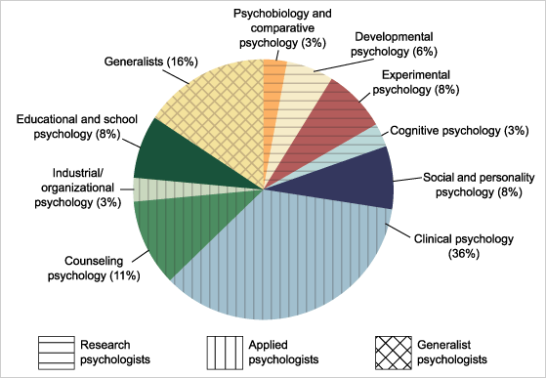
Percentage of Psychology Ph.D.s Awarded by Specialty Area
Source: Based on data from the Summary Report: Doctorate Recipients from U.S. Universities, National Research Council, reported in the APA Education Directorate, 1995, p. 12.

Slide 31
Contemporary Psychology
500,000 psychologists worldwide
130,000 European organizations
160,000 American APA members
Union of Psychological Science has 69 member nations
2002 – two-thirds of new psychology Ph.D.’s went to women

Slide 32
Psychology & Psychiatry
People often confuse psychology with psychiatry:
Psychiatry is a branch of medicine concerned with the diagnosis and treatment of psychological disorders, practiced by physicians.
Psychology deals with the diagnosis and treatment of the above disorders, but this interest represents only one area of specialization and has a much broader scope.

