Slide 1
Treatment for Psychological Disorders

Slide 2
What Are the Therapies for Psychological Disorders?
The two broad categories of therapy:
Psychotherapy: psychological methods that include a personal relationship between a trained therapist and a client
Biomedical therapies: the treatment of psychological disorders by altering brain functioning with physical or chemical interventions

Slide 3
What Are the Therapies for Psychological Disorders?
The two broad categories of therapy:
Psychotherapy: psychological methods including a personal relationship between a trained therapist and a client
Biomedical therapies: altering brain functioning with physical or chemical interventions

Slide 4
What Are the Therapies for Psychological Disorders?
Three mental health professions:
Psychiatry
Social work
Psychology
Two specialty areas in psychology:
Clinical psychology
Counseling psychology

Slide 5
Psychodynamic Therapies
A group of psychotherapies based on the work of Sigmund Freud that say that psychological disorders stem from unconscious forces
Important psychodynamic terms:
Free association: therapy technique in which clients say whatever comes to mind
Resistance: anything client does to interfere with free chain of thought or therapeutic progress
Transference: client transfers feelings for significant others early in life to therapist (countertransference)

Slide 6
Behavior Therapies
Psychotherapies that apply learning principles to the elimination of unwanted behaviors.
Counterconditioning is based on classical conditioning.
Counterconditioning: involves conditioning new responses to stimuli that trigger unwanted behaviors

Slide 7
Counterconditioning: Three Techniques
Systematic desensitization:
used to treat phobias in which client is gradually exposed to feared object, while remaining relaxed
Response prevention:
used to treat obsessive-compulsive disorder; client is exposed to situation that triggers the compulsive behavior but is not permitted to engage in the ritual
Aversive conditioning:
a classically conditioned aversive response is conditioned to occur in response to a stimulus that has previously been associated with an undesired behavior

Slide 8
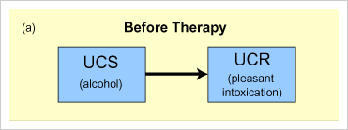
Aversive Conditioning for Alcoholism

Slide 9
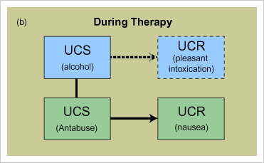
Aversive Conditioning for Alcoholism

Slide 10
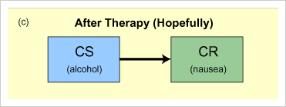
Aversive Conditioning for Alcoholism

Slide 11
Humanistic Therapies Focus on Feelings and Personal Growth
Goal: To help people get in touch with
their feelings,
their “true selves”
their purpose in life

Slide 12
Humanistic Therapies Focus on Feelings and Personal Growth
Humanistic therapies: help people get in touch with their feelings, with their “true selves,” and with their purpose in life
Client-centered therapy: Carl Rogers
Therapists should be facilitators of personal growth providing supportive environment—clients discover their “true selves.”
Gestalt therapy: Fritz Perls
Therapists help people become aware of their true feelings or some other important aspect of the self.

Slide 13
Cognitive Therapies: Focus on Altering Dysfunctional Thought Patterns
Cognitive therapies seek to identify and then modify faulty cognitive processes.
Rational-emotive behavior therapy (REBT): Albert Ellis
Mental distress is caused by the irrational thinking people have about those events.
Cognitive-behavior therapy (CBT): Aaron Beck
Depressed people have negative views of themselves, the world, and their future, and they misinterpret everyday events to support these negative views.

Slide 14
Cognitive Therapy
Cognitive Therapy
teaches people new, more adaptive ways of thinking and acting
based on the assumption that thoughts intervene between events and our emotional reactions

Slide 15
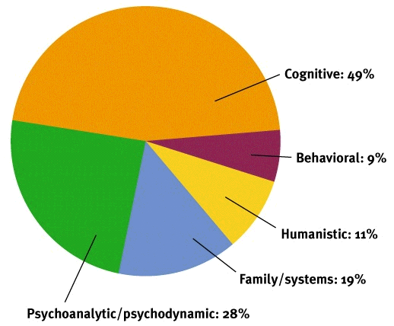
Cognitive Therapy
The Cognitive Revolution

Slide 16
Cognitive Therapy
Cognitive-Behavior Therapy
a popular integrated therapy that combines cognitive therapy (changing self-defeating thinking) with behavior therapy (changing behavior)

Slide 17
Cognitive Therapy
Lost job
A cognitive perspective on psychological disorders
Internal beliefs:
I’m worthless.
It’s hopeless.
Depression
Lost job
Internal beliefs:
My boss is a jerk.
I deserve something better.
No
depression

Slide 18
Child, Group & Family Therapy
Child therapies
Common approach used—play therapy
Therapist provides children with toys and drawing materials
Assumption is that whatever is troubling them will be expressed in play

Slide 19
Child, Group & Family Therapy
Group therapies
Simultaneous treatment of several clients under the guidance of a therapist
Variation of group therapy is the self-help group:
Several people regularly meeting and discussing their problems with one another without the guidance of a therapist

Slide 20
Child, Group & Family Therapy
Family and couples therapies
Family therapies—designed to constructively modify the dysfunctional relationships among family members
Couples therapy—designed to help couples improve the quality of their relationship

Slide 21
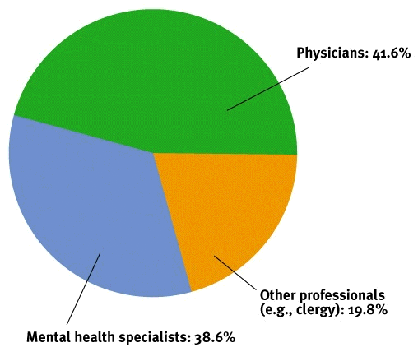
Who Does Therapy?
Where do people turn for help?

Slide 22
Who Does Therapy?
Therapists and Their Training
Type Description
Clinical Ph.D. In psy6chology or Psy.D.
Clinical or A two-year Master of Social Work plus postgraduate supervision
psychiatric About half have earned the National Association of Social Workers’
Social worker designation of clinical social worker.
Counselors LPC,
Marriage & Family (MFT)
Pastoral
Abuse
Psychiatrist Physicians (M.D.) who specialize in the treatment of psychological
disorders.
Not all psychiatrists have had extensive training in psychotherapy Can prescribe medications.

Slide 23
Evaluating Therapy
Client Perceptions
Consumer Reports Study
Clinician’s Perceptions
Outcome Research
Spontaneous Remission
Regression toward the mean

Slide 24
Does Therapy Work?
Meta-analysis
procedure for statistically combining the results of many different research studies
Number of
persons
Average
untreated
person
Average
psychotherapy
client
Poor outcome
Good outcome
80% of untreated people have poorer
outcomes than average treated person

Slide 25
Alternative Therapies
Disconnect between Research and Therapy
Alternative Therapies
Therapeutic touch
Eye movement desensitization
Light exposure therapy

Slide 26
Commonalities among Therapies
A new perspective
Trusting, caring relationship
Culture and values (therapist-client match)

Slide 27
Biomedical Therapies
Psychopharmacology
study of the effects of drugs on mind and behavior
Lithium
chemical that provides an effective drug therapy for the mood swings of bipolar (manic-depressive) disorders

Slide 28
Biomedical Therapies
The emptying of U.S. mental hospitals
State and county
mental hospital
residents, in
thousands
700
600
500
400
300
200
100
0
Introduction of antipsychotic drugs
Rapid decline
in the mental
hospital
population
1900 1910 1920 1930 1940 1950 1960 1970 1980 1990
Year

Slide 29
Biomedical Therapies
Today in the United States, less than one-third the number of people are full-time residents in psychiatric hospitals.
Reason for this sharp decrease—the widespread use of drug therapies in treating psychological disorders
This form of therapy is often less expensive than psychological therapies.

Slide 30
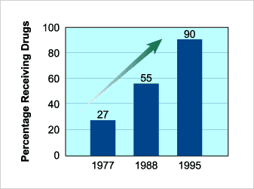
Use of Drugs in Treating Psychological Disorders

Slide 31
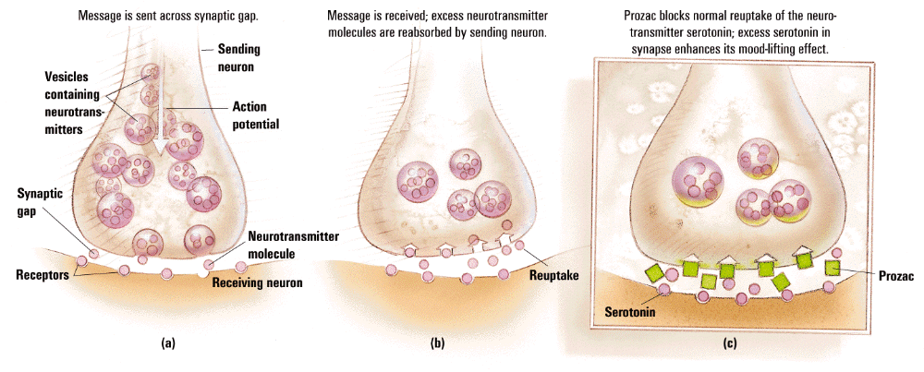
Biomedical Therapies
Message is received;
excess neurotransmitter
molecules are reabsorbed
by sending neuron.
Prozac blocks normal
reuptake of the neuro-
transmitter serotonin;
excess serotonin in
dynapse enhances its
mood-lifting effect.
Message is sent
across synaptic gap.
Vesicles
containing
neurotrans-
mitters
Sending
neuron
Action
potential
Synaptic
gap
Neurotransmitter
molecule
Receptors
Receiving
neuron
Reuptake
Prozac
Serotonin

Slide 32
Antipsychotic Drugs Reduce Dopamine Activity
Antipsychotic drugs:
a group of medications that are effective in treating the delusions, hallucinations, and loose associations of schizophrenia by blocking dopamine receptors & thereby reducing dopamine activity
Do not actually “cure” schizophrenia. They merely help control its severe symptoms.

Slide 33
Classes of Psychoactive Drugs
Antipsychotics
Thorazine
Clozapine
Olanzapine, etc.
Block dopamine receptor sites
Treat Schizophrenia & other psychoses
May cause sluggishness & muscle tremors

Slide 34
Classes of Psychoactive Drugs
Antianxiety
Valium, Librium, Xanax, etc.
Tend to be addictive

Slide 35
Classes of Psychoactive Drugs
Antidepressants
Increase availability of epinephrine or serotonin
Prozac, Zoloft, Paxil, etc. world’s most widely prescribed drugs
Require about a month for full effectiveness

Slide 36
Antidepressant Drugs: Increase Serotonin and Norepinephrine
MAO inhibitors (MAOI) inhibit the enzyme involved in breaking down norepinephrine and serotonin are called the monoamine oxidase inhibitors (MAOI).
Tricyclics are antidepressant drugs that have milder side effects than MAOI inhibitors
Antidepressants that affect only serotonin are selective serotonin reuptake inhibitors (SSRIs).

Slide 37
Biomedical Therapies
Electroconvulsive Therapy (ECT)
therapy for severely depressed patients in which a brief electric current is sent through the brain of an anesthetized patient
Psychosurgery
surgery that removes or destroys brain tissue in an effort to change behavior

Slide 38
Electroconvulsive Therapy (ECT)
A physiological treatment for severe depression in which a brief electric shock is administered to the brain of an anesthetized patient
Although ECT is effective in treating severe depression, no one knows for sure why it works.
Several temporary negative side effects, including confusion, loss of memory, and impaired motor coordination

Slide 39
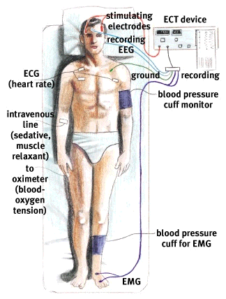
Electroconvulsive Therapy

Slide 40
Psychosurgery: Destroys Portions of the Brain
Most radical & controversial treatment
A seldom-used surgical procedure in which brain tissue thought to cause the disorder is destroyed.
Today, MRI-guided precision psychosurgery is performed only in extreme cases and it focuses on much smaller brain areas than those involved in lobotomies.

Slide 41
Lobotomy
now-rare psychosurgical procedure once used to calm uncontrollably emotional or violent patients
cut the nerves that connect the frontal lobes to the emotion-controlling centers of the brain

