Slide 1
Chapter 8 Intelligence

Slide 2
Intelligence
Intelligence consists of the mental abilities necessary to adapt to and shape the environment.
Intelligence involves not only reacting to one’s surroundings but also actively forming them.

Slide 3
Early IQ Testing Shaped by Racial/Cultural Stereotypes
British Sir Francis Galton founded the eugenics movement to improve the hereditary characteristics of society.
Eugenics proposed that:
White and upper-middle-class individuals—who were assumed to have high mental ability—should marry and have children.
Lower-class Whites and members of other races —who were assumed to have low mental ability—should not reproduce.

Slide 4
Early IQ Testing Shaped by Racial/Cultural Stereotypes
Unlike Galton, French psychologist Alfred Binet:
Made no assumptions about why intelligence differences exist.
Believed intellectual ability could be increased through education.
Over Binet’s objections, American Henry Goddard used Binet’s intelligence test to identify the feebleminded so they could be segregated and prevented from having children.

Slide 5
Aptitude & Achievement Tests
Two categories of mental abilities measures:
Aptitude tests: measure capacity to learn new skill
Achievement tests: measure what is already learned
Scholastic Assessment Test (SAT): measures learned verbal and mathematical skills
SAT scores influenced by quality of test takers’ schools
Difference in intent/use of the test

Slide 6
Aptitude & Achievement Tests
Stanford-Binet Intelligence Test: the widely used American revision of the original French intelligence test.
Intelligence quotient (IQ): originally, the ratio of mental age to chronological age multiplied by 100 (MA/CA × 100).
Today, IQ is calculated by comparing how a person’s performance deviates from the average score of her or his same-age peers, which is 100.
Wechsler Intelligence Scales: the most widely used set of intelligence tests, containing both verbal and performance (nonverbal) subscales

Slide 7
Test Standardization
Process of establishing uniform procedures for administering a test and interpreting its scores
Reliability: the degree to which it yields consistent results
Validity: the degree to which a test measures what it is designed to measure
Content validity
Predictive validity: degree to which test results predict other behaviors or measures

Slide 8
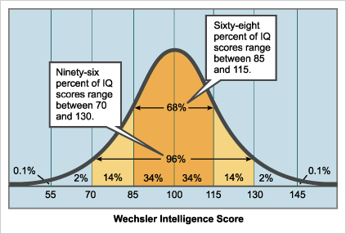
The Normal Distribution

Slide 9
Are intelligence tests culturally biased?
Critics claim that Whites and higher SES individuals have had greater exposure than ethnic minority and lower-class individuals to topics on most commonly used IQ tests.
Supporters of IQ tests respond that although IQ tests do not provide an unbiased measure of cognitive abilities, they do provide a fairly accurate measure of academic and occupational success.

Slide 10
What is Intelligence? One or Several Distinct Abilities?
One of the primary questions about the nature of intelligence is whether it is best conceptualized as:
A general, unifying capacity or
Many separate and relatively independent abilities.

Slide 11
What is Intelligence? One or Several Distinct Abilities?
British psychologist Charles Spearman concluded there was a general intelligence, or g, factor underlying all mental abilities.
Louis Thurstone argued there were seven primary mental abilities:
Reasoning, verbal fluency, verbal comprehension, perceptual speed, spatial skills, numerical computation, and memory

Slide 12
What is Intelligence? One or Several Distinct Abilities?
Howard Gardner’s theory of multiple intelligences contends that intelligence consists of at least eight independent intelligences:
Linguistic, logical-mathematical, spatial, musical, bodily-kinesthetic, naturalist, interpersonal, and intrapersonal

Slide 13
What is Intelligence? One or Several Distinct Abilities?
Robert Sternberg’s triarchic theory of intelligence proposes that intelligence consists of analytical, creative, and practical abilities.
Research still supports both perspectives:
There is evidence that we have distinct mental abilities and a general intelligence factor.

Slide 14
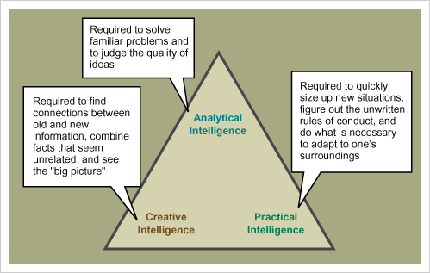
Sternberg’s Triarchic Theory of Intelligence

Slide 15
People Differ in Their Neural Complexity & Quickness
Intelligence is partly based on neural complexity, quickness, and efficiency.
Additional studies suggest that smarter brains become more efficient with practice.
These findings suggest that intelligence is a product of both our biology (nature) and our experience (nurture).

Slide 16
People Differ in Their Neural Complexity & Quickness
Extremes of intelligence
Diagnosis of mental retardation given to people who:
Have an IQ score below 70 and also have difficulty adapting to the routine demands of independent living.
Only 1-2 percent of the population meets both criteria.
Males outnumber females by 50 percent

Slide 17
People Differ in Their Neural Complexity & Quickness
Extremes of intelligence
About 75 percent of mental retardation cases thought to result from unfavorable social conditions or subtle and difficult-to-detect physiological effects
Remaining 25 percent of cases considered to have a specific organic cause, such as fetus or infant exposed to harmful substances
Down syndrome caused by an extra chromosome coming from either the mother’s egg (the primary source) or the father’s sperm.

Slide 18
People Differ in Their Neural Complexity & Quickness
The gifted category used for IQs above 130 or 135
U.S. federal law designates that giftedness should be based on superior potential in any of six areas:
General intelligence, specific aptitudes (for example, math and writing), performing arts, athletics, creativity, and leadership

Slide 19
Twin & Adoption Studies of Intelligence
Twin studies indicate that the average correlation of identical twins’ IQ scores is .86, while fraternal twins’ correlation is .60.
Fraternal twins—who are genetically no more similar than regular siblings, but who are exposed to more similar experiences due to their identical ages—have more similar IQ scores than other siblings.
In addition, nontwin siblings raised together have more similar IQs (r = .47) than siblings raised apart (r = .24).

Slide 20
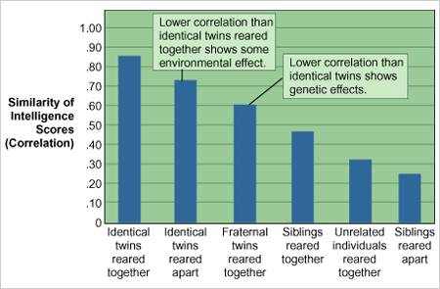
The Nature-Nurture Debate

Slide 21
Twin & Adoption Studies of Intelligence
Adoption studies
Children who were adopted within 2 weeks to 1 year of birth have higher IQ correlations with biological parents than with adoptive parents.
Based on twin and adoption studies:
Heredity accounts for a little over 50 percent of the variation in intelligence, and
Environmental factors account for a little less than 50 percent.

Slide 22
Gender Differences in IQ Scores
Gender differences: male and female IQ scores are virtually identical—few differences in certain aptitudes
Females tend to do better on verbal aptitude tests, while males tend to do better on visual-spatial tests.
Gender differences have also been found in mathematical ability.

Slide 23
Gender Differences in IQ Scores
Some studies suggest female-male differences in verbal and spatial abilities might be linked to differences in the organization of brain areas controlling verbal and spatial abilities and to hormonal fluctuations
Other studies suggest that these differences are a product of gender socialization and the different skills taught to girls and boys.

Slide 24
Group Differences in IQ Scores
African Americans score between 10 and 15 points lower than White Americans and Asian Americans.
Hispanic Americans achieve IQ scores somewhere in between those of Blacks and Whites.
Asian Americans score about 5 points higher than White Americans.

Slide 25
Group Differences in IQ Scores
These IQ test differences also occur on nonverbal test items that do not appear to be culturally biased against ethnic minorities.
Numerous studies suggest that it is “highly unlikely” that genetic differences between the races cause these group IQ differences.

Slide 26
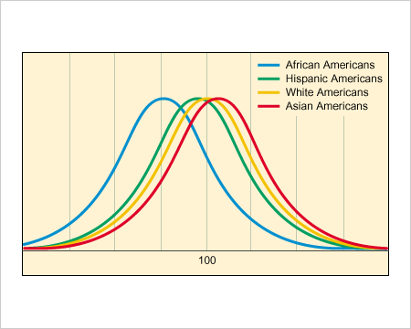
Racial Differences in IQ Scores
Sources: Data from N. J. Mackintosh. (1998). IQ and human intelligence. Oxford: Oxford University Press. Neisser, U. (1998). The rising curve: Long-term gains in IQ and related measures. Washington, DC: American Psychological Association.

Slide 27
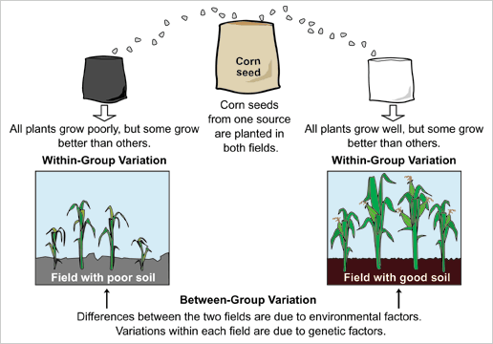
Plant-Pot Analogy

Slide 28
Cultural Factors May Explain Group IQ Differences
Studies in various countries indicate that involuntary minorities achieve lower IQ scores than voluntary minorities.
Many social scientists believe that the primary causes are:
Persisting negative cultural stereotypes within the dominant culture concerning involuntary minorities’ intellectual abilities (self-fulfilling prophecies), and
The self-protective defensive reaction many involuntary minority members subsequently develop against the rejecting mainstream culture (oppositional identities).

Slide 29
Cultural Factors May Explain Group IQ Differences
Intellectual growth is nurtured when parents and the larger culture stress the:
Value of education and
Importance of working hard to achieve intellectual mastery.
Intellectual growth is stunted when cultural beliefs impress upon the child that their academic success is either:
Unlikely (due to negative cultural stereotypes) or
Not highly valued (due to it being incompatible with other cultural values).

