Slide 1
Psychology
Fifth Edition
Learning
Chapter 5
5

Slide 2
Definition of Learning
Learning Objective 5.1 Define the term learning.
Learning: any relatively permanent change in behavior brought about by experience or practice
When people learn anything, some part of their brain is physically changed to record what they have learned.
Not all change accomplished through learning: some is maturation

Slide 3
Pavlov and the Salivating Dogs 1 of 11
Learning Objective 5.2 Identify the key elements of classical conditioning as demonstrated in Pavlov’s classic experiment.
Ivan Pavlov: Russian physiologist who discovered classical conditioning through his work on digestion in dogs
Classical conditioning: learning to make a reflex response to a stimulus other than the original, natural stimulus that normally produces the reflex

Slide 4
Pavlov and the Salivating Dogs 2 of 11
Elements of Classical Conditioning:
Unconditioned stimulus (UCS): a naturally occurring stimulus that leads to an involuntary response
Unconditioned response (UCR): an involuntary response to a naturally occurring or unconditioned stimulus

Slide 5
Pavlov and the Salivating Dogs 3 of 11
Elements of Classical Conditioning continued:
Conditioned stimulus (CS): stimulus that becomes able to produce a learned reflex response by being paired with the original unconditioned stimulus
Conditioned means “learned”
Neutral stimulus (NS) can become a conditioned stimulus when paired with an unconditioned stimulus
Conditioned response (CR): learned reflex response to a conditioned stimulus
Sometimes called a conditioned reflex
CS: ice cream truck
CR: salivation when one hears ice cream truck bell

Slide 6
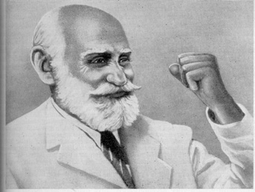
Classical or Pavlovian Conditioning
Ivan Pavlov
1849-1936
Russian physician/ neurophysiologist
Nobel Prize, 1904
studied digestive secretions

Slide 7
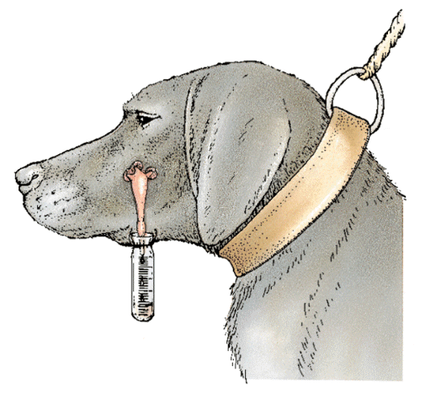
Classical or Pavlovian Conditioning
Pavlov’s device for recording salivation

Slide 8
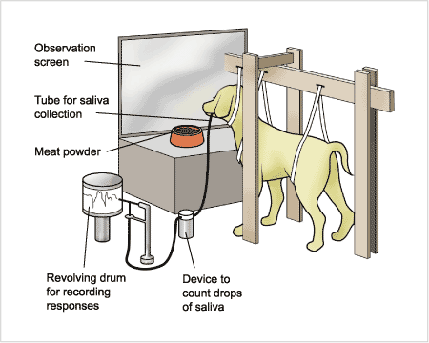
Pavlov’s Apparatus for Studying Classical Conditioning in Dogs

Slide 9
Pavlov and the Salivating Dogs 4 of 11
Acquisition: repeated pairing of the NS and the UCS; the organism is in the process of acquiring learning
although classical conditioning happens quite easily, a few basic principles that researchers have discovered:
CS must come before UCS
CS and UCS must come very close together in time—ideally, only several seconds apart
Neutral stimulus must be paired with the UCS several times, often many times, before conditioning can take place

Slide 10
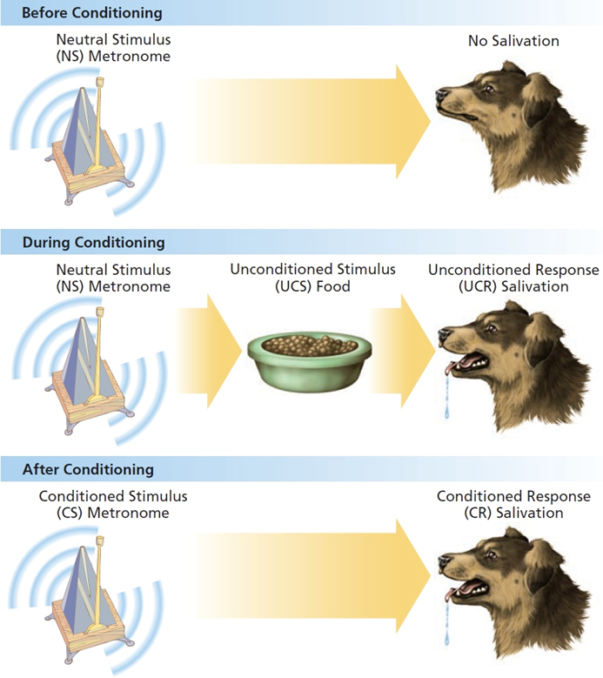
Figure 5.1 Classical Conditioning
Before conditioning takes place, the sound of the metronome does not cause salivation and is a neutral stimulus, or NS. During conditioning, the sound of the metronome occurs just before the presentation of the food, the UCS. The food causes salivation, the UCR. When conditioning has occurred after several pairings of the metronome with the food, the metronome will begin to elicit a salivation response from the dog without any food. This is learning, and the sound of the metronome is now a CS and the salivation to the bell is the CR.

Slide 11
Pavlov and the Salivating Dogs 5 of 11
CS is usually some stimulus that is distinctive or stands out from other competing stimuli
Stimulus generalization: tendency to respond to a stimulus that is only similar to the original conditioned stimulus with the conditioned response

Slide 12
Pavlov and the Salivating Dogs 6 of 11
Stimulus discrimination: tendency to stop making a generalized response to a stimulus that is similar to the original conditioned stimulus because the similar stimulus is never paired with the unconditioned stimulus

Slide 13
Pavlov and the Salivating Dogs 7 of 11
Extinction: disappearance or weakening of a learned response following the removal or absence of the unconditioned stimulus (in classical conditioning) or the removal of a reinforcer (in operant conditioning)

Slide 14
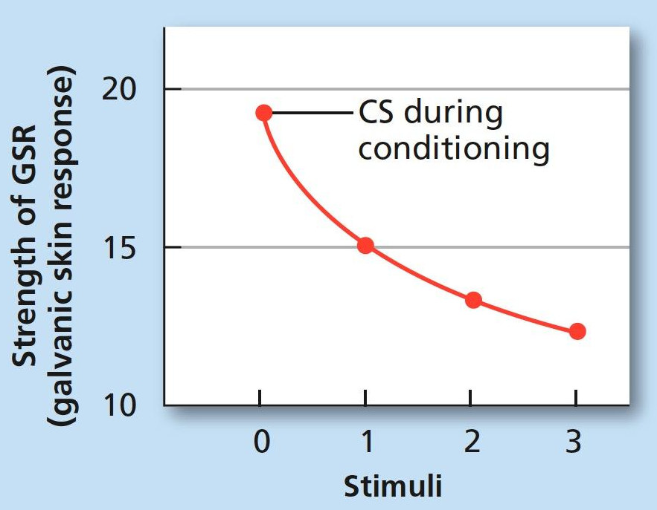
Figure 5.2 Strength of the Generalized Response
An example of stimulus generalization. The UCS was an electric shock and the UCR was the galvanic skin response (GSR), a measure associated with anxiety. The subjects had been conditioned originally to a CS tone (0) of a given frequency. When tested with the original tone, and with tones 1, 2, and 3 of differing frequencies, a clear generalization effect appeared. The closer the frequency of the test tone to the frequency of tone 0, the greater was the magnitude of the galvanic skin response to the tone (Hovland, 1937).

Slide 15
Pavlov and the Salivating Dogs 8 of 11
Spontaneous recovery: reappearance of a learned response after extinction has occurred
Learning is a relatively permanent change in behavior
Higher-order conditioning
Strong conditioned stimulus is paired with a neutral stimulus
Neutral stimulus becomes a second conditioned stimulus

Slide 16
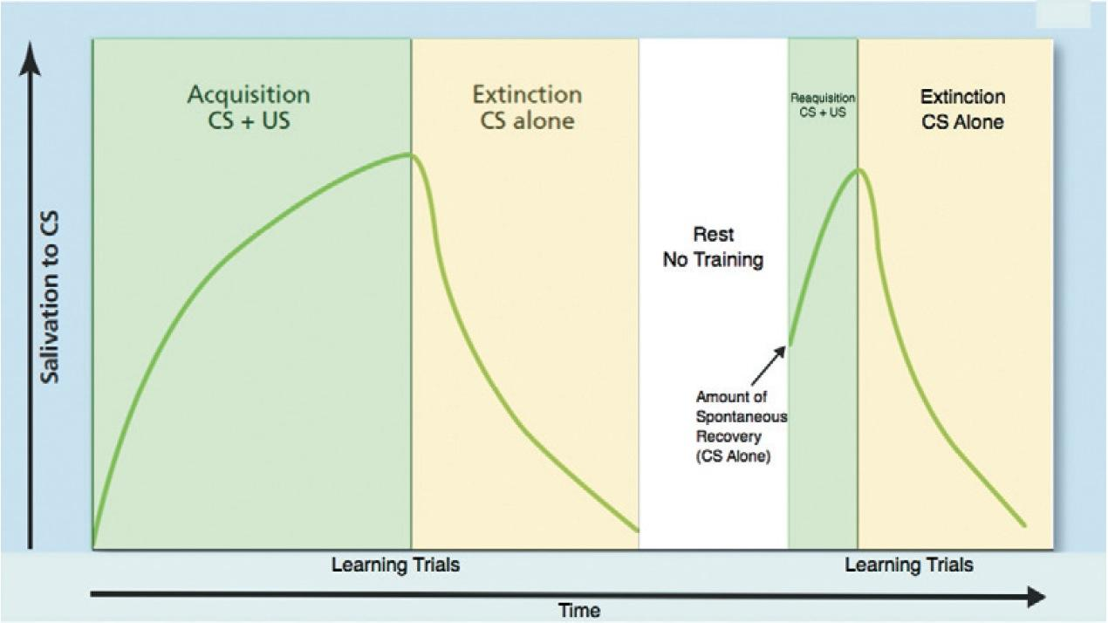
Figure 5.3 Extinction and Spontaneous Recovery
This graph shows the acquisition, extinction, spontaneous recovery, and reacquisition of a conditioned salivary response. Typically, the measure of conditioning is the number of drops of saliva elicited by the CS on each trial. Note that on the day following extinction, the first presentation of the CS elicits quite a large response. This response is due to spontaneous recovery.

Slide 17
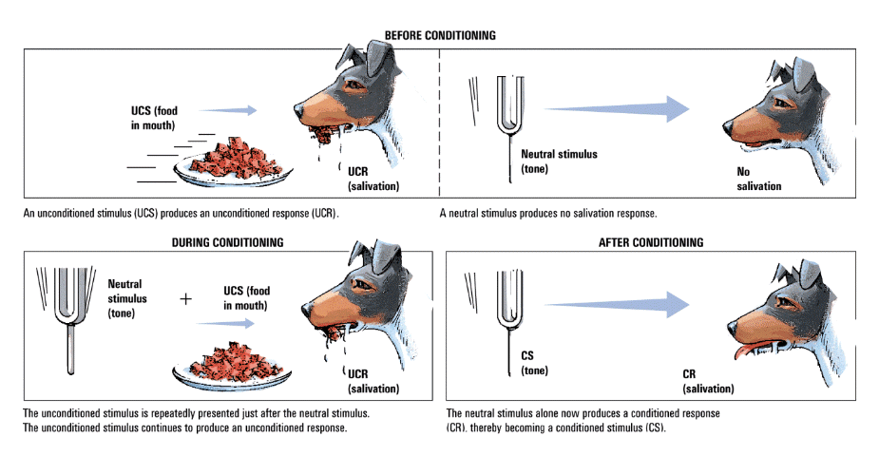
Pavlov’s Classic Experiment
Before Conditioning
UCS (food
in mouth)
Neutral
stimulus
(tone)
UCR
(salivation)
No
salivation
During Conditioning
After Conditioning
UCS (food
in mouth)
Neutral
stimulus
(tone)
CS
(tone)
UCR
(salivation)
CR (salivation)

Slide 18
Other Examples of Classical Conditioning
UCS
(passionate
kiss)
UCR
(sexual
arousal)
CS
(onion
breath)
UCS
(passionate
Kiss)
UCR
(sexual
arousal)
CS
(onion
breath)
CR
(sexual
arousal)

Slide 19
Other Examples of Classical Conditioning
UCS
Loud Noise
UCR
Startle
CS
Bunny Rabbit
UCS
Loud Noise
UCR
Startle
CS
Bunny Rabbit
CR
Startle

Slide 20
Other Examples of Classical Conditioning
UCS
Dog Bite
UCR
Frightened
CS
Sight of Dog
UCS
Dog Bite
UCR
Frightened
CS
Sight of Dog
CR
Frightened

Slide 21
Other Examples of Classical Conditioning
UCS
Car Crash
UCR
Racing Heart
CS
Squealing Brakes
UCS
Car Crash
UCR
Racing Heart
CS
Squealing Brakes
CR
Racing Heart

Slide 22
Other Examples of Classical Conditioning
UCS
Kiss
UCR
Racing Heart
CS
Sight of Significant Other
UCS
Kiss
UCR
Racing Heart
CS
Sight of Significant Other
CR
Racing Heart

Slide 23
Conditioned emotional response (CER)
emotional response that has become classically conditioned to occur to learned stimuli
Examples: fear of dogs; the emotional reaction that occurs when seeing an attractive person
CERs may lead to phobias—irrational fear responses.

Slide 24
Cognitive perspective
: modern theory in which classical conditioning is seen to occur because the conditioned stimulus provides information or an expectancy about the coming of the unconditioned stimulus

Slide 25
Classical Conditioning Applied to Human Behavior 1 of 2
Learning Objective 5.3 Apply classical conditioning to examples of phobias, taste aversions, and drug dependency.
Conditioned emotional response (CER): emotional response that has become classically conditioned to occur to learned stimuli
Vicarious conditioning: classical conditioning of a reflex response or emotion by watching the reaction of another person

Slide 26
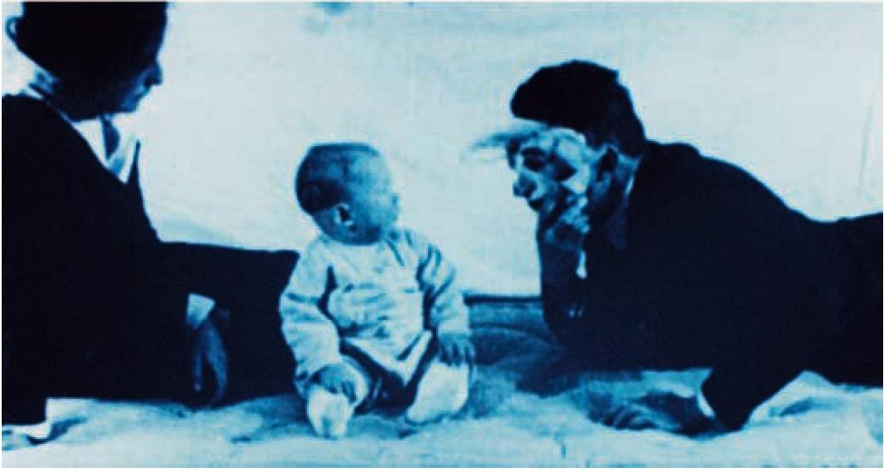
Figure 5.5 Conditioning of “Little Albert”
After “Little Albert” had been conditioned to fear a white rat, he also demonstrated fear to a rabbit, a dog, and a sealskin coat (although it remains uncertain if stimulus generalization actually occurred as this fear was to a single rabbit, a single dog, etc.). Can you think of any emotional reactions you experience that might be classically conditioned emotional responses?

Slide 27
Little Albert’s Fear Conditioning
UCS
(loud noise)
UCR
(fear)
CS
(rat)
UCS
(loud noise)
UCR
(fear)
CS
(rat)
CR
(fear)
Stimulus similar
to rat (such as
rabbit)
Conditioned fear
(generalization)

Slide 28
Conditioned taste aversion: development of a nausea or aversive response to a particular taste because that taste was followed by a nausea reaction
Occurs after only one association
Biological preparedness: tendency of animals to learn certain associations, such as taste and nausea, with only one or few pairings due to the survival value of the learning

Slide 29
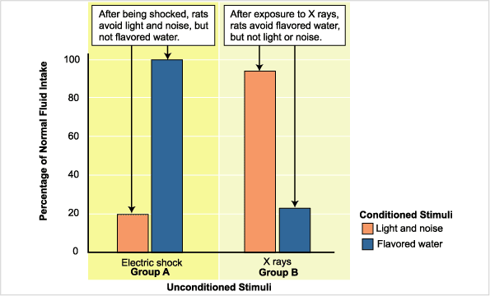
Biological Constraints on Taste Aversion in Rats

Slide 30
Operant Conditioning
Operant conditioning: the learning of voluntary behavior through the effects of pleasant and unpleasant consequences to responses

Slide 31
Thorndike’s law of effect
If a response is followed by a pleasurable consequence, it will tend to be repeated
If a response is followed by an unpleasant consequence, it will tend not to be repeated

Slide 32
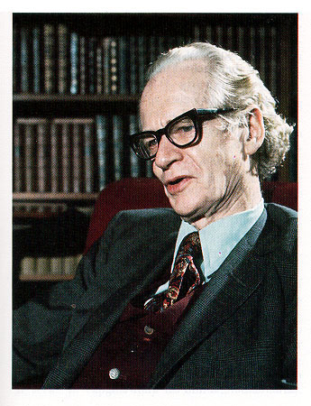
Operant Conditioning
B.F. Skinner (1904-1990)
elaborated Thorndike’s Law of Effect
developed behavioral technology

Slide 33
B. F. Skinner
B.F. Skinner was a behaviorist; he wanted to study only observable, measurable behavior
Gave “operant conditioning” its name
Operant: any behavior that is voluntary
Learning depends on what happens after the response: the consequence

Slide 34
The Concept of Reinforcement 1 of 2
Learning Objective 5.5 Differentiate between primary and secondary reinforcers and positive and negative reinforcement.
Reinforcement: any event or stimulus, that when following a response, increases the probability that the response will occur again
Primary reinforcer: any reinforcer that is naturally reinforcing by meeting a basic biological need, such as hunger, thirst, or touch
Secondary reinforcer: any reinforcer that becomes reinforcing after being paired with a primary reinforcer, such as praise, tokens, or gold stars

Slide 35
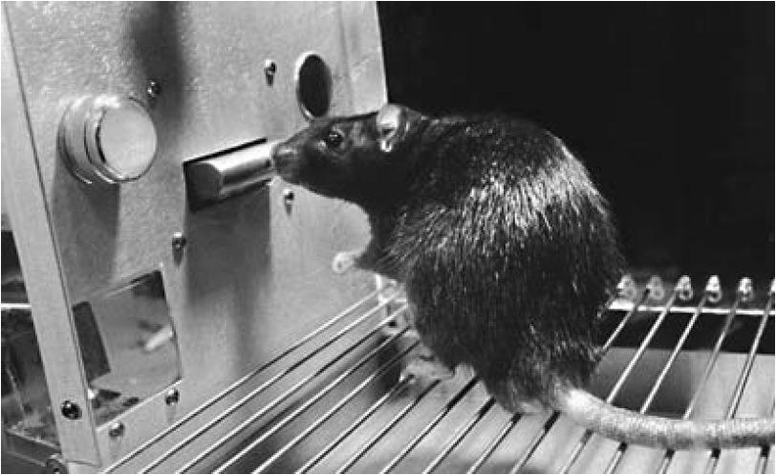
Figure 5.7 A Typical Skinner Box
This rat is learning to press the bar in the wall of the cage in order to get food (delivered a few pellets at a time in the food trough on lower left). In some cases, the light on the top left might be turned on to indicate that pressing the bar will lead to food or to warn of an impending shock delivered by the grate on the floor of the cage.

Slide 36
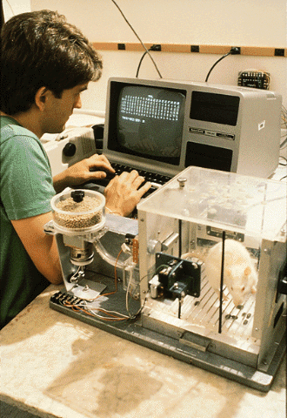
Operant Conditioning
Operant Chamber (“Skinner Box”)
soundproof chamber with a bar or key that an animal can manipulate to obtain a food or water reinforcer
contains a device to record responses

Slide 37
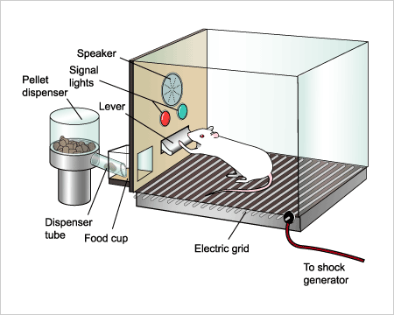
Skinner Box

Slide 38
Table 5.1 Comparing Two Kinds of Conditioning
Operant Conditioning | Classical Conditioning
End result is an increase in the rate of an already occurring response. | End result is the creation of a new response to a stimulus that did not normally produce that response.
Responses are voluntary, emitted by the organism. | Responses are involuntary and reflexive, elicited by a stimulus.
Consequences are important in forming an association. | Antecedent stimuli are important in forming an association.
Reinforcement should be immediate. | CS must occur immediately before the UCS.
An expectancy develops for reinforcement to follow a correct response. | An expectancy develops for UCS to follow CS.

Slide 39
The Concept of Reinforcement 2 of 2
Positive reinforcement: the reinforcement of a response by the addition or experience of a pleasurable stimulus
Negative reinforcement: the reinforcement of a response by the removal, escape from, or avoidance of an unpleasant stimulus
Example: taking aspirin for a headache is negatively reinforced: removal of headache!

Slide 40
Schedules of Reinforcement: Why the One-Armed Bandit Is So Seductive 1 of 3
Learning Objective 5.6 Identify the four schedules of reinforcement.
Partial reinforcement effect: a response that is reinforced after some—but not all—correct responses tends to be very resistant to extinction
Continuous reinforcement: reinforcement of each and every correct response

Slide 41
Schedules of Reinforcement: Why the One-Armed Bandit Is So Seductive 2 of 3
Fixed interval schedule of reinforcement: interval of time that must pass before reinforcement becomes possible is always the same
Variable interval schedule of reinforcement: the interval of time that must pass before reinforcement becomes possible is different for each trial or event

Slide 42
Schedules of Reinforcement: Why the One-Armed Bandit Is So Seductive 3 of 3
Fixed ratio schedule of reinforcement: number of responses required for reinforcement is always the same
Variable ratio schedule of reinforcement: schedule of reinforcement in which the number of responses required for reinforcement is different for each trial or event

Slide 43
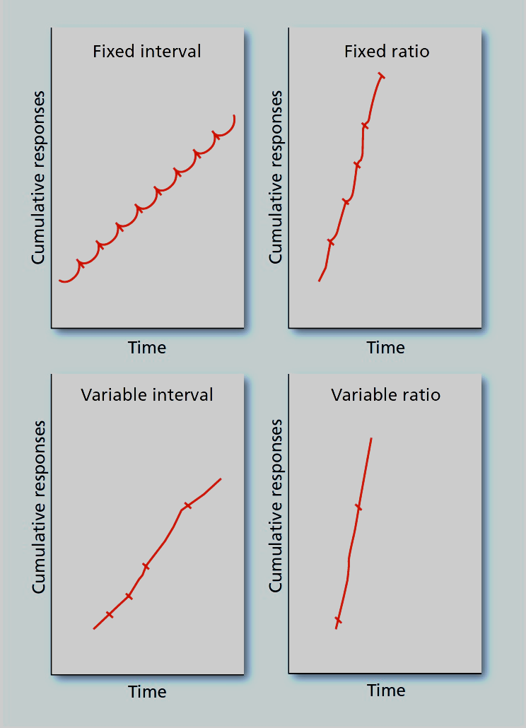
Figure 5.8 Schedules of Reinforcement
These four graphs show the typical pattern of responding for both fixed and variable interval and ratio schedules of reinforcement. The responses are cumulative, which means new responses are added to those that come before, and all graphs begin after the learned pattern is well established. Slash marks mean that a reinforcement has been given. In both the fixed interval and fixed ratio graphs, there is a pause after each reinforcement as the learner briefly “rests.” The “scalloped” shape of the fixed interval curve is a typical indicator of this pause, as is the stair-step shape of the fixed ratio curve. In the variable interval and ratio schedules, no such pause occurs, because the reinforcements are unpredictable. Notice that both fixed and variable interval schedules are slower (less steep) than the two ratio schedules because of the need to respond as quickly as possible in the ratio schedules.
Notes:
43

Slide 44
The Role of Punishment in Operant Conditioning 1 of 3
Learning Objective 5.7 Identify the effect that punishment has on behavior.
Punishment: any event or object that, when following a response, makes that response less likely to happen again
Punishment by application: the punishment of a response by the addition or experiencing of an unpleasant stimulus
Punishment by removal: the punishment of a response by the removal of a pleasurable stimulus

Slide 45
Table 5.2 Four Ways to Modify Behavior
Blank cell | Reinforcement | Punishment
Positive (Adding) | Something valued or desirable | Something unpleasant
Blank cell | Positive Reinforcement Example: getting a gold star for good behavior in school | Punishment by Application Example: getting a spanking for disobeying
Negative (Removing/Avoiding) | Something unpleasant | Something valued or desirable
Blank cell | Negative Reinforcement Example: fastening a seat belt to stop the alarm from sounding | Punishment by Removal Example: losing a privilege such as going out with friends
Notes:
45

Slide 46
Positive and Negative Reinforcement, Positive and Negative Punishment

Slide 47
Table 5.3 Negative Reinforcement Versus Punishment by Removal
Example of Negative Reinforcement | Example of Punishment by Removal
Stopping at a red light to avoid getting in an accident. | Losing the privilege of driving because you got into too many accidents.
Fastening your seat belt to get the annoying warning signal to stop. | Having to spend some of your money to pay a ticket for failure to wear a seat belt.
Obeying a parent before the parent reaches the count of “three” to avoid getting a scolding. | Being “grounded” (losing your freedom) because of disobedience.
Notes:
47

Slide 48
Punishment
LO 5.7 How Does Punishment Differ from Reinforcement?
Punishment: any event or object that, when following a response, makes that response less likely to happen again
Punishment by application: the punishment of a response by the addition or experiencing of an unpleasant stimulus
Punishment by removal: the punishment of a response by the removal of a pleasurable stimulus

Slide 49
Punishment has several drawbacks.
LO 5.8 What Are Some Problems with Punishment?
Severe punishment may cause avoidance of the punisher instead of the behavior being punished.
Severe punishment may encourage lying to avoid punishment.
Severe punishment creates fear and anxiety.

Slide 50
The Role of Punishment in Operant Conditioning 3 of 3
Punishment should immediately follow behavior it is meant to punish.
Punishment should be consistent.
Punishment of the wrong behavior should be paired, whenever possible, with reinforcement of the right behavior.

Slide 51
Other Aspects of Operant Conditioning 1 of 2
Learning Objective 5.8 Explain the concepts of discriminant stimuli, extinction, generalization, and spontaneous recovery as they relate to operant conditioning.
Discriminative stimulus: any stimulus, such as a stop sign or a doorknob, that provides the organism with a cue for making a certain response in order to obtain reinforcement
Extinction occurs if the behavior (response) is not reinforced.
One way to deal with a child’s temper tantrum is to ignore it; lack of reinforcement for the tantrum behavior will eventually result in extinction

Slide 52
Other Aspects of Operant Conditioning 2 of 2
Operantly conditioned responses also can be generalized to stimuli that are only similar—not identical—to the original stimulus
Spontaneous recovery (reoccurrence of a once-extinguished response) also happens in operant conditioning

Slide 53
Applications of Operant Conditioning: Shaping and Behavior Modification 1 of 7
Learning Objective 5.9 Describe how operant conditioning is used to change animal and human behavior.
Shaping: reinforcement of simple steps, leading to a desired complex behavior
Successive approximation: small steps, one after another, that lead to a particular goal behavior

Slide 54
Applications of Operant Conditioning: Shaping and Behavior Modification 2 of 7
Instinctive drift: tendency for an animal’s behavior to revert to genetically controlled patterns
Each animal comes into the world (and lab) with certain genetically determined instinctive patterns of behavior already in place.
Instincts differ from species to species
Some responses simply cannot be trained into an animal regardless of conditioning

Slide 55
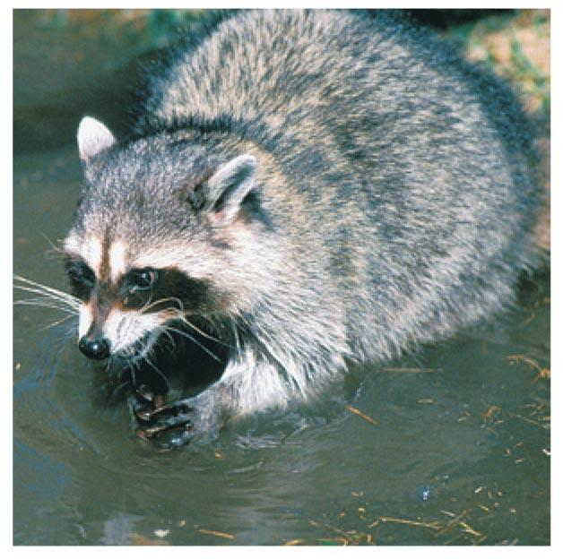
Applications of Operant Conditioning: Shaping and Behavior Modification 3 of 7
Raccoons commonly dunk their food in and out of water before eating. This “washing” behavior is controlled by instinct, and is difficult to change even using operant techniques.
Notes:
Image credit: Bonnie Kamin / PhotoEdit

Slide 56
Applications of Operant Conditioning: Shaping and Behavior Modification 4 of 7
Behavior modification: use of operant conditioning techniques to bring about desired changes in behavior
Token economy: type of behavior modification in which desired behavior is rewarded with tokens

Slide 57
Applications of Operant Conditioning: Shaping and Behavior Modification 5 of 7
Time-out: form of mild punishment by removal in which a misbehaving animal, child, or adult is placed in a special area away from the attention of others
Essentially, the organism is being “removed” from any possibility of positive reinforcement in the form of attention

Slide 58
Applications of Operant Conditioning: Shaping and Behavior Modification 7 of 7
Biofeedback: use of feedback about biological conditions to bring involuntary responses such as blood pressure and relaxation under voluntary control
Neurofeedback: form of biofeedback using devices (EEG, fMRI) to provide feedback about brain activity in an effort to modify behavior

Slide 59
Cognitive Learning Theory
Researchers’ early focus was on observable and measurable behavior
In 1950s and 1960s, many psychologists becoming aware that cognition could no longer be ignored
Cognition: mental events that take place inside a person’s mind while behaving

Slide 60
Tolman’s Maze-Running Rats: Latent Learning 1 of 3
Learning Objective 5.10 Explain the concept of latent learning.
Edward Tolman: early cognitive scientist
Best-known experiments in learning involved teaching three groups of rats the same maze, one at a time (Tolman & Honzik, 1930)

Slide 61
Tolman’s Maze-Running Rats: Latent Learning 3 of 3
Latent learning: learning that remains hidden until its application becomes useful

Slide 62
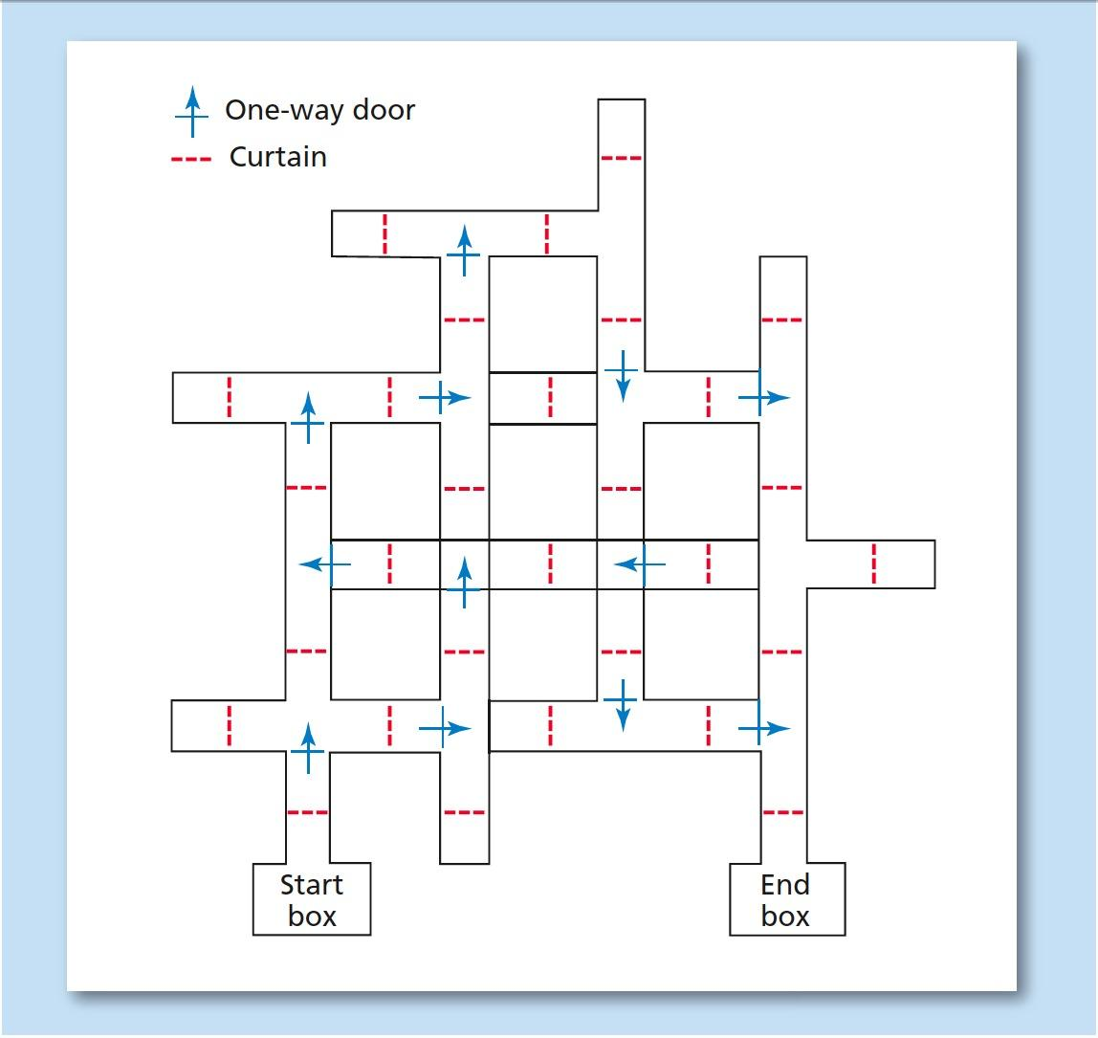
Figure 5.9 A Typical Maze
This is an example of a maze such as the one used in Tolman’s experiments in latent learning. A rat is placed in the start box. The trial is over when the rat gets to the end box.

Slide 63
Tolman’s Maze-Running Rats: Latent Learning 2 of 3
Edward Tolman’s Maze Experiment
Group 1
Rewarded each time at end of maze
Learned maze quickly
Group 2
In maze every day; only rewarded on 10th day
Demonstrated learning of maze almost immediately after receiving reward
Group 3
Never rewarded
Did not learn maze well

Slide 64
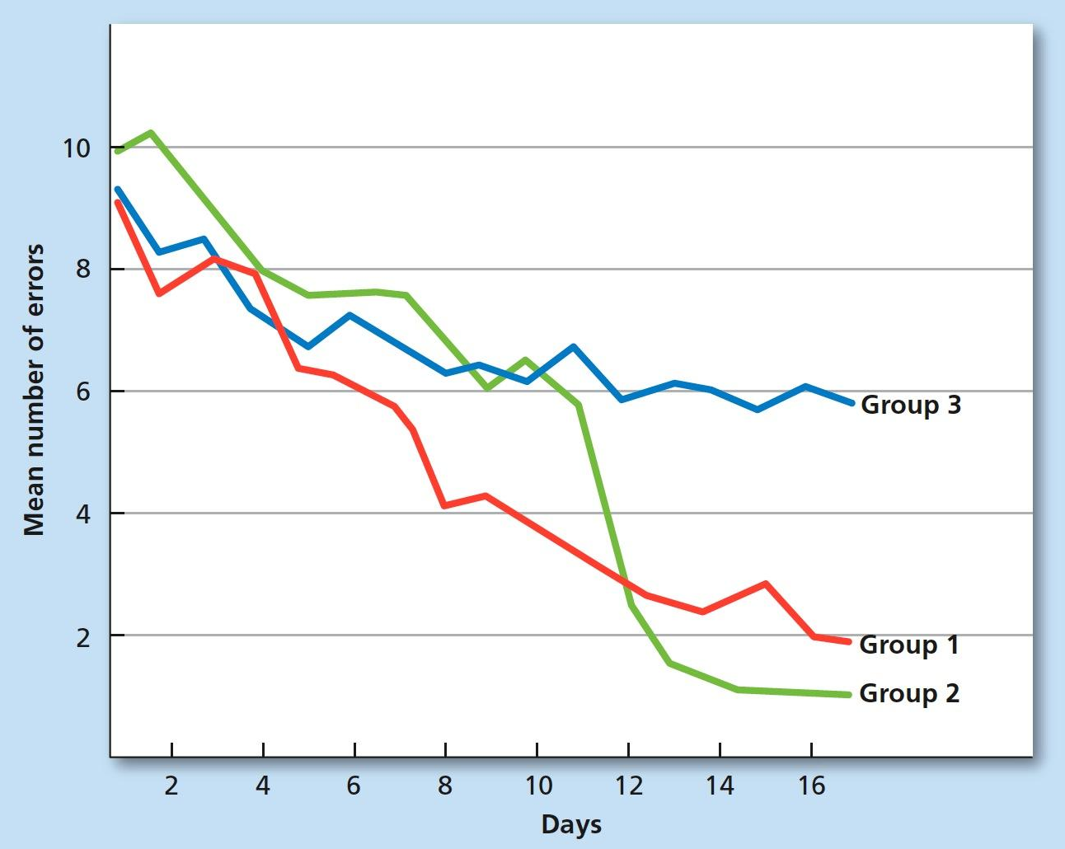
Figure 5.10 Learning Curves for Three Groups of Rats
In the results of the classic study of latent learning, Group 1 was rewarded on each day, while Group 2 was rewarded for the first time on Day 11. Group 3 was never rewarded. Note the immediate change in the behavior of Group 2 on Day 12 (Tolman & Honzik, 1930).

Slide 65
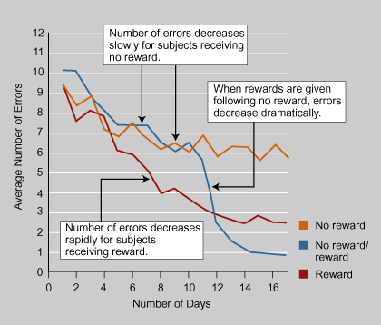
Latent Learning

Slide 66
Seligman’s Depressed Dogs: Learned Helplessness
Learning Objective 5.12 Summarize Seligman’s studies on learned helplessness.
Positive psychology: new way of looking at the entire concept of mental health and therapy that focuses on the adaptive, creative, and psychologically more fulfilling aspects of human experience rather than on mental disorders
Learned helplessness: tendency to fail to act to escape from a situation because of a history of repeated failures in the past

Slide 67
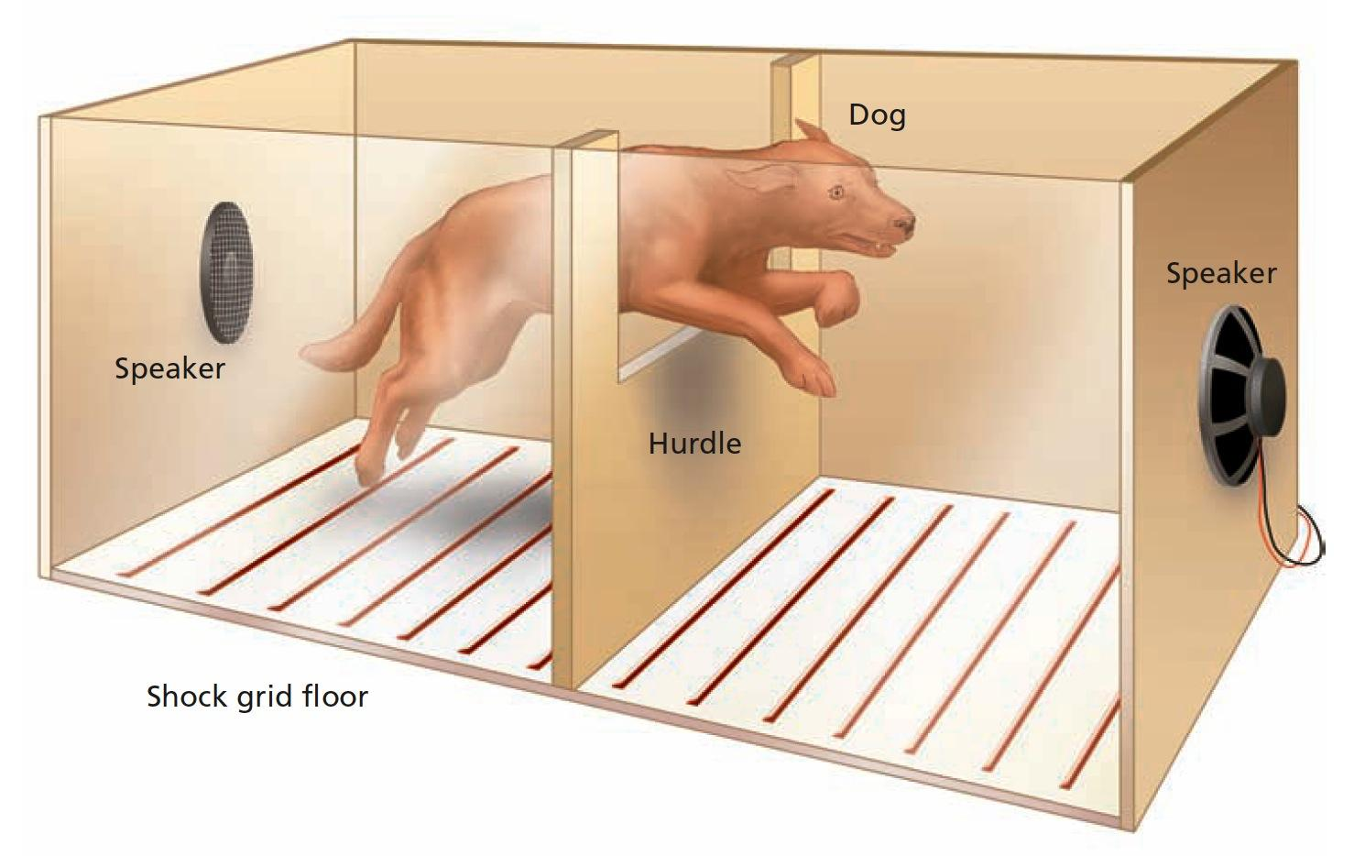
Figure 5.11 Seligman’s Apparatus
In Seligman’s studies of learned helplessness, dogs were placed in a two-sided box. Dogs that had no prior experience with being unable to escape a shock would quickly jump over the hurdle in the center of the box to land on the “safe” side. Dogs that had previously learned that escape was impossible would stay on the side of the box in which the shock occurred, not even trying to go over the hurdle.

Slide 68
Observational Learning: Bandura
LO 5.12 Observational Learning
Observational learning: learning new behavior by watching a model perform that behavior
Learning/performance distinction: learning can take place without actual performance of the learned behavior.

Slide 69
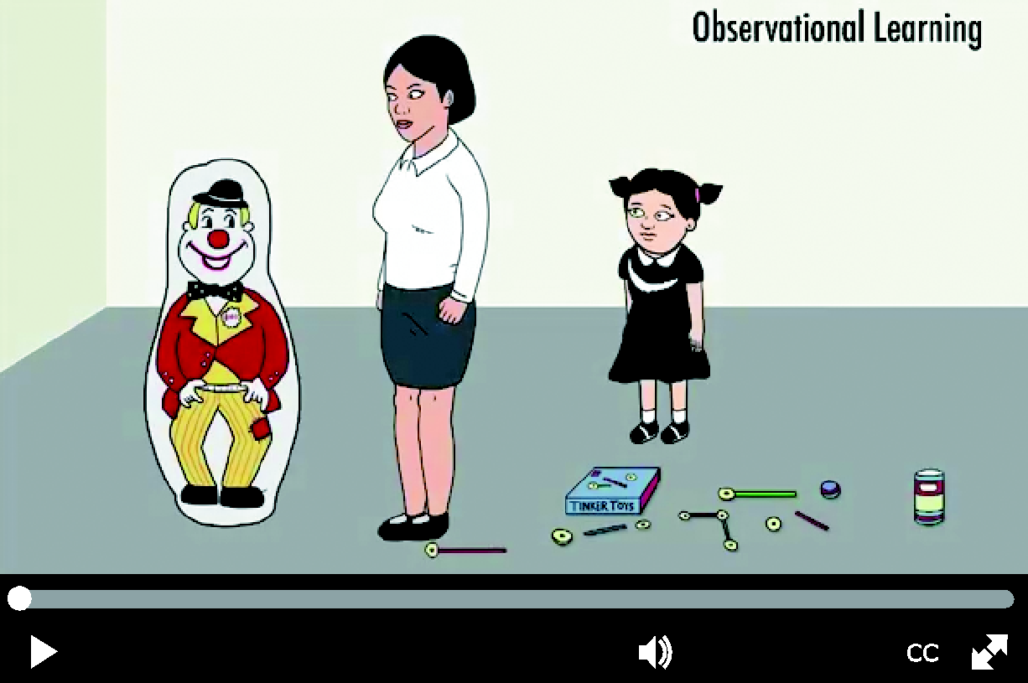
Figure 5.12 Bandura’s Bobo Doll Experiment
In Albert Bandura’s famous Bobo doll experiment, the doll was used to demonstrate the impact of observing an adult model performing aggressive behavior on the later aggressive behavior of children. The children in these photos are imitating the adult model’s behavior even though they believe they are alone and are not being watched.

Slide 70
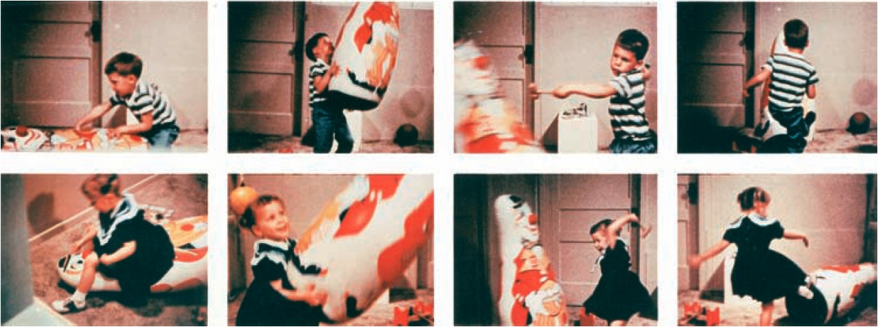
Figure 5.12 Bandura’s Bobo Doll Experiment In Albert Bandura’s famous Bobo doll experiment, the doll was used to demonstrate the impact of observing an adult model performing aggressive behavior on the later aggressive behavior of children. The children in these photos are imitating the adult model’s behavior even though they believe they are alone and are not being watched.

Slide 71
Four Elements of Observational Learning
Attention
To learn anything through observation, the learner must first pay attention to the model.
Memory
The learner must also be able to retain the memory of what was done, such as remembering the steps in preparing a dish that were first seen on a cooking show.

Slide 72
Four Elements of Observational Learning
Imitation
The learner must be capable of reproducing, or imitating, the actions of the model.
Motivation
Finally, the learner must have the desire to perform the action.
An easy way to remember the four elements of modeling is to remember the letters AMIM, which stands for the first letters of each of the four elements.

