Slide 2
Chapter 5

Slide 3
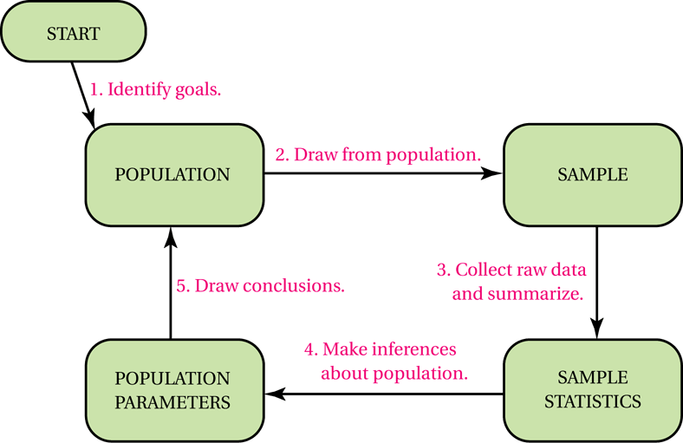
Basic Steps in a Statistical Study
5-A
Notes:
Help students understand this flow chart in the context of statistical research by perhaps using a contemporary example from a professional journal.

Slide 4
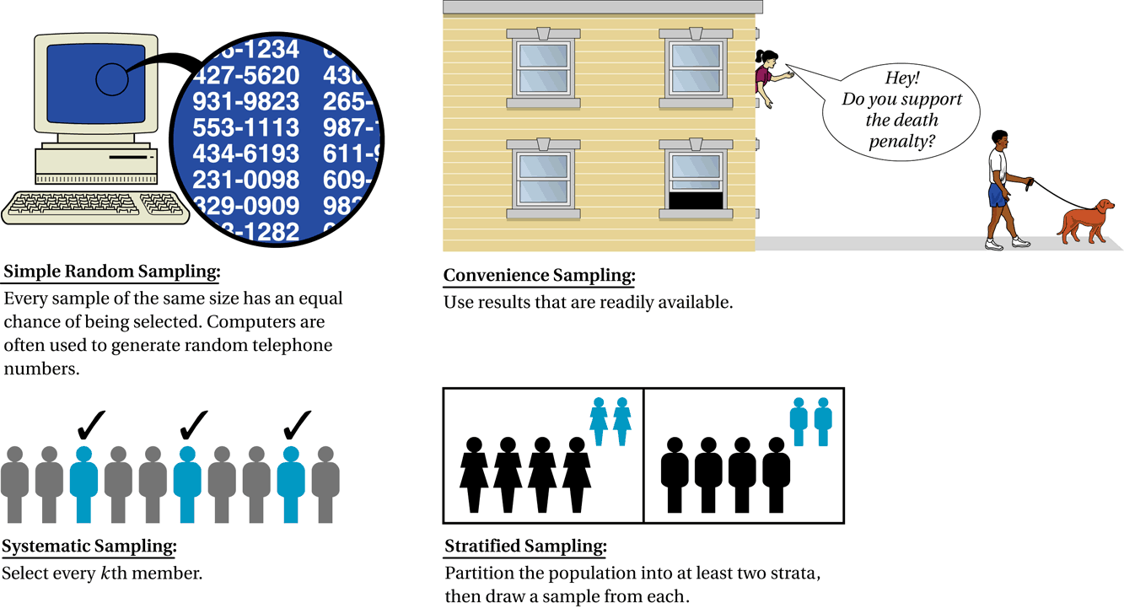
Common Sampling Techniques
5-A
Notes:
Stress that although a simple random sample may not be practical or necessary, it is still vital that the sample be as representative (unbiased) as possible in order to have valid data.

Slide 5
Identify the Sampling Method Used
5-A
You are conducting a survey of students in a school. You choose
your sample by knocking on the every 3rd classroom door.
Choosing every 3rd room makes this a systematic sample.
The sample may be representative, as long as students were
randomly assigned to rooms.
To survey opinions on a new water line, a research firm
randomly draws the addresses or 200 homeowners from a
public list of all homeowners.
The records presumably list all homeowners, so drawing randomly from
this list produce a simple random sample. It has a good chance of being
representative of the population.

Slide 6
Types of Statistical Study
5-A
1. In an observational study, researchers observe or
measure characteristics of the sample members but
do not attempt to influence or modify these
characteristics.
2. In an experiment, researchers apply a treatment to
some or all of the sample members and then look
to see whether the treatment has any effects.

Slide 7
Treatment and Control Groups
5-A
The treatment group in an experiment is the group of sample members who receive the treatment being tested.
The control group in an experiment is the group of sample members who do not receive the treatment being tested.
It is important for the treatment and control groups to be selected randomly and to be alike in all respects except for treatment.

Slide 8
The Placebo Effect and Blinding
5-A
A placebo lacks the active ingredients of a treatment being tested in a study, but is identical in appearance to the treatment. Thus, study participants cannot distinguish the placebo from the real treatment.
The placebo effect refers to the situation in which patients improve simply because they believe they are receiving a useful treatment.
An experiment is single-blind if the participants do not know whether they are members of the treatment group or members of the control group, but the experimenters do know.
An experiment is double-blind if neither the participants nor the experimenters (people administering the treatment) know who belongs to the treatment group and who belongs to the control group.

Slide 9
Should I Believe a Statistical Study?
5-B
Identify the Goal, Population and Type of Study
Consider the Source
Look for Bias in the Sample
Look for Problems in Defining or Measuring the Variables of Interest
Watch out for Confounding Variables
Consider the Setting and Wording in Surveys
Check that Results are Presented Fairly
Stand Back and Consider the Conclusions
Notes:
Have students, in small groups, read a statistical study and evaluate it using the eight guidelines.

Slide 10
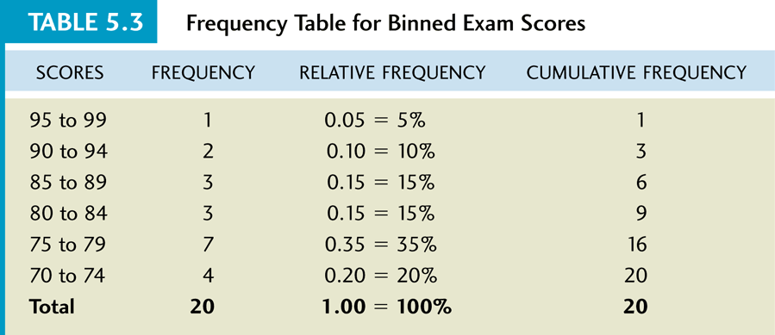
Summarizing Raw Data
5-C
20 scores from a 100-point exam
76 80 78 76 94 75 98 77 84 88
81 72 91 72 74 86 79 88 72 75
Notes:
Show students how to take raw data and do the following: 1) group data, 2) compute actual and relative frequencies, and 3) make a bar and a pie graph.

Slide 11
Important Labels for Graphs
5-C
Title/Caption
Vertical scale and title
Horizontal scale and title
Legend

Slide 12
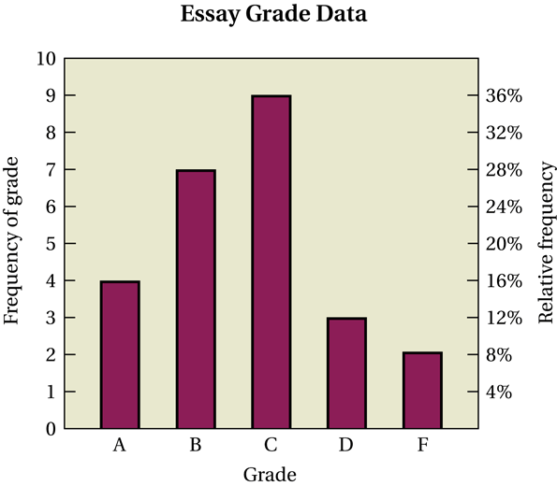
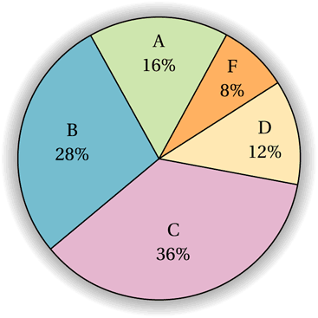
Bar and Pie Graphs
5-C
Notes:
Both graphs represent the same data set. Discuss the pros and cons of the graphs.

Slide 13
Definitions
5-C
Histogram: a bar graph for quantitative data categories. The bars have a natural order and the bar widths have specific meaning.
Line chart: shows the data value for each category as a dot, and the dots are connected with lines. For each dot, the horizontal position is the center of the bin it represents and the vertical position is the data value for the bin.
Time-series diagram: a histogram or line chart in which the horizontal axis represents time.

Slide 14
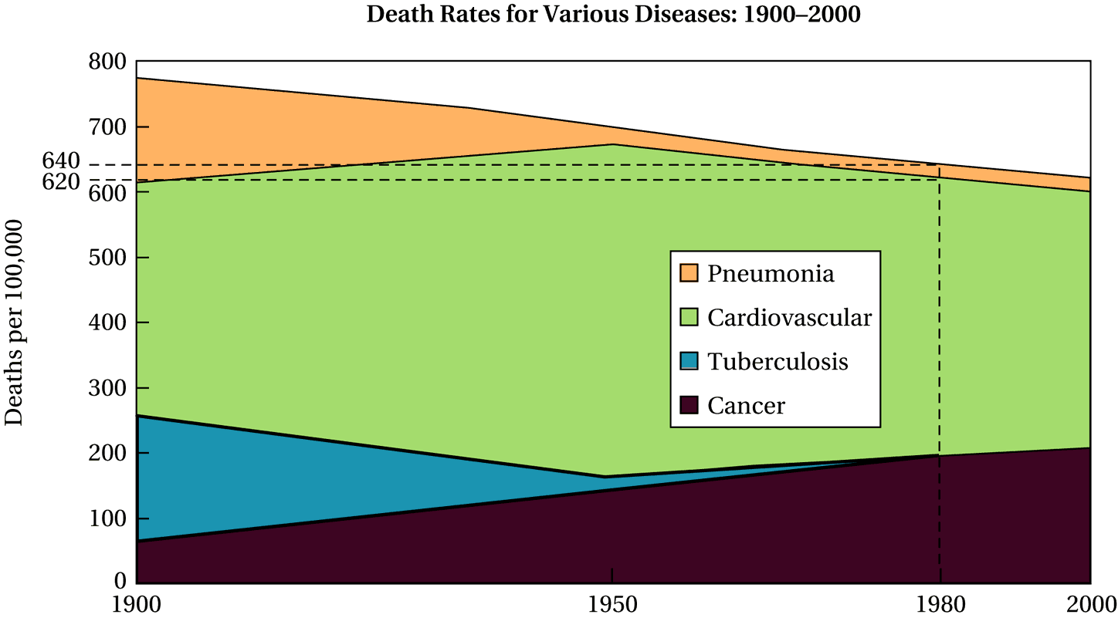
Graphics in the Media
5-D
Notes:
Illustrate with this graphic how color can help the researcher identify, at a glance, patterns and key geographical regions that may be of an influence in the context of the study.

Slide 15
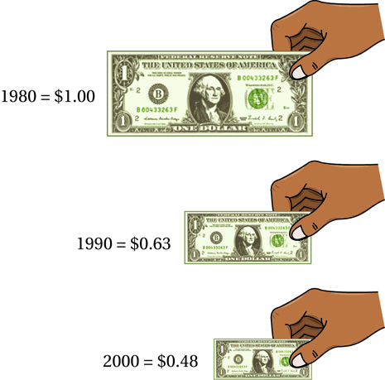
Graphics in the Media
5-D
Notes:
Show students why many two dimensional graphics can distort our perspective either intentionally or unintentionally. Explain the idea of area versus length of the dollars.

Slide 16
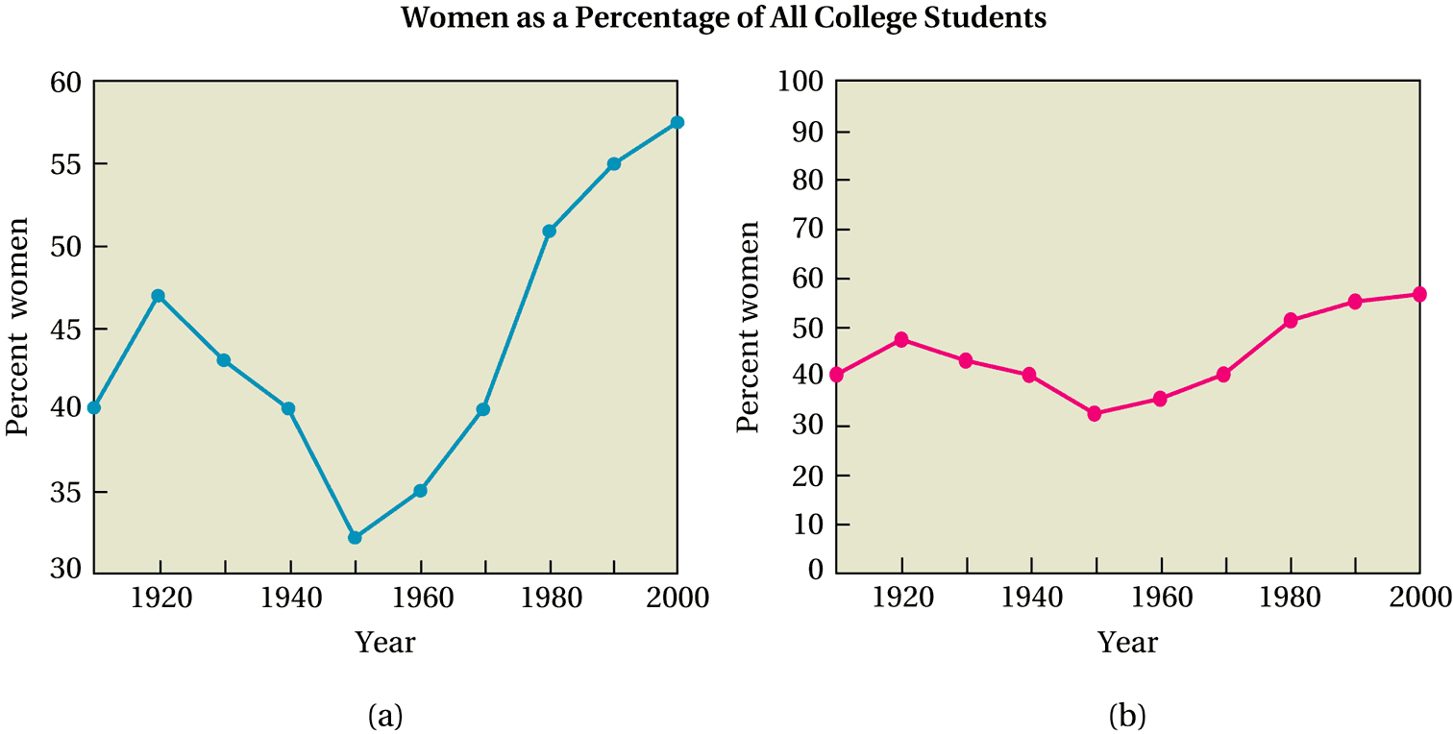
Graphics in the Media
5-D
Notes:
Illustrate and stress the importance of choosing a scale when graphing data and reading a graph's scale carefully. Help students realize that the choice of a scale can change the look of the data.

Slide 17
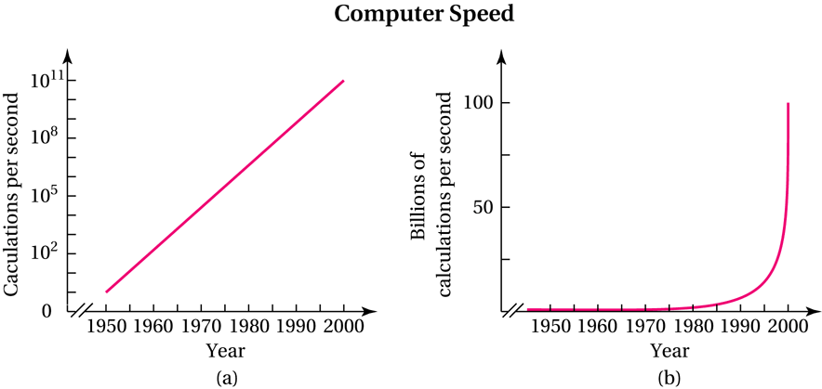
Graphics in the Media
5-D
Notes:
Illustrate and stress the importance of choosing a scale when graphing data and reading a graph's scale carefully. Help students realize that the choice of a scale can change the look of the data.

Slide 18
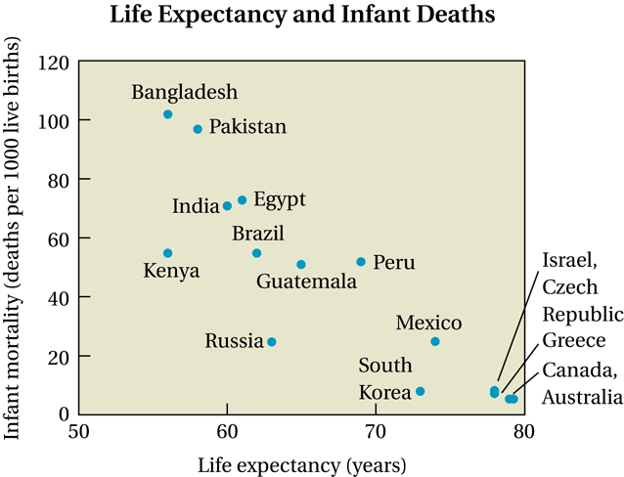
Correlation and Causality
5-E
A scatter diagram for life expectancy and infant mortality.
Notes:
Present students with various scatter plots of data and have them discuss the type and strength of correlation as well as possible explanations for the correlation. This may be an excellent opportunity to touch on the difference between correlation and causation.

Slide 19
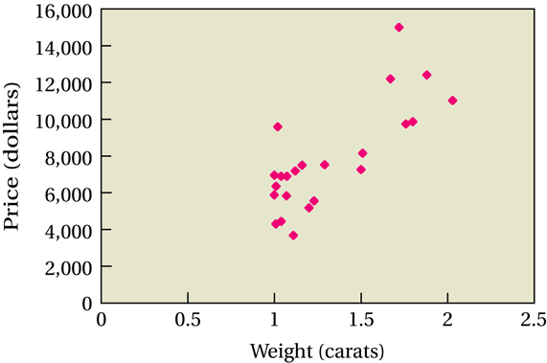
Correlation and Causality
5-E
A scatter diagram for diamond weights and prices.

Slide 20
Relationships Between Two Data Variables
5-E
No correlation: There is no apparent relationship between the
two variables.
Positive correlation: Both variables tend to increase (or decrease) together.
Negative correlation: The two variables tend to change in opposite directions, with one increasing while the other decreases.
Strength of a correlation: The more closely two variables follow the general trend, the stronger the correlation (which may be either positive or negative).
In a perfect correlation, all data points lie on a straight line.
Notes:
Present students with various scatter plots of data and have them discuss the type and strength of correlation as well as possible explanations for the correlation. This may be an excellent opportunity to touch on the difference between correlation and causation.

