Slide 1
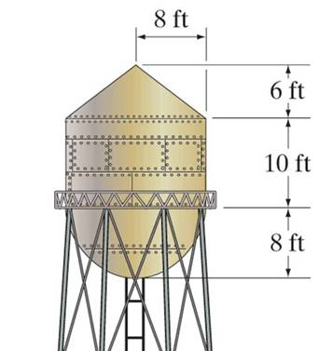
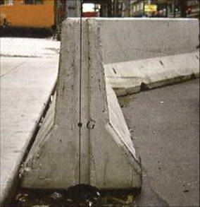
COMPOSITE BODIES
Today’s Objective:
Students will be able to determine:
The location of the center of gravity (CG),
The location of the center of mass,
And, the location of the centroid using the method of composite bodies.
In-Class Activities:
Check homework, if any
Reading Quiz
Applications
Method of Composite Bodies
Concept Quiz
Group Problem Solving
Attention Quiz

Slide 2
READING QUIZ
1. A composite body in this section refers to a body made of ____.
A) Carbon fibers and an epoxy matrix in a car fender
B) Steel and concrete forming a structure
C) A collection of “simple” shaped parts or holes
D) A collection of “complex” shaped parts or holes
2. The composite method for determining the location of the center of gravity of a composite body requires _______.
A) Simple arithmetic B) Integration
C) Differentiation D) All of the above.
Notes:
Answers:
1. C
2. A

Slide 3
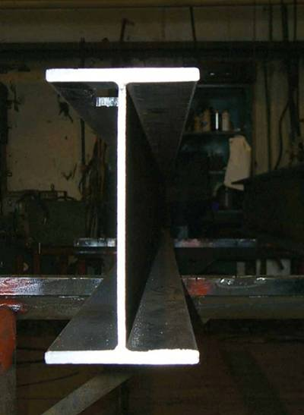
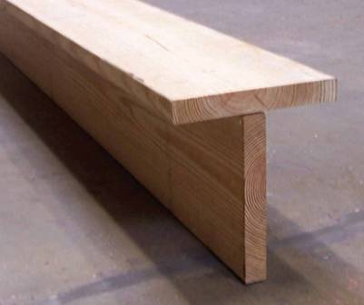
APPLICATIONS
The I-beam (top) or T-beam (bottom) shown are commonly used in building various types of structures.
When doing a stress or deflection analysis for a beam, the location of its centroid is very important.
How can we easily determine the location of the centroid for different beam shapes?

Slide 4
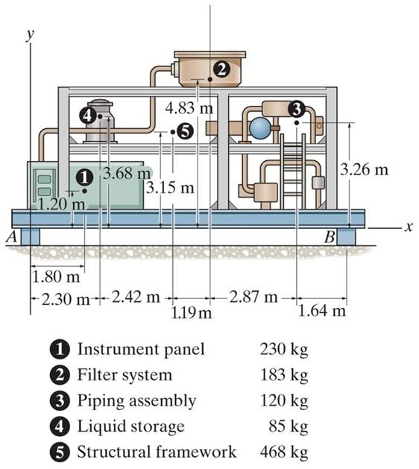
APPLICATIONS (continued)
The compressor is assembled with many individual components.
In order to design the ground support structures, the reactions at blocks A and B have to be found. To do this easily, it is important to determine the location of the compressor’s center of gravity (CG).
If we know the weight and CG of individual components, we need a simple way to determine the location of the CG of the assembled unit.

Slide 5
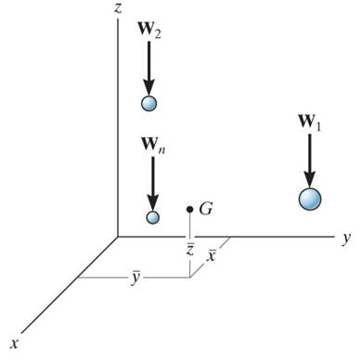
CG/CM OF A COMPOSITE BODY
Consider a composite body which consists of a series of particles (or bodies) as shown in the figure. The net or resultant weight is given as W_{R} = ∑W.
Summing the moments about the y-axis, we get
x W_{R} = x₁W₁ + x₂W₂ + ……….. + x_{n}W_{n}
where x₁ represents x coordinate of W₁, etc..
~
~
~
~
Similarly, we can sum moments about the x- and z-axes to find the coordinates of the CG.
By replacing the W with a M in these equations, the coordinates of the center of mass can be found.

Slide 6
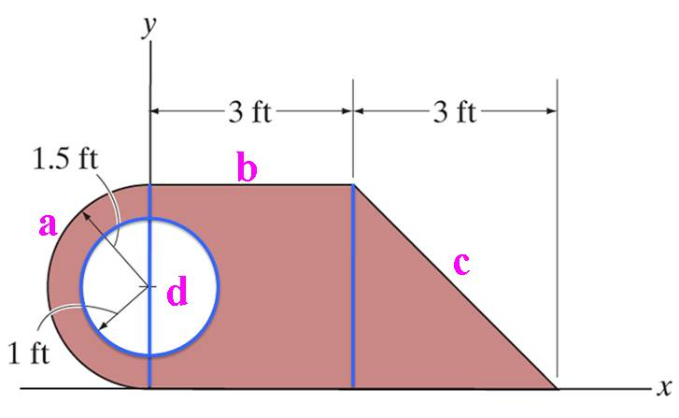
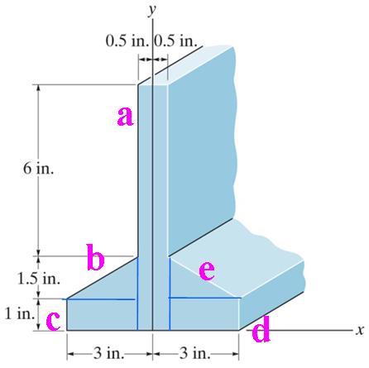
CONCEPT OF A COMPOSITE BODY
Many industrial objects can be considered as composite bodies made up of a series of connected “simple-shaped” parts, like a rectangle, triangle, and semicircle, or holes.
Knowing the location of the centroid, C, or center of gravity, CG, of the simple-shaped parts, we can easily determine the location of the C or CG for the more complex composite body.

Slide 7
CONCEPT OF A COMPOSITE BODY (continued)
This can be done by considering each part as a “particle” and following the procedure as described in Section 9.1.
This is a simple, effective, and practical method of determining the location of the centroid or center of gravity of a complex part, structure or machine.

Slide 8
STEPS FOR ANALYSIS
1. Divide the body into pieces that are known shapes. Holes are considered as pieces with negative weight or size.
2. Make a table with the first column for segment number, the second column for weight, mass, or size (depending on the problem), the next set of columns for the moment arms, and, finally, several columns for recording results of simple intermediate calculations.
3. Fix the coordinate axes, determine the coordinates of the center of gravity of centroid of each piece, and then fill in the table.
4. Sum the columns to get x, y, and z. Use formulas like
x = ( Σ x_{i} A_{i} ) / ( Σ A_{i} ) or x = ( Σ x_{i} W_{i} ) / ( Σ W_{i} )
This approach will become straightforward after doing examples!
∼
∼

Slide 9
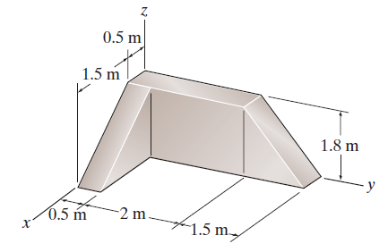
EXAMPLE
Given: Three blocks are assembled as shown.
Find: The center of volume of this assembly.
Plan: Follow the steps for analysis.
A
B
C
Solution:
1. In this problem, the blocks A, B and C can be considered as three pieces (or segments).
Notes:
Source : F9-12

Slide 10
EXAMPLE (continued)
Volumes of each shape:
V_{A} = (0.5) (1.5) (1.8) (0.5) = 0.675 m³
V_{B} = (2.5) (1.8) (0.5) = 2.25 m³
V_{C} = (0.5) (1.5) (1.8) (0.5) = 0.675 m³
A
B
C
Segment
V (m³)
∼
∼
∼
∼
∼
∼
x (m)
y (m)
z (m)
xV (m⁴)
yV (m⁴)
zV (m⁴)
A
B
C
0.675
2.25
0.675
1.0
0.25
0.25
0.25
1.25
3.0
0.6
0.9
0.6
0.675
0.5625
0.1688
0.1688
2.813
2.025
0.405
2.025
0.405
Σ 3.6 1.406 5.007 2.835

Slide 11
EXAMPLE (continued)
Table Summary
∼
∼
∼
V (m³) x V y V z V
(m⁴) (m⁴) (m⁴)
3.6 1.406 5.007 2.835
A
B
C
Substituting into the Center of Volume equations:
~
x = (Σ x V) / ( ΣV ) = 1.406 / 3.6 = 0.391 m
y = (Σ y V) / ( ΣV ) = 5.007 / 3.6 = 1.39 m
z = (Σ z V) / ( ΣV ) = 2.835 / 3.6 = 0.788 m
~
~

Slide 12
CONCEPT QUIZ
1. Based on typical available centroid information, what are the minimum number of pieces to consider for determining the centroid of the area shown at the right?
A) 4 B) 3 C) 2 D) 1
3cm
1 cm
1 cm
3cm
2. A storage box is tilted up to clean the rug underneath the box. It is tilted up by pulling the handle C, with edge A remaining on the ground. What is the maximum angle of tilt possible (measured between bottom AB and the ground) before the box tips over?
A) 30° B) 45 ° C) 60 ° D) 90 °
C
G
30º
B
A
Notes:
Answers:
1. B
2. C

Slide 13
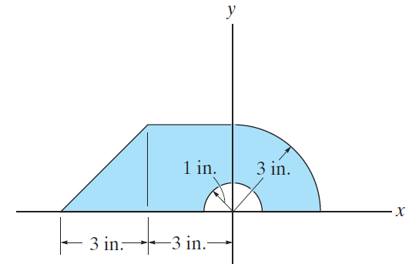
GROUP PROBLEM SOLVING
Given: The part shown.
Find: The centroid of the part.
Plan: Follow the steps for analysis.
b
a
d
c
Solution:
1. This body can be divided into the following pieces: triangle (a) + rectangle (b) + quarter circular (c) – semicircular area (d). Note that a negative sign should be used for the hole!
Notes:
Source : P9-64

Slide 14
GROUP PROBLEM SOLVING (continued)
Steps 2 & 3: Create and complete the table using parts a, b, c, and d. Note the location of the axis system.
y
b
a
c
d
Segment
Area A (in²)
∼
∼
∼
∼
x (in)
y (in)
x A ( in³)
y A ( in³)
Triangle a
Rectangle b
Qtr. Circle c
Semi-Circle d
4.5
9.0
9 π / 4
– π / 2
– 4
– 1.5
4(3) / (3 π)
0
1
1.5
4(3) / (3 π)
4(1) / (3 π)
– 18
– 13.5
9
0
4.5
13.5
9
– 0.67
Σ
19.00
– 22.5
26.33

Slide 15
GROUP PROBLEM SOLVING (continued)
4. Now use the table data results and the formulas to find the coordinates of the centroid.
∼
∼
Area A x A y A
19.00 – 22.5 26.33
∼
x = ( Σ x A) / (Σ A ) = – 22.5 in³/ 19.0 in² = – 1.18 in
y = ( Σ y A) / (Σ A ) = 26.33 in³ / 19.0 in² = 1.39 in
∼
y
C

Slide 16
ATTENTION QUIZ
y
1. A rectangular area has semicircular and triangular cuts as shown. For determining the centroid, what is the minimum number of pieces that you can use?
A) Two B) Three
C) Four D) Five
2cm
4cm
x
2cm
2cm
2. For determining the centroid of the area, two square segments are considered; square ABCD and square DEFG. What are the coordinates (x, y ) of the centroid of square DEFG?
A) (1, 1) m B) (1.25, 1.25) m
C) (0.5, 0.5 ) m D) (1.5, 1.5) m
y
1m
1m
A
D
~
~
E
1m
G
F
1m
B
x
C
Notes:
Answers:
1. B
2. D

Slide 17
End of the Lecture
Let Learning Continue

