Slide 1
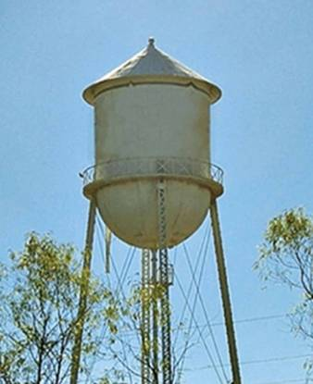
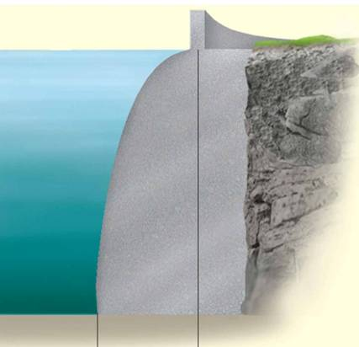
CENTER OF GRAVITY, CENTER OF MASS AND CENTROID OF A BODY
Today’s Objective :
Students will:
a) Understand the concepts of center of gravity, center of mass, and centroid.
b) Be able to determine the location of these points for a body.
In-Class Activities:
Check Homework, if any
Reading Quiz
Applications
Center of Gravity
Determine CG Location
Concept Quiz
Group Problem Solving
Attention Quiz

Slide 2
READING QUIZ
1. The _________ is the point defining the geometric center of an object.
A) Center of gravity B) Center of mass
C) Centroid D) None of the above
2. To study problems concerned with the motion of matter under the influence of forces, i.e., dynamics, it is necessary to locate a point called ________.
A) Center of gravity B) Center of mass
C) Centroid D) None of the above
Notes:
Answers:
1. C
2. B

Slide 3
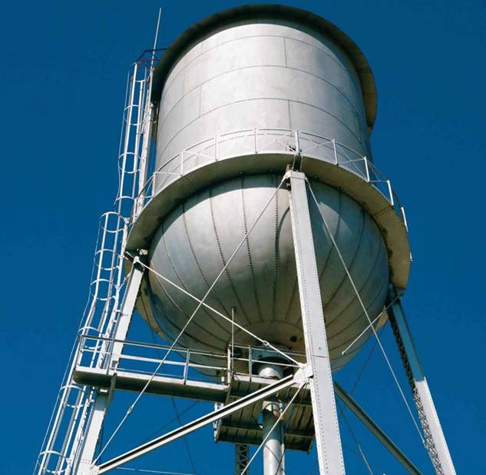
APPLICATIONS
To design the structure for supporting a water tank, we will need to know the weight of the tank and water as well as the locations where the resultant forces representing these distributed loads act.
How can we determine these resultant weights and their lines of action?

Slide 4
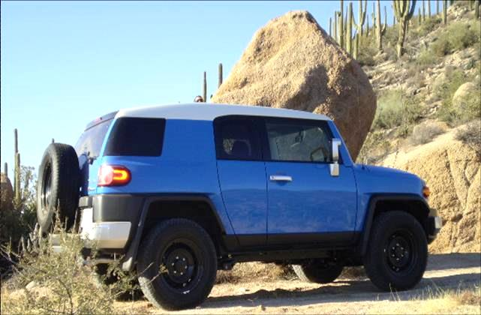
APPLICATIONS (continued)
One concern about a sport utility vehicle (SUV) is that it might tip over when taking a sharp turn.
One of the important factors in determining its stability is the SUV’s center of mass.
Should it be higher or lower to make a SUV more stable?
How do you determine the location of the SUV’s center of mass?

Slide 5
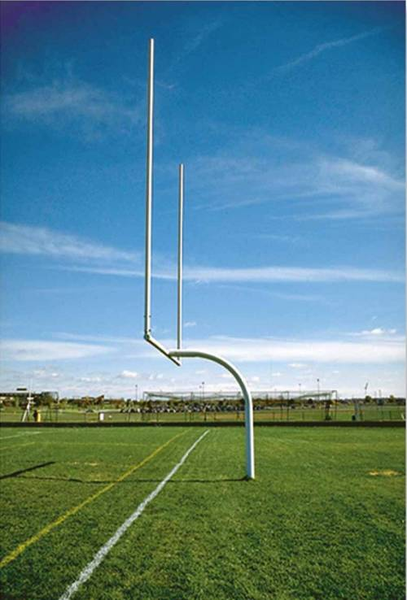
APPLICATIONS (continued)
To design the ground support structure for a goal post, it is critical to find total weight of the structure and the center of gravity’s location.
Integration must be used to determine total weight of the goal post due to the curvature of the supporting member.
How do you determine the location of overall center of gravity?

Slide 6
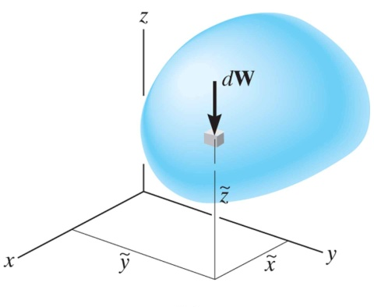
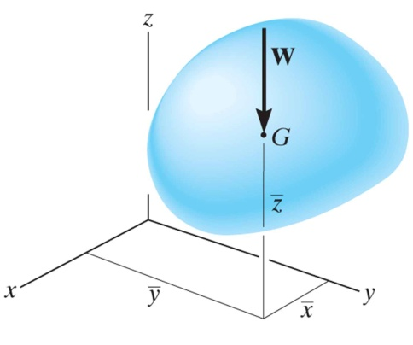
CONCEPT OF CENTER OF GRAVITY (CG)
A body is composed of an infinite number of
particles, and so if the body is located within a
gravitational field, then each of these particles will have a weight dW.
The center of gravity (CG) is a point, often shown as G, which locates the resultant weight of a system of particles or a solid body.
From the definition of a resultant force, the sum of moments due to individual particle weight about any point is the same as the moment due to the resultant weight located at G.
Also, note that the sum of moments due to the individual particle’s weights about point G is equal to zero.

Slide 7
CONCEPT OF CG (continued)
The location of the center of gravity, measured from the y axis, is determined by equating the moment of W about the y-axis to the sum of the moments of the weights of the particles about this same axis.
~
~
~
If dW is located at point (x, y, z), then
_
~
x W = ∫ x dW
_
_
~
Similarly,
~
z W = ∫ z dW
y W = ∫ y dW
Therefore, the location of the center of gravity G with respect to the x, y, z-axes becomes

Slide 8
CM & CENTROID OF A BODY
By replacing the W with a m in these equations, the coordinates of the center of mass can be found.
Similarly, the coordinates of the centroid of volume, area, or length can be obtained by replacing W by V, A, or L, respectively.

Slide 9
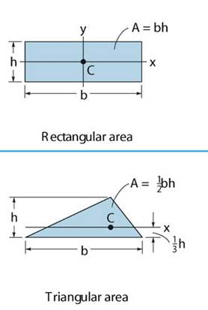
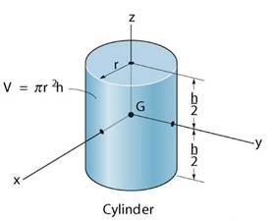
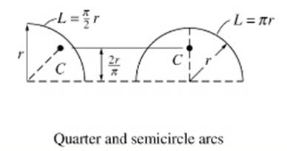
CONCEPT OF CENTROID
The centroid, C, is a point defining the geometric center of an object.
The centroid coincides with the center of mass or the center of gravity only if the material of the body is homogenous (density or specific weight is constant throughout the body).
If an object has an axis of symmetry, then the centroid of object lies on that axis.
In some cases, the centroid may not be located on the object.

Slide 10
STEPS TO DETERME THE CENTROID OF AN AREA
1. Choose an appropriate differential element dA at a general point (x,y). Hint: Generally, if y is easily expressed in terms of x (e.g., y = x² + 1), use a vertical rectangular element. If the converse is true, then use a horizontal rectangular element.
2. Express dA in terms of the differentiating element dx (or dy).
~
~
3. Determine coordinates (x, y) of the centroid of the rectangular element in terms of the general point (x, y).
4. Express all the variables and integral limits in the formula using either x or y depending on whether the differential element is in terms of dx or dy, respectively, and integrate.
Note: Similar steps are used for determining the CG or CM. These steps will become clearer by doing a few examples.

Slide 11
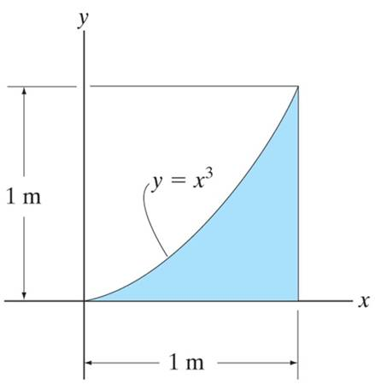
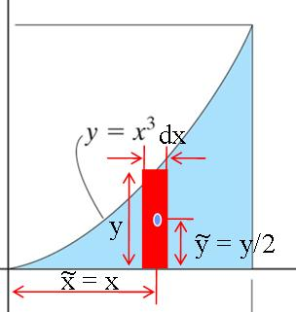
EXAMPLE I
Given: The area as shown.
Find: The centroid location (x , y)
Plan: Follow the steps.
Solution:
1. Since y is given in terms of x, choose dA as a vertical rectangular strip.
2. dA = y dx = x³ dx
3. x = x and y = y / 2 = x³ / 2
~
~
Notes:
Source : F9-2

Slide 12
EXAMPLE I (continued)
~
4. x = ( ∫_{A} x dA ) / ( ∫_{A} dA )
₀∫ x (x³ ) d x 1/5 [ x⁵ ]¹
₀∫ (x³ ) d x 1/4 [ x⁴ ]¹
= ( 1/5) / ( 1/4) = 0.8 m
¹
0
=
=
¹
0
~
¹
∫_{A} y dA ₀ ∫ (x³ / 2) ( x³ ) dx 1/14[x⁷]¹
∫_{A} dA ₀ ∫ x³ dx 1/4
y =
=
=
0
¹
= (1/14) / (1/4) = 0.2857 m

Slide 13
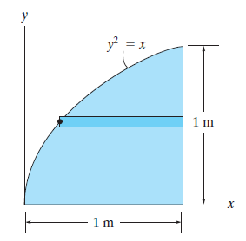
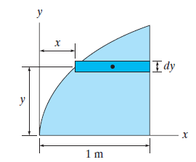
EXAMPLE II
Given: The shape and associated horizontal rectangular strip shown.
Find: dA and (x , y)
Plan: Follow the steps.
~
~
Solution:
1. dA = (1-x) dy =(1- y²)dy
~
x
~
~
2. x = x + (1−x) / 2 = (1 + x) /2 = (1 + y²)/2
3. y = y
y
~
Notes:
Source : Preliminary Prob 9-1

Slide 14
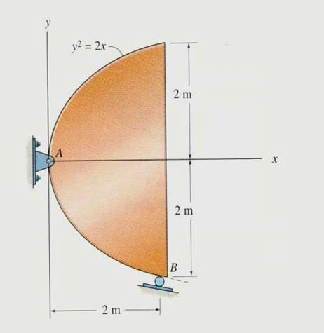
CONCEPT QUIZ
1. The steel plate, with known weight and non-uniform thickness and density, is supported as shown. Of the three parameters CG, CM, and centroid, which one is needed for determining the support reactions? Are all three parameters located at the same point?
A) (center of gravity, yes) B) (center of gravity, no) C) (centroid, yes) D) (centroid, no)
2. When determining the centroid of the area above, which type of differential area element requires the least computational work?
A) Vertical B) Horizontal
C) Polar D) Any one of the above.
Notes:
Answers:
1. B
2. A

Slide 15
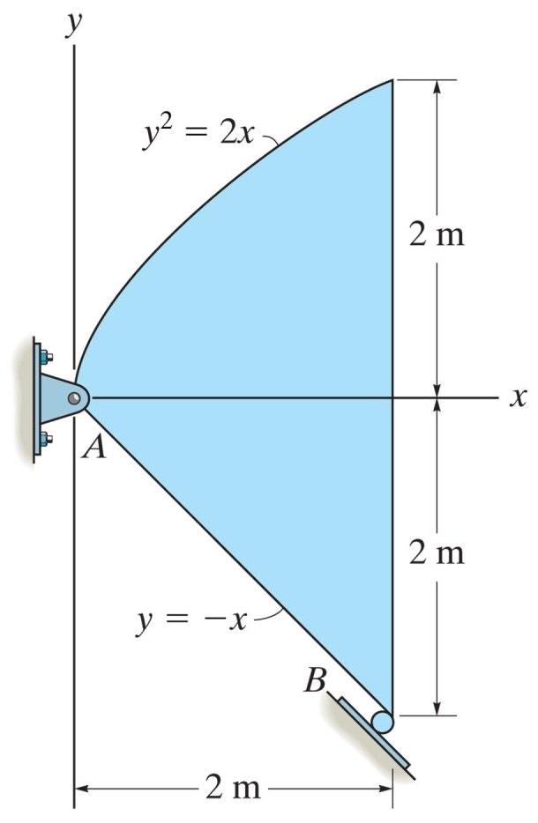
GROUP PROBLEM SOLVING
Given: The steel plate is 0.3 m thick and has a density of 7850 kg/m³.
Find: The location of its center of mass. Also compute the reactions at A and B.
Plan:
Follow the solution steps to find the CM by integration. Then use 2-dimensional equations of equilibrium to solve for the external reactions.
Notes:
Source : P9-34

Slide 16
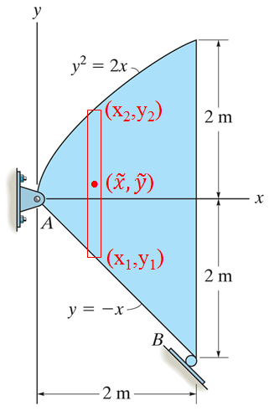
GROUP PROBLEM SOLVING (continued)
Solution:
1. Choose dA as a vertical rectangular strip.
2. dA = (y₂ – y₁) dx
= ($\sqrt{2x}$ + x) dx
3. $\tilde{x}$ = x
$\tilde{y}$ = ( y₁ + y₂) / 2
= ($\sqrt{2x}$ – x) /2

Slide 17
GROUP PROBLEM SOLVING (continued)
4.
$\overline{x}$ = $\frac{\int_{A}{\tilde{x}dA}}{\int_{A}{dA}}$ = $\frac{\int_{0}^{2}{x\left(\sqrt{2x}+x\right)dx}}{\int_{0}^{2}{\left(\sqrt{2x}+x\right)dx}}$ = $\frac{{\left[\left(\frac{2\sqrt{2}}{5}\right)x^{\frac{5}{2}}+\frac{1}{3}x^{3}\right]}_{0}^{2}}{{\left[\left(\frac{2\sqrt{2}}{3}\right)x^{\frac{3}{2}}+\frac{1}{2}x^{2}\right]}_{0}^{2}}$
$= \frac{5.867}{4.667}=1.257 m$
$\overline{y}$ = $\frac{\int_{A}{\tilde{y}dA}}{\int_{A}{dA}}$ = $\frac{\int_{0}^{2}{\{(\sqrt{2x}−x)/2\}\left(\sqrt{2x}+x\right)dx}}{\int_{0}^{2}{\left(\sqrt{2x}+x\right)dx}}$ = $\frac{{\left[\frac{x^{2}}{2} − \frac{1}{6}x^{3}\right]}_{0}^{2}}{{\left[\left(\frac{2\sqrt{2}}{3}\right)x^{\frac{3}{2}}+\frac{1}{2}x^{2}\right]}_{0}^{2}}$
$= \frac{0.6667}{4.667}=0.143 m$
$\overline{x}$ = 1.26 m and $\overline{y}$ = 0.143 m

Slide 18
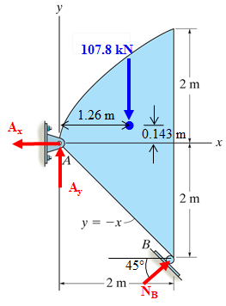
GROUP PROBLEM SOLVING (continued)
Place the weight of the plate at the centroid G.
Area, A = 4.667 m²
Weight, W = (7850) (9.81) (4.667) 0.3 = 107.8 kN
Here is FBD to find the reactions at A and B.
Applying Equations of Equilibrium:
+ ∑ M_{A} = N_{B} (2$\sqrt{2}$) – 107.8 (1.26) = 0
N_{B} = 47.92 = 47.9 kN
+ → ∑ F_{X} = – A_{x} + 47.92 sin 45° = 0
A_{X} = 33.9 kN
+ ↑ ∑ F_{Y} = A_{y} + 47.92 cos 45° – 107.8 = 0
A_{Y} = 73.9 kN

Slide 19
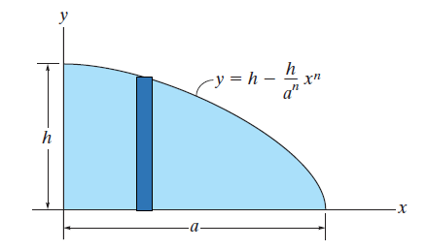
ATTENTION QUIZ
1. If a vertical rectangular strip is chosen as the differential element, then all the variables, including the integral limit, should be in terms of _____ .
A) x B) y
C) z D) Any of the above.
2. If a vertical rectangular strip is chosen, then what are the values of x and y?
A) (x , y) B) (x / 2 , y / 2)
C) (x , 0) D) (x , y / 2)
~
~
Notes:
Answers:
1. A
2. D

Slide 20
End of the Lecture
Let Learning Continue

