Slide 1
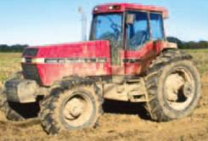
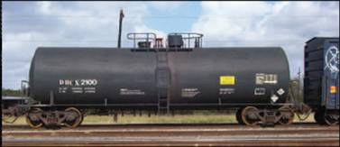
CHARACTERISTICS OF DRY FRICTION & PROBLEMS INVOLVING DRY FRICTION
Today’s Objective:
Students will be able to:
a) Understand the characteristics of dry friction
b) Draw a FBD including friction.
c) Solve problems involving friction.
In-Class Activities:
Check Homework, if any
Reading Quiz
Applications
Characteristics of Dry Friction
Problems involving Dry Friction
Concept Quiz
Group Problem Solving
Attention Quiz

Slide 2
READING QUIZ
1. A friction force always acts _____ to the contact surface.
A) Normal B) At 45°
C) Parallel D) At the angle of static friction
2. If a block is stationary, then the friction force acting on it is ________ .
A) ≤ μ_{s} N B) = μ_{s} N
C) ≥ μ_{s} N D) = μ_{k} N
Notes:
Answers:
1. C
2. A

Slide 3
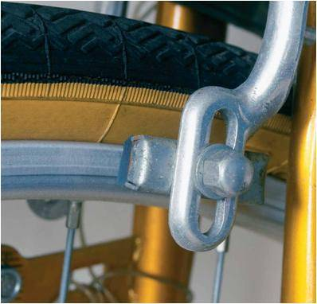
APPLICATIONS
In designing a brake system for a bicycle, car, or any other vehicle, it is important to understand the frictional forces involved.
For an applied force on the bike tire brake pads, how can we determine the magnitude and direction of the resulting friction force?

Slide 4
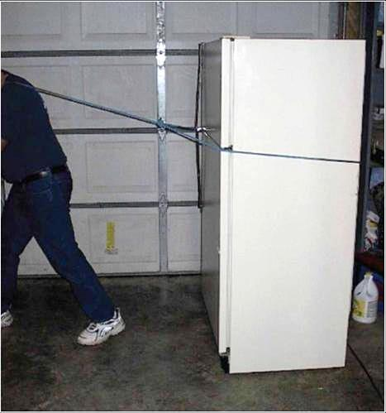
APPLICATIONS (continued)
The rope is used to tow the refrigerator.
In order to move the refrigerator, is it best to pull up as shown, pull horizontally, or pull downwards on the rope?
What physical factors affect the answer to this question?

Slide 5
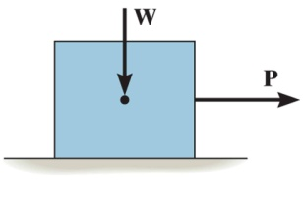
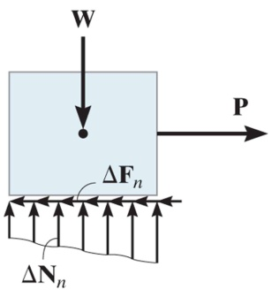
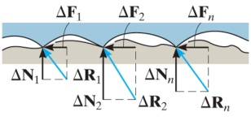
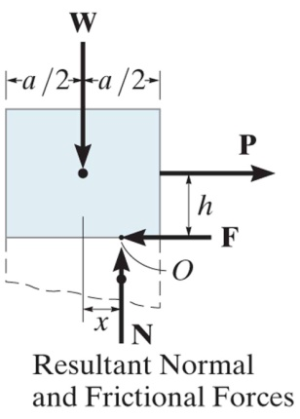
CHARACTERISTICS OF DRY FRICTION (Section 8.1)
Friction is defined as a force of resistance acting on a body which prevents or resists the slipping of a body relative to a second body.
Experiments show that frictional forces act tangent (parallel) to the contacting surface in a direction opposing the relative motion or tendency for motion.
For the body shown in the figure to be in equilibrium, the following must be true: F = P, N = W, and W*x = P*h.

Slide 6
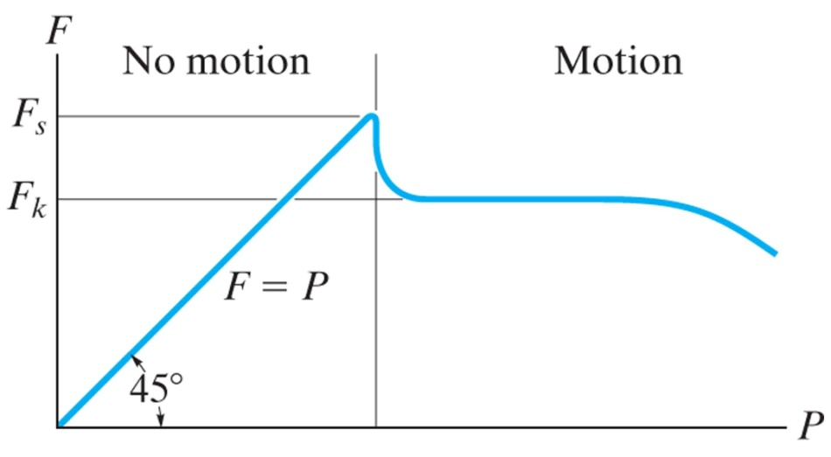
CHARACTERISTICS OF DRY FRICTION (continued)
To study the characteristics of the friction force F, let us assume that tipping does not occur (i.e., “h” is small or “a” is large).
Then we gradually increase the magnitude of the force P.
Typically, experiments show that the friction force F varies with P, as shown in the right figure above.

Slide 7
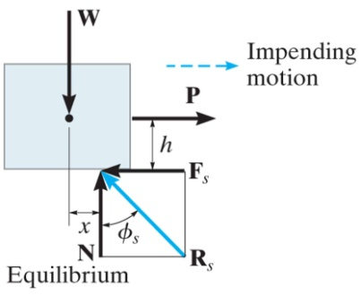
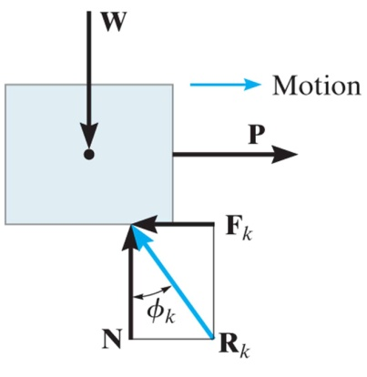
CHARACTERISTICS OF DRY FRICTION (continued)
The maximum friction force is attained just before the block begins to move (a situation that is called “impending motion”). The value of the force is found using F_{s} = μ_{s} N, where μ_{s} is called the coefficient of static friction. The value of μ_{s} depends on the two materials in contact.
Once the block begins to move, the frictional force typically drops and is given by F_{k} = μ_{k} N. The value of μ_{k} (coefficient of kinetic friction) is less than μ_{s} .

Slide 8
CHARACTERISTICS OF DRY FRICTION (continued)
It is also very important to note that the friction force may be less than the maximum friction force. So, just because the object is not moving, don’t assume the friction force is at its maximum of F_{s} = μ_{s} N unless you are told or know motion is impending!

Slide 9
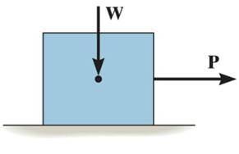
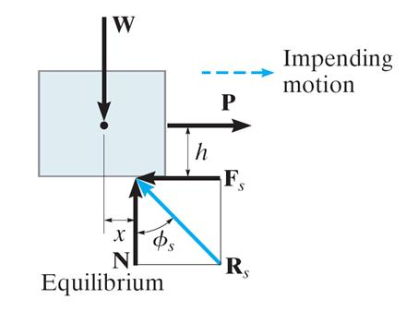
DETERMING μ_{s} EXPERIMENTALLY
If the block just begins to slip, the maximum friction force is F_{s} = μ_{s} N, where μ_{s} is the coefficient of static friction.
Thus, when the block is on the verge of sliding, the normal force N and
frictional force F_{s} combine to create a resultant R_{s}.
From the figure,
tan φ_{s} = ( F_{s} / N ) = (μ_{s} N / N ) = μ_{s}

Slide 10
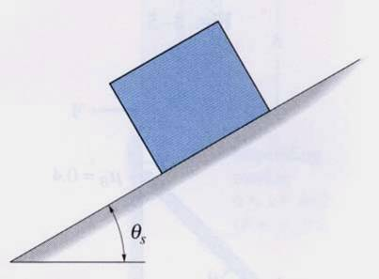
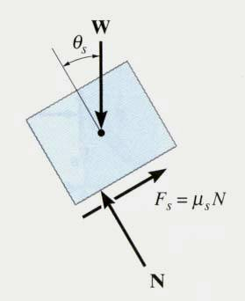
DETERMING μ_{s} EXPERIMENTALLY (continued)
A block with weight w is placed on an inclined plane. The plane is slowly tilted until the block just begins to slip.
The inclination, θ_{s}, is noted. Analysis of the block just before it begins to move gives (using F_{s} = μ_{s} N):
+ ∑ F_{y} = N – W cos θ_{s} = 0
+ ∑ F_{X} = μ_{S} N – W sin θ_{s} = 0
Using these two equations, we get μ_{s} = (W sin θ_{s} ) / (W cos θ_{s} ) = tan θ_{s} This simple experiment allows us to find the μ_{S} between two materials in contact.

Slide 11
PROBLEMS INVOLVING DRY FRICTION (Section 8.2)
Steps for solving equilibrium problems involving dry friction:
1. Draw necessary free body diagrams. Make sure that you show the friction force in the correct direction (it always opposes the motion or impending motion).
2. Determine the number of unknowns. Do not assume that F = μ_{S} N unless the impending motion condition is given.
3. Apply the equations of equilibrium and appropriate frictional equations to solve for the unknowns.

Slide 12
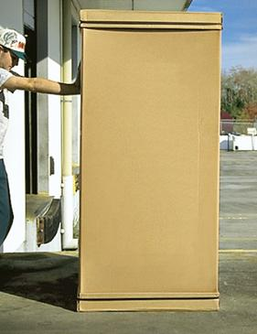
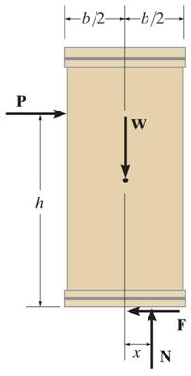
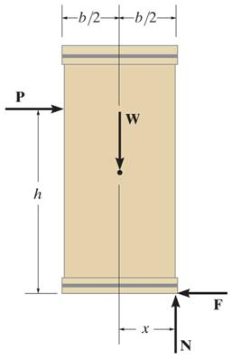
IMPENDING TIPPING versus SLIPPING
For a given W and h of the box, how can we determine if the block will slide or tip first? In this case, we have four unknowns (F, N, x, and P) and only the three E-of-E.
Hence, we have to make an assumption to give us another equation (the friction equation!). Then we can solve for the unknowns using the three E-of-E. Finally, we need to check if our assumption was correct.

Slide 13
IMPENDING TIPPING versus SLIPPING (continued)
Assume: Slipping occurs
Known: F = μ_{s} N
Solve: x, P, and N
Check: 0 ≤ x ≤ b/2
Or
Assume: Tipping occurs
Known: x = b/2
Solve: P, N, and F
Check: F ≤ μ_{s} N

Slide 14
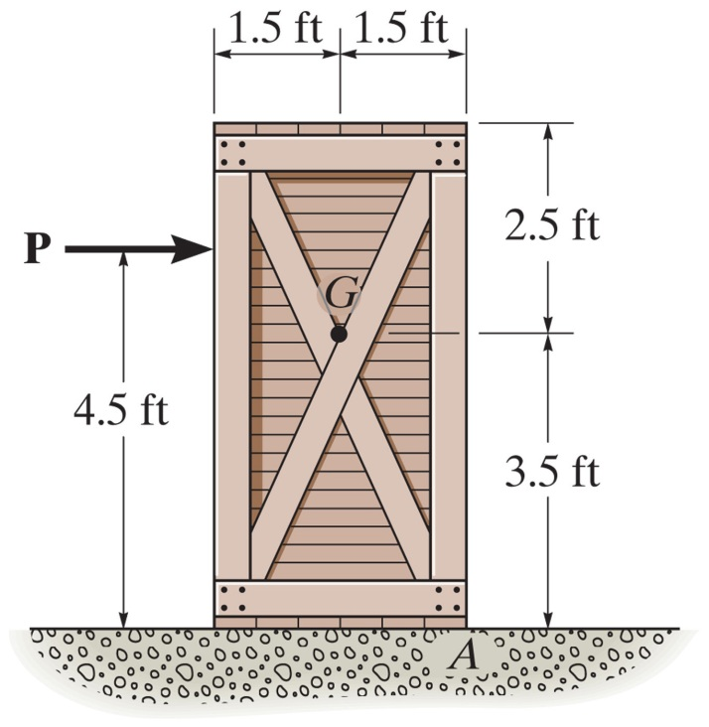
EXAMPLE
Given: Crate weight = 250 lb and μ_{s} = 0.4
Find: The maximum force P that can be applied without causing movement of the crate.
Plan:
??
a) Draw a FBD of the box.
b) Determine the unknowns.
c) Make your friction assumptions.
d) Apply E-of-E (and friction equations, if appropriate ) to solve for the unknowns.
e) Check assumptions, if required.
Notes:
Source : F8-5

Slide 15
EXAMPLE (continued)
Solution:
1.5 ft
1.5 ft
P
250 lb
4.5 ft
3.5 ft
0
F
x
N
FBD of the crate
There are four unknowns: P, N, F and x.
First, let’s assume the crate slips. Then the friction equation is F = μ_{s} N = 0.4 N.

Slide 16
EXAMPLE (continued)
1.5 ft
1.5 ft
P
250 lb
4.5 ft
3.5 ft
0
F
+ → ∑ F_{X} = P – 0.4 N = 0
+ ↑ ∑ F_{Y} = N – 250 = 0
Solving these two equations gives:
P = 100 lb and N = 250 lb
x
N
FBD of the crate
+ ∑ M_{O} = -100 (4.5) + 250 (x) = 0
Check: x = 1.8 ≥ 1.5 : No slipping will occur since x > 1.5

Slide 17
EXAMPLE (continued)
Since tipping occurs, here is the correct FBD:
1.5 ft
1.5 ft
+ → ∑ F_{X} = P – F = 0
+ ↑ ∑ F_{Y} = N – 250 = 0
These two equations give:
P = F and N = 250 lb
250 lb
P
4.5 ft
3.5 ft
0
F
N
FBD of the crate
+ ∑M_{O} = – P (4.5) + 250 (1.5) = 0
P = 83.3 lb, and F = 83.3 lb < μ_{s} N = 100 lb

Slide 18
CONCEPT QUIZ
1. A 100 lb box with a wide base is pulled by a force P and μ_{s} = 0.4. Which force orientation requires the least force to begin sliding?
A) P(A) B) P(B)
C) P(C) D) Can not be determined
P(A)
100 lb
P(B)
P(C)
2. A ladder is positioned as shown. Please indicate the direction of the friction force on the ladder at B.
A) ↑ B) ↓
C) D)
B
A
Notes:
Answer:
1. A
2. C

Slide 19
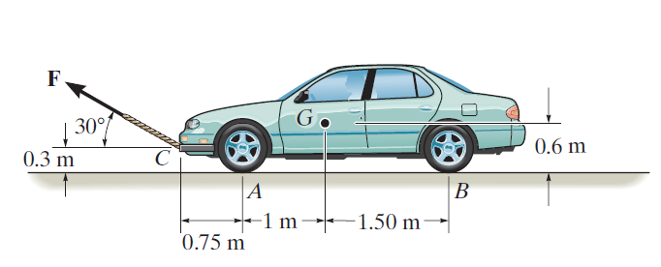
GROUP PROBLEM SOLVING
Given: Automobile has a mass of 2000 kg and μ_{s} = 0.3.
Find: The smallest magnitude of F required to move the car if the back brakes are locked and the front wheels are free to roll.
Plan:
a) Draw FBDs of the car.
b) Determine the unknowns.
d) Apply the E-of-E and friction equations to solve for the unknowns.
Notes:
Source : P8-5

Slide 20
GROUP PROBLEM SOLVING (continued)
Here is the correct FBD:
FBD of the car
2000 × 9.81 N
Note that there are four unknowns: F, N_{A}, N_{B}, and F_{B}.
F_{B}
Equations of Equilibrium:
N_{A}
N_{B}
+ → ∑ F_{X} = F_{B} – F (cos 30°) = 0 (1)
+ ↑ ∑ F_{Y} = N_{A} + N_{B} + F (sin 30°) – 19620 = 0 (2)
+ ∑ M_{A} = F cos30°(0.3) – F sin30°(0.75) + N_{B} (2.5) – 19620(1) = 0 (3)
Assume that the rear wheels are on the verge of slip. Thus
F_{B} = µ_{s} N_{B} = 0.3 N_{B} (4)

Slide 21
GROUP PROBLEM SOLVING (continued)
Solving Equations (1) to (4),
F = 2763 N
and N_{A} =10263 N, N_{B} = 7975 N, F_{B} = 2393 N.

Slide 22
ATTENTION QUIZ
1. A 10 lb block is in equilibrium. What is the magnitude of the friction force between this block and the surface?
A) 0 lb B) 1 lb
C) 2 lb D) 3 lb
μ _{S} = 0.3
2 lb
2. The ladder AB is positioned as shown. What is the direction of the friction force on the ladder at B.
A) B)
C) ← D) ↑
B
A
Notes:
Answers are:
1. C
2. D

Slide 23
End of the Lecture
Let Learning Continue

