Slide 1
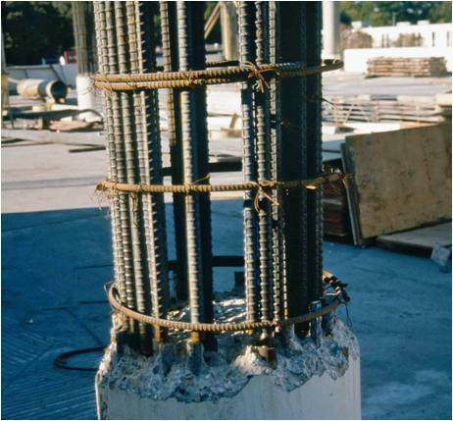
INTERNAL FORCES
Today’s Objective:
Students will be able to:
Use the method of sections for determining internal forces in 2-D load cases.
In-Class Activities:
Check Homework
Reading Quiz
Applications
Types of Internal Forces
Steps for Determining
Internal Forces
Concept Quiz
Group Problem Solving
Attention Quiz

Slide 2
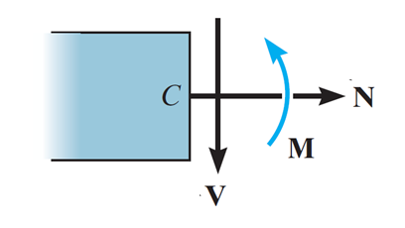
READING QUIZ
1. In a multiforce member, the member is generally subjected to an internal _________.
A) Normal force B) Shear force
C) Bending moment D) All of the above.
2. In mechanics, the force component V acting tangent to, or along the face of, the section is called the _________ .
A) Axial force B) Shear force
C) Normal force D) Bending moment
Notes:
Answers :
1. D
2. B

Slide 3
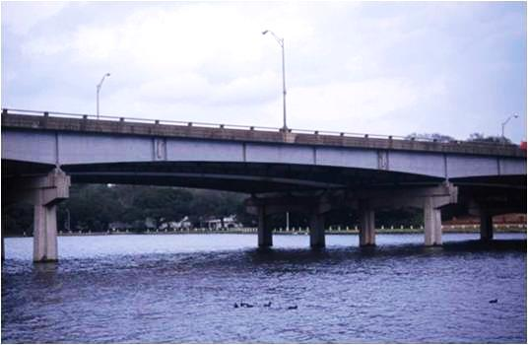
APPLICATIONS
Beams are structural members designed to support loads applied perpendicularly to their axes.
Beams can be used to support the span of bridges. They are often thicker at the supports than at the center of the span.
Why are the beams tapered? Internal forces are important in making such a design decision. In this lesson, you will learn about these forces and how to determine them.

Slide 4
APPLICATIONS (continued)
A fixed column supports these rectangular billboards.
Usually such columns are wider/thicker at the bottom than at the top. Why?

Slide 5
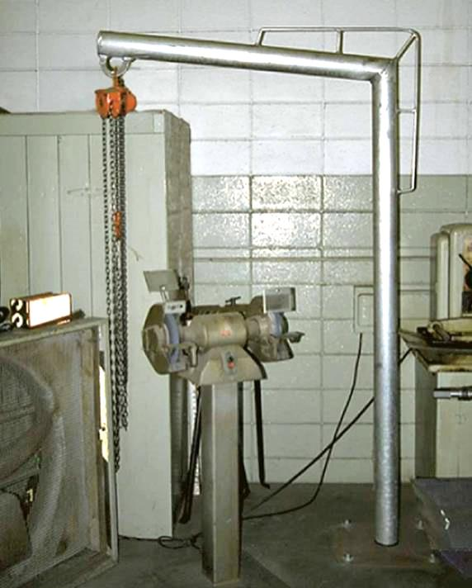
APPLICATIONS (continued)
The shop crane is used to move heavy machine tools around the shop.
The picture shows that an additional frame around the joint is added.
Why might have this been done?

Slide 6
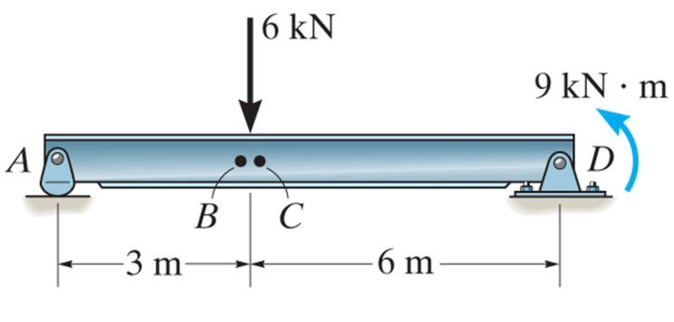
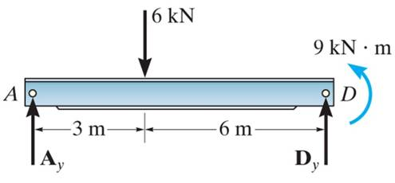
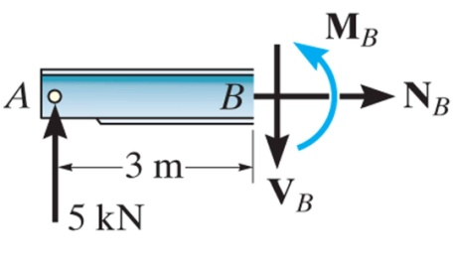
INTERNAL FORCES
The design of any structural member requires finding the forces acting within the member to make sure the material can resist those loads.
B
For example, we want to determine the internal forces acting on the cross section at B. But, first, we first need to determine the support reactions.
B
Then we need to cut the beam at B and draw a FBD of one of the halves of the beam. This FBD will include the internal forces acting at B. Finally, we need to solve for these unknowns using the E-of-E.

Slide 7
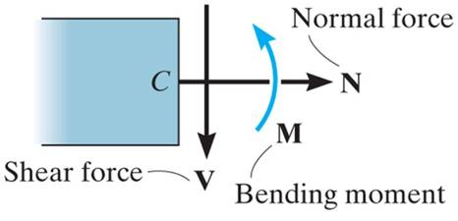
INTERNAL FORCES (continued)
In two-dimensional cases, typical internal
loads are normal or axial forces (N, acting perpendicular to the section), shear forces (V, acting along the surface), and the bending moment (M).
The loads on the left and right sides of the section at B are equal in magnitude but opposite in direction. This is because when the two sides are reconnected, the net loads are zero at the section.

Slide 8
STEPS FOR DETERMINING INTERNAL FORCES
1. Take an imaginary cut at the place where you need to determine the internal forces. Then, decide which resulting section or piece will be easier to analyze.
2. If necessary, determine any support reactions or joint forces you need by drawing a FBD of the entire structure and solving for the unknown reactions.
3. Draw a FBD of the piece of the structure you’ve decided to analyze. Remember to show the N, V, and M loads at the “cut” surface.
4. Apply the E-of-E to the FBD (drawn in step 3) and solve for the unknown internal loads.

Slide 9
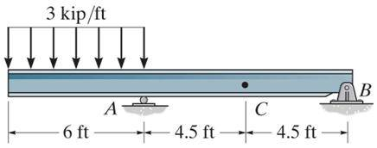
EXAMPLE
Given: The loading on the beam.
Find: The internal forces at point C.
Plan: Follow the procedure!!
Solution
Plan on taking the imaginary cut at C. It will be easier to work with the right section (from the cut at C to point B) since the geometry is simpler and there are no external loads.
Notes:
Source : F7-3

Slide 10
EXAMPLE (continued)
2. We need to determine B_{y}. Use a FBD of the entire frame and solve the E-of-E for B_{y}.
FBD of the entire beam:
18 kip
3 ft
3 ft
9 ft
B_{x}
A_{y}
B_{y}
Applying the E-of-E to this FBD, we get
→ + Σ F_{x} = B_{x} = 0;
+ Σ M_{A} = − B_{y} ( 9 ) + 18 ( 3 ) = 0 ; B_{y} = 6 kip

Slide 11
EXAMPLE (continued)
3. Now draw a FBD of the right section. Assume directions for V_{C}, N_{C} and M_{C}.
4.5 ft
N_{C}
C
B
M_{C}
V_{C}
6 kip
4. Applying the E-of-E to this FBD, we get
→ + Σ F_{x} = N_{C} = 0; N_{C} = 0
↑ + Σ F_{y} = – V_{C} – 6 = 0; V_{C} = – 6 kip
+ Σ M_{C} = – 6 (4.5) – M_{C} = 0 ; M_{C} = – 27 kip ft

Slide 12
CONCEPT QUIZ
1. A column is loaded with a vertical 100 N force. At which sections are the internal loads the same?
A) P, Q, and R B) P and Q
C) Q and R D) None of the above.
P
•
100 N
Q
R
2. A column is loaded with a horizontal 100 N force. At which section are the internal loads largest?
A) P B) Q
C) R D) S
P
Q
100 N
R
S
Notes:
Answers :
1.C
2.D

Slide 13
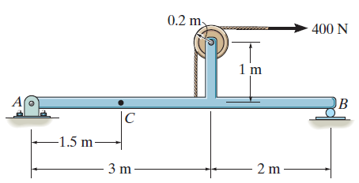
GROUP PROBLEM SOLVING I
Given: The loading on the beam.
Find: The internal forces at point C.
Plan: Follow the procedure!!
Solution:
1. Plan on taking the imaginary cut at C. It will be easier to work with the left section (point A to the cut at C) since the geometry is simpler.
Notes:
Source : P7-23

Slide 14
GROUP PROBLEM SOLVING I (continued)
2. First, we need to determine A_{x} and A_{y} using a FBD of the entire frame.
400 N
A_{x}
A_{y}
B_{y}
Free Body Diagram
Applying the E-of-E to this FBD, we get
→ + Σ F_{x} = A_{x} + 400 = 0 ; A_{x} = – 400 N
+ Σ M_{B} = – A_{y}(5) – 400 (1.2) = 0 ; A_{y} = – 96 N

Slide 15
GROUP PROBLEM SOLVING I (continued)
3. Now draw a FBD of the left section. Assume directions for V_{C}, N_{C} and M_{C} as shown.
1.5 m
400 N
N_{C}
M_{C}
A
C
96 N
V_{C}
4. Applying the E-of-E to this FBD, we get
→ + Σ F_{x} = N_{C} – 400 = 0; N_{C} = 400 N
↑ + Σ F_{y} = – V_{C} – 96 = 0; V_{C} = – 96N
+ Σ M_{C} = 96 (1.5) + M_{C} = 0 ; M_{C} = -144 N m

Slide 16
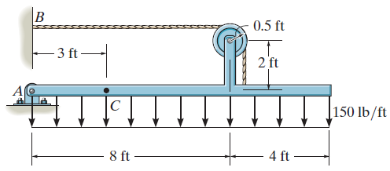
GROUP PROBLEM SOLVING II
Given: The loading on the beam.
Find: The internal forces at point C.
Plan: Follow the procedure!!
Solution:
1. Make an imaginary cut at C. Why there?
Which section will you pick to analyze via the FBD?
Why will it be easier to work with segment AC?
Notes:
Source : P7-19

Slide 17
GROUP PROBLEM SOLVING II (continued)
2. Determine the reactions at A, using a FBD and the E-of-E for the entire frame.
Free Body Diagram
T
A_{x}
A_{y}
6 ft
1800 lb
+ Σ M_{A} = T ( 2.5 ) − 1800 (6) = 0 ; T = 4320 lb
→ + Σ F_{x} = A_{x} − 4320 = 0 ; A_{x} = 4320 lb
↑ + Σ F_{y} = A_{y} − 1800 = 0 ; A_{y} = 1800 lb

Slide 18
GROUP PROBLEM SOLVING II (continued)
3. A FBD of section AC is shown below.
FBD of Section AC
450 lb
4320 lb
1.5 ft
1.5 ft
N_{C}
M_{C}
A
C
1800 lb
V_{C}
4. Applying the E-of-E to the FBD, we get
→ + Σ F_{x} = N_{C} + 4320 = 0 ; N_{C} = – 4320 lb
↑ + Σ F_{y} = 1800 – 450 – V_{C} = 0 ; V_{C} = 1350 lb
+ Σ M_{C} = – 1800 (3) + 450 (1.5) + M_{C} = 0 ; M_{C} = 4725 lb⋅ft

Slide 19
ATTENTION QUIZ
1. Determine the magnitude of the internal loads
(normal, shear, and bending moment) at point C.
A) (100 N, 80 N, 80 N m)
B) (100 N, 80 N, 40 N m)
C) (80 N, 100 N, 40 N m)
D) (80 N, 100 N, 0 N m )
100 N
•
C
80 N
0.5m
1 m
2. A column is loaded with a horizontal 100 N force. At which section are the internal loads the lowest?
A) P B) Q
C) R D) S
P
100N
Q
R
S
Notes:
Answers:
1. B
2. A

Slide 20
End of the Lecture
Let Learning Continue

