Slide 1
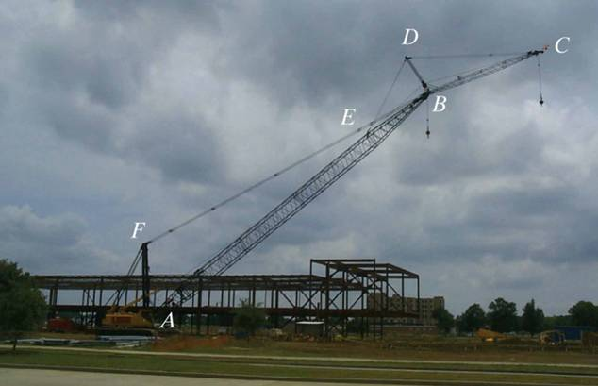
FRAMES AND MACHINES
Today’s Objectives:
Students will be able to:
a) Draw the free body diagram of a frame or machine and its members.
b) Determine the forces acting at the joints and supports of a frame or machine.
In-Class Activities:
Check Homework, if any
Reading Quiz
Applications
Analysis of a Frame/Machine
Concept Quiz
Group Problem Solving
Attention Quiz

Slide 2
READING QUIZ
1. Frames and machines are different as compared to trusses since they have ___________.
A) Only two-force members B) Only multiforce members
C) At least one multiforce member D) At least one two-force member
2. Forces common to any two contacting members act with _______ on the other member.
A) Equal magnitudes but opposite sense
B) Equal magnitudes and the same sense
C) Different magnitudes and the opposite sense
D) Different magnitudes and the same sense
Notes:
Answers:
1. C
2. A

Slide 3
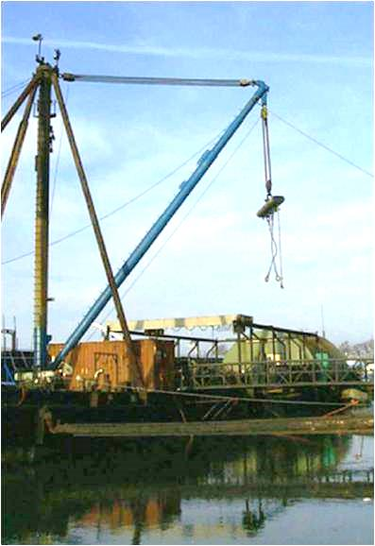
APPLICATIONS
Frames are commonly used to support various external loads.
How is a frame different than a truss?
To be able to design a frame, you need to determine the forces at the joints and supports.

Slide 4
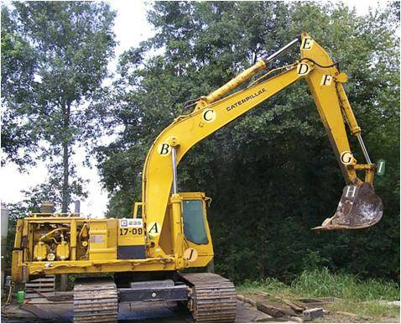
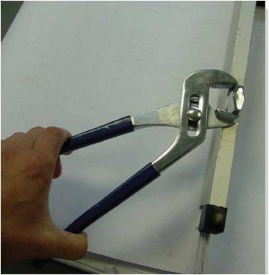
APPLICATIONS (continued)
“Machines,” like those above, are used in a variety of applications. How are they different from trusses and frames?
How can you determine the loads at the joints and supports? These forces and moments are required when designing the machine’s members.

Slide 5
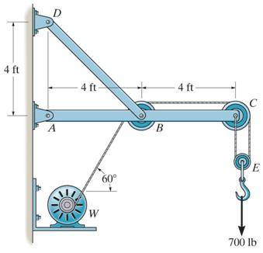
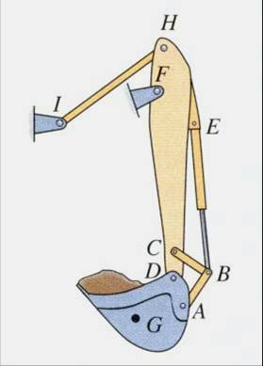
FRAMES AND MACHINES: DEFINITIONS
Frame
Machine
Frames and machines are two common types of structures that have at least one multi-force member. (Recall that trusses have nothing but two-force members).
Frames are generally stationary and support external loads.
Machines contain moving parts and are designed to alter the effect of forces.

Slide 6
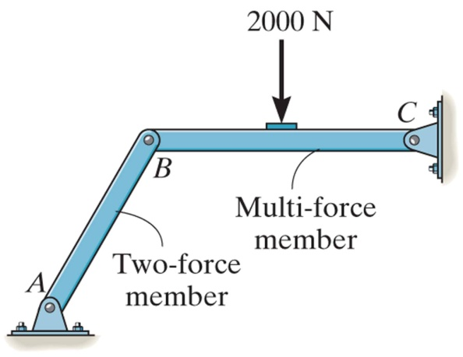
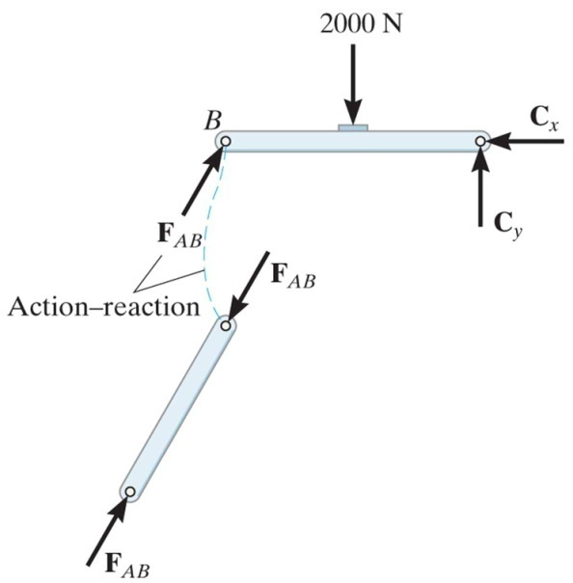
STEPS FOR ANALYZING A FRAME OR MACHINE
1. Draw a FBD of the frame or machine and its members, as necessary.
Hints: a) Identify any two-force members,
b) Note that forces on contacting surfaces (usually between a pin and a member) are equal and opposite, and,
c) For a joint with more than two members or an external force, it is advisable to draw a FBD of the pin.
F_{AB}

Slide 7
STEPS FOR ANALYZING A FRAME OR MACHINE
2. Develop a strategy to apply the equations of equilibrium to solve for the unknowns. Look for ways to form single equations and single unknowns.
Problems are going to be challenging since there are usually several unknowns. A lot of practice is needed to develop good strategies and ease of solving these problems.
F_{AB}

Slide 8
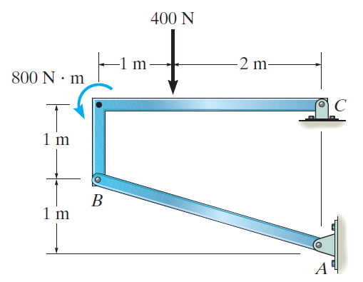
EXAMPLE
Given: The frame supports an external load and moment as shown.
Find: The horizontal and vertical components of the pin reactions at C and the magnitude of reaction at B.
Plan:
a) Draw a FBD of frame member BC. Why pick this part of the frame?
b) Apply the equations of equilibrium and solve for the unknowns at C and B.
Notes:
Source : F6-16

Slide 9
EXAMPLE (continued)
FBD of member BC
800 N m
400 N
C_{X}
1 m
C_{Y}
1 m
2 m
B
1
F_{AB}
3
Note that member AB is a two-force member.
Equations of Equilibrium:
Start with ∑ M_{C} since it yields one unknown.
+ ∑ M_{C} = – F_{AB} (3/$\sqrt{10})$ (1) – F_{AB} (1/$\sqrt{10})$ (3) + 800 + 400 (2) = 0
F_{AB} = 843.3 = 843 N

Slide 10
EXAMPLE (continued)
FBD of member BC
800 N m
400 N
C_{X}
1 m
C_{Y}
1 m
2 m
B
1
F_{AB}
3
Now use the x and y-direction Equations of Equilibrium:
+ ∑ F_{X} = – C_{X} – 843.3 (3/$\sqrt{10})$ = 0
C_{X} = – 800 N = 800 N →
↑ + ∑ F_{Y} = – C_{Y} + 843.3 (1/$\sqrt{10})$ – 400 = 0
C_{Y} = – 133 N = 133 N ↑

Slide 11
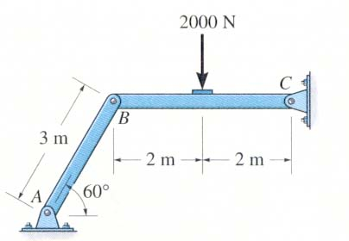
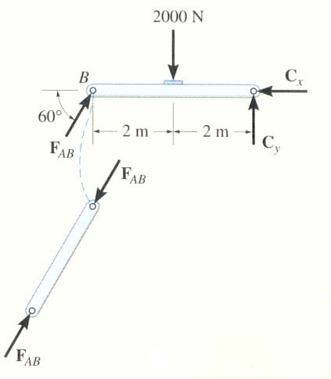
CONCEPT QUIZ
1. The figures show a frame and its FBDs. If an additional couple moment is applied at C, how will you change the FBD of member BC at B?
A) No change, still just one force (F_{AB}) at B. B) Will have two forces, B_{X} and B_{Y}, at B. C) Will have two forces and a moment at B. D) Will add one moment at B.
Notes:
Answer:
1. A

Slide 12
CONCEPT QUIZ (continued)
• D
2. The figures show a frame and its FBDs. If an additional force is applied at D, then how will you change the FBD of member BC at B?
A) No change, still just one force (F_{AB}) at B. B) Will have two forces, B_{X} and B_{Y}, at B. C) Will have two forces and a moment at B. D) Will add one moment at B.
Notes:
Answer:
2. B

Slide 13
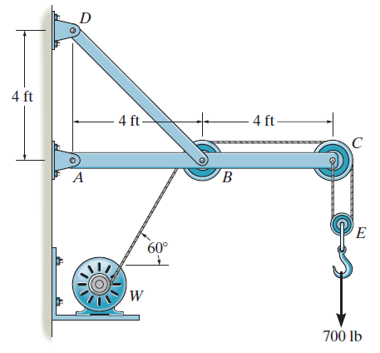
GROUP PROBLEM SOLVING
Given: The wall crane supports an external load of 700 lb.
Find: The force in the cable at winch motor W and the horizontal and vertical components of pin reactions at A, B, C, and D.
Plan:
a) Draw FBDs of the frame’s members and pulleys.
b) Apply the equations of equilibrium and solve for the unknowns.
Notes:
Source : P6-74

Slide 14
GROUP PROBLEM SOLVING (continued)
FBD of the Pulley E
T
T
E
700 lb
Necessary Equations of Equilibrium:
↑+ ∑ F_{Y} = 2 T – 700 = 0
T = 350 lb

Slide 15
GROUP PROBLEM SOLVING (continued)
350 lb
C_{Y}
+ ∑ F_{X} = C_{X} – 350 = 0 C_{X} = 350 lb
+ ↑ ∑ F_{Y} = C_{Y} – 350 = 0 C_{Y} = 350 lb
C
C_{X}
350 lb
FBD of pulley C
350 lb
+ ∑ F_{X} = – B_{X} + 350 – 350 sin 30° = 0 B_{X} = 175 lb
↑ + ∑ F_{Y} = B_{Y} – 350 cos 30° = 0 B_{Y} = 303.1 lb
B_{Y}
B
30°
B_{X}
350 lb
FBD of pulley B

Slide 16
GROUP PROBLEM SOLVING (continued)
Please note that member BD is a two-force member.
T_{BD}
A_{X}
A
45°
175 lb
350 lb
B
700 lb
A_{Y}
303.11 lb
4 ft
4 ft
FBD of member ABC
+ ∑ M_{A} = T_{BD} sin 45° (4) – 303.1 (4) – 700 (8) = 0
T_{BD} = 2409 lb
+ ∑ F_{X} = A_{X} – 2409 cos 45° + 175 – 350 = 0
A_{X} = 1880 lb
+ ∑ F_{Y} = A_{Y} + 2409 sin 45° – 303.1 – 700 = 0
A_{Y} = – 700 lb

Slide 17
GROUP PROBLEM SOLVING (continued)
FBD of member BD
D_{Y}
D_{X}
D
45°
B
2409 lb
At D, the X and Y component are
+ D_{X} = –2409 cos 45° = –1700 lb
↑ + D_{Y} = 2409 sin 45° = 1700 lb

Slide 18
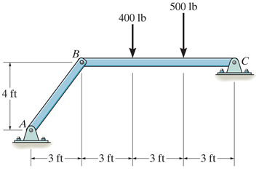
ATTENTION QUIZ
1. When determining reactions at joints A, B and C, what is the minimum number of unknowns in solving this problem?
A) 6 B) 5
C) 4 D) 3
2. For the above problem, imagine that you have drawn a FBD of member BC. What will be the easiest way to write an equation involving unknowns at B?
A) ∑ M_{C} = 0 B) ∑ M_{B} = 0
C) ∑ M_{A} = 0 D) ∑ F_{Y} = 0
Notes:
Answers:
1. D
2. A

Slide 19
End of the Lecture
Let Learning Continue

