Slide 1
SIMPLE TRUSSES, THE METHOD OF JOINTS, & ZERO-FORCE MEMBERS
Today’s Objectives:
Students will be able to:
a) Define a simple truss.
b) Determine forces in members of a simple truss.
c) Identify zero-force members.
In-Class Activities:
Check Homework, if any
Reading Quiz
Applications
Simple Trusses
Method of Joints
Zero-force Members
Concept Quiz
Group Problem Solving
Attention Quiz

Slide 2
READING QUIZ
1. One of the assumptions used when analyzing a simple truss is that the members are joined together by __________.
A) Welding B) Bolting C) Riveting
D) Smooth pins E) Super glue
2. When using the method of joints, typically _________ equations of equilibrium are applied at every joint.
A) Two B) Three
C) Four D) Six
Notes:
Answers:
1.D
2.A

Slide 3
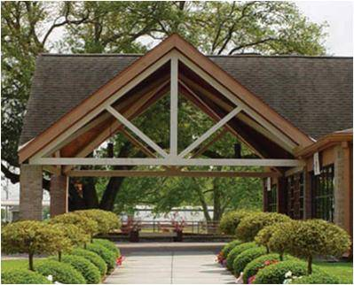
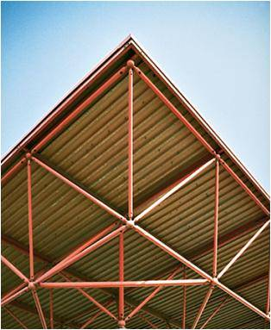
APPLICATIONS
Trusses are commonly used to support roofs.
For a given truss geometry and load, how can you determine the forces in the truss members to be able to select their sizes?
A more challenging question is, that for a given load, how can we design the trusses’ geometry to minimize cost?

Slide 4
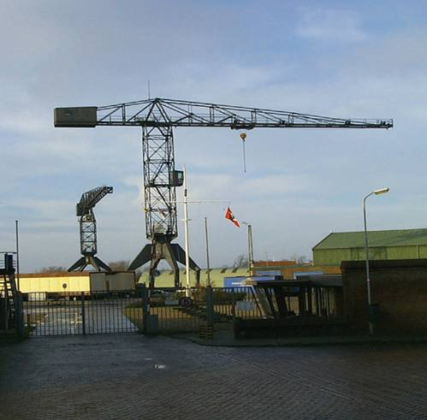
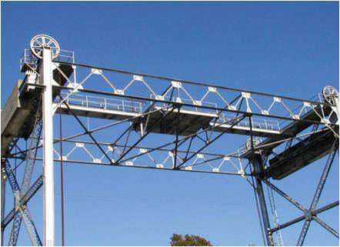
APPLICATIONS (continued)
Trusses are also used in a variety of structures like cranes, the frames of aircraft or the space station.
How can you design a light weight structure satisfying load, safety, cost specifications, that is simple to manufacture and allows easy inspection over its lifetime?

Slide 5
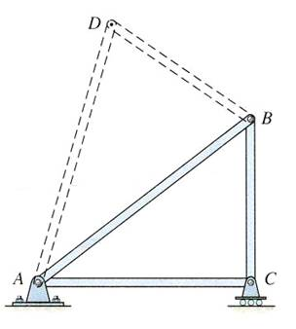
SIMPLE TRUSSES (Section 6.1)
A truss is a structure composed of slender members joined together at their end points.
If a truss, along with the imposed load, lies in a single plane (as shown at the top right), then it is called a planar truss.
A simple truss is a planar truss which begins with a triangular element and can be expanded by adding two members and a joint. For these trusses, the number of members (M) and the number of joints (J) are related by the equation M = 2 J – 3.

Slide 6
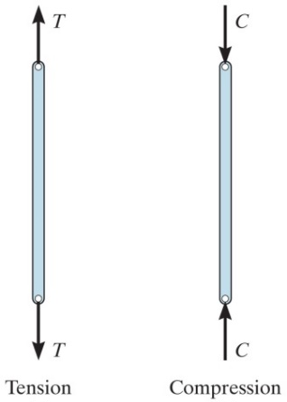
ANALYSIS & DESIGN ASSUMPTIONS
When designing the members and joints of a truss, first it is necessary to determine the forces in each truss member. This is called the force analysis of a truss. When doing this, two assumptions are made:
1. All loads are applied at the joints. The weight of the truss members is often neglected as the weight is usually small as compared to the forces supported by the members.
2. The members are joined together by smooth pins. This assumption is satisfied in most practical cases where the joints are formed by bolting the ends together.
With these two assumptions, the members act as two-force members. They are loaded in either tension or compression. Often compressive members are made thicker to prevent buckling.

Slide 7
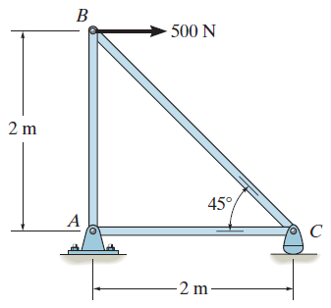
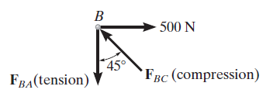
THE METHOD OF JOINTS (Section 6.2)
A free-body diagram of Joint B
When using the method of joints to solve for the forces in truss members, the equilibrium of a joint (pin) is considered. All forces acting at the joint are shown in a FBD. This includes all external forces (including support reactions) as well as the forces acting in the members. Equations of equilibrium (∑ F_{X}= 0 and ∑ F_{Y} = 0) are used to solve for the unknown forces acting at the joints.

Slide 8
STEPS FOR ANALYSIS
If the truss’s support reactions are not given, draw a FBD of the entire truss and determine the support reactions (typically using scalar equations of equilibrium).
2. Draw the free-body diagram of a joint with one or two unknowns. Assume that all unknown member forces act in tension (pulling on the pin) unless you can determine by inspection that the forces are compression loads.
3. Apply the scalar equations of equilibrium, ∑ F_{X} = 0 and ∑ F_{Y} = 0, to determine the unknown(s). If the answer is positive, then the assumed direction (tension) is correct, otherwise it is in the opposite direction (compression).
4. Repeat steps 2 and 3 at each joint in succession until all the required forces are determined.

Slide 9
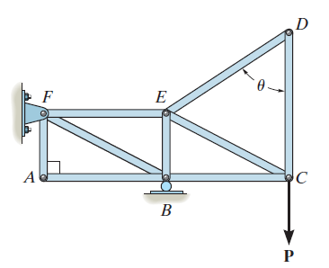
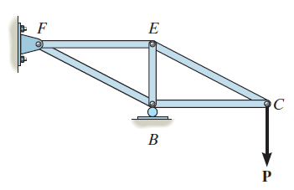
ZERO-FORCE MEMBERS (Section 6.3)
If a joint has only two non-collinear members and there is no external load or support reaction at that joint, then those two members are zero-force members. In this example members DE, DC, AF, and AB are zero force members.
You can easily prove these results by applying the equations of equilibrium to joints D and A.
Zero-force members can be removed (as shown in the figure) when analyzing the truss.

Slide 10
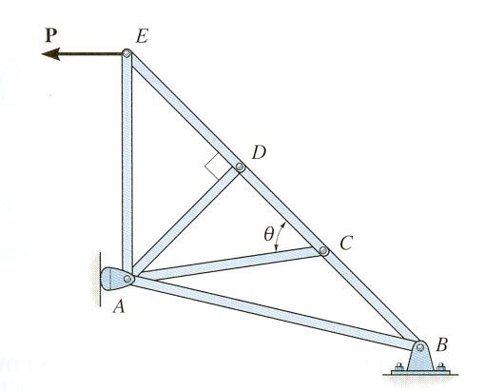
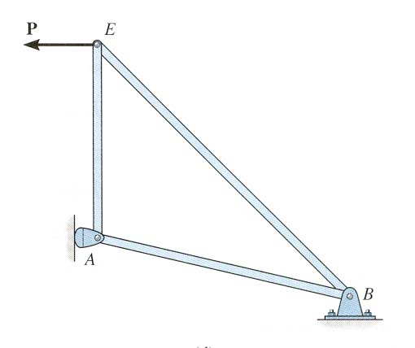
ZERO – FORCE MEMBERS (continued)
If three members form a truss joint for which two of the members are collinear and there is no external load or reaction at that joint, then the third non-collinear member is a zero force member, e.g., DA.
Again, this can easily be proven. One can also remove the zero-force member, as shown, on the left, for analyzing the truss further.
Please note that zero-force members are used to increase stability and rigidity of the truss, and to provide support for various different loading conditions.

Slide 11
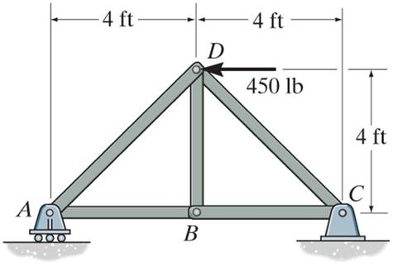
EXAMPLE
Given: Loads as shown on the truss
Find: The forces in each member of the truss.
Plan:
Check if there are any zero-force members.
First analyze pin D and then pin A
Note that member BD is zero-force member. F_{BD} = 0
Why, for this problem, do you not have to find the external reactions before solving the problem?
Notes:
Source : F6-1

Slide 12
EXAMPLE (continued)
D
450 lb
45 º
45 º
F_{AD}
F_{CD}
FBD of pin D
+ → ∑ F_{X} = – 450 + F_{CD} cos 45° – F_{AD} cos 45° = 0
+ ↑ ∑ F_{Y} = – F_{CD} sin 45° – F_{AD} sin 45° = 0
F_{CD} = 318 lb (Tension) or (T)
and F_{AD} = – 318 lb (Compression) or (C)

Slide 13
EXAMPLE (continued)
Analyzing pin A:
F_{AD}
Recall F_{AD} = – 318 lb
A
45 º
F_{AB}
A_{Y}
FBD of pin A
+ → ∑ F_{X} = F_{AB} + (– 318) cos 45° = 0; F_{AB} = 225 lb (T)
Could you have analyzed Joint C instead of A?

Slide 14
CONCEPT QUIZ
1. Truss ABC is changed by decreasing its height from H to 0.9 H. Width W and load P are kept the same. Which one of the following statements is true for the revised truss as compared to the original truss?
A) Force in all its members have decreased.
B) Force in all its members have increased.
C) Force in all its members have remained the same.
D) None of the above.
P
A
H
B
C
W
Notes:
Answers:
1. B

Slide 15
CONCEPT QUIZ (continued)
F
F
F
2. For this truss, determine the number of zero-force members.
A) 0 B) 1 C) 2
D) 3 E) 4
Notes:
Answer:
2. D

Slide 16
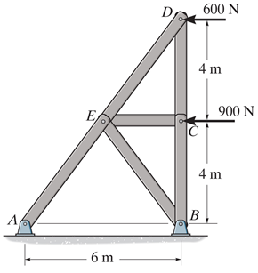
GROUP PROBLEM SOLVING
Given: Loads as shown on the truss
Find: Determine the force in all the truss members (do not forget to mention whether they are in T or C).
Plan:
a) Check if there are any zero-force members. Is Member CE zero-force member?
Draw FBDs of pins D, C, and E, and then apply E-of-E at those pins to solve for the unknowns.
Notes:
Source : P6-8

Slide 17
GROUP PROBLEM SOLVING (continued)
FBD of pin D
Y
D
600N
X
5
4
F_{DE}
3
F_{CD}
Analyzing pin D: → + ∑ F_{X} = F_{DE} (3/5) – 600 = 0
F_{DE} = 1000 N = 1.00 kN (C)
↑+ ∑ F_{Y} = 1000 (4/5) – F_{CD} = 0
F_{CD} = 800 N = 0.8 kN (T)

Slide 18
GROUP PROBLEM SOLVING (continued)
FBD of pin C
Y
F_{CD} = 800 N
F_{CE}
C
900 N
X
F_{BC}
Analyzing pin C:
→ + ∑ F_{X} = F_{CE} – 900 = 0
F_{CE} = 900 N = 0.90 kN (C)
↑+ ∑ F_{Y} = 800 – F_{BC} = 0
F_{BC} = 800 N = 0.80 kN (T)

Slide 19
GROUP PROBLEM SOLVING (continued)
FBD of pin E
Y
F_{DE} = 1000 N
3
4
5
E
F_{CE} = 900 N
3
X
4
5
4
5
F_{AE}
3
F_{BE}
Analyzing pin E:
→ + ∑ F_{X} = F_{AE} (3/5) + F_{BE} (3/5) – 1000 (3/5) – 900 = 0
↑ + ∑ F_{Y} = F_{AE} (4/5) – F_{BE} (4/5) – 1000 (4/5) = 0
Solving these two equations, we get F_{AE} = 1750 N = 1.75 kN (C)
F_{BE} = 750 N = 0.75 kN (T)

Slide 20
ATTENTION QUIZ
1. Using this FBD, you find that F_{BC} = – 500 N. Member BC must be in __________.
Tension
Compression
C) Cannot be determined
F_{BC}
B
F_{BD}
B_{Y}
2. When supporting the same magnitude of force, truss members in compression are generally made _______ as compared to members in tension.
A) Thicker
B) Thinner
C) The same size
Notes:
Answers:
1. B
2. A

Slide 21
End of the Lecture
Let Learning Continue

