Slide 1
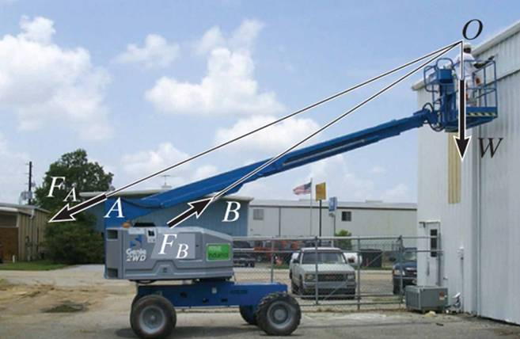
EQUATIONS OF EQUILIBRIUM & TWO- AND THREE-FORCE MEMEBERS
Today’s Objectives:
Students will be able to:
a) Apply equations of equilibrium to solve for unknowns, and,
b) Recognize two-force members.
In-Class Activities:
Check Homework, if any
Reading Quiz
Applications
Equations of Equilibrium
Two-Force Members
Concept Quiz
Group Problem Solving
Attention Quiz

Slide 2
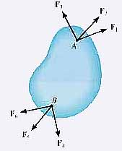
READING QUIZ
1. The three scalar equations, ∑ F_{X} = ∑ F_{Y} = ∑ M_{O} = 0, are ____ equations of equilibrium in two dimensions.
A) Incorrect B) The only correct
C) The most commonly used D) Not sufficient
2. A rigid body is subjected to forces as shown. This body can be considered as a ______ member.
A) Single-force B) Two-force
C) Three-force D) Six-force
Notes:
Answers:
1. C
2. B

Slide 3
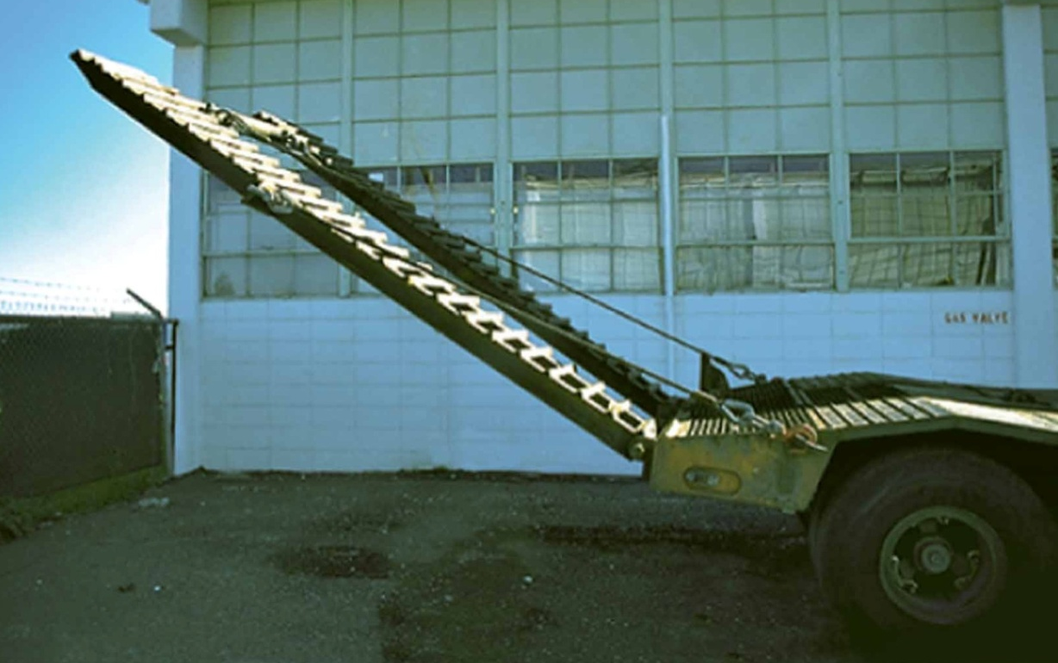
APPLICATIONS
A
The uniform truck ramp has a weight of 400 lb.
The ramp is pinned at A and held in the position by the cables.
How can we determine the forces acting at the pin A and the force in the cables?

Slide 4
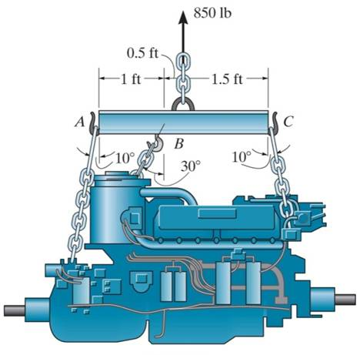
APPLICATIONS (continued)
An 850 lb engine is supported by three chains, which are attached to the spreader bar of a hoist.
You need to check to see if the breaking strength of any of the chains is going to be exceeded. How can you determine the force acting in each of the chains?

Slide 5
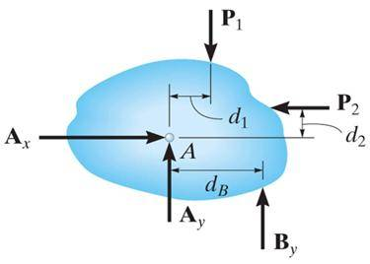
EQUATIONS OF EQUILIBRIUM (Section 5.3)
A body is subjected to a system of forces that lie in the x-y plane. When in equilibrium, the net force and net moment acting on the body are zero (as discussed earlier in Section 5.1). This 2-D condition can be represented by the three scalar equations:
∑ F_{x} = 0 ∑ F_{y} = 0 ∑ M_{O} = 0
where point O is any arbitrary point.
Please note that these equations are the ones most commonly used for solving 2-D equilibrium problems. There are two other sets of equilibrium equations that are rarely used. For your reference, they are described in the textbook.

Slide 6
TWO-FORCE MEMBERS & THREE FORCE-MEMBERS (Section 5.4)
The solution to some equilibrium problems can be simplified if we recognize members that are subjected to forces at only two points (e.g., at points A and B in the figure below).
If we apply the equations of equilibrium to such a member, we can quickly determine that the resultant forces at A and B must be equal in magnitude and act in the opposite directions along the line joining points A and B.

Slide 7
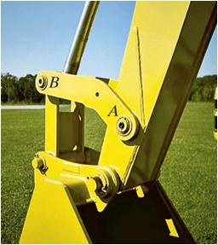
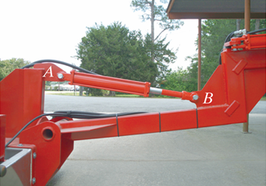
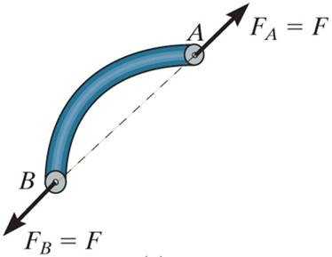
EXAMPLES OF TWO-FORCE MEMBERS
In the cases above, members AB can be considered as two-force members, provided that their weight is neglected.
This fact simplifies the equilibrium analysis of some rigid bodies since the directions of the resultant forces at A and B are thus known (along the line joining points A and B).

Slide 8
STEPS FOR SOLVING 2-D EQUILIBRIUM PROBLEMS
1. If not given, establish a suitable x - y coordinate system.
2. Draw a free-body diagram (FBD) of the object under analysis.
3. Apply the three equations of equilibrium (E-of-E) to solve for the unknowns.

Slide 9
IMPORTANT NOTES
1. If there are more unknowns than the number of independent equations, then we have a statically indeterminate situation. We cannot solve these problems using just statics.
2. The order in which we apply equations may affect the simplicity of the solution. For example, if we have two unknown vertical forces and one unknown horizontal force, then solving ∑ F_{X} = 0 first allows us to find the horizontal unknown quickly.
3. If the answer for an unknown comes out as negative number, then the sense (direction) of the unknown force is opposite to that assumed when starting the problem.

Slide 10
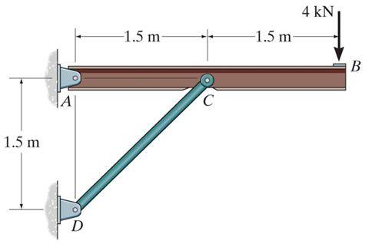
EXAMPLE
Given: The 4kN load at B of the beam is supported by pins at A and C.
Find: The support reactions at A and C.
Plan:
1. Put the x and y-axes in the horizontal and vertical directions, respectively.
2. Determine if there are any two-force members.
3. Draw a complete FBD of the boom.
4. Apply the E-of-E to solve for the unknowns.
Notes:
Source : F5-2

Slide 11
EXAMPLE (continued)
FBD of the beam:
A_{Y}
4 kN
1.5 m
1.5 m
A_{X}
A
45°
C
B
F_{CD}
Note: Upon recognizing CD as a two-force member, the number of unknowns at C is reduced from two to one. Now, using E-o-f E, we get,
+ ∑M_{A} = F_{CD} sin 45° × 1.5 – 4 × 3 = 0
F_{CD} = 11.31 kN or 11.3 kN
→ + ∑F_{X} = A_{X} + 11.31 cos 45° = 0; A_{X} = – 8.00 kN
↑ + ∑F_{Y} = A_{Y} + 11.31 sin 45° – 4 = 0; A_{Y} = – 4.00 kN
Note that the negative signs means that the reactions have the opposite directions to that assumed (as originally shown on FBD).

Slide 12
CONCEPT QUIZ
1. For this beam, how many support reactions are there and is the problem statically determinate?
A) (2, Yes) B) (2, No)
C) (3, Yes) D) (3, No)
F
F
F
F
2. The beam AB is loaded and supported as shown: a) how many support reactions are there on the beam, b) is this problem statically determinate, and c) is the structure stable?
A) (4, Yes, No) B) (4, No, Yes)
C) (5, Yes, No) D) (5, No, Yes)
Fixed support
F
A
•
B
•
Notes:
Answers:
1. D
2. B

Slide 13
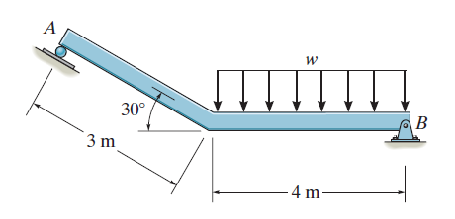
GROUP PROBLEM SOLVING
Given: The beam is supported by the roller at A and a pin at B.
Find: The reactions at points A and B on the beam.
3 kN/m
Plan:
a) Establish the x–y axis system.
b) Draw a complete FBD of the beam.
c) Apply the E-of-E to solve for the unknowns.
Notes:
Source : P5-22

Slide 14
GROUP PROBLEM SOLVING (continued)
FBD of the beam
3 kN/m
30°
12 kN
N_{A}
2 m
30°
B_{x}
3 m
4 m
B_{y}
Note that the distributed load has been reduced to a single force.
First, write a moment equation about point B. Why point B?
+ ∑ M_{B} = – (N_{A} cos 30°) × (4 + 3 cos 30°) – (N_{A} sin 30°) × (3 sin 30°) + 12 × 2 = 0
N_{A} = 3.713 = 3.71 kN

Slide 15
GROUP PROBLEM SOLVING (continued)
FBD of the beam
3 kN/m
30°
12 kN
N_{A}
2 m
30°
B_{x}
3 m
4 m
B_{y}
Recall N_{A} = 3.713 =3.71 kN
Now write the ∑ F_{X} = ∑ F_{Y} = 0 equations.
→ + ∑ F_{X} = 3.713 sin 30° – B_{x} = 0
↑ + ∑ F_{Y} = 3.713 cos 30°– 12 + B_{y} = 0
Solving these two equations, we get B_{x} = 1.86 kN ←
B_{y} = 8.78 kN ↑

Slide 16
ATTENTION QUIZ
1. Which equation of equilibrium allows you to determine F_{B} right away?
A) ∑ F_{X} = 0 B) ∑ F_{Y} = 0
C) ∑ M_{A} = 0 D) Any one of the above.
100 lb
A_{X}
A
B
A_{Y}
F_{B}
2. A beam is supported by a pin joint and a roller. How many support reactions are there and is the structure stable for all types of loadings?
A) (3, Yes) B) (3, No)
C) (4, Yes) D) (4, No)
Notes:
Answers:
1. C
2. B

Slide 17
End of the Lecture
Let Learning Continue

