Slide 1
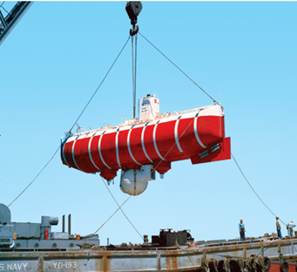
EQUILIBRIUM OF A RIGID BODY &
FREE-BODY DIAGRAMS
Today’s Objectives:
Students will be able to:
a) Identify support reactions, and,
b) Draw a free-body diagram.
In-Class Activities:
Check Homework
Reading Quiz
Applications
Support Reactions
Free-Body Diagrams
Concept Quiz
Group Problem Solving
Attention Quiz

Slide 2
READING QUIZ
1. If a support prevents translation of a body, then the support exerts a ___________ on the body.
A) Couple moment
B) Force
C) Both A and B.
D) None of the above
2. Internal forces are _________ shown on the free body diagram of a whole body.
A) Always
B) Often
C) Rarely
D) Never
Notes:
Answers:
1. B
2. D

Slide 3
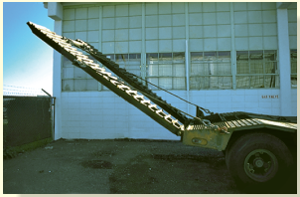
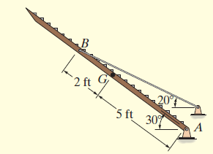
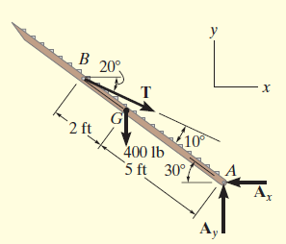
APPLICATIONS
The truck ramps have a weight of 400 lb each.
Each ramp is pinned to the body of the truck and held in the position by a cable. How can we determine the cable tension and support reactions?
How are the idealized model and the free body diagram used to do this?
Which diagram above is the idealized model?

Slide 4
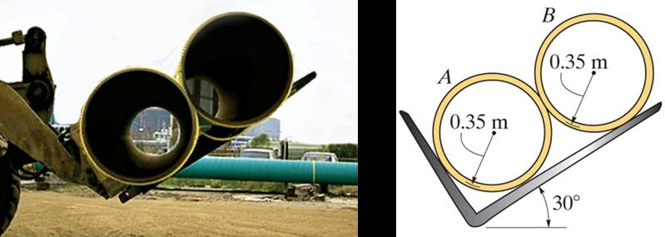
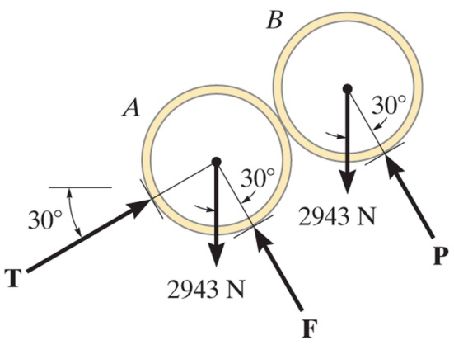
APPLICATIONS (continued)
Two smooth pipes, each having a mass of 300 kg, are supported by the tines of the loader’s fork attachment.
How can we determine all the reactive forces?
Again, how can we make use of an idealized model and a free body diagram to answer this question?

Slide 5
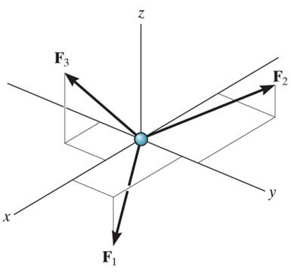
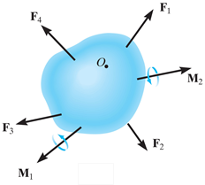
CONDITIONS FOR RIGID-BODY EQUILIBRIUM (Section 5.1)
In contrast to the forces on a particle, the forces on a rigid-body are not usually concurrent and may cause rotation of the body (due to moments created by the forces).
Forces on a particle
For a rigid body to be in equilibrium, the net force as well as the net moment about any arbitrary point O must be equal to zero.
∑ F = 0 (no translation)
and ∑ M_{O} = 0 (no rotation)
Forces on a rigid body

Slide 6
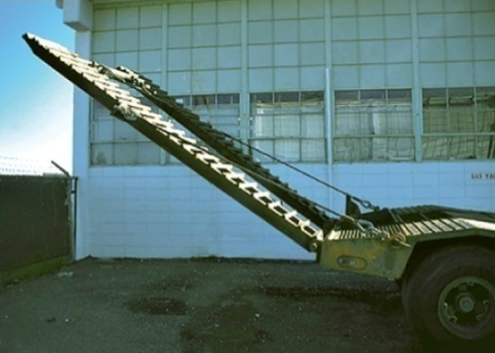
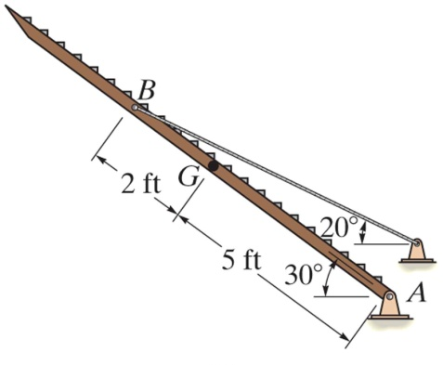
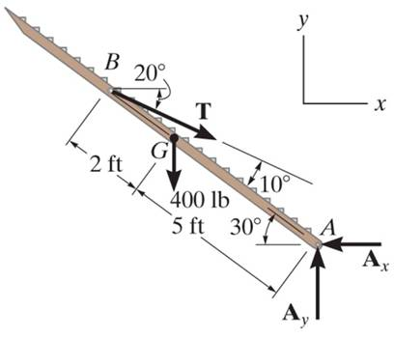
THE PROCESS OF SOLVING RIGID BODY EQUILIBRIUM PROBLEMS
For analyzing an actual physical system, first we need to create an idealized model (above right).
Then we need to draw a free-body diagram (FBD) showing all the external (active and reactive) forces.
Finally, we need to apply the equations of equilibrium to solve for any unknowns.

Slide 7
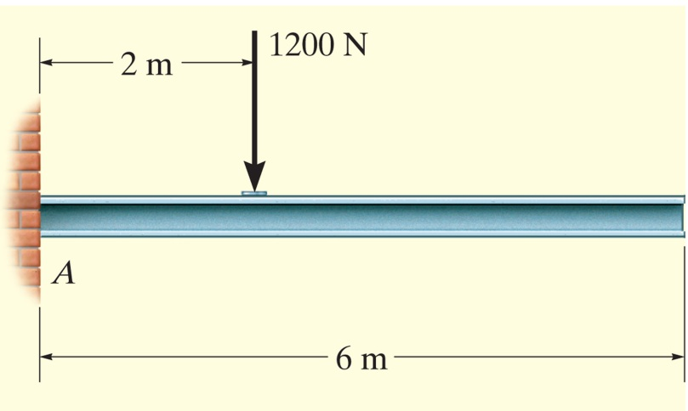
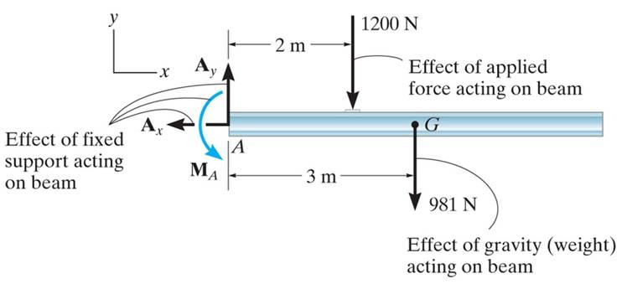
FREE-BODY DIAGRAMS (Section 5.2)
Idealized model
Free-body diagram (FBD)
  1. Draw an outlined shape. Imagine the body to be isolated or cut “free” from its constraints and draw its outlined shape.
  2. Show all the external forces and couple moments. These typically include: a) applied loads, b) support reactions, and, c) the weight of the body.

Slide 8
FREE-BODY DIAGRAMS (continued)
Idealized model
Free-body diagram
  3. Label loads and dimensions on the FBD: All known forces and couple moments should be labeled with their magnitudes and directions. For the unknown forces and couple moments, use letters like A_{x}, A_{y}, M_{A}. Indicate any necessary dimensions.

Slide 9
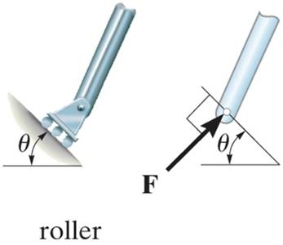
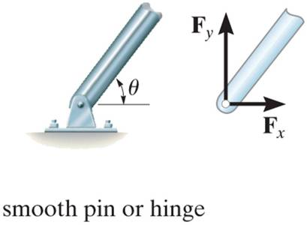
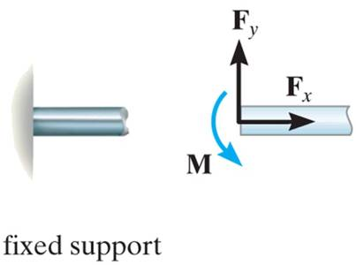
SUPPORT REACTIONS IN 2-D
A few example sets of diagrams s are shown above. Other support reactions are given in your textbook (Table 5-1).
As a general rule, if a support prevents translation of a body in a given direction, then a force is developed on the body in the opposite direction.
Similarly, if rotation is prevented, a couple moment is exerted on the body in the opposite direction.

Slide 10
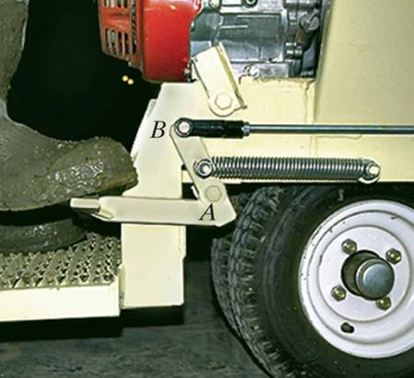
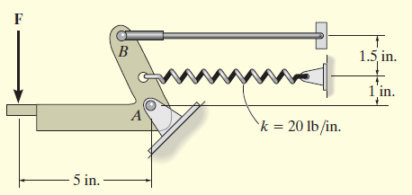
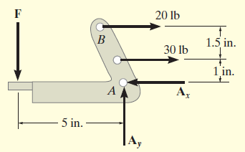
EXAMPLE I
Given: The operator applies a vertical force to the pedal so that the spring is stretched 1.5 in. and the force in the short link at B is
20 lb.
Draw: An idealized model and free-
body diagram of the foot pedal.
The idealized model
The free-body diagram
Notes:
Source : Example 5.2

Slide 11
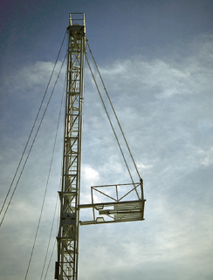
EXAMPLE II
Given: The unloaded platform is
suspended off the edge of the oil rig. The platform has a mass of 200 kg.
Draw: An idealized model and free-body diagram of the platform.
The idealized model of the platform is considered in two dimensions because the loading and the dimensions are all symmetrical about a vertical plane passing through its center.
Notes:
Source : Example 5.4

Slide 12
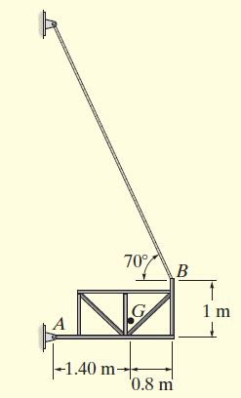
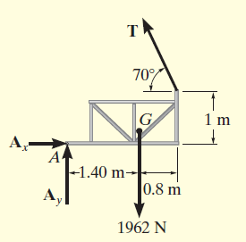
EXAMPLE II (continued)
The connection at A is treated as a pin, and the cable supports the platform at B. Note the assumed directions of the forces!
The point G is the center of gravity of the platform.
The idealized model
The free-body diagram

Slide 13
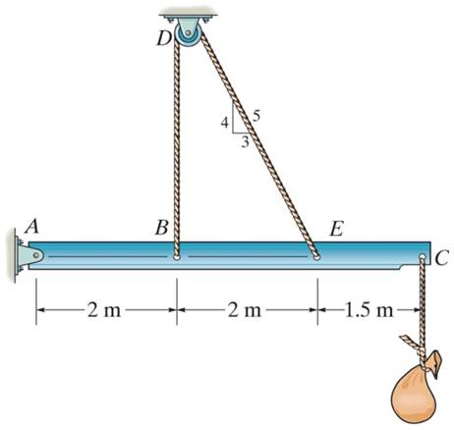
CONCEPT QUIZ
1. The beam and the cable (with a frictionless pulley at D) support an 80 kg load at C. In a FBD of only the beam, there are how many unknowns?
A) Two forces and one couple moment
B) Three forces and one couple moment
C) Three forces
D) Four forces
Notes:
Answers :
1. C

Slide 14
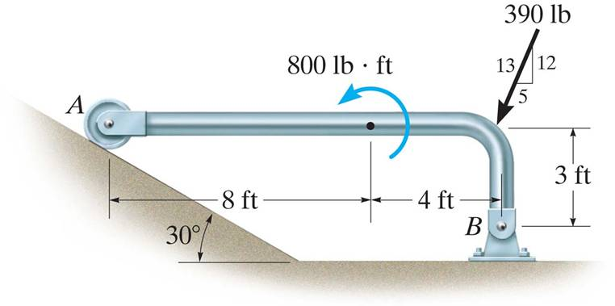
CONCEPT QUIZ (continued)
2. If the directions of the force and the couple moments are both reversed, what will happen to the beam?
A) The beam will lift from A.
B) The beam will lift at B.
C) The beam will be restrained.
D) The beam will break.
Notes:
Answer
2. A

Slide 15
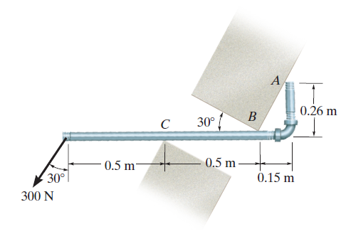
GROUP PROBLEM SOLVING I
Given:
Draw:
A FBD of the smooth pipe which rests against the opening at the points of contact A, B, and C.
Notes:
Source : P5-35

Slide 16
GROUP PROBLEM SOLVING I (continued)
N_{A}
The idealized model
30°
N_{B}
0.26m
300 N
30°
0.5m
0.5m
0.15m
N_{C}
The free body diagram

Slide 17
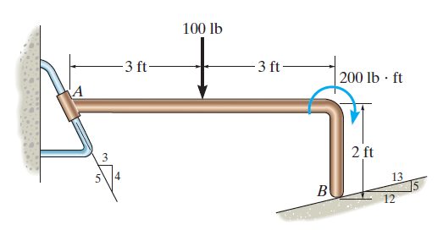
GROUP PROBLEM SOLVING II
Given:
Draw:
Draw a FBD of the bent rod supported by a smooth surface at B and by a collar at A, which is fixed to the rod and is free to slide over the fixed inclined rod.
Notes:
Source : P5-25

Slide 18
GROUP PROBLEM SOLVING II (continued)
The idealized model
R_{A}
3
4
5
The free body diagram
R_{B}
12

Slide 19
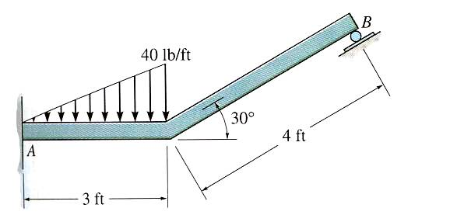
ATTENTION QUIZ
1. Internal forces are not shown on a free-body diagram because the internal forces are _____. (Choose the most appropriate answer.)
A) Equal to zero B) Equal and opposite and they do not affect the calculations
C) Negligibly small D) Not important
2. How many unknown support reactions are there in this problem?
A) Two forces and two couple moments
B) One force and two couple moments
C) Three forces
D) Three forces and one couple moment
Notes:
Answers:
1.B
2.D

Slide 20
End of the Lecture
Let Learning Continue

