Slide 1
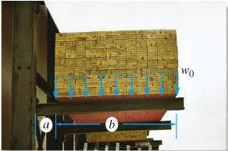
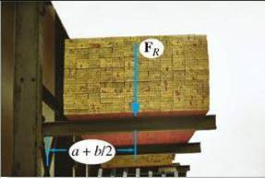
REDUCTION OF A SIMPLE DISTRIBUTED LOADING
Today’s Objectives:
Students will be able to determine an equivalent force for a distributed load.
In-Class Activities:
Check Homework
Reading Quiz
Applications
Equivalent Force
Concept Quiz
Group Problem Solving
Attention Quiz
=

Slide 2
READING QUIZ
1. The resultant force (F_{R}) due to a distributed load is equivalent to the _____ under the distributed loading curve, w = w(x).
A) Centroid B) Arc length
C) Area D) Volume
y
Distributed load curve
w
x
F
R
2. The line of action of the distributed load’s equivalent force passes through the ______ of the distributed load.
A) Centroid B) Mid-point
C) Left edge D) Right edge
Notes:
Answers:
1. C
2. A

Slide 3
APPLICATIONS
There is a bundle (called a bunk) of 2” x 4” boards stored on a storage rack. This lumber places a distributed load (due to the weight of the wood) on the beams holding the bunk.
To analyze the load’s effect on the steel beams, it is often helpful to reduce this distributed load to a single force. How would you do this?

Slide 4
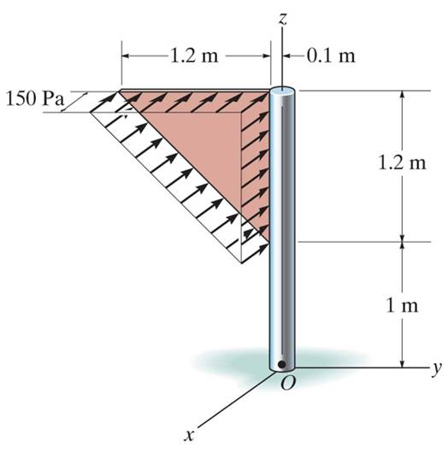
APPLICATIONS (continued)
The uniform wind pressure is acting on a triangular sign (shown in light brown).
To be able to design the joint between the sign and the sign post, we need to determine a single equivalent resultant force and its location.

Slide 5
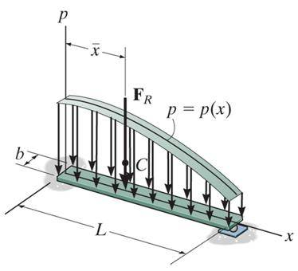
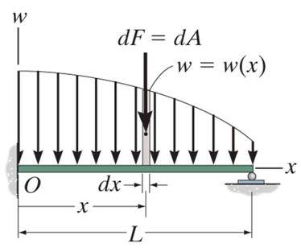
DISTRIBUTED LOADING
In many situations, a surface area of a body is subjected to a distributed load. Such forces are caused by winds, fluids, or the weight of items on the body’s surface.
We will analyze the most common case of a distributed pressure loading. This is a uniform load along one axis of a flat rectangular body.
In such cases, w is a function of x and has units of force per length.

Slide 6
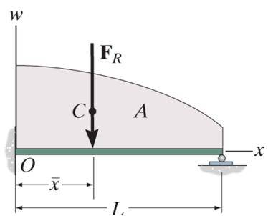
MAGNITUDE OF RESULTANT FORCE
Consider an element of length dx.
The force magnitude dF acting on it is given as
dF = w(x) dx
The net force on the beam is given by
+ ↓ F_{R} = ∫_{L} dF = ∫_{L} w(x) dx = A
Here A is the area under the loading curve w(x).

Slide 7
LOCATION OF THE RESULTANT FORCE
The force dF will produce a moment of (x)(dF) about point O.
The total moment about point O is given as
+ M_{RO} = ∫_{L} x dF = ∫_{L} x w(x) dx
$$\overline{x}$$
Assuming that F_{R} acts at , it will produce the moment about point O as
+ M_{RO} = ( ) (F_{R}) = ∫_{L} w(x) dx
$$\overline{x}$$
$$\overline{x}$$

Slide 8
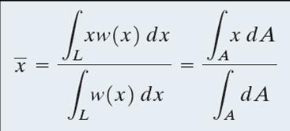
LOCATION OF THE RESULTANT FORCE (continued)
Comparing the last two equations, we get
You will learn more detail later, but F_{R} acts through a point “C,” which is called the geometric center or centroid of the area under the loading curve w(x).

Slide 9
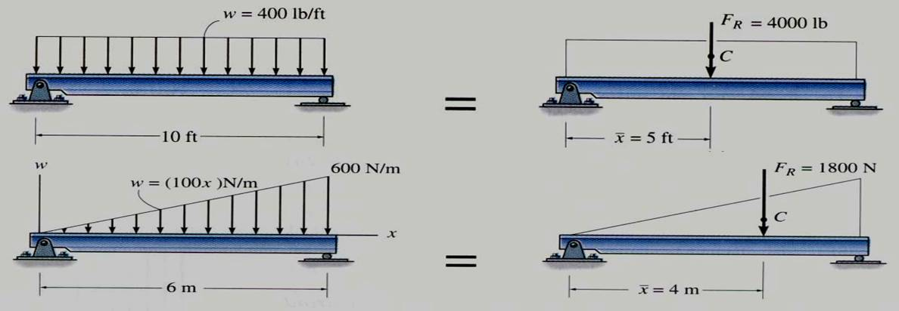
EXAMPLE I
Until you learn more about centroids, we will consider only rectangular and triangular loading diagrams whose centroids are well defined and shown on the inside back cover of your textbook.
Look at the inside back cover of your textbook. You should find the rectangle and triangle cases. Finding the area of a rectangle and its centroid is easy!
Note that triangle presents a bit of a challenge but still is pretty straightforward.

Slide 10
EXAMPLE I (continued)
Now let’s complete the calculations to find the concentrated loads (which is a common name for the resultant of the distributed load).
$$\overline{x}$$
The rectangular load: F_{R} = 400 × 10 = 4,000 lb and = 5 ft.
The triangular loading:
F_{R} = (0.5) (600) (6) = 1,800 N and = 6 – (1/3) 6 = 4 m.
Please note that the centroid of a right triangle is at a distance one third the width of the triangle as measured from its base.
$$\overline{x}$$

Slide 11
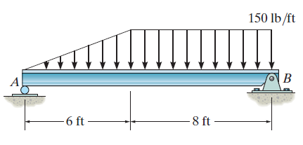
EXAMPLE II
Given: The loading on the beam as shown.
Find: The equivalent force and its location from point A.
Plan:
The distributed loading can be divided into two parts. (one rectangular loading and one triangular loading).
2) Find F_{R} and its location for each of the distributed loads.
3) Determine the overall F_{R} of the point loadings and its location.
Notes:
Source : F4-38

Slide 12
EXAMPLE II (continued)
10 ft
F_{R2}
F_{R1}
4 ft
For the triangular loading of height 150 lb/ft and width 6 ft,
F_{R1} = (0.5) (150) (6) = 450 lb
and its line of action is at ${\overline{x}}_{1}$= (2/3)(6) = 4 ft from A
For the rectangular loading of height 150 lb/ft and width 8 ft,
F_{R2} = (150) (8) = 1200 lb
and its line of action is at ${\overline{x}}_{2}$= 6 + (1/2)(8) = 10 ft from A

Slide 13
EXAMPLE II (continued)
10 ft
F_{R2}
F_{R}
F_{R1}
8.36 ft
4 ft
The equivalent force and couple moment at A will be
F_{R} = 450 + 1200 = 1650 lb
+ M_{RA}= 4 (450) +10(1200) = 13800 lb⋅ft
Since (F_{R} $\overline{x}$) has to equal M_{RA} : 1650 $\overline{x}$ =13800
Solve for $\overline{x}$ to find the equivalent force’s location. $\overline{x}$ = 8.36 ft from A.

Slide 14
CONCEPT QUIZ
1. What is the location of F_{R}, i.e., the distance d?
A) 2 m B) 3 m C) 4 m
D) 5 m E) 6 m
F
R
A
B
A
B
d
3 m
3 m
2. If F₁ = 1 N, x₁ = 1 m, F₂ = 2 N and x₂ = 2 m, what is the location of F_{R}, i.e., the distance x.
A) 1 m B) 1.33 m C) 1.5 m
D) 1.67 m E) 2 m
x
F
F
2
1
F
x
R
2
x
1
Notes:
Answers:
1. D
2. D

Slide 15
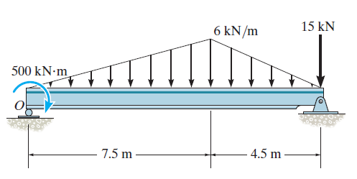
GROUP PROBLEM SOLVING
Given: The distributed loading on the beam as shown.
Find: The equivalent force and couple moment acting at point O.
Plan:
The distributed loading can be divided into two parts--two triangular loads.
2) Find F_{R} and its location for each of these distributed loads.
3) Determine the overall F_{R} of the point loadings and couple moment at point O.
Notes:
Source : P4-151

Slide 16
GROUP PROBLEM SOLVING (continued)
9 m
F_{R1}
5 m
F_{R2}
For the left triangular loading of height 6 kN/m and width 7.5 m,
F_{R1} = (0.5) (6) (7.5) = 22.5 kN
and its line of action is at ${\overline{x}}_{1}$= (2/3)(7.5) = 5 m from O
For the right triangular loading of height 6 kN/m and width 4.5 m,
F_{R2} = (0.5) (6) (4.5) = 13.5 kN
and its line of action is at ${\overline{x}}_{2}$= 7.5 + (1/3)(4.5) = 9 m from O

Slide 17
GROUP PROBLEM SOLVING (continued)
F_{R1}
9 m
5 m
F_{R2}
For the combined loading of the three forces, add them.
F_{R} = 22.5 + 13.5 + 15 = 51 kN
The couple moment at point O will be
+ M_{RO}= 500 + 5 (22.5) +9 (13.5) + 12 (15) = 914 kN⋅m

Slide 18
ATTENTION QUIZ
100 N/m
F
R
12 m
x
1. F_{R} = ____________
A) 12 N B) 100 N
C) 600 N D) 1200 N
2. x = __________.
A) 3 m B) 4 m
C) 6 m D) 8 m
Notes:
Answers:
1. C
2. B

Slide 19
End of the Lecture
Let Learning Continue

