Slide 1
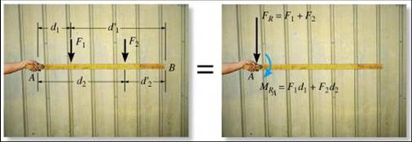
SIMPLIFICATION OF FORCE AND COUPLE SYSTEMS
& THEIR FURTHER SIMPLIFICATION
Today’s Objectives:
Students will be able to:
Determine the effect of moving a force.
b) Find an equivalent force-couple system for a system of forces and couples.
In-Class Activities:
Check Homework
Reading Quiz
Applications
Equivalent Systems
System Reduction
Concept Quiz
Group Problem Solving
Attention Quiz

Slide 2
READING QUIZ
1. A general system of forces and couple moments acting on a rigid body can be reduced to a ___ .
A) single force
B) single moment
C) single force and two moments
D) single force and a single moment
2. The original force and couple system and an equivalent force-couple system have the same _____ effect on a body.
A) internal B) external
C) internal and external D) microscopic
Notes:
Answers:
1. D
2. B

Slide 3
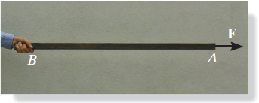
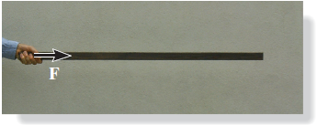
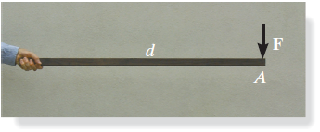
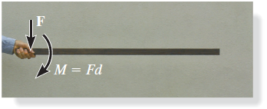
APPLICATIONS
What are the resultant effects on the person’s hand when the force is applied in these four different ways?
Why is understanding these differences important when designing various load-bearing structures?

Slide 4
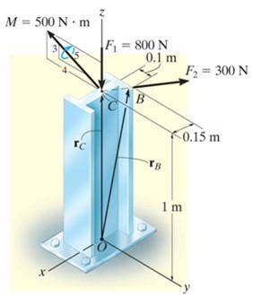
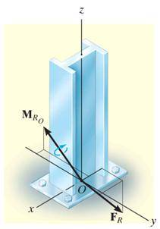
APPLICATIONS (continued)
Several forces and a couple moment are acting on this vertical section of an I-beam.
| |
??
For the process of designing the I-beam, it would be very helpful if you could replace the various forces and moment just one force and one couple moment at point O with the same external effect? How will you do that?

Slide 5
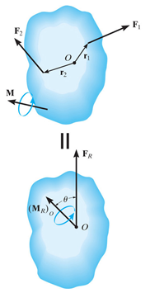
SIMPLIFICATION OF FORCE AND COUPLE SYSTEM (Section 4.7)
When a number of forces and couple moments are acting on a body, it is easier to understand their overall effect on the body if they are combined into a single force and couple moment having the same external effect.
The two force and couple systems are called equivalent systems since they have the same external effect on the body.

Slide 6
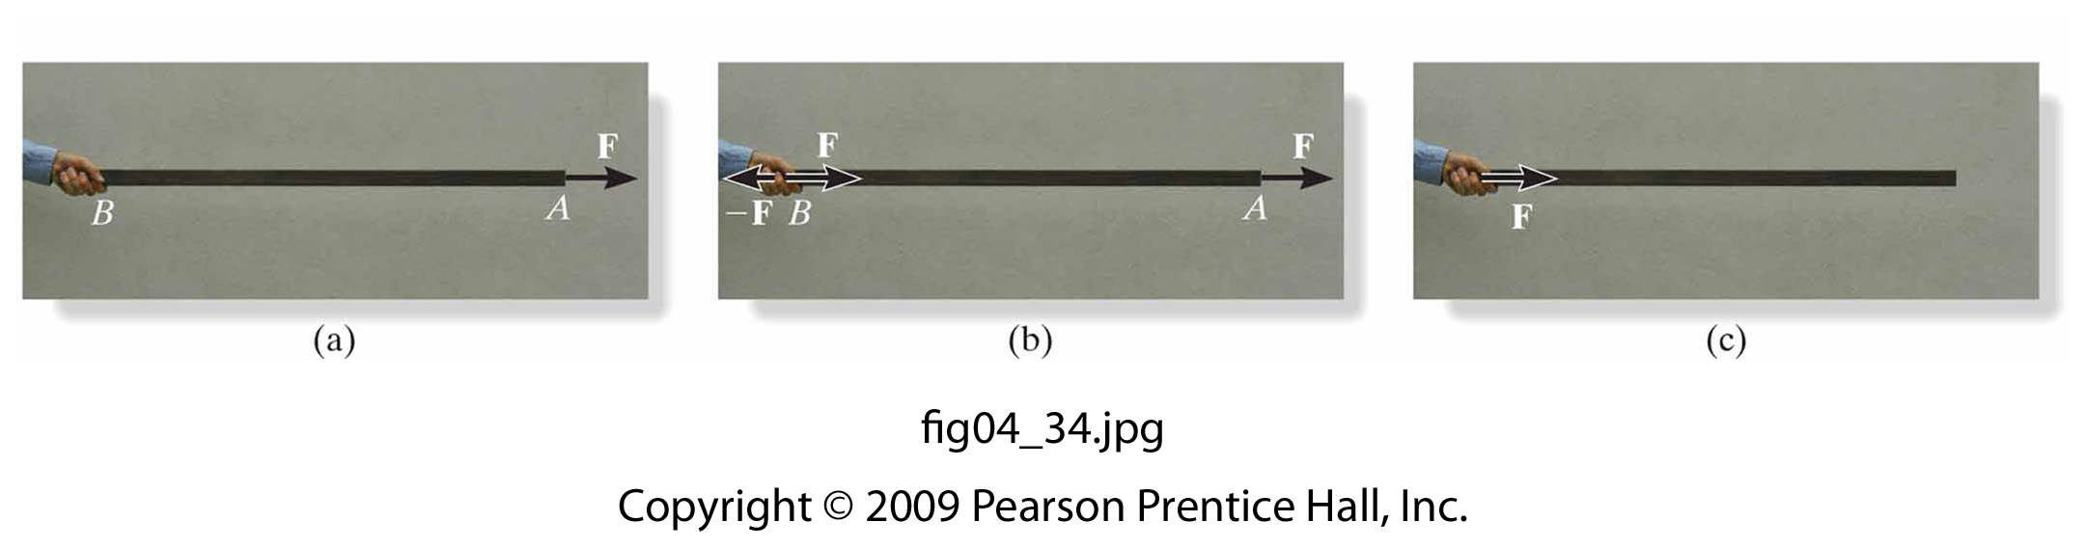
MOVING A FORCE ON ITS LINE OF ACTION
Moving a force from A to B, when both points are on the vector’s line of action, does not change the external effect.
Hence, a force vector is called a sliding vector. (But the internal effect of the force on the body does depend on where the force is applied).

Slide 7
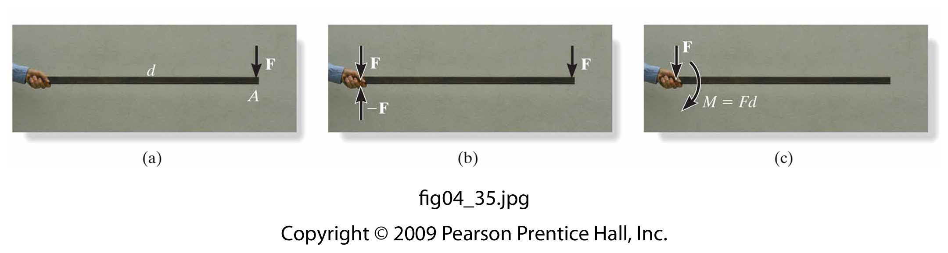
MOVING A FORCE OFF OF ITS LINE OF ACTION
B
When a force is moved, but not along its line of action, there is a change in its external effect!
Essentially, moving a force from point A to B (as shown above) requires creating an additional couple moment. So moving a force means you have to “add” a new couple.
Since this new couple moment is a “free” vector, it can be applied at any point on the body.

Slide 8
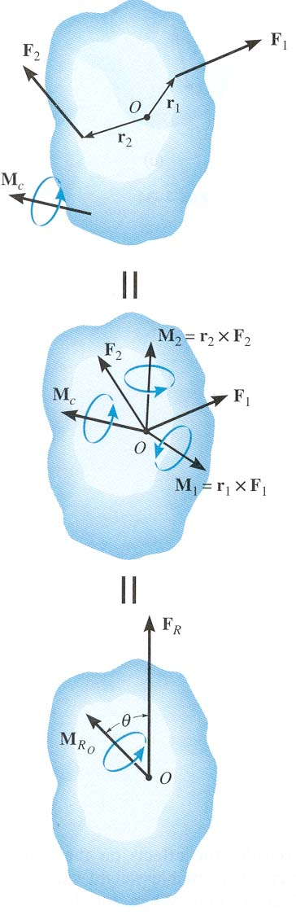
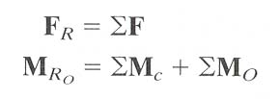
SIMPLIFICATION OF A FORCE AND COUPLE SYSTEM
When several forces and couple moments act on a body, you can move each force and its associated couple moment to a common point O.
Now you can add all the forces and couple moments together and find one resultant force-couple moment pair.

Slide 9
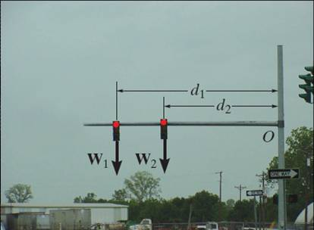
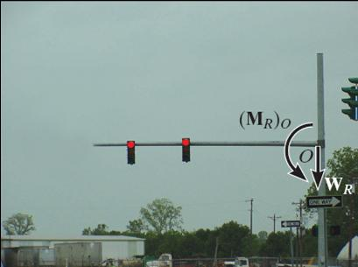
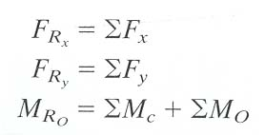
SIMPLIFICATION OF A FORCE AND COUPLE SYSTEM (continued)
W_{R} = W₁ + W₂
(M_{R})_{o} = W₁ d₁ + W₂ d₂
If the force system lies in the x-y plane (a 2-D case), then the reduced equivalent system can be obtained using the following three scalar equations.

Slide 10
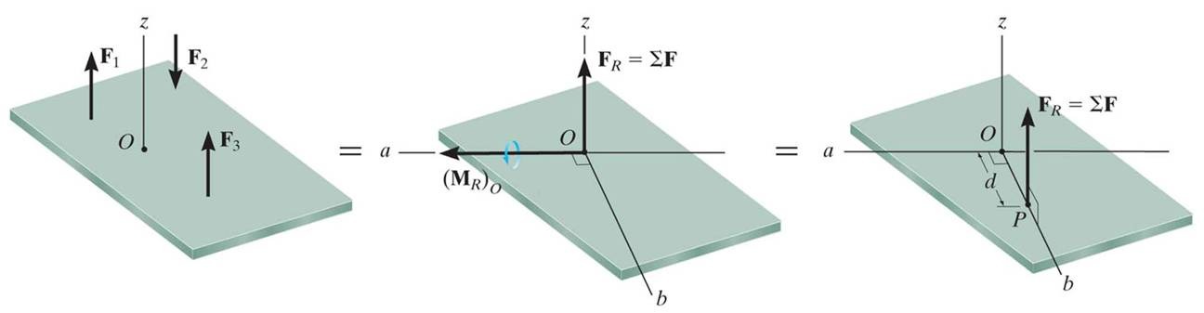
FURTHER SIMPLIFICATION OF A FORCE AND COUPLE SYSTEM (Section 4.8)
=
=
If F_{R} and M_{RO} are perpendicular to each other, then the system can be further reduced to a single force, F_{R} , by simply moving F_{R} from O to P.
In three special cases, concurrent, coplanar, and parallel systems of forces, the system can always be reduced to a single force.

Slide 11
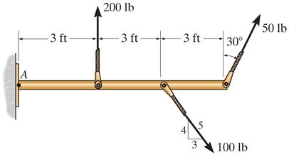
EXAMPLE I
Given: A 2-D force system with geometry as shown.
Find: The equivalent resultant force and couple moment acting at A and then the equivalent single force location measured from A.
Plan:
1) Sum all the x and y components of the forces to find F_{RA}.
2) Find and sum all the moments resulting from moving each force component to A.
3) Shift F_{RA} to a distance d such that d = M_{RA}/F_{Ry}
Notes:
Source : F4-32

Slide 12
EXAMPLE I (continued)
+→ ΣF_{Rx}= 50(sin 30) + 100(3/5)
= 85 lb
+ ↑ ΣF_{Ry}= 200 + 50(cos 30) – 100(4/5)
= 163.3 lb
+ M_{RA} = 200 (3) + 50 (cos 30) (9)
– 100 (4/5) 6 = 509.7 lb·ft CCW
F_{R}
F_{R} = ( 85² + 163.3² )^{1/2} = 184 lb
θ = tan⁻¹ ( 163.3/85) = 62.5°
The equivalent single force F_{R} can be located at a distance d measured from A.
d = M_{RA}/F_{Ry} = 509.7 / 163.3 = 3.12 ft

Slide 13
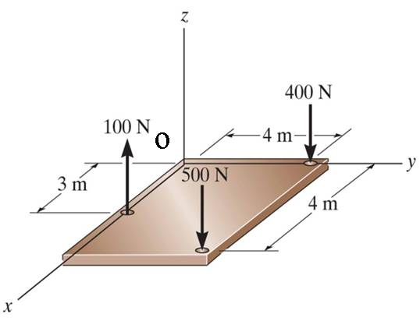
EXAMPLE II
Given: The slab is subjected to three parallel forces.
Find: The equivalent resultant force and couple moment at the origin O. Also find the location (x, y) of the single equivalent resultant force.
Plan:
1) Find F_{RO} = ∑F_{i} = F_{Rzo} k
2) Find M_{RO} = ∑ (r_{i} × F_{i}) = M_{RxO} i + M_{RyO} j
3) The location of the single equivalent resultant force is given as x = – M_{RyO} / F_{RzO} and y = M_{RxO} / F_{RzO}
Notes:
Source : F4-35

Slide 14
EXAMPLE II (continued)
F_{RO} = {100 k – 500 k – 400 k} = – 800 k N
M_{RO} = (3 i) × (100 k) + (4 i + 4 j) × (-500 k)
+ (4 j) × (-400 k)
= {–300 j + 2000 j – 2000 i – 1600 i}
= { – 3600 i + 1700 j }N·m
The location of the single equivalent resultant force is given as,
x = – M_{Ryo} / F_{Rzo} = (–1700) / (–800) = 2.13 m
y = M_{Rxo} / F_{Rzo} = (–3600) / (–800) = 4.5 m

Slide 15
CONCEPT QUIZ
z
1. The forces on the pole can be reduced to a single force and a single moment at point ____ .
A) P B) Q C) R
D) S E) Any of these points.
•
S
R
•
Q
•
P
y
•
x
2. Consider two couples acting on a body. The simplest possible equivalent system at any arbitrary point on the body will have
A) One force and one couple moment.
B) One force.
C) One couple moment.
D) Two couple moments.
Notes:
Answers:
1. E
2. C

Slide 16
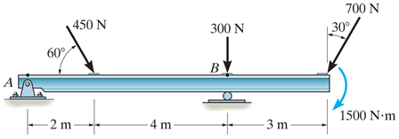
GROUP PROBLEM SOLVING I
Given: A 2-D force and couple system as shown.
Find: The equivalent resultant force and couple moment acting at A.
Plan:
1) Sum all the x and y components of the two forces to find F_{RA}.
2) Find and sum all the moments resulting from moving each force to A and add them to the 1500 N⋅m free moment to find the resultant M_{RA} .
Notes:
Source : P4-117

Slide 17
GROUP PROBLEM SOLVING I (continued)
Summing the force components:
+→ ΣF_{x} = 450 (cos 60) – 700 (sin 30)
= – 125 N
+ ↑ ΣF_{y} = – 450 (sin 60) – 300 – 700 (cos 30)
= – 1296 N
Now find the magnitude and direction of the resultant.
F_{RA} = (125² + 1296²)^{1/2} = 1302 N and θ = tan⁻¹ (1296 /125) = 84.5°
+ M_{RA} = 450 (sin 60) (2) + 300 (6) + 700 (cos 30) (9) + 1500
= 9535 N⋅m

Slide 18
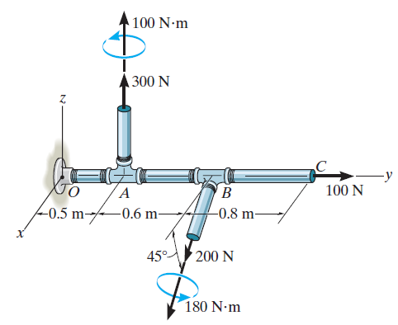
GROUP PROBLEM SOLVING II
Given: Forces and couple moments are applied to the pipe.
Find: An equivalent resultant force and couple moment at point O.
Plan:
a) Find F_{RO} = Σ F_{i} = F₁ + F₂+ F₃
b) Find M_{RO} = Σ M_{C} + Σ ( r_{i} × F_{i} )
where,
M_{C} are any free couple moments.
r_{i} are the position vectors from the point O to any point on the line of action of F_{i} .
Notes:
Source : P4-134

Slide 19
GROUP PROBLEM SOLVING II (continued)
M_{C1}
F₁ = {300 k} N
F₂ = 200{cos45° i – sin 45° k} N
= {141.4 i – 141.4 k} N
F₃ = {100 j} N
r₁ = {0.5 i } m, r₂ = {1.1 i } m,
r₃ = {1.9 i } m
F₁
F₃
F₂
M_{C2}
Free couple moments are:
M_{C1} = {100 k} N⋅m
M_{C2} = 180{cos45° i – sin 45°k}N⋅m
= {127.3 i – 127.3k}N⋅m

Slide 20
GROUP PROBLEM SOLVING II (continued)
Resultant force and couple moment at point O:
F_{RO} = Σ F_{i} = F₁ + F₂+ F₃
= {300 k}+{141.4 i – 141.4 k}
+ {100 j}
F_{RO} = {141 i + 100 j + 159 k} N
M_{C1}
F₁
F₃
F₂
M_{RO} = Σ M_{C} + Σ ( r_{i} × F_{i} )
M_{C2}
M_{RO} = {100 k} + {127.3 i – 127.3k}
i j k
0 0.5 0
0 0 300
i j k
0 1.1 0
141.4 0 -141.4
i j k
0 1.9 0
0 100 0
+
+
+
M_{RO} = {122 i – 183 k} N⋅m

Slide 21
ATTENTION QUIZ
1. For this force system, the equivalent system at P is ___________ .
A) F_{RP} = 40 lb (along +x-dir.) and M_{RP} = +60 ft ·lb
B) F_{RP} = 0 lb and M_{RP} = +30 ft · lb
C) F_{RP} = 30 lb (along +y-dir.) and M_{RP} = -30 ft ·lb
D) F_{RP} = 40 lb (along +x-dir.) and M_{RP} = +30 ft ·lb
y
30 lb
1'
1'
x
•
40 lb
P
30 lb
Notes:
Answer:
1. D

Slide 22
ATTENTION QUIZ
2. Consider three couples acting on a body. Equivalent systems will be _______ at different points on the body.
A) Different when located
B) The same even when located
C) Zero when located
D) None of the above.
Notes:
Answer:
2. B

Slide 23
End of the Lecture
Let Learning Continue

