Slide 1
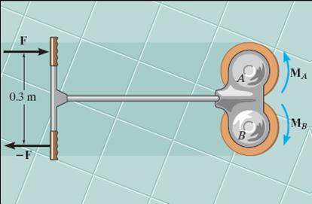
MOMENT OF A COUPLE
Today’s Objectives:
Students will be able to
a) define a couple, and,
b) determine the moment of a couple.
In-Class activities:
Check Homework
Reading Quiz
Applications
Moment of a Couple
Concept Quiz
Group Problem Solving
Attention Quiz

Slide 2
READING QUIZ
1. In statics, a couple is defined as __________ separated by a perpendicular distance.
A) two forces in the same direction
B) two forces of equal magnitude
C) two forces of equal magnitude acting in the same direction
D) two forces of equal magnitude acting in opposite directions
2. The moment of a couple is called a _________ vector.
A) Free B) Spinning
C) Fixed D) Sliding
Notes:
Answers:
1. D
2. A

Slide 3
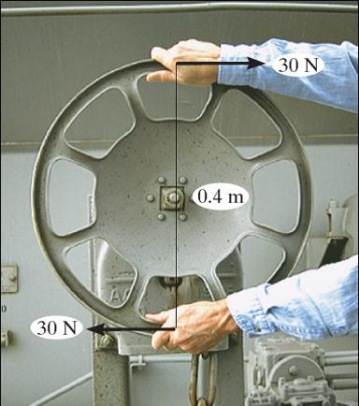
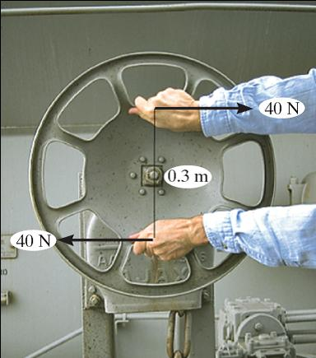
APPLICATIONS
A torque or moment of 12 N·m is required to rotate the wheel. Why does one of the two grips of the wheel above require less force to rotate the wheel?

Slide 4
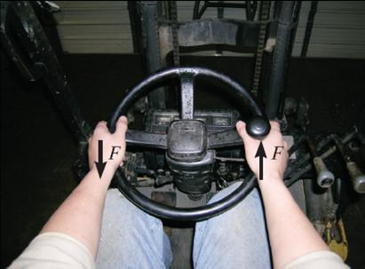
APPLICATIONS (continued)
When you grip a vehicle’s steering wheel with both hands and turn, a couple moment is applied to the wheel.
Would older vehicles without power steering have needed larger or smaller steering wheels?

Slide 5
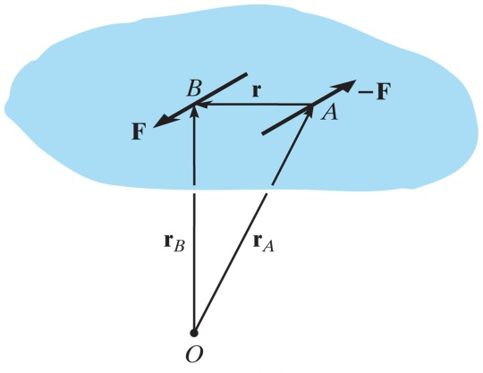
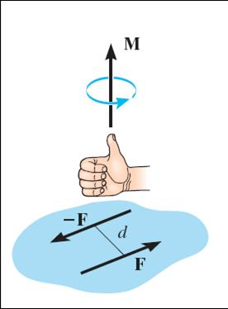
MOMENT OF A COUPLE
A couple is defined as two parallel forces with the same magnitude but opposite in direction separated by a perpendicular distance “d.”
The moment of a couple is defined as
M_{O} = F d (using a scalar analysis) or as
M_{O} = r × F (using a vector analysis).
Here r is any position vector from the line of action of F to the line of action of F.

Slide 6
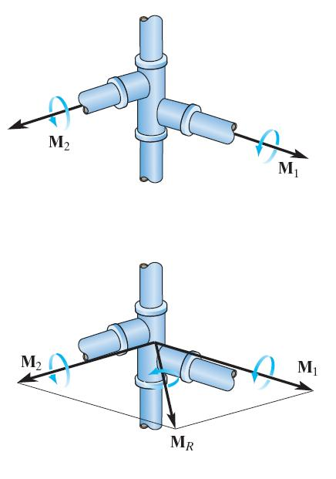
MOMENT OF A COUPLE (continued)
The net external effect of a couple is that the net force equals zero and the magnitude of the net moment equals F *d.
Since the moment of a couple depends only on the distance between the forces, the moment of a couple is a free vector. It can be moved anywhere on the body and have the same external effect on the body.
Moments due to couples can be added together using the same rules as adding any vectors.

Slide 7
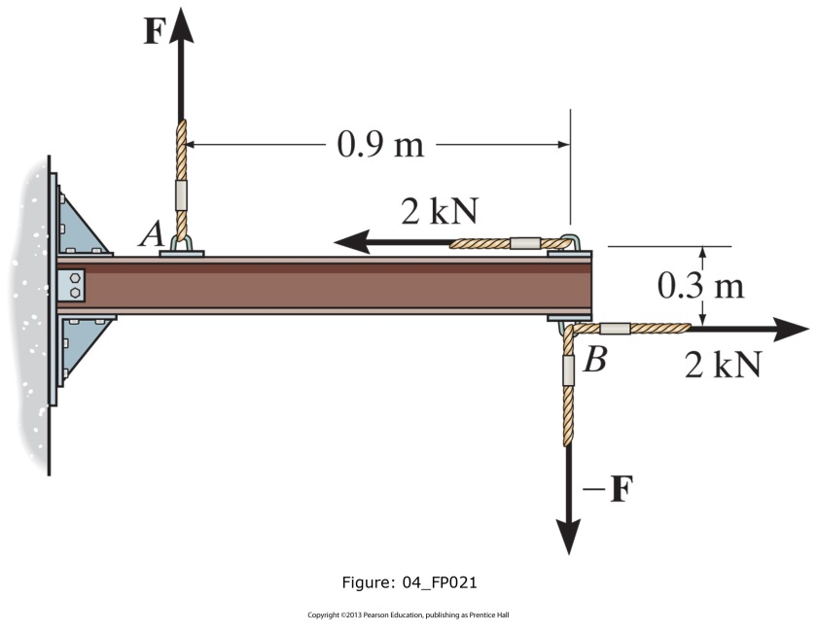
EXAMPLE I : SCALAR APPROACH
Given: Two couples act on the beam with the geometry shown.
Find: The magnitude of F so that the resultant couple moment is 1.5 kN⋅m clockwise.
Plan:
1) Add the two couples to find the resultant couple.
2) Equate the net moment to 1.5 kN⋅m clockwise to find F.
Notes:
Source : F4-21

Slide 8
EXAMPLE I : SCALAR APPROACH (continued)
Solution:
The net moment is equal to:
+ Σ M = – F (0.9) + (2) (0.3)
= – 0.9 F + 0.6
– 1.5 kN⋅m = – 0.9 F + 0.6
Solving for the unknown force F, we get
F = 2.33 kN

Slide 9
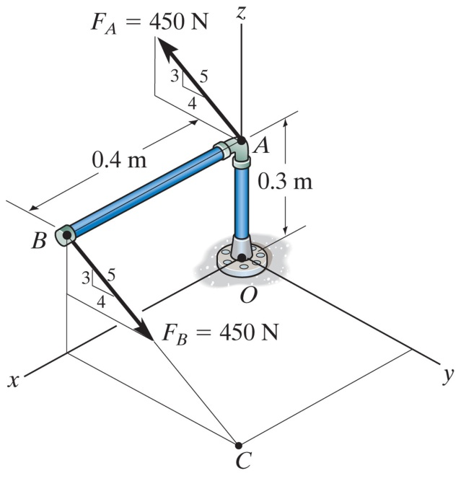
EXAMPLE II : VECTOR APPROACH
Given: A 450 N force couple acting on the pipe assembly.
Find: The couple moment in Cartesian vector notation.
Plan:
r_{AB}
F_{B}
1) Use M = r × F to find the couple moment.
2) Set r = r_{AB} and F = F_{B}.
3) Calculate the cross product to find M.
Notes:
Source : F4-24

Slide 10
EXAMPLE II: VECTOR APPROACH (continued)
Solution:
r_{AB} = { 0.4 i } m
F_{B} = {0 i + 450(4/5) j − 450(3/5) k} N
= {0 i + 360 j − 270 k} N
r_{AB}
M = r_{AB} × F_{B}
F_{B}
i j k
=
0.4 0 0
N·m
0 360 −270
= [{0(-270) – 0(360)} i – {4(-270) – 0(0)} j + {0.4(360) – 0(0)} k] N·m
= {0 i + 108 j + 144 k} N·m

Slide 11
CONCEPT QUIZ
1. F₁ and F₂ form a couple. The moment of the couple is given by ____ .
A) r₁ × F₁ B) r₂ × F₁
C) F₂ × r₁ D) r₂ × F₂
F₁
r₁
r₂
F₂
2. If three couples act on a body, the overall result is that
A) The net force is not equal to 0.
B) The net force and net moment are equal to 0.
C) The net moment equals 0 but the net force is not necessarily equal to 0.
D) The net force equals 0 but the net moment is not necessarily equal to 0 .
Notes:
Answers:
1. B
2. D

Slide 12
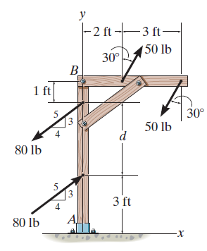
GROUP PROBLEM SOLVING I
Given: Two couples act on the beam with the geometry shown and d = 4 ft.
Find: The resultant couple
Plan:
1) Resolve the forces in x and y-directions so they can be treated as couples.
2) Add these two couples to find the resultant couple.
Notes:
Source : P4-80

Slide 13
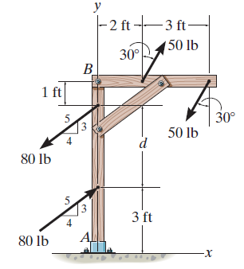
GROUP PROBLEM SOLVING I (continued)
The x and y components of the upper-left 50 lb force are:
50 lb (cos 30°) = 43.30 lb vertically up
50 lb (sin 30°) = 25 lb to the right
Do both of these components form couples with their matching components of the other 50 force?
No! Only the 43.30 lb components create a couple. Why?

Slide 14
GROUP PROBLEM SOLVING I (continued)
Now resolve the lower 80 lb force:
(80 lb) (3/5), acting up
(80 lb) (4/5), acting to the right
Do both of these components create a couple with components of the other 80 lb force?
d = 4 ft
The net moment is equal to:
+ ΣM = – (43.3 lb)(3 ft) + (64 lb)(4 ft)
= – 129.9 + 256 = 126 ft·lb CCW

Slide 15
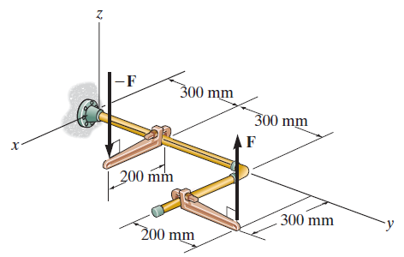
GROUP PROBLEM SOLVING II
Given: F = {80 k} N and
– F = {– 80 k} N
Find: The couple moment acting on the pipe assembly using Cartesian vector notation.
Plan:
r_{AB}
1) Use M = r × F to find the couple moment.
2) Set r = r_{AB} and F = {80 k} N.
3) Calculate the cross product to find M.
Notes:
Source : P4-92

Slide 16
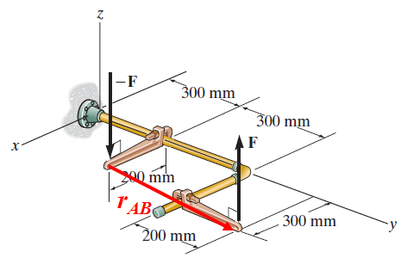
GROUP PROBLEM SOLVING II (continued)
r_{AB} = { (0.3 – 0.2 ) i + (0.8 – 0.3) j + (0 – 0) k } m
= { 0.1 i + 0.5 j } m
F = {80 k} N
i
j
k
M = r_{AB} × F
=
0.1 0.5 0
N · m
0 0 80
= {(40 – 0) i – (8 – 0) j + (0) k} N · m
= { 40 i – 8 j } N · m

Slide 17
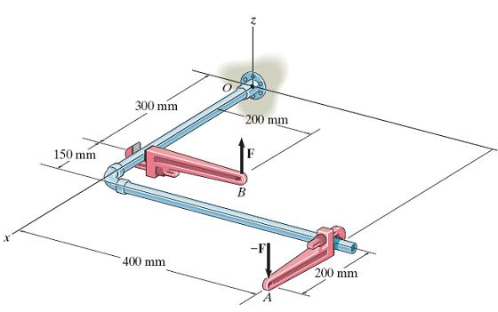
ATTENTION QUIZ
1. A couple is applied to the beam as shown. Its moment equals _____ N·m.
A) 50 B) 60
C) 80 D) 100
50 N
1m
2m
5
3
4
2. You can determine the couple moment as M = r × F
If F = { -20 k} lb, then r is
A) r_{BC} B) r_{AB}
C) r_{CB} D) r_{BA}
Notes:
Answers:
1. B
2. D

Slide 18
End of the Lecture
Let Learning Continue

