Slide 1
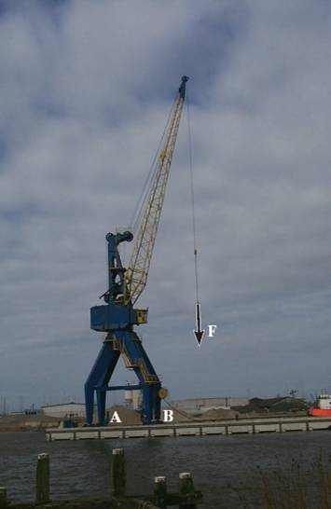
MOMENT ABOUT AN AXIS
Today’s Objectives:
Students will be able to determine the moment of a force about an axis using
a) scalar analysis, and,
b) vector analysis.
In-Class Activities:
Check Homework
Reading Quiz
Applications
Scalar Analysis
Vector Analysis
Concept Quiz
Group Problem Solving
Attention Quiz

Slide 2
READING QUIZ
1. When determining the moment of a force about a specified axis, the axis must be along _____________.
A) the x axis B) the y axis C) the z axis
D) any line in 3-D space E) any line in the x-y plane
2. The triple scalar product u • ( r × F ) results in
A) a scalar quantity ( + or - ). B) a vector quantity.
C) zero. D) a unit vector.
E) an imaginary number.
Notes:
1. D
2. A

Slide 3
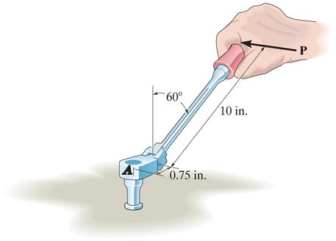
APPLICATIONS
With the force P, a person is creating a moment M_{A} using this flex-handle socket wrench. Does all of M_{A} act to turn the socket? How would you calculate an answer to this question?

Slide 4
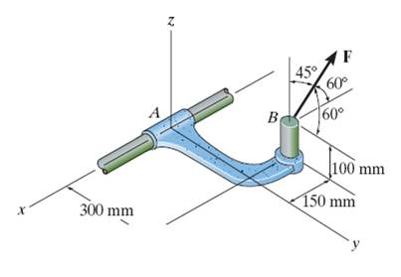
APPLICATIONS (continued)
Sleeve A of this bracket can provide a maximum resisting moment of 125 N·m about the x-axis. How would you determine the maximum magnitude of F before turning about the x-axis occurs?

Slide 5
SCALAR ANALYSIS
Recall that the moment of a scalar force about any point O is M_{O}= F d_{O} where d_{O} is the perpendicular (or shortest) distance from the point to the force’s line of action. This concept can be extended to find the moment of a force about an axis.
Finding the moment of a force about an axis can help answer the types of questions we just considered.

Slide 6
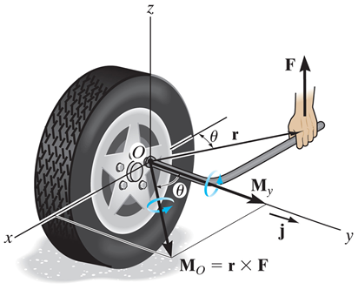
SCALAR ANALYSIS (continued)
In the figure above, the moment about the y-axis would be M_{y}= F_{z} (d_{x}) = F (r cos θ). However, unless the force can easily be broken into components and the “d_{x}” found quickly, such calculations are not always trivial and vector analysis may be much easier (and less likely to produce errors).

Slide 7
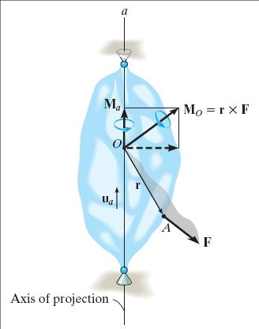
VECTOR ANALYSIS
Our goal is to find the moment of F (the tendency to rotate the body) about the a-axis.
First compute the moment of F about any arbitrary point O that lies on the a-axis using the cross product.
M_{O} = r × F
Now, find the component of M_{O} along the a-axis using the dot product.
M_{a} = u_{a} • M_{O}

Slide 8
VECTOR ANALYSIS (continued)
M_{a} can also be obtained as
The above equation is also called the triple scalar product.
In the this equation,
u_{a} represents the unit vector along the a-axis,
r is the position vector from any point on the a-axis to any point A on the line of action of the force, and
F is the force vector.

Slide 9
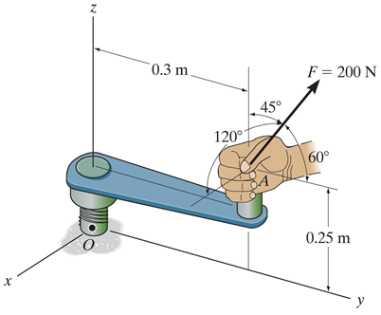
EXAMPLE
Given: A force is applied to the tool as shown.
Find: The magnitude of the moment of this force about the x axis of the value.
Plan:
A
B
Use M_{z} = u • (r × F ).
First, find F in Cartesian vector form.
Note that u = 1 i in this case.
4) The vector r is the position vector from O to A.
Notes:
Source : F4-15

Slide 10
EXAMPLE (continued)
Solution:
u = 1 i
r_{OA} = {0 i + 0.3 j + 0.25 k} m
F = 200 (cos 120 i + cos 60 j + cos 45 k) N
= {-100 i + 100 j + 141.4 k} N
Now find M_{z} = u • (r_{OA} × F )
1 0 0
M_{z} =
0 0.3 0.25
= 1{0.3 (141.4) – 0.25 (100) } N·m
-100 100 141.4
M_{z} = 17.4 N·m CCW

Slide 11
CONCEPT QUIZ
1. The vector operation (P × Q) • R equals
A) P × (Q • R).
B) R • (P × Q).
C) (P • R) × (Q • R).
D) (P × R) • (Q × R ).
Notes:
Answers:
1.B

Slide 12
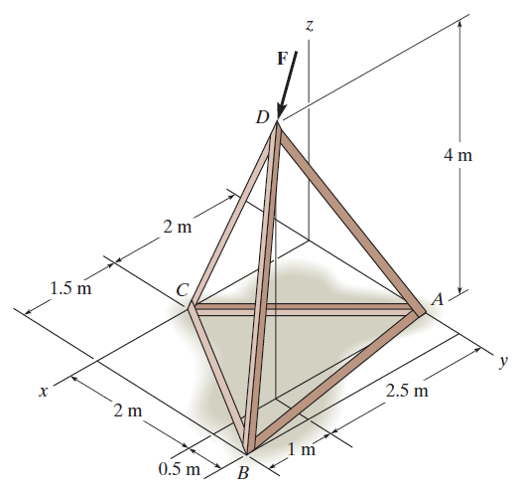
CONCEPT QUIZ (continued)
2. The force F is acting along DC. Using the triple scalar product to determine the moment of F about the bar BA, you could use any of the following position vectors except ______.
A) r_{BC} B) r_{AD}
C) r_{AC} D) r_{DB}
E) r_{BD}
Notes:
ANSWER:
2. D

Slide 13
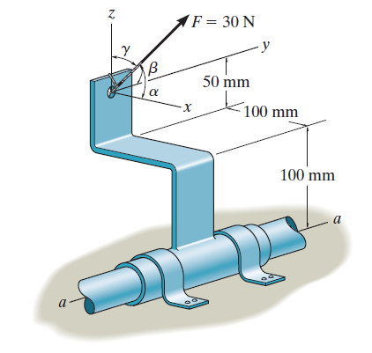
GROUP PROBLEM SOLVING
Given: The force of F = 30 N acts on the bracket. α = 60°, β = 60°, γ = 45°.
Find: The moment of F about the a-a axis.
Plan:
A
•
r_{OA}
u_{a}
•
O
1) Find u_{a} and r_{OA}
2) Find F in Cartesian vector form.
3) Use M_{a} = u_{a} • (r_{OA} × F)
Notes:
Source : P4-66

Slide 14
GROUP PROBLEM SOLVING (continued)
Solution:
u_{a} = j
r_{OA} = {– 0.1 i + 0.15 k} m
A
•
r_{OA}
F = 30 {cos 60° i + cos 60° j + cos 45° k} N
F = { 15 i + 15 j + 21.21 k} N
u_{a}
•
O

Slide 15
GROUP PROBLEM SOLVING (continued)
Now find the triple product, M_{a} = u_{a} • (r_{OA} × F)
0 1 0
M_{a} =
- 0.1 0 0.15
N·m
15 15 21.21
M_{a} = -1 {-0.1 (21.21) – 0.15 (15)}
= 4.37 N·m
A
•
r_{OA}
u_{a}
•
M_{a}
O

Slide 16
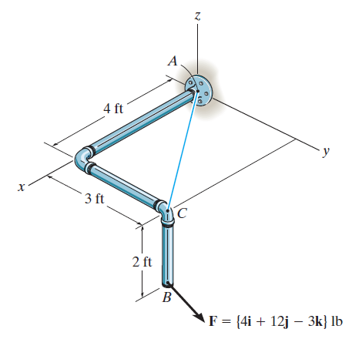
ATTENTION QUIZ
1. For finding the moment of the force F about the x-axis, the position vector in the triple scalar product should be ___ .
A) r_{AC} B) r_{BA}
C) r_{AB} D) r_{BC}
2. If r = {1 i + 2 j} m and F = {10 i + 20 j + 30 k} N, then the moment of F about the y-axis is ____ N·m.
A) 10 B) -30
C) -40 D) None of the above.
Notes:
ANSWERS:
1. C
2. B

Slide 17
End of the Lecture
Let Learning Continue

