Slide 1
MOMENT OF A FORCE (SCALAR FORMULATION), CROSS PRODUCT, MOMENT OF A FORCE (VECTOR FORMULATION), & PRINCIPLE OF MOMENTS
Today’s Objectives :
Students will be able to:
a) understand and define moment, and,
b) determine moments of a force in 2-D and 3-D cases.
In-Class Activities :
Reading Quiz
Applications
Moment in 2-D
Moment in 3-D
Concept Quiz
Group Problem Solving
Attention Quiz

Slide 2
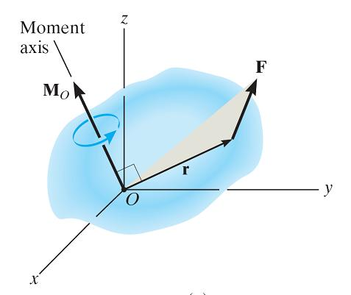
READING QUIZ
F = 12 N
1. What is the moment of the 12 N force about point A (M_{A})?
A) 3 N·m B) 36 N·m C) 12 N·m
D) (12/3) N·m E) 7 N·m
d = 3 m
• A
2. The moment of force F about point O is defined as M_{O} = ___________ .
A) r × F B) F × r
C) r • F D) r * F
Notes:
Answers:
1. B
2. A

Slide 3
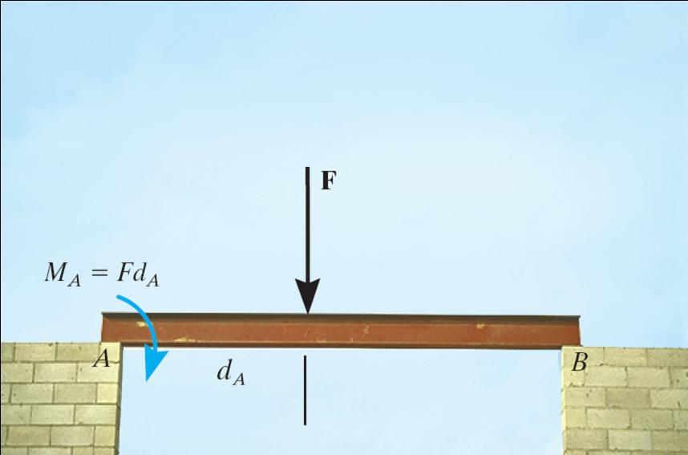
APPLICATIONS
Beams are often used to bridge gaps in walls. We have to know what the effect of the force on the beam will have on the supports of the beam.
What do you think is happening at points A and B?

Slide 4
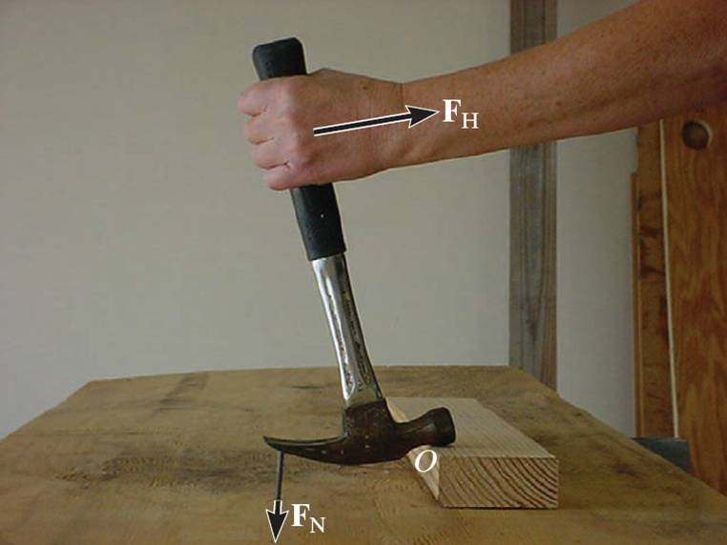
APPLICATIONS (continued)
Carpenters often use a hammer in this way to pull a stubborn nail. Through what sort of action does the force F_{H} at the handle pull the nail? How can you mathematically model the effect of force F_{H} at point O?

Slide 5
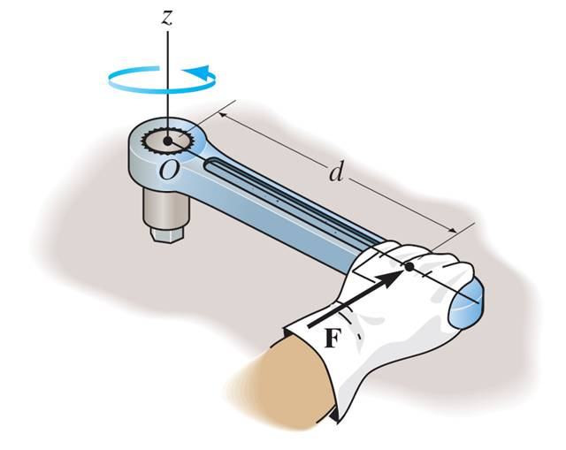
MOMENT OF A FORCE - SCALAR FORMULATION (Section 4.1)
The moment of a force about a point provides a measure of the tendency for rotation (sometimes called a torque).

Slide 6
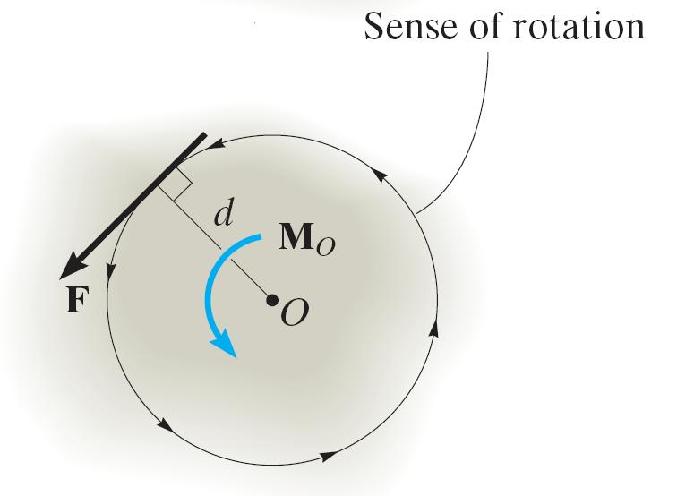
MOMENT OF A FORCE - SCALAR FORMULATION (continued)
In a 2-D case, the magnitude of the moment is M_{o} = F d
As shown, d is the perpendicular distance from point O to the line of action of the force.
In 2-D, the direction of M_{O} is either clockwise (CW) or counter-clockwise (CCW), depending on the tendency for rotation.

Slide 7
MOMENT OF A FORCE - SCALAR FORMULATION (continued)
a
F
For example, M_{O} = F d and the direction is counter-clockwise.
b
O
d
F _{y}
F
Often it is easier to determine M_{O} by using the components of F as shown.
F _{x}
b
a
O
Then M_{O} = (F_{y} a) – (F_{x} b). Note the different signs on the terms! The typical sign convention for a moment in 2-D is that counter-clockwise is considered positive. We can determine the direction of rotation by imagining the body pinned at O and deciding which way the body would rotate because of the force.

Slide 8
VECTOR CROSS PRODUCT (Section 4.2)
While finding the moment of a force in 2-D is straightforward when you know the perpendicular distance d, finding the perpendicular distances can be hard—especially when you are working with forces in three dimensions.
So a more general approach to finding the moment of a force exists. This more general approach is usually used when dealing with three dimensional forces but can be used in the two dimensional case as well.
This more general method of finding the moment of a force uses a vector operation called the cross product of two vectors.

Slide 9
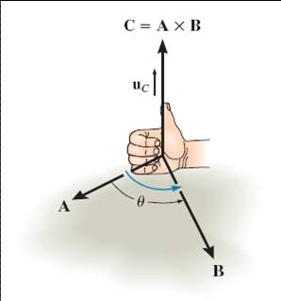
CROSS PRODUCT (Section 4.2)
In general, the cross product of two vectors A and B results in another vector, C , i.e., C = A × B. The magnitude and direction of the resulting vector can be written as
C = A × B = A B sin θ u_{C}
As shown, u_{C} is the unit vector perpendicular to both A and B vectors (or to the plane containing the A and B vectors).

Slide 10
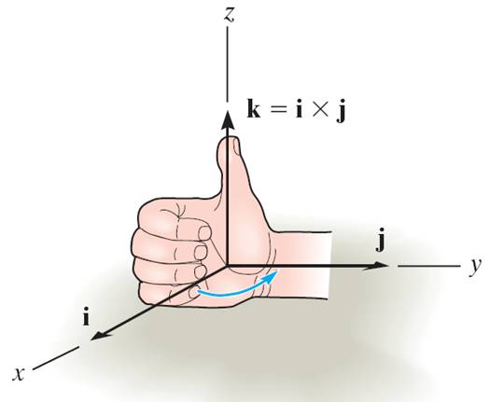
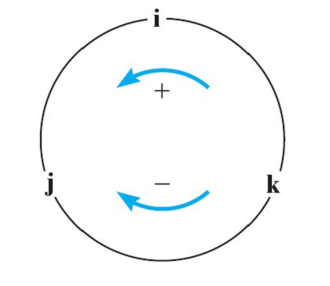
CROSS PRODUCT (continued)
The right-hand rule is a useful tool for determining the direction of the vector resulting from a cross product.
For example: i × j = k
Note that a vector crossed into itself is zero, e.g., i × i = 0

Slide 11
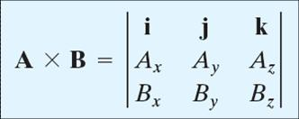
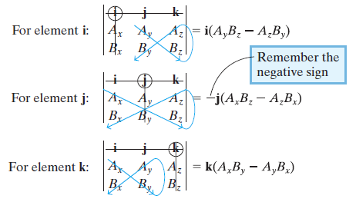
CROSS PRODUCT (continued)
Also, the cross product can be written as a determinant.
Each component can be determined using 2 × 2 determinants.

Slide 12
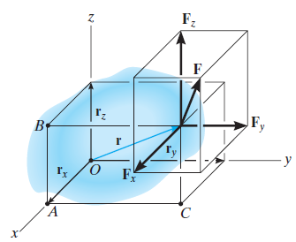
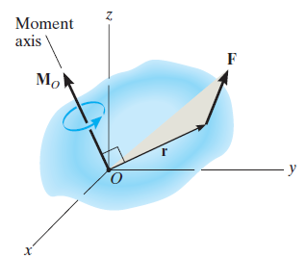
MOMENT OF A FORCE – VECTOR FORMULATION (Section 4.3)
Moments in 3-D can be calculated using scalar (2-D) approach, but it can be difficult and time consuming. Thus, it is often easier to use a mathematical approach called the vector cross product.
Using the vector cross product, M_{O} = r × F.
Here r is the position vector from point O to any point on the line of action of F.

Slide 13
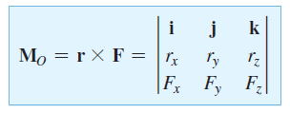
MOMENT OF A FORCE – VECTOR FORMULATION (continued)
So, using the cross product, a moment can be expressed as
By expanding the above equation using 2 × 2 determinants (see Section 4.2), we get (sample units are N - m or lb - ft)
M_{O} = (r_{y} F_{z} - r_{z} F_{y}) i − (r_{x} F_{z} - r_{z} F_{x} ) j + (r_{x} F_{y} - r_{y} F_{x} ) k
The physical meaning of the above equation becomes evident by considering the force components separately and using a 2-D formulation.

Slide 14
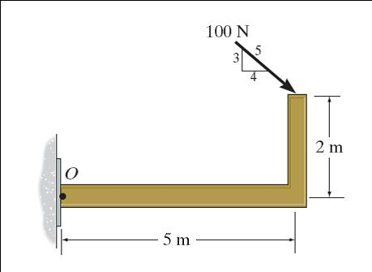
EXAMPLE I
Given: A 100 N force is applied to the frame.
Find: The moment of the force at point O.
Plan:
1) Resolve the 100 N force along x and y-axes.
2) Determine M_{O} using a scalar analysis for the two force components and then add those two moments together.
Notes:
Source : F4-1

Slide 15
EXAMPLE I (continued)
Solution:
+ ↑ F_{y} = – 100 (3/5) N
+ → F_{x} = 100 (4/5) N
+ M_{O} = {– 100 (3/5)N (5 m) – (100)(4/5)N (2 m)} N·m
= – 460 N·m or 460 N·m CW

Slide 16
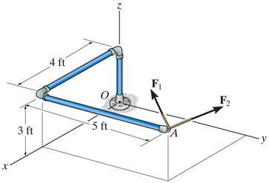
EXAMPLE II
Given: F₁={100 i - 120 j + 75 k}lb
F₂={-200 i +250 j + 100 k}lb
Find: Resultant moment by the forces about point O.
Plan:
o
1) Find F = F₁ + F₂ and r_{OA}.
2) Determine M_{O} = r_{OA} × F .
Notes:
Source : F4-12

Slide 17
EXAMPLE II (continued)
Solution:
First, find the resultant force vector F
F = F₁ + F₂
= { (100 - 200) i + (-120 + 250) j + (75 + 100) k} lb
= {-100 i +130 j + 175 k} lb
Find the position vector r_{OA}
r_{OA} = {4 i + 5 j + 3 k} ft
Then find the moment by using the vector cross product.
i
j
k
M_{O} =
= [{5(175) – 3(130)} i – {4(175) – 3(-100)} j + {4(130) – 5(-100)} k] ft·lb
= {485 i – 1000 j + 1020 k} ft·lb
4 5 3
-100 130 175

Slide 18
CONCEPT QUIZ
1. If a force of magnitude F can be applied in four different 2-D configurations (P,Q,R, & S), select the cases resulting in the maximum and minimum torque values on the nut. (Max, Min).
A) (Q, P) B) (R, S)
C) (P, R) D) (Q, S)
S
P
Q
R
2. If M = r × F, then what will be the value of M • r?
A) 0 B) 1
C) r ² F D) None of the above.
Notes:
Answers:
1. D
2. A

Slide 19
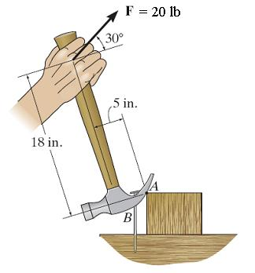
GROUP PROBLEM SOLVING I
y
Given: A 20 lb force is applied to the hammer.
Find: The moment of the force at A.
Plan:
x
Since this is a 2-D problem:
1) Resolve the 20 lb force along the handle’s x and y axes.
2) Determine M_{A} using a scalar analysis.
Notes:
Source : P4-20

Slide 20
GROUP PROBLEM SOLVING I (continued)
y
Solution:
+ ↑ F_{y} = 20 sin 30° lb
+ → F_{x} = 20 cos 30° lb
x
+ M_{A} = {–(20 cos 30°)lb (18 in) – (20 sin 30°)lb (5 in)}
= – 361.77 lb·in = 362 lb·in (clockwise or CW)

Slide 21
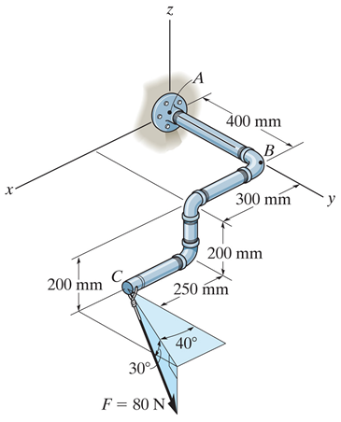
GROUP PROBLEM SOLVING II
Given: The force and geometry shown.
Find: Moment of F about point A
Plan:
1) Find F and r_{AC}.
2) Determine M_{A} = r_{AC} × F
Notes:
Source : P4-43

Slide 22
GROUP PROBLEM SOLVING II (continued)
Solution:
F ={ (80 cos30) sin 40 i
+ (80 cos30) cos 40 j − 80 sin30 k} N
={44.53 i + 53.07 j − 40 k } N
r_{AC} ={0.55 i + 0.4 j − 0.2 k } m
Find the moment by using the cross product.
i j k
M_{A} =
0.55 0.4 − 0.2
44.53 53.07 − 40
= { -5.39 i + 13.1 j +11.4 k } N·m

Slide 23
ATTENTION QUIZ
10 N
5 N
3 m P 2 m
1. Using the CCW direction as positive, the net moment of the two forces about point P is
A) 10 N • m B) 20 N • m C) - 20 N • m
D) 40 N • m E) - 40 N • m
2. If r = { 5 j } m and F = { 10 k } N, the moment
r × F equals { _______ } N·m.
A) 50 i B) 50 j C) –50 i
D) – 50 j E) 0
Notes:
Answers:
1. B
2. A

Slide 24
End of the Lecture
Let Learning Continue

