Slide 1
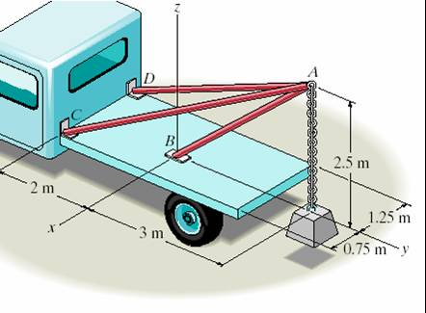
THREE-DIMENSIONAL FORCE SYSTEMS
Today’s Objectives:
Students will be able to solve 3-D particle equilibrium problems by
a) Drawing a 3-D free body diagram, and,
b) Applying the three scalar equations (based on one vector equation) of equilibrium.
In-class Activities:
Check Homework
Reading Quiz
Applications
Equations of Equilibrium
Concept Questions
Group Problem Solving
Attention Quiz

Slide 2
READING QUIZ
1. Particle P is in equilibrium with five (5) forces acting on it in 3-D space. How many scalar equations of equilibrium can be written for point P?
A) 2 B) 3 C) 4
D) 5 E) 6
2. In 3-D, when a particle is in equilibrium, which of the following equations apply?
A) (Σ F_{x}) i + (Σ F_{y}) j + (Σ F_{z}) k = 0
B) Σ F = 0
C) Σ F_{x} = Σ F_{y} = Σ F_{z} = 0
D) All of the above.
E) None of the above.
Notes:
Answers:
1. B
2. D

Slide 3
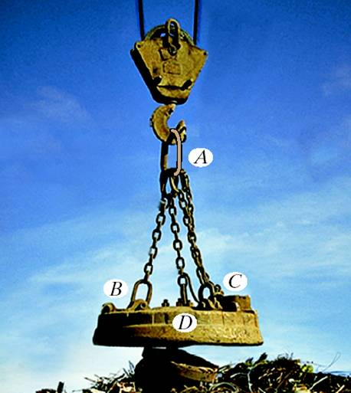
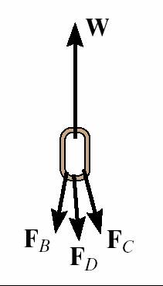
APPLICATIONS
You know the weight of the electromagnet and its load. But, you need to know the forces in the chains to see if it is a safe assembly. How would you do this?

Slide 4
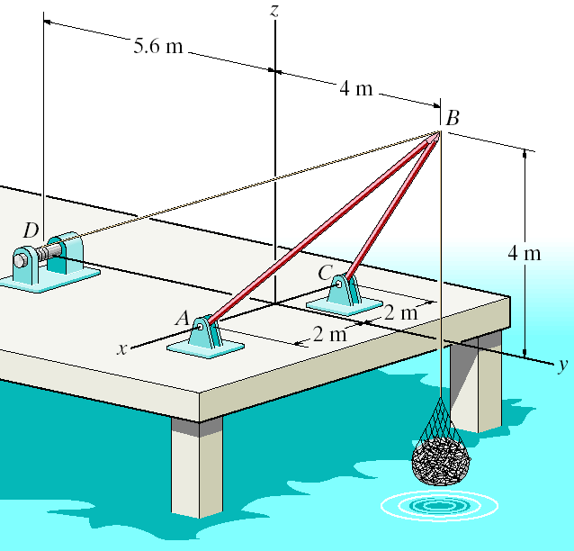
APPLICATIONS (continued)
This shear-leg derrick is to be designed to lift a maximum of 200 kg of fish.
How would you find the effect of different offset distances on the forces in the cable and derrick legs?
Offset distance

Slide 5
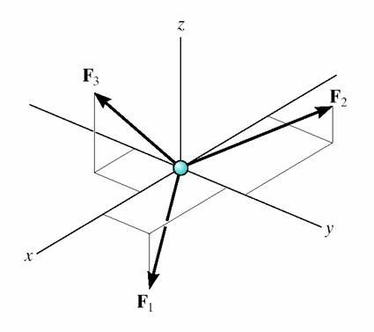
THE EQUATIONS OF 3-D EQUILIBRIUM
When a particle is in equilibrium, the vector sum of all the forces acting on it must be zero (Σ F = 0 ) .
This equation can be written in terms of its x, y and z components. This form is written as follows.
(Σ F_{x}) i + (Σ F_{y}) j + (Σ F_{z}) k = 0
This vector equation will be satisfied only when
ΣF_{x} = 0
ΣF_{y} = 0
ΣF_{z} = 0
These equations are the three scalar equations of equilibrium. They are valid for any point in equilibrium and allow you to solve for up to three unknowns.

Slide 6
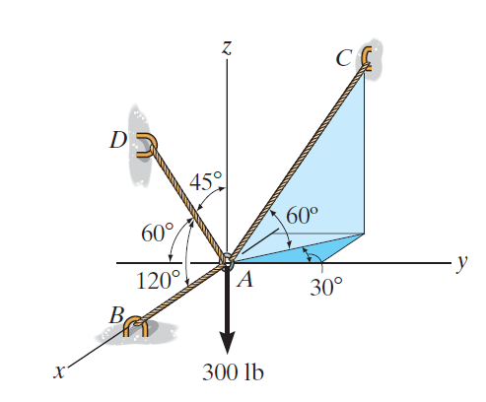
EXAMPLE I
Given: The four forces and geometry shown.
Find: The tension developed in cables AB, AC, and AD.
Plan:
1) Draw a FBD of particle A.
2) Write the unknown cable forces T_{B}, T_{C} , and T_{D} in Cartesian vector form.
3) Apply the three equilibrium equations to solve for the tension
in cables.
Notes:
Source : F3-10

Slide 7
EXAMPLE I (continued)
Solution:
FBD at A
T_{C}
T_{B} = T_{B} i
T_{C} = − (T_{C} cos 60°) sin30° i + (T_{C} cos 60°) cos30° j + T_{C} sin 60° k
T_{C} = T_{C} (-0.25 i +0.433 j +0.866 k )
T_{D}
T_{B}
T_{D} = T_{D} cos 120° i + T_{D} cos 120° j +T_{D} cos 45° k
T_{D} = T_{D} (− 0.5 i − 0.5 j + 0.7071 k )
W = -300 k

Slide 8
EXAMPLE I (continued)
Applying equilibrium equations:
ΣF_{R} = 0 = T_{B} i + T_{C} (− 0.25 i +0.433 j + 0.866 k )
+ T_{D} (− 0.5 i − 0.5 j + 0.7071 k )
− 300 k
Equating the respective i, j, k components to zero, we have
F_{x} = T_{B} – 0.25 T_{C} – 0.5 T_{D} = 0 (1)
F_{y} = 0.433 T_{C} – 0.5 T_{D} = 0 (2)
F_{z} = 0.866 T_{C} + 0.7071 T_{D} – 300 = 0 (3)
Using (2) and (3), we can determine T_{C} = 203 lb, T_{D} = 176 lb
Substituting T_{C} and T_{D} into (1), we can find T_{B} = 139 lb

Slide 9
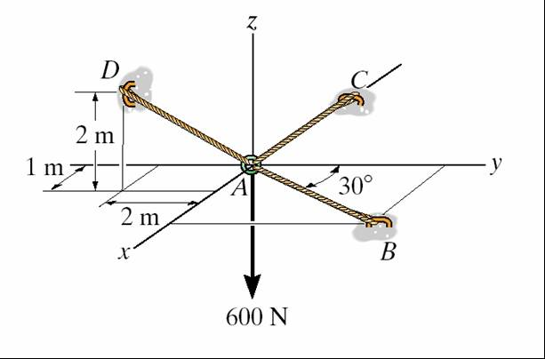
EXAMPLE II
Given: A 600 N load is supported by three cords with the geometry as shown.
Find: The tension in cords AB, AC and AD.
Plan:
1) Draw a free body diagram of Point A. Let the unknown force magnitudes be F_{B}, F_{C}, F_{D} .
2) Represent each force in its Cartesian vector form.
3) Apply equilibrium equations to solve for the three unknowns.
Notes:
Source : F3-9

Slide 10
EXAMPLE II (continued)
FBD at A
z
F_{D}
F_{C}
2 m
1 m
A
30˚
y
2 m
F_{B}
x
600 N
F_{B} = F_{B} (sin 30° i + cos 30° j) N
= {0.5 F_{B} i + 0.866 F_{B} j} N
F_{C} = – F_{C} i N
F_{D} = F_{D} (r_{AD} /r_{AD})
= F_{D} { (1 i – 2 j + 2 k) / (1² + 2² + 2²)^{½} } N
= { 0.333 F_{D} i – 0.667 F_{D} j + 0.667 F_{D} k } N

Slide 11
EXAMPLE II (continued)
Now equate the respective i, j, and k components to zero.
∑ F_{x} = 0.5 F_{B} – F_{C} + 0.333 F_{D} = 0
∑ F_{y} = 0.866 F_{B} – 0.667 F_{D} = 0
∑ F_{z} = 0.667 F_{D} – 600 = 0
FBD at A
z
F_{D}
F_{C}
2 m
y
1 m
A
30˚
2 m
F_{B}
x
600 N
Solving the three simultaneous equations yields
F_{C} = 646 N (since it is positive, it is as assumed, e.g., in tension)
F_{D} = 900 N
F_{B} = 693 N

Slide 12
CONCEPT QUIZ
1. In 3-D, when you know the direction of a force but not its magnitude, how many unknowns corresponding to that force remain?
A) One B) Two C) Three D) Four
2. If a particle has 3-D forces acting on it and is in static equilibrium, the components of the resultant force (Σ F_{x}, Σ F_{y}, and Σ F_{z} ) ___ .
A) have to sum to zero, e.g., -5 i + 3 j + 2 k
B) have to equal zero, e.g., 0 i + 0 j + 0 k
C) have to be positive, e.g., 5 i + 5 j + 5 k
D) have to be negative, e.g., -5 i - 5 j - 5 k
Notes:
Answers:
1. A
2. B

Slide 13
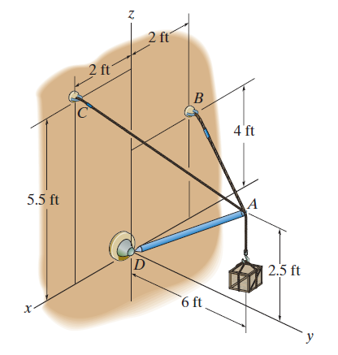
GROUP PROBLEM SOLVING
Given: A 400 lb crate, as shown, is in equilibrium and supported by two cables and a strut AD.
Find: Magnitude of the tension in each of the cables and the force developed along strut AD.
Plan:
1) Draw a free body diagram of Point A. Let the unknown force magnitudes be F_{B}, F_{C}, F _{D} .
2) Represent each force in the Cartesian vector form.
3) Apply equilibrium equations to solve for the three unknowns.
Notes:
Source : P3-52

Slide 14
GROUP PROBLEM SOLVING (continued)
FBD of Point A
z
F_{B}
F_{C}
F_{D}
W
x
y
W = weight of crate = - 400 k lb F_{B} = F_{B}(r_{AB}/r_{AB}) = F_{B} {(– 4 i – 12 j + 3 k) / (13)} lb
F_{C} = F_{C} (r_{AC}/r_{AC}) = F_{C} {(2 i – 6 j + 3 k) / (7)}lb
F_{D} = F_{D}( r_{AD}/r_{AD}) = F_{D} {(12 j + 5 k) / (13)}lb

Slide 15
GROUP PROBLEM SOLVING (continued)
The particle A is in equilibrium, hence
F_{B} + F_{C} + F_{D} + W = 0
Now equate the respective i, j, k components to zero (i.e., apply the three scalar equations of equilibrium).
∑ F_{x} = – (4 / 13) F_{B} + (2 / 7) F_{C} = 0 (1)
∑ F_{y} = – (12 / 13) F_{B} – (6 / 7) F_{C} + (12 / 13) F_{D} = 0 (2)
∑ F_{z} = (3 / 13) F_{B} + (3 / 7) F_{C} + (5 / 13) F_{D} – 400 = 0 (3)
Solving the three simultaneous equations gives the forces
F_{B} = 274 lb
F_{C} = 295 lb
F_{D} = 547 lb

Slide 16
ATTENTION QUIZ
z
1. Four forces act at point A and point A is in equilibrium. Select the correct force vector P.
A) {-20 i + 10 j – 10 k}lb
B) {-10 i – 20 j – 10 k} lb
C) {+ 20 i – 10 j – 10 k}lb
D) None of the above.
F₃ = 10 lb
P
F₂ = 10 lb
F₁ = 20 lb
A
y
x
2. In 3-D, when you don’t know the direction or the magnitude of a force, how many unknowns do you have corresponding to that force?
A) One B) Two C) Three D) Four
Notes:
Answer
1. D
2. C

Slide 17
End of the Lecture
Let Learning Continue

