Slide 1
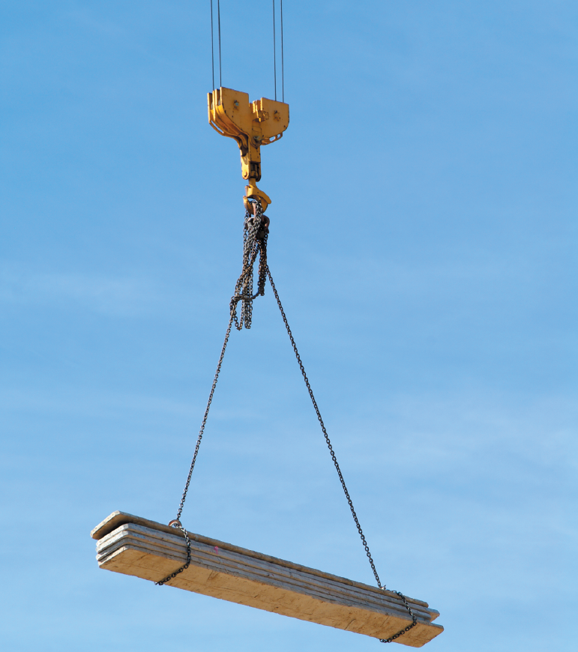
EQUILIBRIUM OF A PARTICLE, THE FREE-BODY DIAGRAM & COPLANAR FORCE SYSTEMS
Today’s Objectives:
Students will be able to :
a) Draw a free body diagram (FBD), and,
b) Apply equations of equilibrium to solve a 2-D problem.
In-Class Activities:
Reading Quiz
Applications
What, Why and How of a FBD
Equations of Equilibrium
Analysis of Spring and Pulleys
Concept Quiz
Group Problem Solving
Attention Quiz

Slide 2
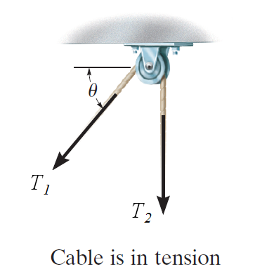
READING QUIZ
1) When a particle is in equilibrium, the sum of forces acting on it equals ___ . (Choose the most appropriate answer)
A) A constant B) A positive number C) Zero
D) A negative number E) An integer
2) For a frictionless pulley and cable, tensions in the cable (T₁ and T₂) are related as _____ .
A) T₁ > T₂
B) T₁ = T₂
C) T₁ < T₂
D) T₁ = T₂ sin θ
Notes:
Answers:
1. C
2. B

Slide 3
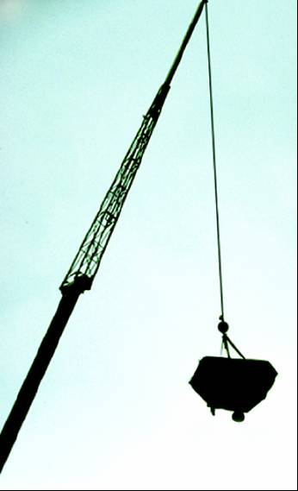
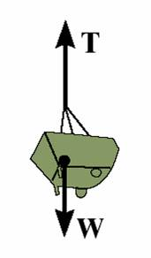
APPLICATIONS
The crane is lifting a load. To decide if the straps holding the load to the crane hook will fail, you need to know forces in the straps. How could you find those forces?
Straps

Slide 4
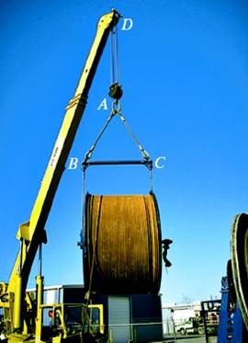
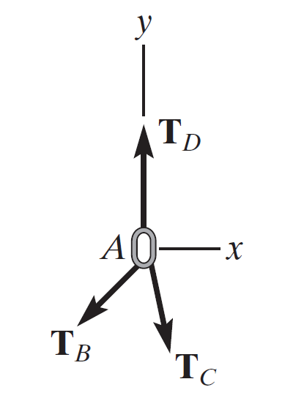
APPLICATIONS (continued)
For a spool of given weight, how would you find the forces in cables AB and AC? If designing a spreader bar like the one being used here, you need to know the forces to make sure the rigging doesn’t fail.

Slide 5
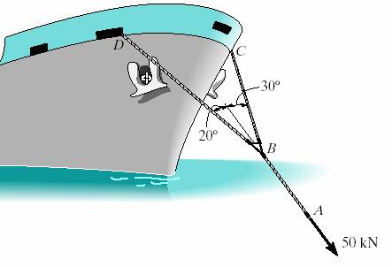
APPLICATIONS (continued)
For a given force exerted on the boat’s towing pendant, what are the forces in the bridle cables? What size of cable must you use?

Slide 6
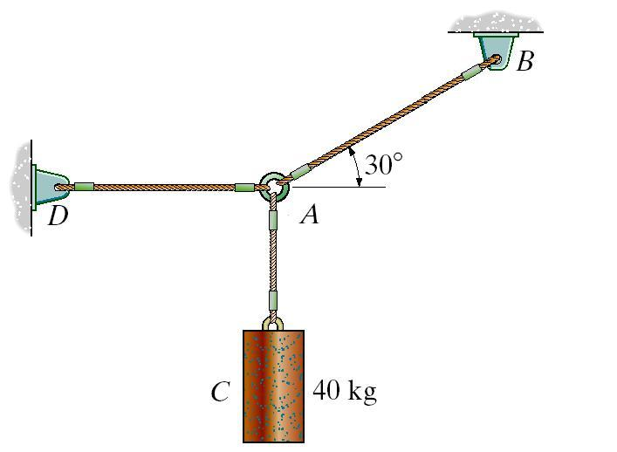
COPLANAR FORCE SYSTEMS (Section 3.3)
This is an example of a 2-D or coplanar force system.
If the whole assembly is in equilibrium, then particle A is also in equilibrium.
To determine the tensions in the cables for a given weight of cylinder, you need to learn how to draw a free-body diagram and apply the equations of equilibrium.
Notes:
Explain the following terms :
Coplanar force system – The forces lie on a sheet of paper (plane).
A particle – It has a mass, but a size that can be neglected.
Equilibrium – A condition of rest or constant velocity.

Slide 7
THE WHAT, WHY AND HOW
OF A FREE BODY DIAGRAM (FBD)
Free-body diagrams are one of the most important things for you to know how to draw and use for statics and other subjects!
What? - It is a drawing that shows all external forces acting on the particle.
Why? - It is key to being able to write the equations of equilibrium—which are used to solve for the unknowns (usually forces or angles).

Slide 8

How?
1. Imagine the particle to be isolated or cut free from its surroundings.
2. Show all the forces that act on the particle.
Active forces: They want to move the particle. Reactive forces: They tend to resist the motion.
3. Identify each force and show all known magnitudes and directions. Show all unknown magnitudes and / or directions as variables.
y
FBD at A
F_{B}
30˚
A
A
x
F_{D}
F_{C} = 392.4 N (What is this?)
Note : Cylinder mass = 40 Kg
Notes:
Mainly explain the three steps using the example .

Slide 9
EQUATIONS OF 2-D EQUILIBRIUM
y
FBD at A
Since particle A is in equilibrium, the net force at A is zero.
So F_{B} + F_{C} + F_{D} = 0
or ΣF = 0
F_{B}
30˚
A
A
x
F_{D}
A
F_{C} = 392.4 N
FBD at A
In general, for a particle in equilibrium,
Σ F = 0 or
Σ F_{x} i + Σ F_{y} j = 0 = 0 i + 0 j (a vector equation)
Or, written in a scalar form,
F_{x} = 0 and Σ F_{y} = 0
These are two scalar equations of equilibrium (E-of-E). They can be used to solve for up to two unknowns.

Slide 10
EQUATIONS OF 2-D EQUILIBRIUM (continued)
y
FBD at A
F_{B}
30˚
A
A
x
F_{D}
F_{C} = 392.4 N
Note : Cylinder mass = 40 Kg
Write the scalar E-of-E:
+ → Σ F_{x} = F_{B} cos 30º – F_{D} = 0
+ ↑ Σ F_{y} = F_{B} sin 30º – 392.4 N = 0
Solving the second equation gives: F_{B} = 785 N →
From the first equation, we get: F_{D} = 680 N ←
Notes:
You may tell students that they should know how to solve linear simultaneous equations by hand and also using calculator . If they need help they can see you .

Slide 11
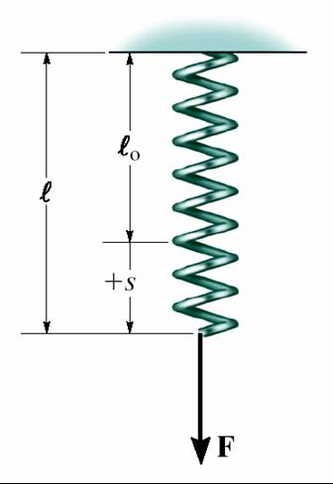
SIMPLE SPRINGS
Spring Force = spring constant * deformation of spring
or F = k * s

Slide 12
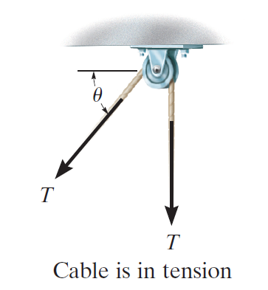
CABLES AND PULLEYS
With a frictionless pulley and cable
T₁ = T₂.
T₁
Cable can support only a tension or “pulling” force, and this force always acts in the direction of the cable.
T₂

Slide 13
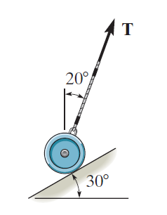
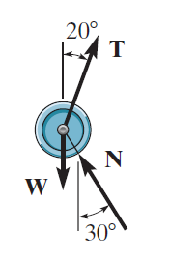
Smooth Contact
If an object rests on a smooth surface, then the surface will exert a force on the object that is normal to the surface at the point of contact.
In addition to this normal force N, the cylinder is also subjected to its weight W and the force T of the cord.
Since these three forces are concurrent at the center of the cylinder, we can apply the
equation of equilibrium to this “particle,” which is the same as applying it to the cylinder.

Slide 14
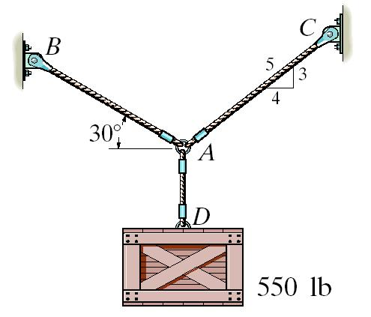
EXAMPLE I
Given: The box weighs 550 lb and geometry is as shown.
Find: The forces in the ropes AB and AC.
Plan:
1. Draw a FBD for point A.
2. Apply the E-of-E to solve for the forces in ropes AB and AC.
Notes:
Source : F3-1

Slide 15
EXAMPLE I (continued)
FBD at point A
y
F_{C}
F_{B}
5
3
30˚
4
A
x
F_{D} = 550 lb
Applying the scalar E-of-E at A, we get;
+ → ∑ F _{x} = – F_{B} cos 30° + F_{C} (4/5) = 0
+ ↑ ∑ F _{y} = F_{B} sin 30° + F_{C} (3/5) - 550 lb = 0
Solving the above equations, we get;
F_{B} = 478 lb and F_{C} = 518 lb

Slide 16
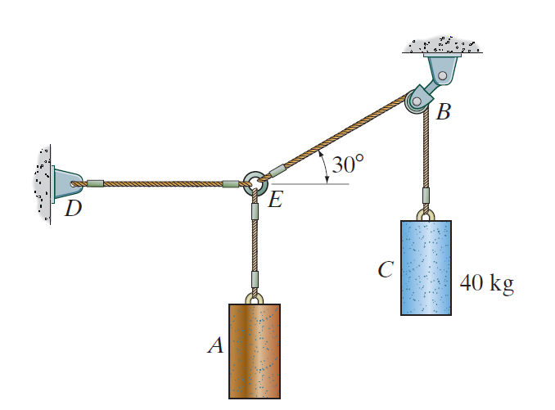
EXAMPLE II
Given: The mass of cylinder C is 40 kg and geometry is as shown.
Find: The tensions in cables DE, EA, and EB.
Plan:
1. Draw a FBD for point E.
2. Apply the E-of-E to solve for the forces in cables DE, EA, and EB.
Notes:
Source : F3-5

Slide 17
EXAMPLE II (continued)
FBD at point E
y
T_{EB} = 40*9.81 N
T_{ED}
30˚
E
x
T_{EA}
Applying the scalar E-of-E at E, we get;
+ → ∑ F _{x} = − T_{ED} + (40*9.81) cos 30° = 0
+ ↑ ∑ F _{y} = (40*9.81) sin 30° − T_{EA} = 0
Solving the above equations, we get;
T_{ED} = 340 N ← and T_{EA} = 196 N ↓

Slide 18
CONCEPT QUIZ
1000 lb
1000 lb
1000 lb
( A ) ( B ) ( C )
1) Assuming you know the geometry of the ropes, in which system above can you NOT determine forces in the cables?
2) Why?
A) The weight is too heavy.
B) The cables are too thin.
C) There are more unknowns than equations.
D) There are too few cables for a 1000 lb weight.
Notes:
Answers:
1. C
2. C
You may ask the students to record their answers, first, without group discussion and later after the group discussion with their neighbors. Again, like after reading quiz, they should verbally indicate the answers. You can comment on the answers, emphasizing statically indeterminate condition.

Slide 19
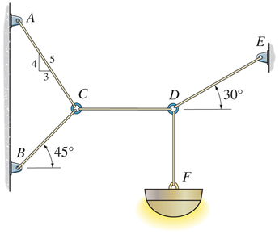
GROUP PROBLEM SOLVING
Given: The mass of lamp is 20 kg and geometry is as shown.
Find: The force in each cable.
Plan:
1. Draw a FBD for Point D.
2. Apply E-of-E at Point D to solve for the unknowns (F_{CD} & F_{DE}).
3. Knowing F_{CD}, repeat this process at point C.
Notes:
Source : P3-29

Slide 20
GROUP PROBLEM SOLVING (continued)
FBD at point D
y
F_{DE}
F_{CD}
30˚
D
x
W = 20 (9.81) N
Applying the scalar E-of-E at D, we get;
+↑ ∑ F_{y} = F_{DE} sin 30° – 20 (9.81) = 0
+→ ∑ F_{x} = F_{DE} cos 30° – F_{CD} = 0
Solving the above equations, we get:
F_{DE} = 392 N and F_{CD} = 340 N

Slide 21
GROUP PROBLEM SOLVING (continued)
FBD at point C
F_{AC}
y
4
5
3
F_{CD} =340 N
C
x
F_{BC}
45˚
Applying the scalar E-of-E at C, we get;
+→ ∑ F_{x} = 340 – F_{BC} sin 45° – F_{AC} (3/5) = 0
+ ↑ ∑ F_{y} = F_{AC} (4/5) – F_{BC} cos 45° = 0
Solving the above equations, we get;
F_{BC} = 275 N and F_{AC} = 243 N

Slide 22
ATTENTION QUIZ
1. Select the correct FBD of particle A.
30°
A
40°
100 lb
F1 F2
A)
A
B)
30°
40°
100 lb
A
F
F1
F2
C)
D)
30°
40°
30°
A
A
100 lb
100 lb
Notes:
Answers:
1. D

Slide 23
ATTENTION QUIZ
2. Using this FBD of Point C, the sum of forces in the x-direction (Σ F_{X}) is ___ . Use a sign convention of + → .
A) F₂ sin 50° – 20 = 0
B) F₂ cos 50° – 20 = 0
C) F₂ sin 50° – F₁ = 0
D) F₂ cos 50° + 20 = 0
F₂
20 lb
50°
C
F₁
Notes:
Answers:
2. B

Slide 24
End of the Lecture
Let Learning Continue

