Slide 1
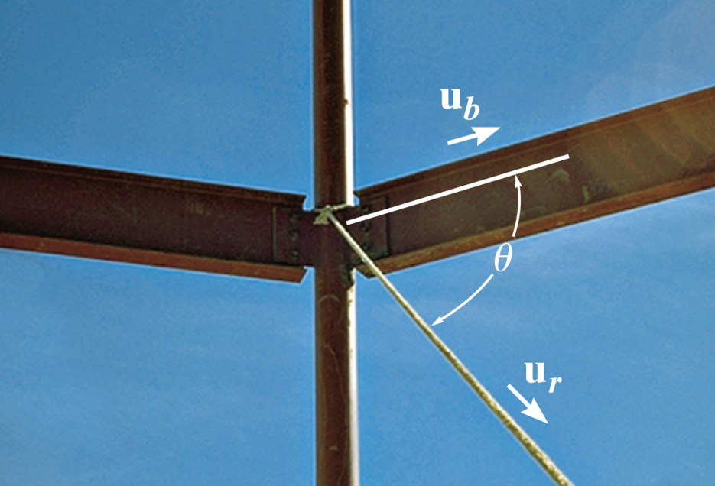
DOT PRODUCT
Today’s Objective:
Students will be able to use the vector dot product to:
a) determine an angle between two vectors and,
b) determine the projection of a vector along a specified line.
In-Class Activities:
Check Homework
Reading Quiz
Applications / Relevance
Dot product - Definition
Angle Determination
Determining the Projection
Concept Quiz
Group Problem Solving
Attention Quiz

Slide 2
READING QUIZ
1. The dot product of two vectors P and Q is defined as
A) P Q sin θ B) P Q cos θ
C) P Q tan θ D) P Q sec θ
P
θ
Q
2. The dot product of two vectors results in a _________ quantity.
A) Scalar B) Vector
C) Complex D) Zero
Notes:
Answers:
1. B
2. A

Slide 3
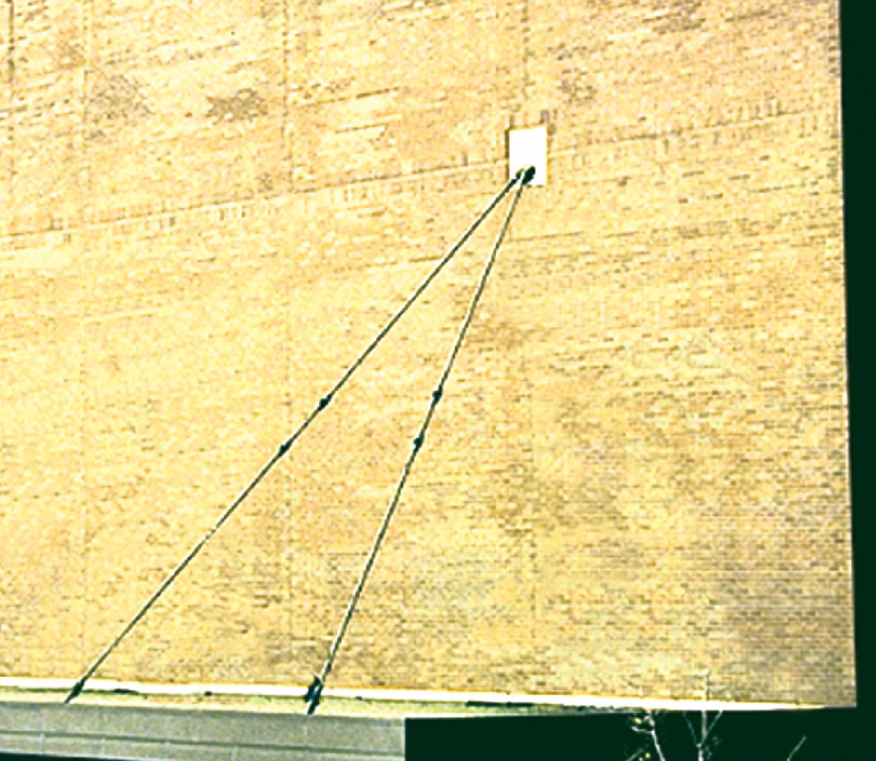
APPLICATIONS
If you know the physical locations of the four cable ends, how could you calculate the angle between the cables at the common anchor?

Slide 4
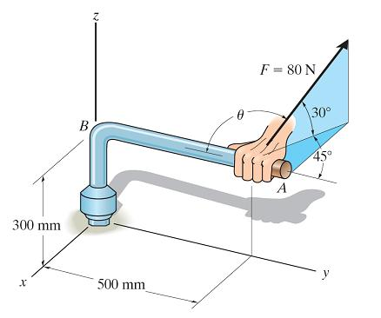
APPLICATIONS (continued)
For the force F applied to the wrench at Point A, what component of it actually helps turn the bolt (i.e., the force component acting perpendicular to arm AB of the pipe)?

Slide 5
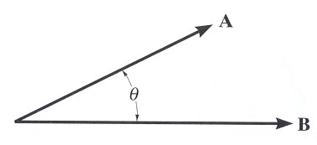
DEFINITION
The dot product of vectors A and B is defined as A•B = A B cos θ.
The angle θ is the smallest angle between the two vectors and is always in a range of 0º to 180º.
Dot Product Characteristics:
1. The result of the dot product is a scalar (a positive or negative number).
2. The units of the dot product will be the product of the units of the A and B vectors.

Slide 6
DOT PRODUCT DEFINITON (continued)
Examples: By definition, i • j = 0
i • i = 1
A • B = (A_{x} i + A_{y} j + A_{z} k) • (B_{x} i + B_{y} j + B_{z} k)
= A_{x} B_{x} + A_{y}B_{y} + A_{z}B_{z}

Slide 7
USING THE DOT PRODUCT TO DETERMINE THE ANGLE BETWEEN TWO VECTORS
For these two vectors in Cartesian form, one can find the angle by
a) Find the dot product, A • B = (A_{x}B_{x} + A_{y}B_{y} + A_{z}B_{z} ),
b) Find the magnitudes (A & B) of the vectors A & B, and
c) Use the definition of dot product and solve for θ, i.e.,
θ = cos⁻¹ [(A • B)/(A B)], where 0º ≤ θ ≤ 180º .

Slide 8
DETERMINING THE PROJECTION OF A VECTOR
You can determine the components of a vector parallel and perpendicular to a line using the dot product.
Steps:
1. Find the unit vector, u_{a} along line aa
2. Find the scalar projection of A along line aa by
A|| = A • u_{a} = A_{x} u_{x} + A_{y} u_{y} + A_{z} u_{z}

Slide 9
DETERMINING THE PROJECTION OF A VECTOR (continued)
3. If needed, the projection can be written as a vector, A|| , by using the unit vector u_{a} and the magnitude found in step 2.
A|| = A|| u_{a}
4. The scalar and vector forms of the perpendicular component can easily be obtained by
A ⊥ = (A ² - A|| ²) ^{½} and
A ⊥ = A – A||
(rearranging the vector sum of A = A⊥ + A|| )

Slide 10
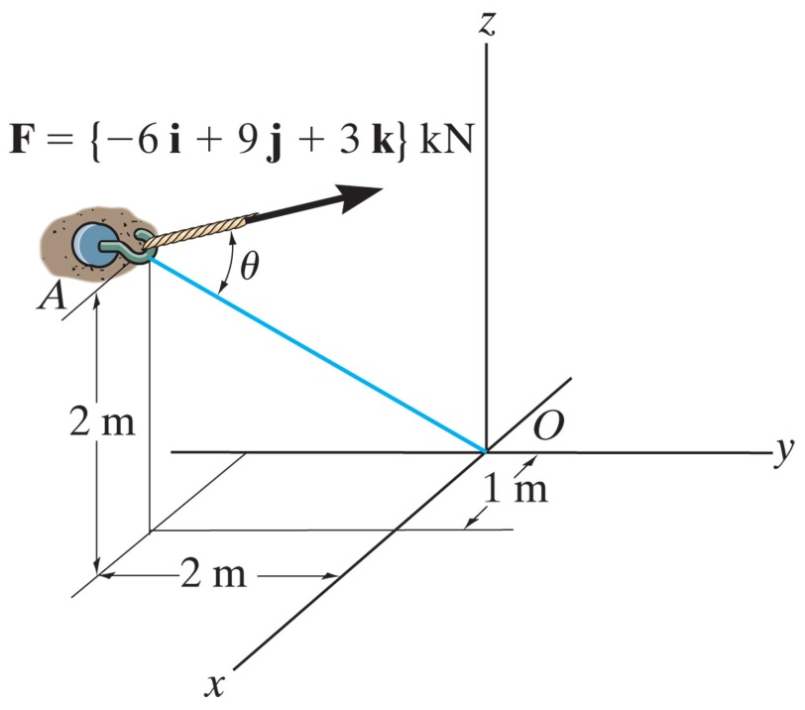
EXAMPLE I
Given: The force acting on the hook at point A.
Find: The angle between the force vector and the line AO, and the magnitude of the projection of the force along the line AO.
Plan:
1. Find r_{AO}
2. Find the angle θ = cos⁻¹{(F • r_{AO})/(F r_{AO})}
3. Find the projection via F_{AO} = F • u_{AO} (or F cos θ )
Notes:
Source : F2-25

Slide 11
EXAMPLE I (continued)
r_{AO} = {−1 i + 2 j − 2 k} m
r_{AO} = {(-1)² + 2² + (-2)²}^{1/2} = 3 m
F = {− 6 i + 9 j + 3 k} kN
F = {(-6)² + 9² + 3²}^{1/2} = 11.22 kN
F • r_{AO} = (− 6)(−1) + (9)(2) + (3)(−2) = 18 kN⋅m
θ = cos⁻¹{(F • r_{AO})/(F r_{AO})}
θ = cos⁻¹ {18 / (11.22 × 3)} = 57.67°

Slide 12
EXAMPLE I(continued)
u_{AO} = r_{AO} / r_{AO} = (−1/3) i + (2/3) j + (−2/3) k
F_{AO} = F • u_{AO} = (− 6)(−1/3) + (9)(2/3) + (3)(−2/3) = 6.00 kN
Or: F_{AO} = F cos θ = 11.22 cos (57.67°) = 6.00 kN

Slide 13
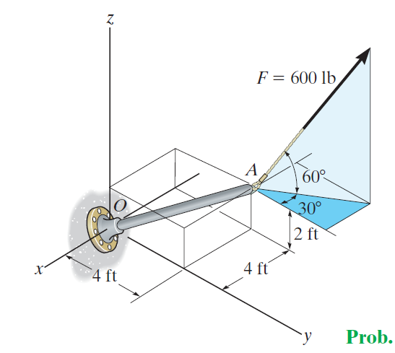
EXAMPLE II
Given: The force acting on the pole at point A.
Find: The components of the force acting parallel and perpendicular to the axis of the pole.
Plan:
1. Find F, r_{OA} and u_{OA}
2. Determine the parallel component of F using F|| = F • u_{OA}
3. The perpendicular component of F is F⊥ = (F² - F|| ²) ^{½}
Notes:
Source : F2-30

Slide 14
EXAMPLE II (continued)
r_{OA} = {−4 i + 4 j + 2 k} m
r_{OA} = {(-4)² + 4² + 2²}^{1/2} = 6 m
u_{OA} = −2/3 i + 2/3 j + 1/3 k
F = {-(600 cos 60°) sin30° i + (600 cos 60°) cos30° j + (600 sin 60°) k} lb
F = {-150 i + 259.8 j + 519.6 k} lb
The parallel component of F :
F|| = F • u_{OA} ={-150 i + 259.8 j + 519.6 k}• {-2/3 i + 2/3 j + 1/3 k}
F|| = (-150) × (-2/3) + 259.8 × (2/3) + 519.6 × (1/3) = 446 lb

Slide 15
EXAMPLE II (continued)
F = 600 lb
F|| = 446 lb
The perpendicular component of F :
F⊥ = (F² - F|| ²) ^{½} = ( 600 ² – 446 ²) ^{½} = 401 lb

Slide 16
CONCEPT QUIZ
1. If a dot product of two non-zero vectors is 0, then the two vectors must be _____________ to each other.
A) Parallel (pointing in the same direction)
B) Parallel (pointing in the opposite direction)
C) Perpendicular
D) Cannot be determined.
2. If a dot product of two non-zero vectors equals -1, then the vectors must be ________ to each other.
A) Collinear but pointing in the opposite direction
B) Parallel (pointing in the opposite direction)
C) Perpendicular
D) Cannot be determined.
Notes:
Answers:
1. C
2. A

Slide 17
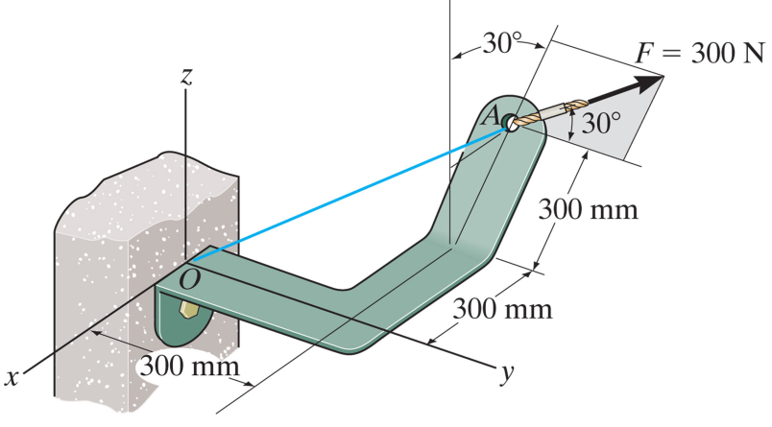
GROUP PROBLEM SOLVING
Given: The 300 N force acting on the bracket.
Find: The magnitude of the projected component of this force acting along line OA
Plan:
1. Find r_{OA} and u_{OA}
2. Find the angle θ = cos⁻¹{(F • r_{OA})/(F × r_{OA})}
3. Then find the projection via F_{OA} = F • u_{OA} or F (1) cos θ
Notes:
Source : P2-137

Slide 18
GROUP PROBLEM SOLVING (continued)
F´
r_{OA} = {−0.450 i + 0.300 j + 0.260 k} m
r_{OA} = {(−0.450)² + 0.300² + 0.260² }^{1/2} = 0.60 m
u_{OA} = r_{OA} / r_{OA} = {-0.75 i + 0.50 j + 0.433 k }

Slide 19
GROUP PROBLEM SOLVING (continued)
F´
F´ = 300 sin 30° = 150 N
F = {−150 sin 30°i + 300 cos 30°j + 150 cos 30°k} N
F = {−75 i + 259.8 j + 129.9 k} N
F = {(-75)² + 259.8² + 129.9²}^{1/2} = 300 N

Slide 20
GROUP PROBLEM SOLVING (continued)
F • r_{OA} = (-75) (-0.45) + (259.8) (0.30) + (129.9) (0.26)
= 145.5 N·m
θ = cos⁻¹{(F • r_{OA})/(F × r_{OA})}
θ = cos⁻¹{145.5 /(300 × 0.60)} = 36.1°
The magnitude of the projected component of F along line OA will be
F_{OA} = F • u_{OA} = (-75)(-0.75) + (259.8) (0.50) + (129.9) (0.433) = 242 N
Or
F_{OA} = F cos θ = 300 cos 36.1° = 242 N

Slide 21
ATTENTION QUIZ
1. The dot product can be used to find all of the following except ____ .
A) sum of two vectors
B) angle between two vectors
C) component of a vector parallel to another line
D) component of a vector perpendicular to another line
2. Find the dot product of the two vectors P and Q.
P = {5 i + 2 j + 3 k} m
Q = {-2 i + 5 j + 4 k} m
A) -12 m B) 12 m C) 12 m ²
D) -12 m ² E) 10 m ²
Notes:
Answers:
1. A
2. C

Slide 22
End of the Lecture
Let Learning Continue

