Slide 1
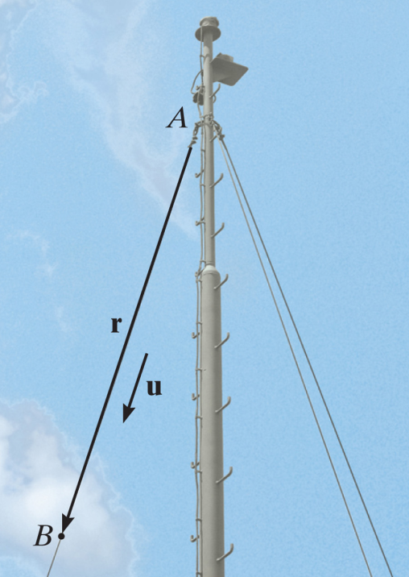
POSITION VECTORS & FORCE VECTORS
Today’s Objectives:
Students will be able to :
a) Represent a position vector in Cartesian coordinate form, from given geometry.
b) Represent a force vector directed along a line.
In-Class Activities:
Check Homework
Reading Quiz
Applications / Relevance
Write Position Vectors
Write a Force Vector along a line
Concept Quiz
Group Problem
Attention Quiz

Slide 2
READING QUIZ
1. The position vector r_{PQ} is obtained by
A) Coordinates of Q minus coordinates of the origin
B) Coordinates of P minus coordinates of Q
C) Coordinates of Q minus coordinates of P
D) Coordinates of the origin minus coordinates of P
2. A force of magnitude F, directed along a unit vector U, is given by F = ______ .
A) F (U)
B) U / F
C) F / U
D) F + U
E) F – U
Notes:
Answers:
1. C
2. A

Slide 3
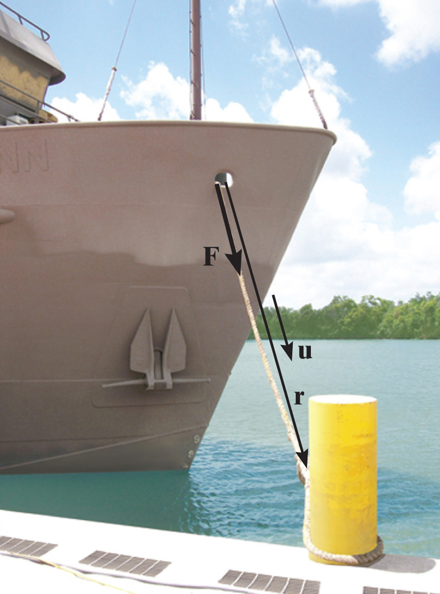
APPLICATIONS
This ship’s mooring line, connected to the bow, can be represented as a Cartesian vector.
What are the forces in the mooring line and how do we find their directions?
Why would we want to know these things?

Slide 4
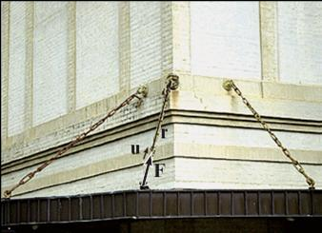
APPLICATIONS (continued)
This awning is held up by three chains. What are the forces in the chains and how do we find their directions? Why would we want to know these things?

Slide 5
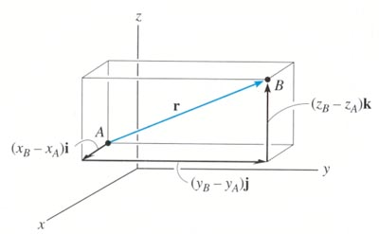
POSITION VECTOR
A position vector is defined as a fixed vector that locates a point in space relative to another point.
Consider two points, A and B, in 3-D space.
Let their coordinates be (X_{A}, Y_{A}, Z_{A}) and (X_{B}, Y_{B}, Z_{B}), respectively.

Slide 6
POSITION VECTOR (continued)
The position vector directed from A to B, r_{AB} , is defined as
r_{AB} = {( X_{B} – X_{A} ) i + ( Y_{B} – Y_{A} ) j + ( Z_{B} – Z_{A} ) k }m
Please note that B is the ending point and A is the starting point. ALWAYS subtract the “tail” coordinates from the “tip” coordinates!

Slide 7
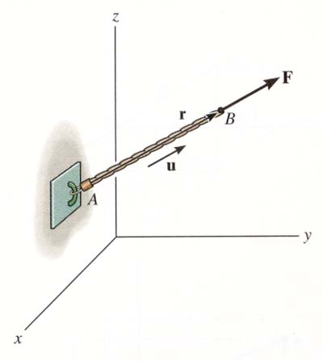
FORCE VECTOR DIRECTED ALONG A LINE (Section 2.8)
If a force is directed along a line, then we can represent the force vector in Cartesian coordinates by using a unit vector and the force’s magnitude. So we need to:
a) Find the position vector, r_{AB} , along two points on that line.
b) Find the unit vector describing the line’s direction, u_{AB} = (r_{AB}/r_{AB}).
c) Multiply the unit vector by the magnitude of the force, F = F u_{AB} .

Slide 8
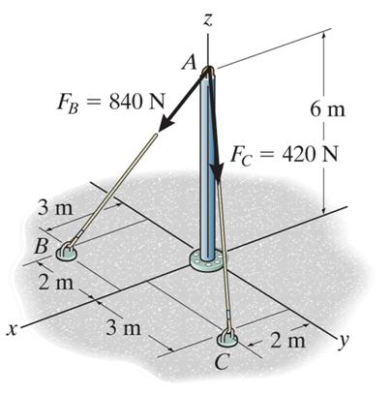
EXAMPLE
Given: The 420 N force
along the cable AC.
Find: The force F_{AC} in the Cartesian vector form.
Plan:
1. Find the position vector r_{AC} and its unit vector u_{AC.}
2. Obtain the force vector as F_{AC} = 420 N u_{AC} .
Notes:
Source : F2-23

Slide 9
EXAMPLE (continued)
As per the figure, when relating A to C, we will have to go 2 m in the x-direction, 3 m in the y-direction, and -6 m in the z-direction. Hence,
r_{AC} = {2 i + 3 j − 6 k} m.
(We can also find r_{AC} by subtracting the coordinates of A from the coordinates of C.)
r_{AC} = {2² + 3² + (-6)²}^{1/2} = 7 m
Now u_{AC} = r_{AC}/r_{AC} and F_{AC} = 420 u_{AC} = 420 (r_{AC}/r_{AC} )
So F_{AC} = 420{ (2 i + 3 j − 6 k) / 7 } N
= {120 i + 180 j − 360 k } N

Slide 10
CONCEPT QUIZ
1. P and Q are two points in a 3-D space. How are the position vectors r_{PQ} and r_{QP} related?
A) r_{PQ} = r_{QP} B) r_{PQ} = - r_{QP}
C) r_{PQ} = 1/r_{QP} D) r_{PQ} = 2 r_{QP}
2. If F and r are force and position vectors, respectively, in SI units, what are the units of the expression (r * (F / F)) ?
A) Newton B) Dimensionless
C) Meter D) Newton - Meter
E) The expression is algebraically illegal.
Notes:
Answers:
1. B
2. C

Slide 11
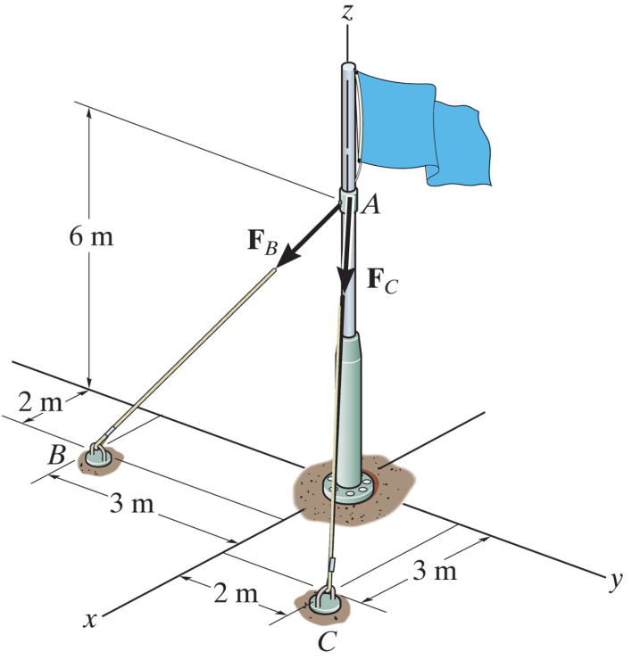
GROUP PROBLEM SOLVING
Given: Two forces are acting on a flag pole as shown in the figure. F_{B} = 560 N and F_{C} = 700 N
Find: The magnitude and the coordinate direction angles of the resultant force.
Plan:
1) Find the forces along AB and AC in the Cartesian vector form.
2) Add the two forces to get the resultant force, F_{R}.
3) Determine the magnitude and the coordinate angles of F_{R}.
Notes:
Source : P2-94

Slide 12

GROUP PROBLEM SOLVING (continued)
r_{AB} = {2 i − 3 j − 6 k} m
r_{AC} = {3 i + 2 j − 6 k} m
r_{AB} = {2² + (-3)² + (-6)²}^{1/2} = 7 m
r_{AC} = {3² + 2² + (-6)²}^{1/2} = 7 m
F_{AB} = 560 (r_{AB} / r_{AB}) N
F_{AB} = 560 ( 2 i – 3 j – 6 k) / 7 N
F_{AB} = (160 i – 240 j – 480 k) N
F_{AC} = 700 (r_{AC} / r_{AC}) N
F_{AC} = 700 (3 i + 2 j – 6 k) / 7 N
F_{AC} = {300 i + 200 j – 600 k} N

Slide 13
GROUP PROBLEM SOLVING (continued)
F_{R} = F_{AB} + F_{AC}
= {460 i – 40 j – 1080 k} N
F_{R} = {460² + (-40)² + (-1080)²}^{1/2}
= 1174.6 N
F_{R} = 1175 N
α = cos⁻¹(460/1175) = 66.9°
β = cos⁻¹(–40/1175) = 92.0°
γ = cos⁻¹(–1080/1175) = 157°

Slide 14
ATTENTION QUIZ
1. Two points in 3–D space have coordinates of P (1, 2, 3) and Q (4, 5, 6) meters. The position vector r_{QP} is given by
A) {3 i + 3 j + 3 k} m
B) {– 3 i – 3 j – 3 k} m
C) {5 i + 7 j + 9 k} m
D) {– 3 i + 3 j + 3 k} m
E) {4 i + 5 j + 6 k} m
2. A force vector, F, directed along a line defined by PQ is given by
A) (F/ F) r_{PQ} B) r_{PQ}/r_{PQ}
C) F(r_{PQ}/r_{PQ}) D) F(r_{PQ}/r_{PQ})
Notes:
Answers
1. B
2. C

Slide 15
End of the Lecture
Let Learning Continue

