Slide 1
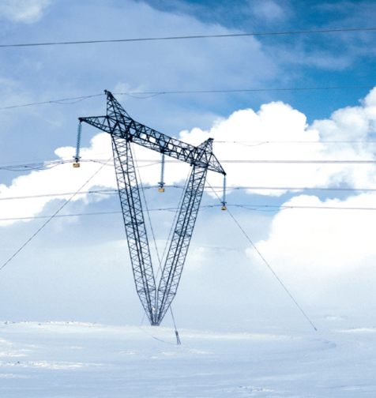
CARTESIAN VECTORS AND
THEIR ADDITION & SUBTRACTION
Today’s Objectives:
Students will be able to:
a) Represent a 3-D vector in a Cartesian coordinate system.
b) Find the magnitude and coordinate angles of a 3-D vector
c) Add vectors (forces) in 3-D space
In-Class Activities:
Reading Quiz
Applications/Relevance
A Unit Vector
3-D Vector Terms
Adding Vectors
Concept Quiz
Examples
Attention Quiz

Slide 2
READING QUIZ
1. Vector algebra, as we are going to use it, is based on a ___________ coordinate system.
A) Euclidean B) Left-handed
C) Greek D) Right-handed E) Egyptian
2. The symbols α, β, and γ designate the __________ of a 3-D Cartesian vector.
A) Unit vectors B) Coordinate direction angles
C) Greek societies D) X, Y and Z components
Notes:
Answers:
1. D
2. B

Slide 3
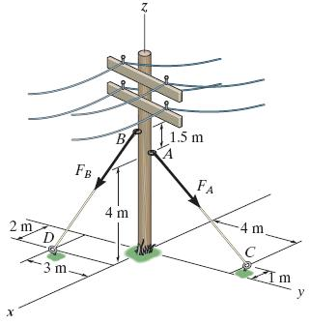
APPLICATIONS
Many structures and machines involve 3-dimensional space.
In this case, the power pole has guy wires helping to keep it upright in high winds. How would you represent the forces in the cables using Cartesian vector form?

Slide 4
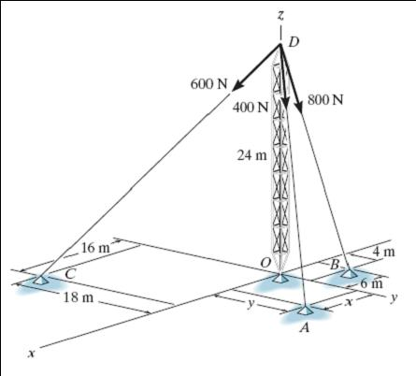
APPLICATIONS (continued)
In the case of this radio tower, if you know the forces in the three cables, how would you determine the resultant force acting at D, the top of the tower?

Slide 5
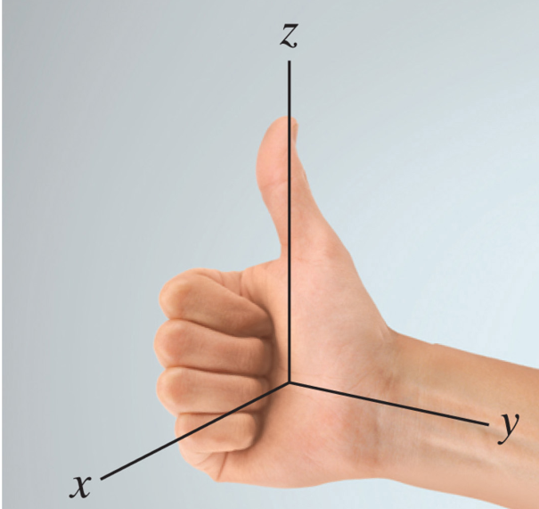
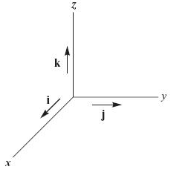
CARTESIAN UNIT VECTORS
For a vector A, with a magnitude of A, an unit vector is defined as
u_{A} = A / A .
Characteristics of a unit vector :
a) Its magnitude is 1.
b) It is dimensionless (has no units).
c) It points in the same direction as the
original vector (A).
The unit vectors in the Cartesian axis system are i, j, and k. They are unit vectors along the positive x, y, and z axes respectively.

Slide 6
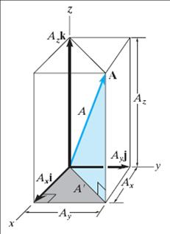
CARTESIAN VECTOR REPRESENTATION
Consider a box with sides A_{X}, A_{Y}, and A_{Z} meters long.
The vector A can be defined as
A = (A_{X} i + A_{Y} j + A_{Z} k) m
The projection of vector A in the x-y plane is A´. The magnitude of A´ is found by using the same approach as a
2-D vector: A´ = (A_{X}² + A_{Y}²)^{1/2} .
The magnitude of the position vector A can now be obtained as
A = ((A´)² + A_{Z}²) ^{½} = (A_{X}² + A_{Y}² + A_{Z}²) ^{½}

Slide 7
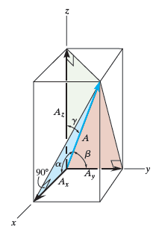
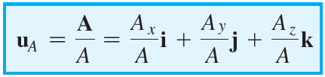

DIRECTION OF A CARTESIAN VECTOR
The direction or orientation of vector A is defined by the angles α, β, and γ.
These angles are measured between the vector and the positive X, Y and Z axes, respectively. Their range of values are from 0° to 180°
Using trigonometry, “direction cosines” are found using
$$cosα=\frac{A_{x}}{A} cosβ=\frac{A_{y}}{A} cosγ=\frac{A_{z}}{A}$$
These angles are not independent. They must satisfy the following equation.
cos² α + cos² β + cos² γ = 1
This result can be derived from the definition of a coordinate direction angles and the unit vector. Recall, the formula for finding the unit vector of any position vector:
or written another way, u_{A} = cos α i + cos β j + cos γ k .

Slide 8

ADDITION OF CARTESIAN VECTORS
(Section 2.6)
Once individual vectors are written in Cartesian form, it is easy to add or subtract them. The process is essentially the same as when 2-D vectors are added.
For example, if
A = A_{X} i + A_{Y} j + A_{Z} k and
B = B_{X} i + B_{Y} j + B_{Z} k , then
A + B = (A_{X} + B_{X}) i + (A_{Y} + B_{Y}) j + (A_{Z} + B_{Z}) k
or
A – B = (A_{X} - B_{X}) i + (A_{Y} - B_{Y}) j + (A_{Z} - B_{Z}) k .

Slide 9
IMPORTANT NOTES
Sometimes 3-D vector information is given as:
a) Magnitude and the coordinate direction angles, or,
b) Magnitude and projection angles.
You should be able to use both these sets of information to change the representation of the vector into the Cartesian form, i.e.,
F = {10 i – 20 j + 30 k} N .

Slide 10
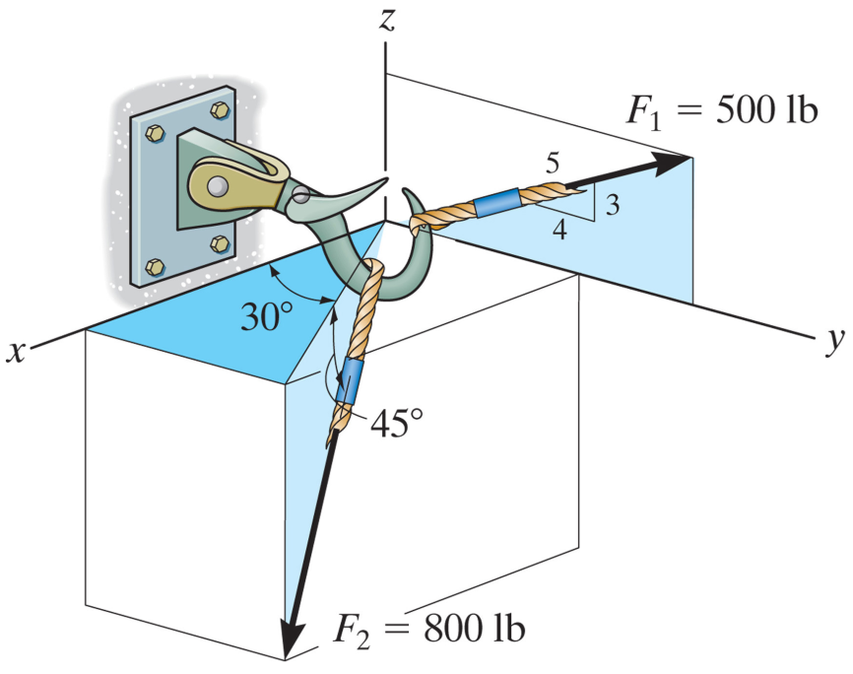
EXAMPLE
Given: Two forces F₁ and F₂ are applied to a hook.
Find: The resultant force in Cartesian vector form.
Plan:
G
Using geometry and trigonometry, write F₁ and F₂ in Cartesian vector form.
2) Then add the two forces (by adding x and y-components).
Notes:
Source : F 2-18

Slide 11
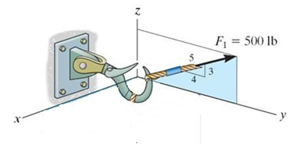
EXAMPLE (continued)
Solution:
First, resolve force F₁.
F_{x} = 0 = 0 lb
F_{y} = 500 (4/5) = 400 lb
F_{z} = 500 (3/5) = 300 lb
Now, write F₁ in Cartesian vector form (don’t forget the units!).
F₁ = {0 i + 400 j + 300 k} lb

Slide 12
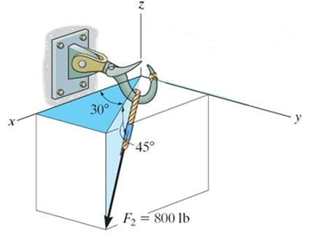
EXAMPLE (continued)
Now, resolve force F₂.
F_{2z} = -800 sin 45° = − 565.7 lb
F₂’ = 800 cos 45° = 565.7 lb
F₂’ can be further resolved as,
F_{2x} = 565.7 cos 30° = 489.9 lb
F_{2y} = 565.7 sin 30° = 282.8 lb
F₂’
F_{2z}
Thus, we can write:
F₂ = {489.9 i + 282.8 j − 565.7 k } lb

Slide 13
EXAMPLE (continued)
So F_{R} = F₁ + F₂ and
F₁ = {0 i + 400 j + 300 k} lb
F₂ = {489.9 i + 282.8 j − 565.7 k } lb
F_{R} = { 490 i + 683 j − 266 k } lb

Slide 14
CONCEPT QUIZ
1. If you know only u_{A}, you can determine the ________ of A
uniquely.
A) magnitude B) angles (α, β and γ)
C) components (A_{X}, A_{Y}, & A_{Z}) D) All of the above.
2. For a force vector, the following parameters are randomly generated. The magnitude is 0.9 N, α = 30º , β= 70º , γ = 100º. What is wrong with this 3-D vector ?
A) Magnitude is too small.
B) Angles are too large.
C) All three angles are arbitrarily picked.
D) All three angles are between 0º to 180º.
Notes:
Answers:
1. B
2. C

Slide 15
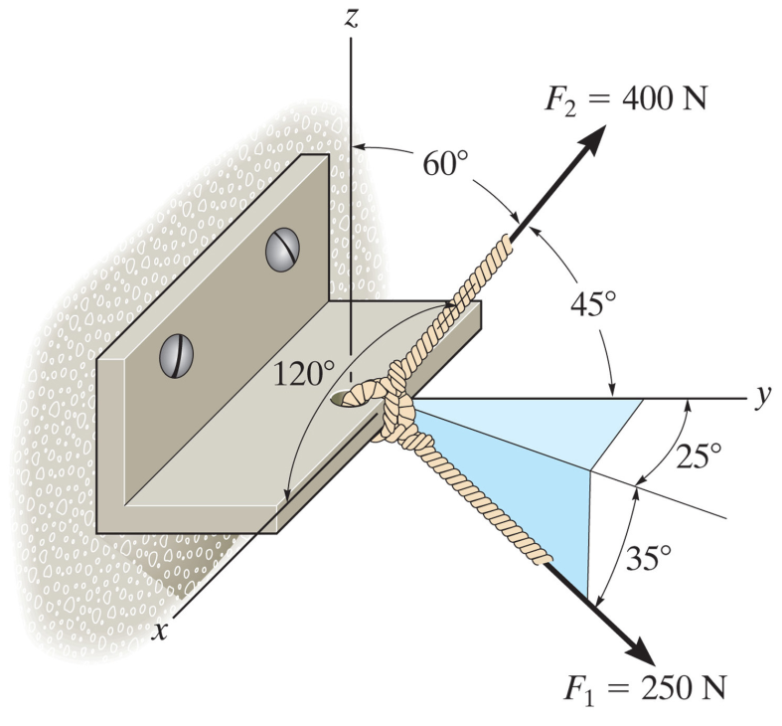
GROUP PROBLEM SOLVING
Given: The screw eye is subjected to two forces, F₁ and F₂.
Find: The magnitude and the coordinate direction angles of the resultant force.
Plan:
1) Using the geometry and trigonometry, resolve and write F₁ and F₂ in the Cartesian vector form.
2) Add F₁ and F₂ to get F_{R}.
3) Determine the magnitude and angles α, β, γ.
Notes:
Source : P2-80

Slide 16

GROUP PROBLEM SOLVING (continued)
First resolve the force F₁.
F_{1z} = - 250 sin 35° = - 143.4 N
F´ = 250 cos 35° = 204.8 N
F´
F´ can be further resolved as,
F_{1x} = 204.8 sin 25° = 86.6 N
F_{1y} = 204.8 cos 25° = 185.6 N
F_{1z}
Now we can write:
F₁ = {86.6 i + 185.6 j − 143.4 k } N

Slide 17

GROUP PROBLEM SOLVING (continued)
Now, resolve force F₂.
The force F₂ can be represented in the Cartesian vector form as:
F₂ = 400{ cos 120° i + cos 45° j + cos 60° k } N
= { -200 i + 282.8 j + 200 k } N
F₂ = { -200 i + 282.8 j +200 k } N

Slide 18

GROUP PROBLEM SOLVING (continued)
So F_{R} = F₁ + F₂ and
F₁ = { 86.6 i + 185.6 j − 143.4 k} N
F₂ = { -200 i + 282.8 j + 200 k} N
F_{R} = { -113.4 i + 468.4 j + 56.6 k} N
Now find the magnitude and direction angles for the vector.
F_{R} = {(-113.4)² + 468.4² + 56.6²}^{1/2} = 485.2 = 485 N
α = cos⁻¹ (F_{Rx} / F_{R}) = cos⁻¹ (-113.4 / 485.2) = 104°
β = cos⁻¹ (F_{Ry} / F_{R}) = cos⁻¹ (468.4 / 485.2) = 15.1°
γ = cos⁻¹ (F_{Rz} / F_{R}) = cos⁻¹ (56.6 / 485.2) = 83.3°

Slide 19
ATTENTION QUIZ
1. What is not true about an unit vector, e.g., u_{A}?
A) It is dimensionless.
B) Its magnitude is one.
C) It always points in the direction of positive X- axis.
D) It always points in the direction of vector A.
2. If F = {10 i + 10 j + 10 k} N and
G = {20 i + 20 j + 20 k } N, then F + G = { ____ } N
A) 10 i + 10 j + 10 k
B) 30 i + 20 j + 30 k
C) – 10 i – 10 j – 10 k
D) 30 i + 30 j + 30 k
Notes:
Answers:
1. C
2. D

Slide 20
End of the Lecture
Let Learning Continue

