Slide 1
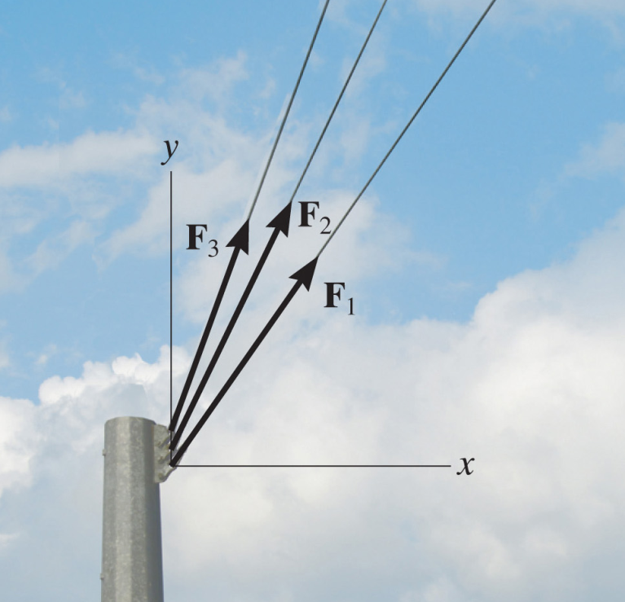
FORCE VECTORS, VECTOR OPERATIONS & ADDITION COPLANAR FORCES
Today’s Objective:
Students will be able to :
a) Resolve a 2-D vector into components.
b) Add 2-D vectors using Cartesian vector notations.
In-Class activities:
Check Homework
Reading Quiz
Application of Adding Forces
Parallelogram Law
Resolution of a Vector Using
Cartesian Vector Notation (CVN)
Addition Using CVN
Example Problem
Concept Quiz
Group Problem
Attention Quiz

Slide 2
READING QUIZ
1. Which one of the following is a scalar quantity?
A) Force B) Position
C) Mass D) Velocity
2. For vector addition, you have to use ______ law.
A) Newton’s Second
B) the arithmetic
C) Pascal’s
D) the parallelogram
Notes:
Answers:
1. C
2. D

Slide 3
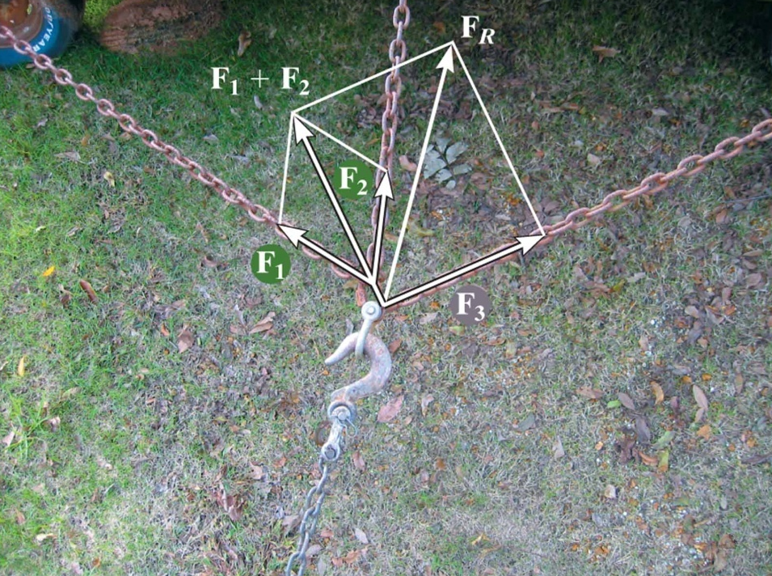
APPLICATION OF VECTOR ADDITION
There are three concurrent forces acting on the hook due to the chains.
We need to decide if the hook will fail (bend or break).
To do this, we need to know the resultant or total force acting on the hook as a result of the three chains.
FR

Slide 4
SCALARS AND VECTORS
(Section 2.1)
Scalars Vectors
Examples: Mass, Volume Force, Velocity
Characteristics: It has a magnitude It has a magnitude
(positive or negative) and direction
Addition rule: Simple arithmetic Parallelogram law
Special Notation: None Bold font, a line, an
arrow or a “carrot”
In these PowerPoint presentations, a vector quantity is represented like this (in bold, italics, and red).

Slide 5
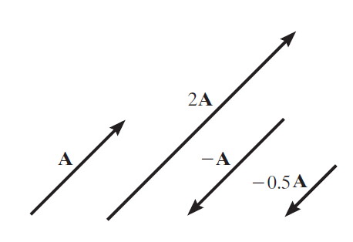
VECTOR OPERATIONS (Section 2.2)
Scalar Multiplication
and Division

Slide 6
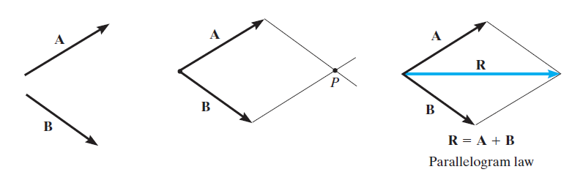
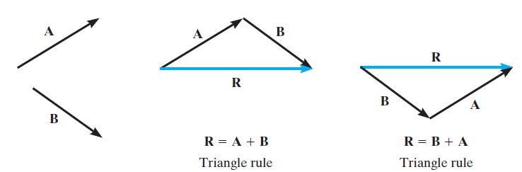
VECTOR ADDITION USING EITHER THE
PARALLELOGRAM LAW OR TRIANGLE
Parallelogram Law:
Triangle method (always ‘tip to tail’):
How do you subtract a vector?
How can you add more than two concurrent vectors graphically?

Slide 7
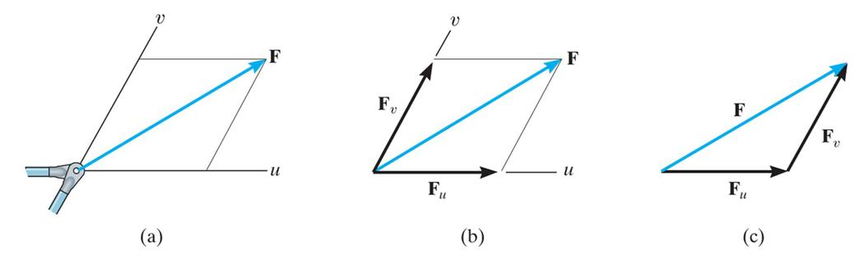
RESOLUTION OF A VECTOR
“Resolution” of a vector is breaking up a vector into components.
It is kind of like using the parallelogram law in reverse.

Slide 8
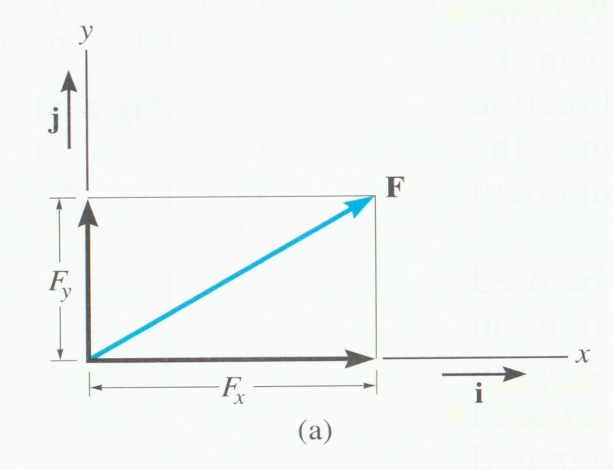
ADDITION OF A SYSTEM OF COPLANAR FORCES (Section 2.4)
We ‘resolve’ vectors into components using the x and y-axis coordinate system.
Each component of the vector is shown as a magnitude and a direction.
The directions are based on the x and y axes. We use the “unit vectors” i and j to designate the x and y-axes.

Slide 9
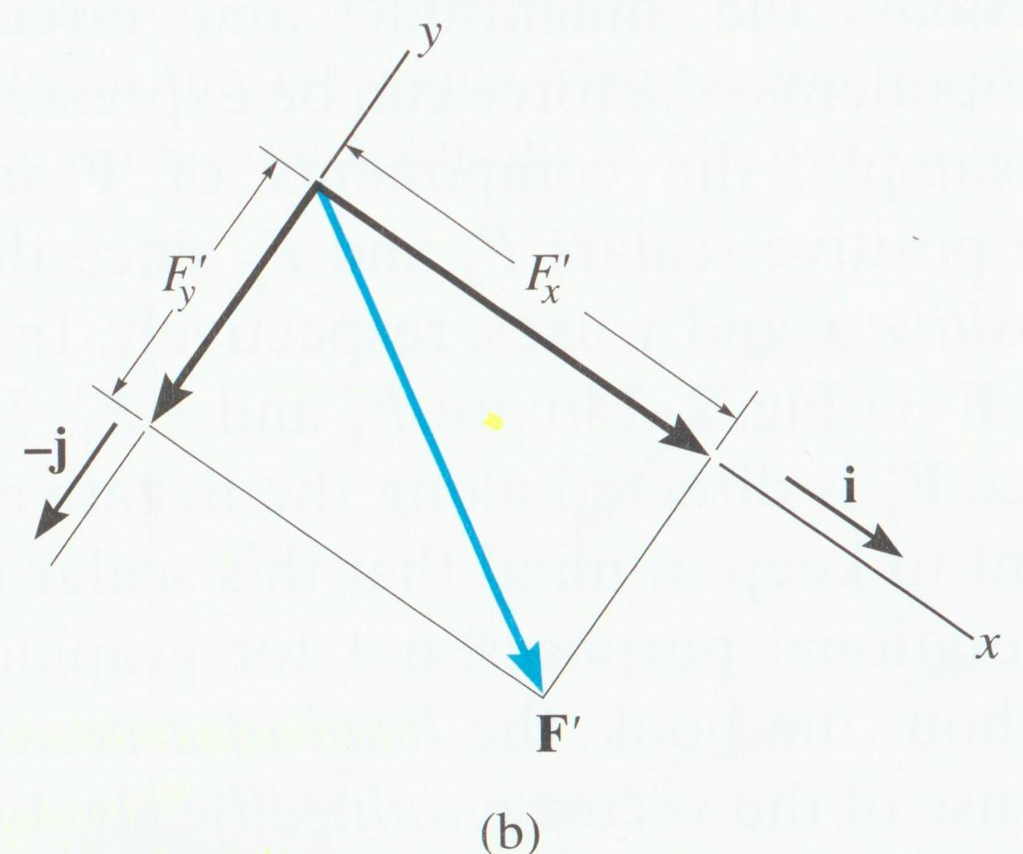
For example,
F = Fx i + Fy j or F' = F'x i + (− F'y ) j
The x and y-axis are always perpendicular to each other. Together, they can be “set” at any inclination.

Slide 10
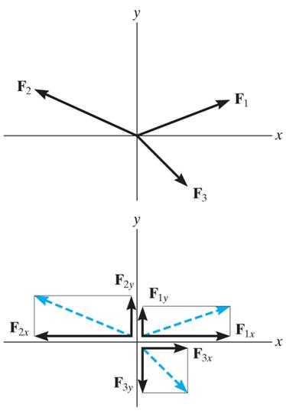
ADDITION OF SEVERAL VECTORS
Step 1 is to resolve each force into its components.
Step 2 is to add all the x-components together, followed by adding all the y-components together. These two totals are the x and y-components of the resultant vector.
Step 3 is to find the magnitude and angle of the resultant vector.

Slide 11
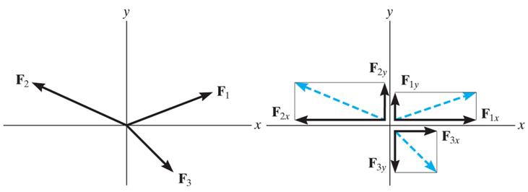
An example of the process:
Break the three vectors into components, then add them.
FR = F1 + F2 + F3
= F1x i + F1y j − F2x i + F2y j + F3x i − F3y j
= (F1x − F2x + F3x) i + (F1y + F2y − F3y) j
= (FRx) i + (FRy) j

Slide 12
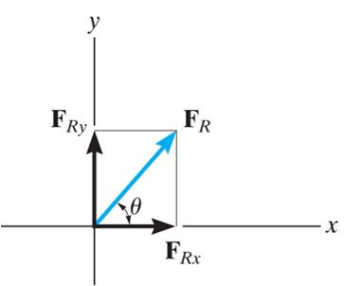
You can also represent a 2-D vector with a magnitude and angle.

Slide 13
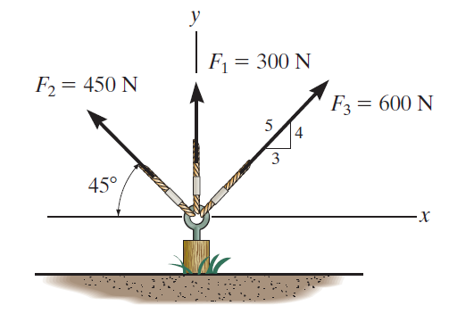
EXAMPLE I
Given: Three concurrent forces acting on a tent post.
Find: The magnitude and angle of the resultant force.
Plan:
a) Resolve the forces into their x-y components.
b) Add the respective components to get the resultant vector.
c) Find magnitude and angle from the resultant components.
Notes:
Source : F2-7

Slide 14
EXAMPLE I (continued)
F1 = {0 i + 300 j } N
F2 = {– 450 cos (45°) i + 450 sin (45°) j } N
= {– 318.2 i + 318.2 j } N
F3 = { (3/5) 600 i + (4/5) 600 j } N
= { 360 i + 480 j } N

Slide 15
EXAMPLE I (continued)
Summing up all the i and j components respectively, we get,
FR = { (0 – 318.2 + 360) i + (300 + 318.2 + 480) j } N
= { 41.80 i + 1098 j } N
Using magnitude and direction:
FR = ((41.80)² + (1098)²)^{1/2} = 1099 N
φ = tan⁻¹(1098/41.80) = 87.8°
y
FR
φ
x

Slide 16
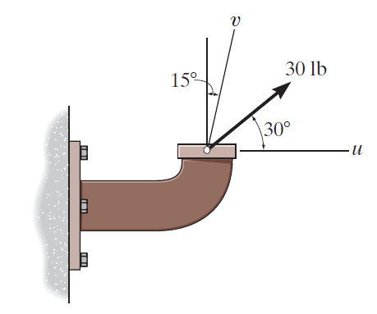
EXAMPLE II
Given: A force acting on a pipe.
Find: Resolve the force into components along the u and v-axes, and determine the magnitude of each of these components.
Plan:
a) Construct lines parallel to the u and v-axes, and form a parallelogram.
b) Resolve the forces into their u-v components.
c) Find magnitude of the components from the law of sines.
Notes:
Source : F2-4

Slide 17
EXAMPLE II (continued)
Solution:
Draw lines parallel to the u and v-axes.
Fu
Fv
And resolve the forces into
the u-v components.
Redraw the top portion of the parallelogram to illustrate a
Triangular, head-to-tail, addition of the components.
Fu
105°
30°
Fv
F
45°

Slide 18
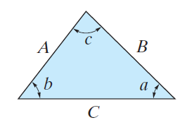
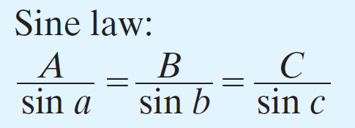

EXAMPLE II (continued)
The magnitudes of two force components are determined from the law of sines. The formulas are given in Fig. 2–10c.
Fu
105°
30°
Fv
F=30 lb
45°
Fu = (30/sin105°) sin 45° = 22.0 lb
Fv = (30/sin105°) sin 30° = 15.5 lb

Slide 19
CONCEPT QUIZ
1. Can you resolve a 2-D vector along two directions, which are not at 90° to each other?
A) Yes, but not uniquely.
B) No.
C) Yes, uniquely.
2. Can you resolve a 2-D vector along three directions (say at 0, 60, and 120°)?
A) Yes, but not uniquely.
B) No.
C) Yes, uniquely.
Notes:
Answers:
1. C
2. A

Slide 20
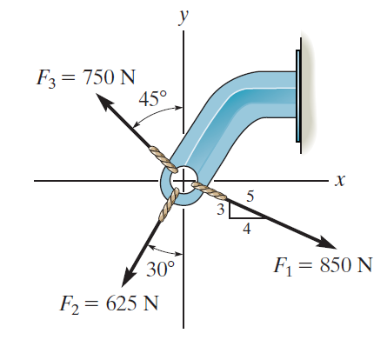
GROUP PROBLEM SOLVING
Given: Three concurrent forces acting on a bracket.
Find: The magnitude and angle of the resultant force. Show the resultant in a sketch.
Plan:
a) Resolve the forces into their x and y-components.
b) Add the respective components to get the resultant vector.
c) Find magnitude and angle from the resultant components.
Notes:
Source : P2-42 and P2-43

Slide 21
GROUP PROBLEM SOLVING (continued)
F1 = {850 (4/5) i − 850 (3/5) j } N
= { 680 i − 510 j } N
F2 = {- 625 sin (30°) i − 625 cos (30°) j } N
= {- 312.5 i − 541.3 j } N
F3 = {-750 sin (45°) i + 750 cos (45°) j } N
{- 530.3 i + 530.3 j } N

Slide 22
GROUP PROBLEM SOLVING (continued)
Summing all the i and j components, respectively, we get,
FR = { (680 − 312.5 − 530.3) i + (−510 − 541.3 + 530.3) j }N
= {− 162.8 i − 520.9 j } N
y
Now find the magnitude and angle,
FR = ((− 162.8)² + (− 520.9)²) ^{½} = 546 N
φ = tan^{–1}( 520.9 / 162.8 ) = 72.6°
From the positive x-axis, θ = 253°
θ
-162.8
x
φ
FR
-520.9

Slide 23
ATTENTION QUIZ
1. Resolve F along x and y axes and write it in vector form. F = { ___________ } N
A) 80 cos (30°) i – 80 sin (30°) j
B) 80 sin (30°) i + 80 cos (30°) j
C) 80 sin (30°) i – 80 cos (30°) j
D) 80 cos (30°) i + 80 sin (30°) j
y
x
30°
F = 80 N
2. Determine the magnitude of the resultant (F1 + F2) force in N when F1 = { 10 i + 20 j } N and F2 = { 20 i + 20 j } N .
A) 30 N B) 40 N C) 50 N
D) 60 N E) 70 N
Notes:
Answers:
1. C
2. C

Slide 24
End of the Lecture
Let Learning Continue

