Slide 1
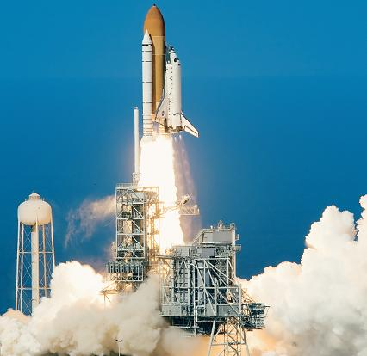
MECHANICS, UNITS, NUMERICAL CALCULATIONS & GENERAL PROCEDURE FOR ANALYSIS
Today’s Objectives:
Students will be able to:
a) Explain mechanics/statics.
b) Work with two types of units.
c) Round the final answer appropriately.
d) Apply problem-solving strategies.
In-Class activities:
Reading Quiz
What is Mechanics?
System of Units
Numerical Calculations
Concept Quiz
Problem-Solving Strategy
Attention Quiz

Slide 2
READING QUIZ
1. The subject of mechanics deals with what happens to a body when ______ is/are applied to it.
A) a magnetic field B) heat C) forces
D) neutrons E) lasers
2. ________________ still remains the basis of most of today’s engineering sciences.
A) Newtonian Mechanics B) Relativistic Mechanics
C) Greek Mechanics C) Euclidean Mechanics
Notes:
Answers:
1.C
2.A

Slide 3
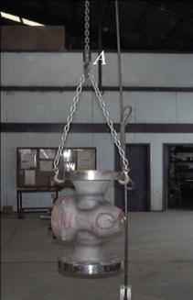
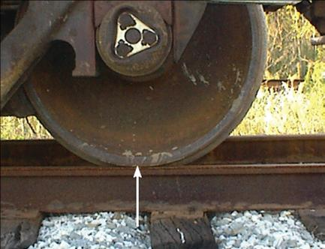
WHAT IS MECHANICS?
Study of what happens to a “thing” (the technical name is “BODY”) when FORCES are applied to it.
Either the body or forces can be large or small.

Slide 4
BRANCHES OF MECHANICS

Slide 5
UNITS OF MEASUREMENT (Section 1.3)
Four fundamental physical quantities (or dimensions).
Length
Mass
Time
Force
Newton’s 2nd Law relates them: F = m × a
We use this equation to develop systems of units.
Units are arbitrary names we give to the physical quantities.

Slide 6
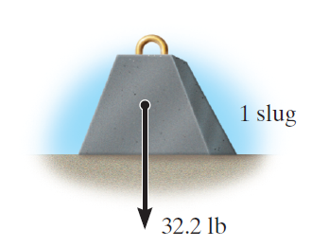
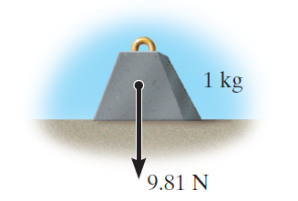
UNIT SYSTEMS
Force, mass, time and acceleration are related by Newton’s 2nd law. Three of these are assigned units (called base units) and the fourth unit is derived. Which one is derived varies by the system of units.
We will work with two unit systems in statics:
International System (SI)
U.S. Customary (USCS)

Slide 7
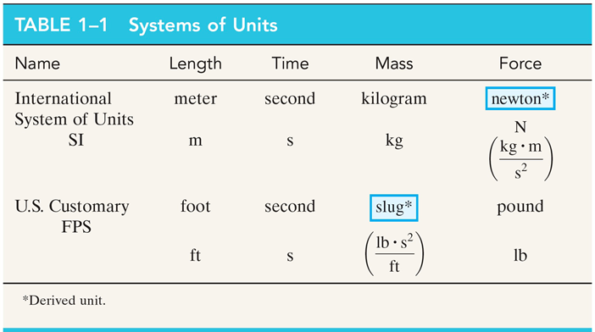
Table 1-1 in the textbook summarizes these unit systems.

Slide 8
COMMON CONVERSION FACTORS
Work problems in the units given unless otherwise instructed!
Can you convert a force value of 47 lb into SI units?
Answer is 209.06 N

Slide 9
THE INTERNATIONAL SYSTEM OF UNITS (Section 1.4)
No plurals (e.g., m = 5 kg, not kgs )
Separate units with a • (e.g., meter second = m • s )
Most symbols are in lowercase.
Key exceptions are N, Pa, M and G.
Exponential powers apply to units, e.g., cm • cm = cm²
Compound prefixes should not be used.
Table 1-3 in the textbook shows prefixes used in the SI system

Slide 10
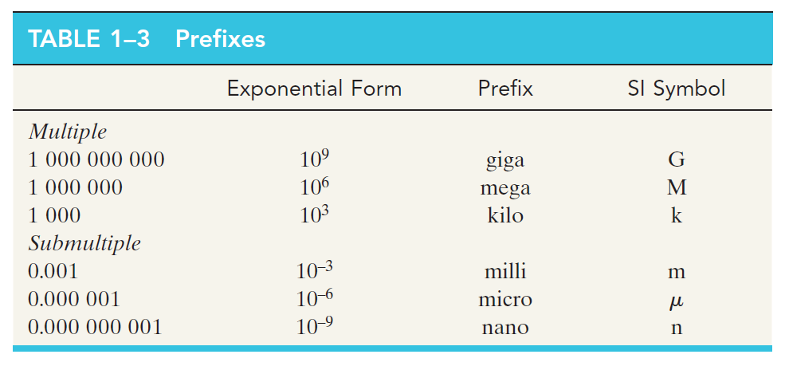
Table 1–3 shows some of the prefixes used in the SI system.

Slide 11
NUMERICAL CALCULATIONS (Section 1.5)
Must have dimensional “homogeneity.” Dimensions have to be the same on both sides of the equal sign, (e.g. distance = speed × time.)
Use an appropriate number of significant figures (3 for answer, at least 4 for intermediate calculations). Why?
Be consistent when rounding off.
- greater than 5, round up (3528 ⇒ 3530)
- smaller than 5, round down (0.03521 ⇒ 0.0352)
- equal to 5, see your textbook for an explanation.

Slide 12
CONCEPT QUIZ
1. Evaluate the situation in which mass (kg), force (N), and length (m) are the base units and recommend one of the following.
A) A new system of units will have to be formulated.
B) Only the unit of time have to be changed from second to
something else.
C) No changes are required.
D) The above situation is not feasible.
Notes:
Answers:
1. C

Slide 13
CONCEPT QUIZ (continued)
2. Give the most appropriate reason for using three significant figures in reporting results of typical engineering calculations.
A) Historically slide rules could not handle more than three significant figures.
B) Three significant figures gives better than one-percent accuracy.
C) Telephone systems designed by engineers have area codes consisting of three figures.
D) Most of the original data used in engineering calculations do not have accuracy better than one percent.
Notes:
Answers:
2. D

Slide 14
PROBLEM SOLVING STRATEGY IPE: A 3-Step Approach
1. Interpret: Read carefully and determine what is given and what is to be found/ delivered. Ask, if not clear. If necessary, make assumptions and indicate them.
2. Plan: Think about major steps (or a road map) that you will take to solve a given problem. Think of alternative/creative solutions and choose the best one.
3. Execute: Carry out your steps. Use appropriate diagrams and equations. Estimate your answers. Avoid simple calculation mistakes. Reflect on and then revise your work, if necessary.

Slide 15
ATTENTION QUIZ
1. For a static’s problem, your calculations show the final answer as 12345.6 N. What should you write as your final answer?
A) 12345.6 N B) 12.3456 kN C) 12 kN
D) 12.3 kN E) 123 kN
2. In the three-step approach to problem solving called IPE, what does P stand for?
A) Position B) Plan C) Problem
D) Practical E) Possible
Notes:
Answers:
1. D
2. B

Slide 16
End of the Lecture
Let Learning Continue

