Slide 1
The Thesis Road
Dos & Donts of Writing a Thesis Statement for Narrative Essays

Slide 2
The thesis statement is that sentence or two in your text that contains the focus of your essay and tells your reader what the essay is going to be about.
This Photo by Unknown Author is licensed under CC BY-SA-NC

Slide 3
The thesis is

Slide 4
The lack of a thesis statement may make the paper feel like it is all over the place without a central thought that ties it altogether.
Many writers think of a thesis statement as an umbrella: everything that you carry along in your essay has to fit under this umbrella, and if you try to take on packages that don't fit, you will either have to get a bigger umbrella or something's going to get wet.

Slide 5
It more frequently appears at or near the end of the first paragraph.

Slide 6
Many narrative essay assignments ask students to write the story of an experience where they learned a valuable lesson. The thesis sentence for these types of narratives should include the lesson or moral of the story. For example, a thesis for an essay about how you responded to peer pressure could be, "I learned that I shouldn't do whatever my friends wanted me to do the night I got caught driving without a license."

Slide 7
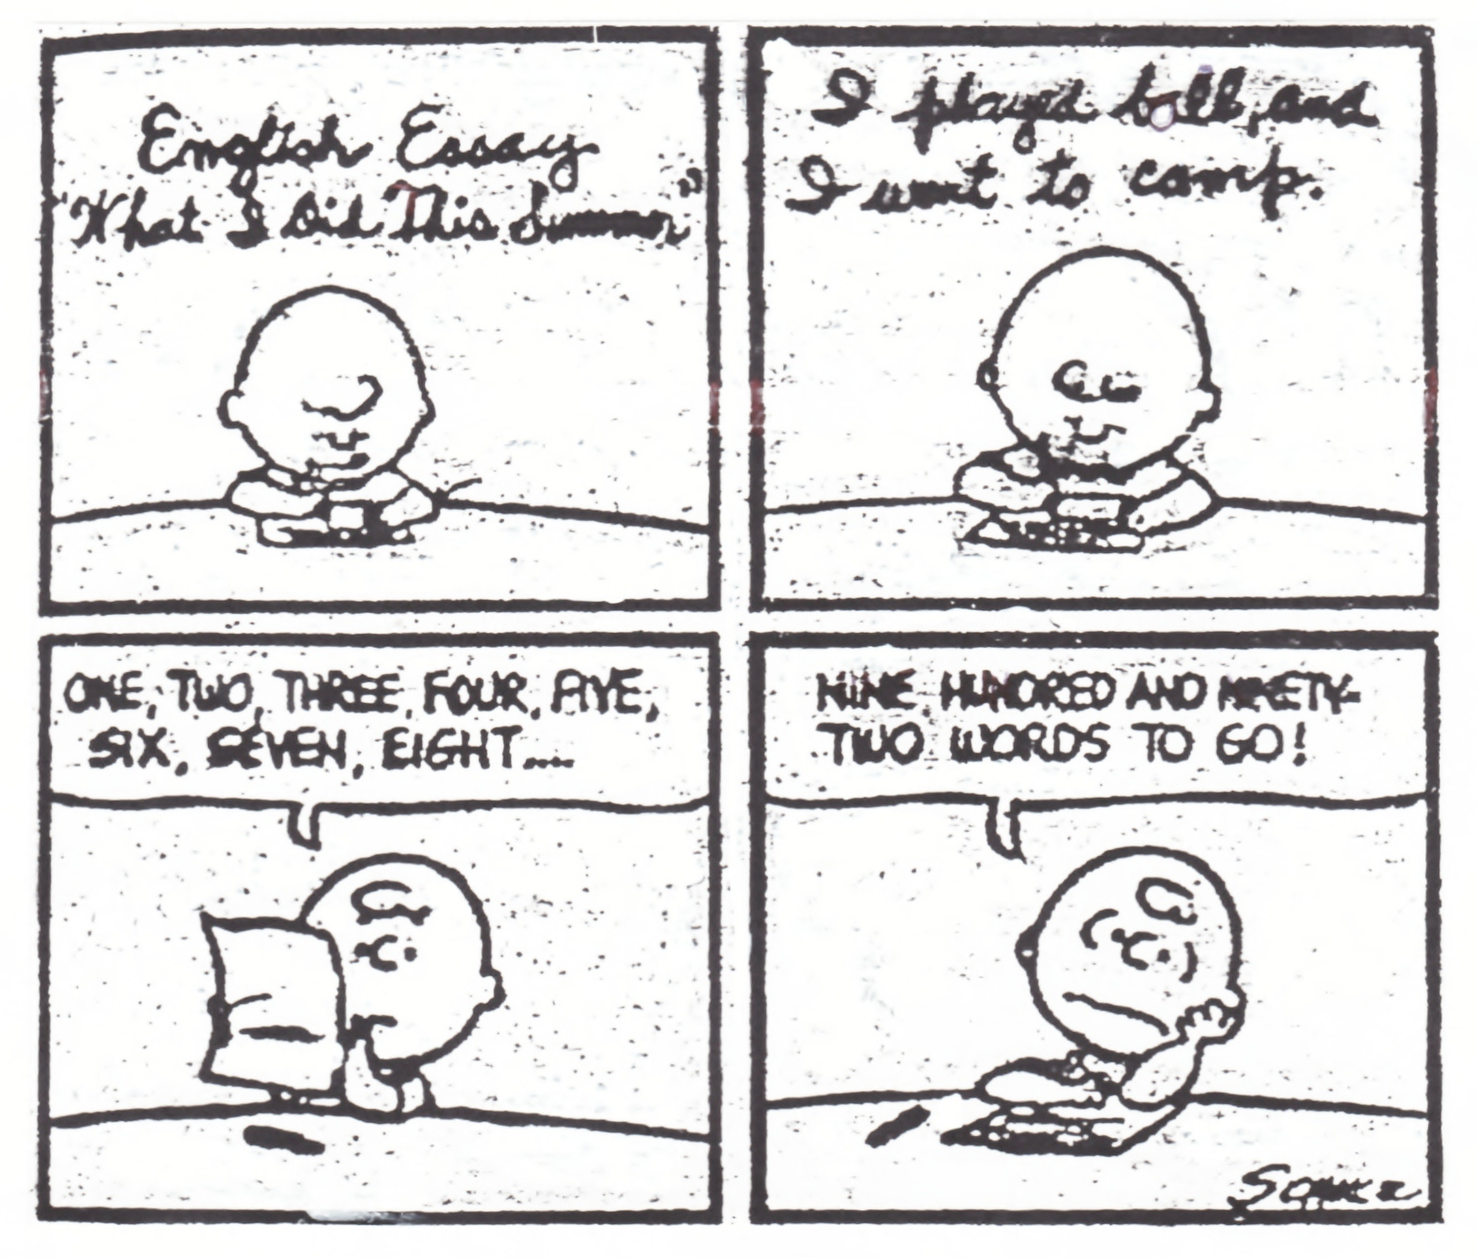
This Photo by Unknown Author is licensed under CC BY-ND

Slide 8
Include the essay theme in your thesis sentence. For example, if you are writing a narrative about a great one-day trip you took with friends, the thesis could be, "Spending time with close friends gives memories that can last forever, even if the trip is just one day." Think about the main idea(s) or the main thing that happens and condense it into one single sentence.

Slide 9
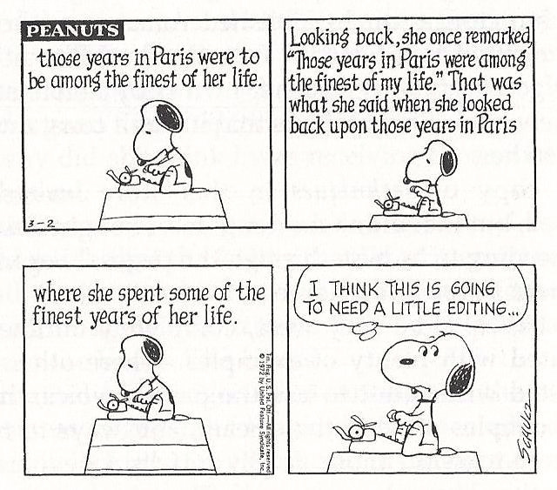

Slide 10
Sample Thesis for a narrative: My daughter, Isabel, and I were in the Wal-Mart parking lot right before school started when she saw some people giving away German Shepherd puppies. My first reply was we did not need a puppy that would become a huge dog. Little did we know that this incident would change our lives because it would lead us to find a small Beagle dog after discussing the matter over dinner that night, which helped us in the recovery of a painful divorce.

Slide 11
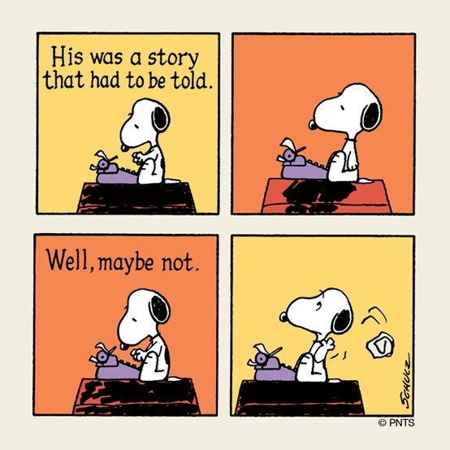
For example:
“Grief affects everyone's life at one point or another, and it certainly has affected mine; when my grandmother became sick and passed away, I had to learn how to deal with the aftermath of her death.”

Slide 12
20. Technology is supposed to solve our problems, but sometimes it just complicates them. Write about a time when technology made your life more difficult.
21. • It can be hard to fit in when you feel awkward. Write about a time when you felt out of place. How did you adapt to the situation?
22. • The world needs heroes and anyone can be one. Write about a time when you did something heroic. It doesn’t have to be as dramatic as saving someone’s life. It can be as simple as helping someone out when they needed it.
We are all tempted to do things that we shouldn’t at times. It takes integrity to do the right thing against your baser desires. Write about a time when you resisted the temptation to do something wrong
Many people are resistant to change, even when it is good for them. Write about a time when you grew to appreciate something that you once resisted.
There’s a time for work and a time for play, but it’s a lot more fun to play. Write about a time when you put off doing something important to have fun. How did it work out for you in the end and what did you learn?
Write about a time you went above and beyond heroics. What did you do? Was it required of you to do this act or was it more impulsive? Did you succeed? Why or why not?
28. Have you ever had a goal or dream that someone close to you laughed at? Describe it and what happened between you and this person. If this never happened to you, it must have had happened to a friend! (“On the Sidelines”)
29. Has there ever been a time when either you or a friend faced a moment when someone was prejudice. Describe the moment and what happened? (“Momma, Dentist & Me”)

