Slide 1
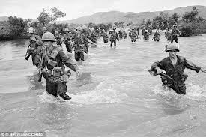
THINGS THEY CARRIED (STYLE)

Slide 2
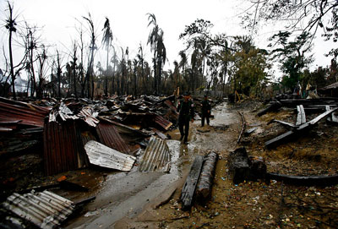
There was no music. Most of the hamlet had burned down, including her house,
which was now smoke.
Notes:
Hamlet Burned Down

Slide 3
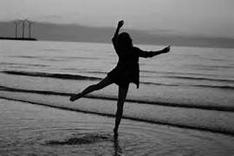
The girl danced with her eyes half closed , her feet bare. She was maybe fourteen. She had
black hair and brown skin. “Why’s she dancing?” Azar said.

Slide 4
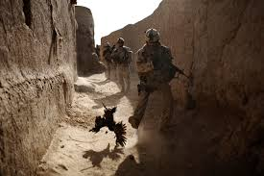
We searched through the wreckage but there wasn’t much to find. Rat Kiley caught a
chicken for dinner. Lieutenant Cross radioed up to the gunships and told them to go
away. The girl danced mostly on her toes. She took tiny steps in the dirt in front of her
House, sometimes making a slow twirl, sometimes smiling to herself.
Notes:
Chicken being Caught

Slide 5
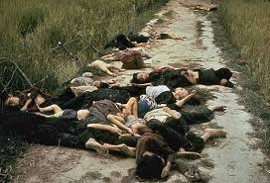
Later we found her family house. They were dead and badly burned. It wasn’t a big family
: an infant and an old woman and a woman whose age was hard to tell. We dragged them
out, the girl kept dancing. She put the palms of her hands against her ears, which must’ve
Meant something, and she danced sideways for a short while, and then backwards.

Slide 6
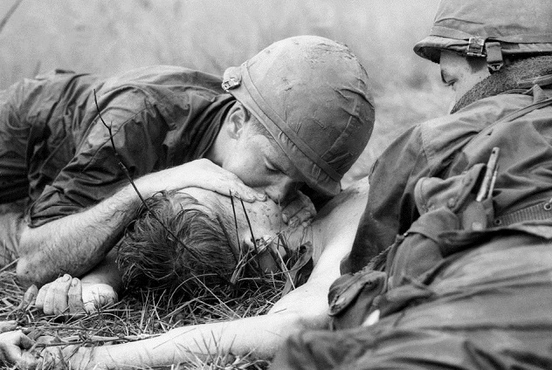
Trying to attempt to save the young woman

Slide 7
That night, after we’d marched away from the smoking village, Azar mocked the girl’s
dancing. He did funny jumps and spins. He put the palms of his hands against his ears and danced sideways for a while, and then backwards, and then did an erotic thing with his hips.

