Slide 1
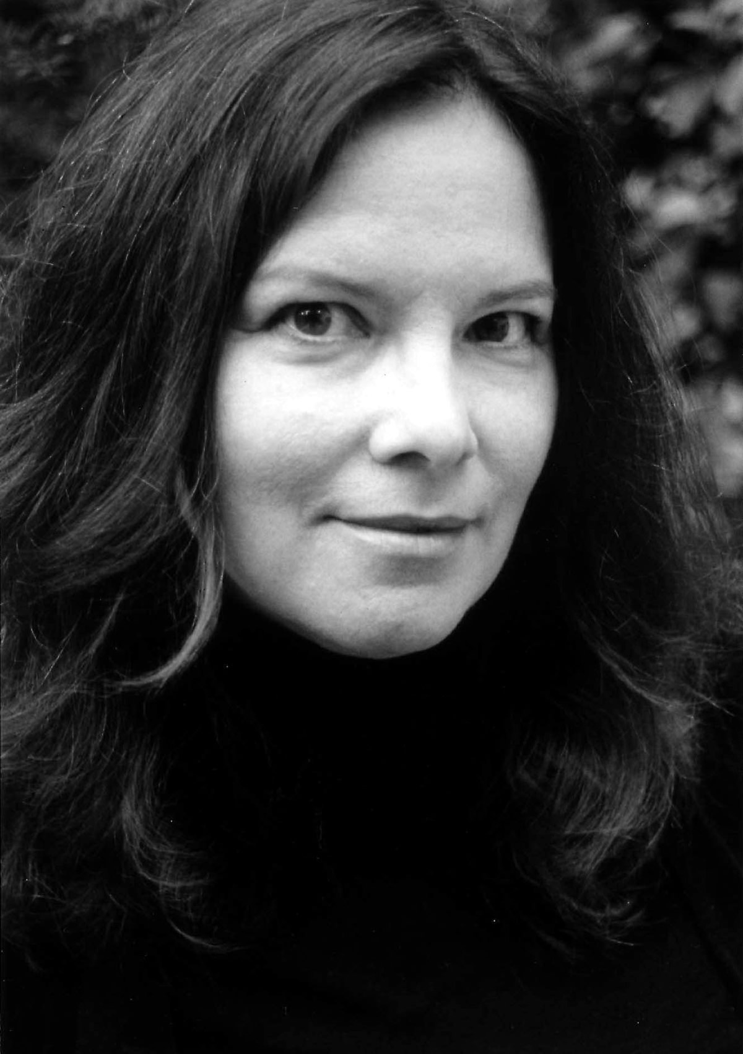
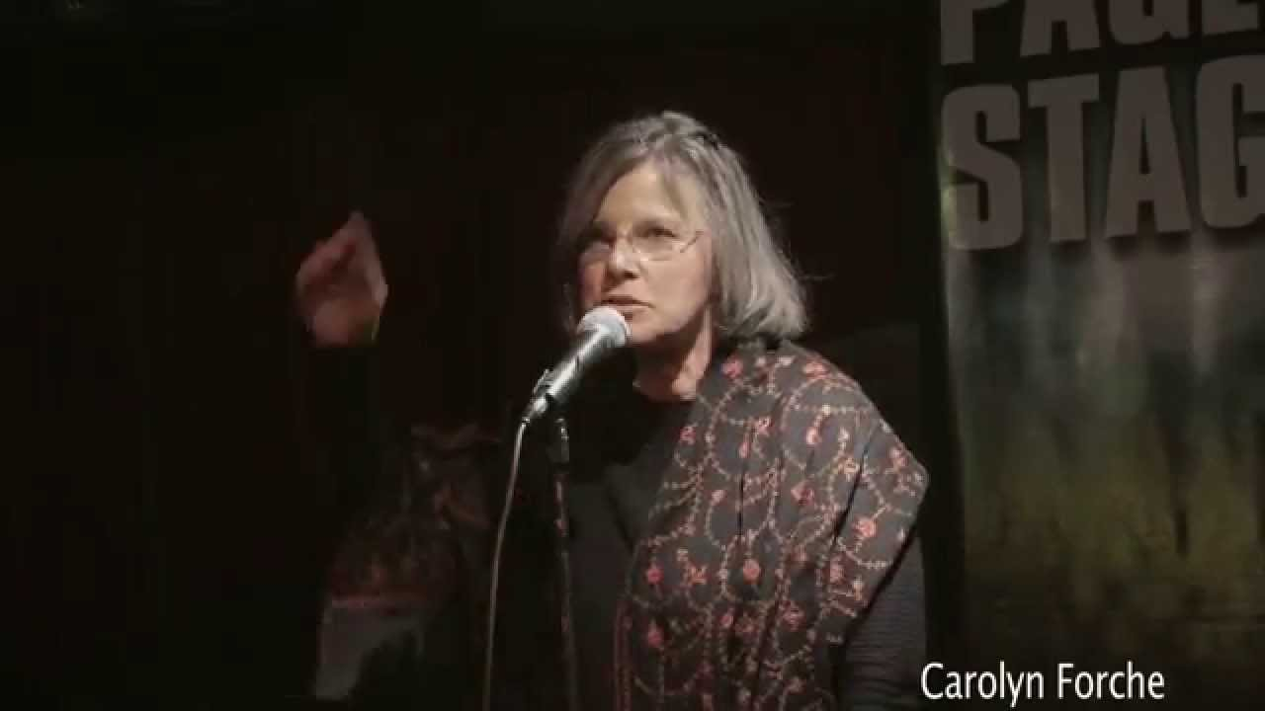
“The Colonel” by Carolyn Forché
All lines from “The Colonel” from The Country Between Us by Carolyn Forché, Copyright (c) 1981 by Carolyn Forché.

Slide 2
Brief Bio
from Detroit, Michigan
nomadic journalist
coined two literary terms
"poetry of witness"
"documentary poem"
social justice and political advocate
assisted Amnesty International

Slide 3
WHAT YOU HAVE HEARD is true. I was in his house.
1. Predict what you think will happen next.

Slide 4
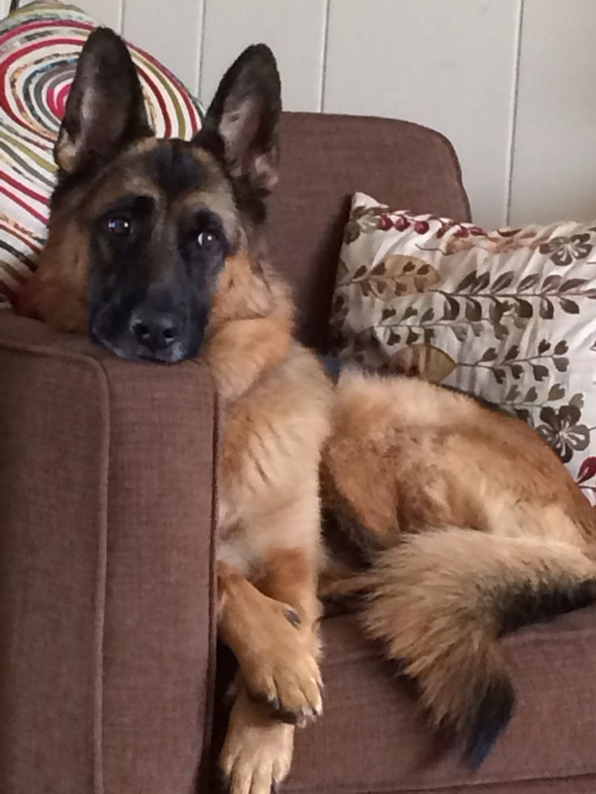
His wife carried a tray of coffee and sugar. His daughter filed her nails, his son went out for the night. There were daily papers, pet dogs, a pistol on the cushion beside him.
2. What do you think will happen next?

Slide 5
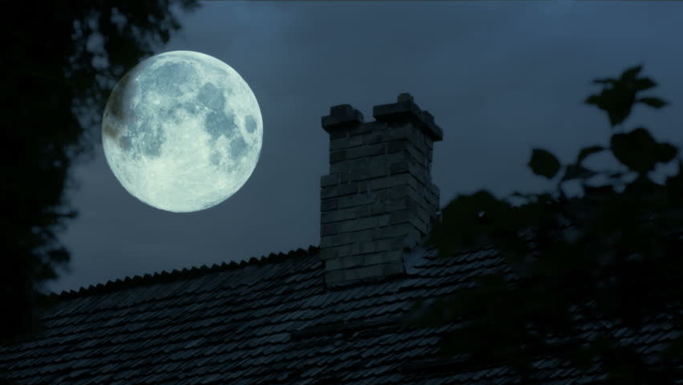
The moon swung bare on its black cord over the house.
3. What does this mean?

Slide 6
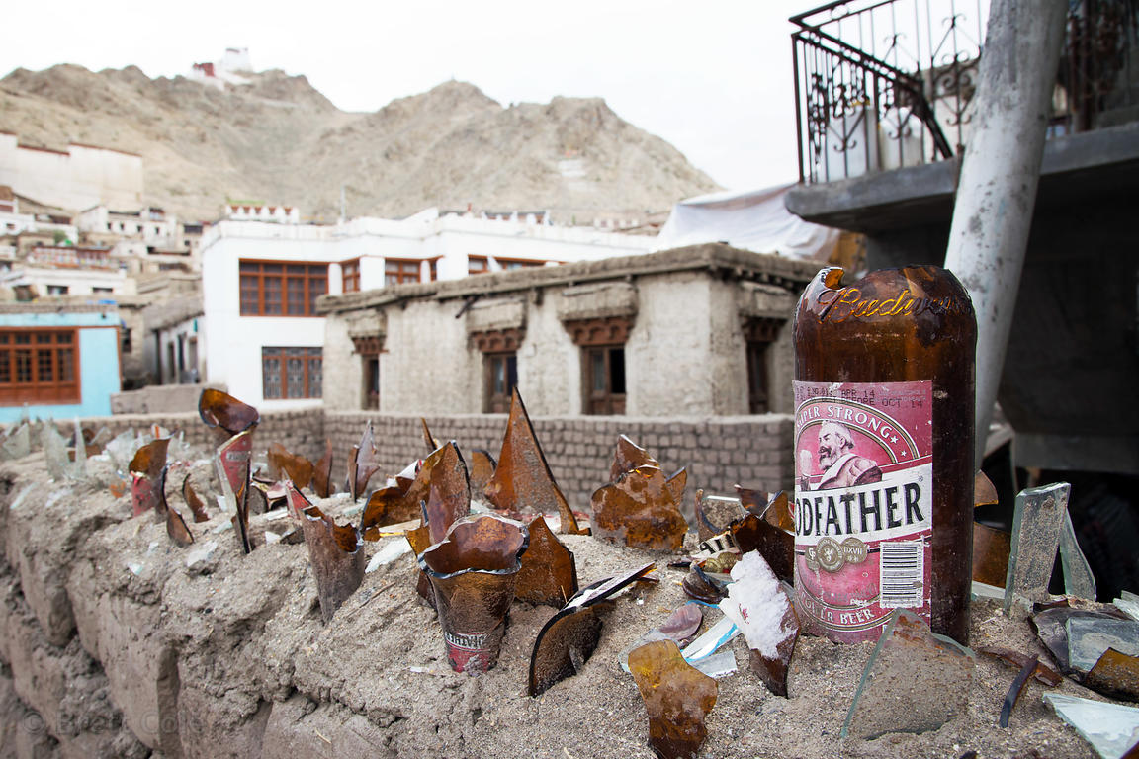
On the television was a cop show. It was in English. Broken bottles were embedded in the walls around the house to scoop the kneecaps from a man's legs or cut his hands to lace.
4. Why do you think The Colonel had this feature?
5. What is the action verb above?

Slide 7
We had dinner, rack of lamb, good wine, a gold bell was on the table for calling the maid. The maid brought green mangoes, salt, a type of bread. I was asked how I enjoyed the country. There was a brief commercial in Spanish. His wife took everything away.
6. What is the setting? How do we know this?

Slide 8
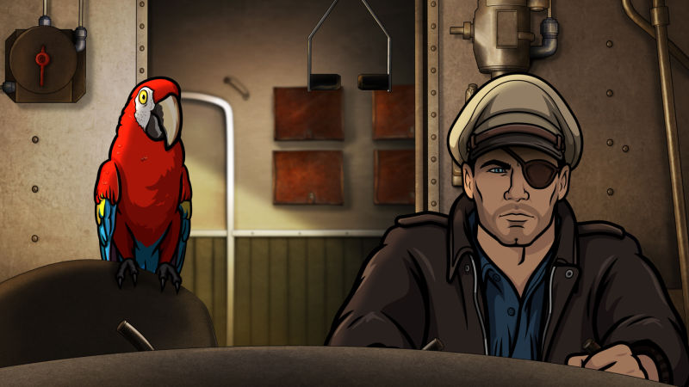
There was some talk then of how difficult it had become to govern. The parrot said hello on the terrace. The colonel told it to shut up, and pushed himself from the table.
7. What is the point of these 3 sentences?
What is the author trying to show us?

Slide 9
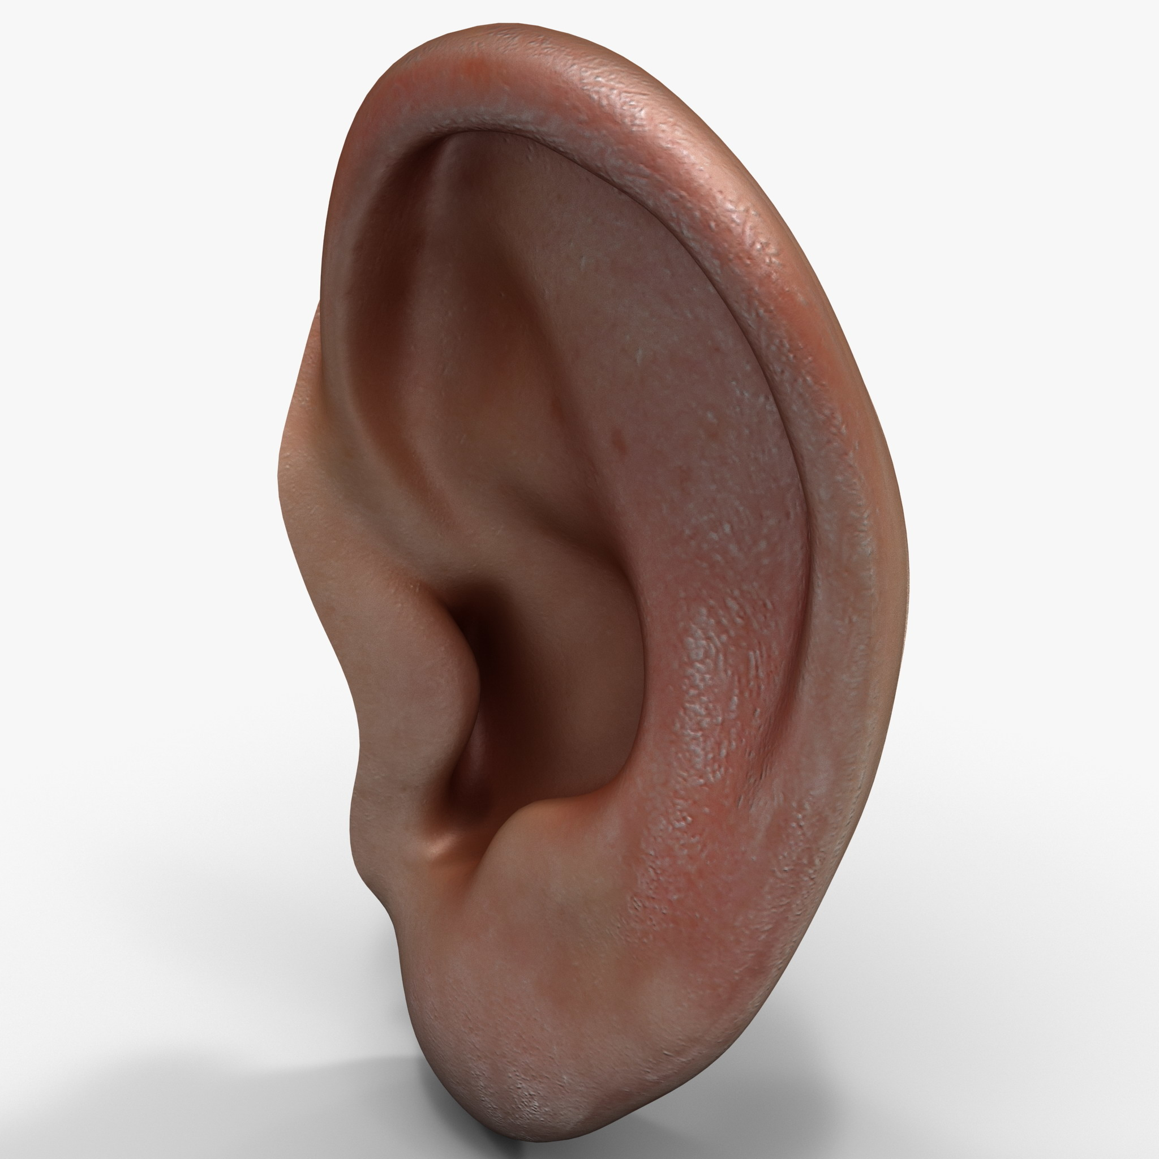
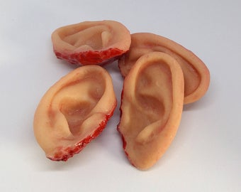
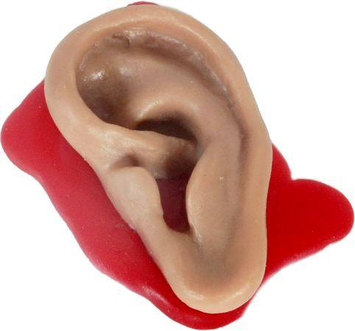
My friend said to me with his eyes: say nothing. The colonel returned with a sack
used to bring groceries home.
He spilled many human ears on the table.
They were like dried peach halves.
8. What is the simile doing here?
9. Is this TRUE or FICTION?

Slide 10
There is no other way to say this. He took one of them in his hands, shook it in our faces, dropped it into a water glass. It came alive there. I am tired of fooling around he said. As for the rights of anyone, tell your people they can go fuck them-selves. He swept the ears to the floor with his arm and held the last of his wine in the air. Something for your poetry, no? he said.
10. What part of speech are the 4 words in yellow?

Slide 11
Some of the ears on the floor caught this scrap of his voice.
Some of the ears on the floor were pressed to the ground.
May 1978
11. Why did Forché put the date at the end?

Slide 12
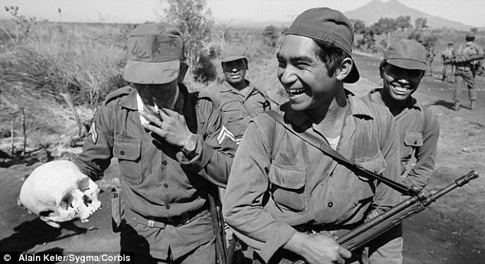
12. What do we the viewer get from this photo?
Describe it. How does it affect us?

Slide 13
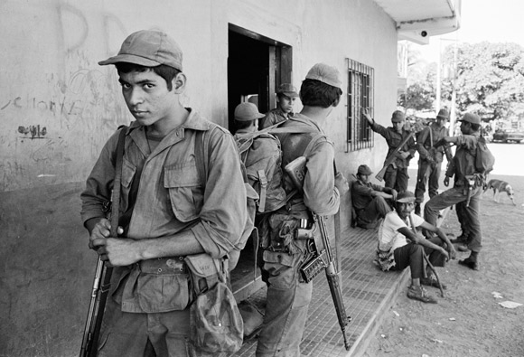
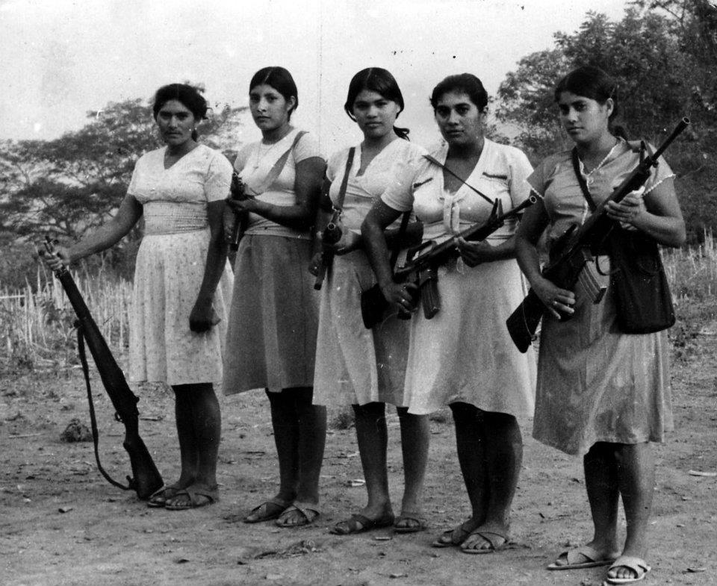
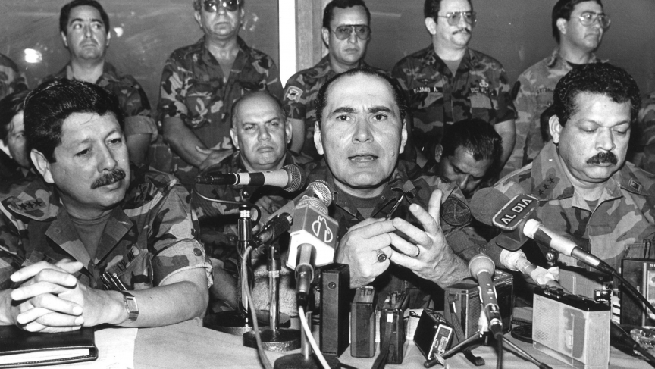
The Civil War in El Salvador

