Slide 1
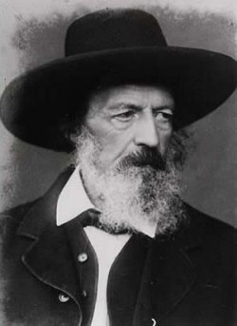
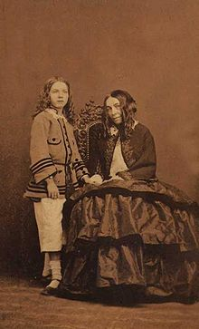
Tennyson & Browning Quiz

Slide 2
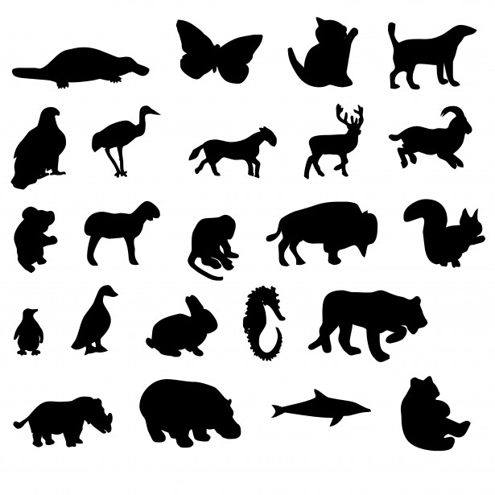
What animal can jump higher than a building?
No animal can jump higher than a building!

Slide 3
1. Name some inventions from the Victorian period (12 total).
Steam Power
Railways
Telegraph
Iron Ships
Loom
Printing Press
Gas Lighting
Photography
Anesthetics
Universal compulsory education
Sewers
Indoor plumbing

Slide 4
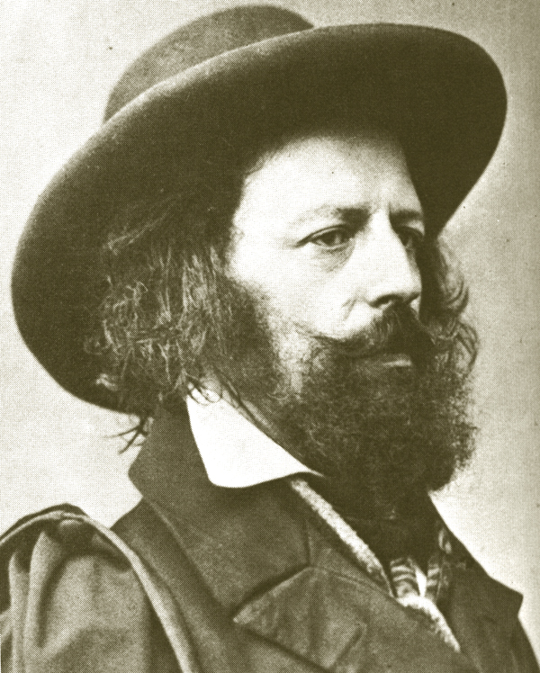
2. Which of the following famous phrases did Tennyson pen?
(a) Miles to go before I sleep
(b) The best-laid schemes of mice and men
(c) How do I love thee?
(d) ’Tis better to have loved and lost
This Photo by Unknown Author is licensed under CC BY

Slide 5
Other phrases from Tennyson include:
(a) To strive, to seek, to find, and not to yield.
(b) Knowledge comes but wisdom lingers.
(c) I am a part of all that I have met.
(d) Dreams are true while they last, and do we not live in dreams?
This Photo by Unknown Author is licensed under CC BY

Slide 6
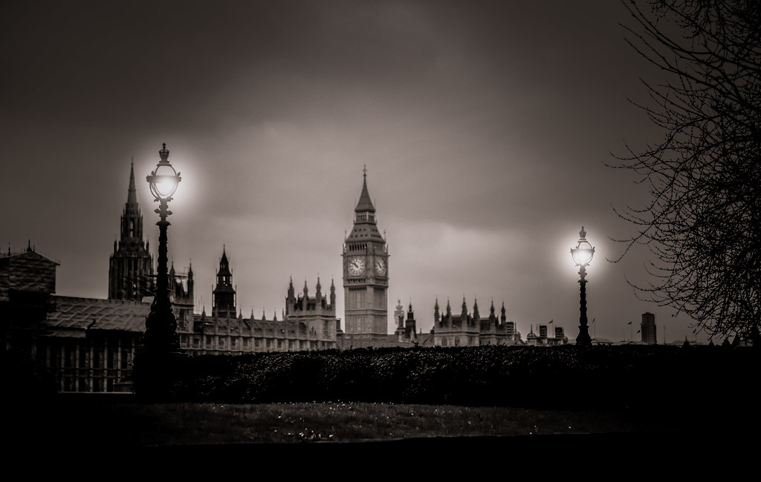
3. For which of the following poems is classical mythology not the primary inspiration?
(a) “Crossing the Bar”
(b) “Ulysses”
(c) “Tiresias”
(d) “Tithonus”
(e) “Lady of Shallot”
This Photo by Unknown Author is licensed under CC BY-NC-ND

Slide 7
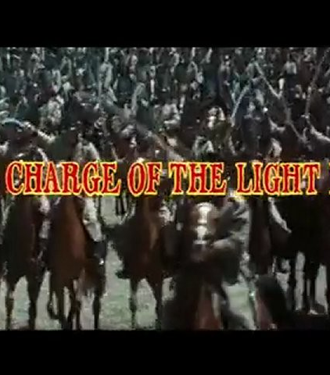
4. Which of the following historical events does “The Charge of the Light Brigade” describe? D-Day The Battle of Waterloo The Battle of Bull Run The Crimean War

Slide 8
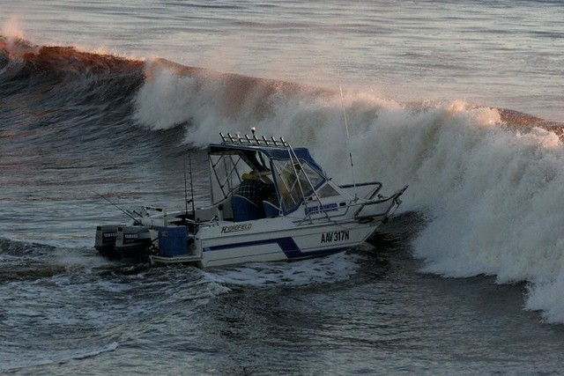
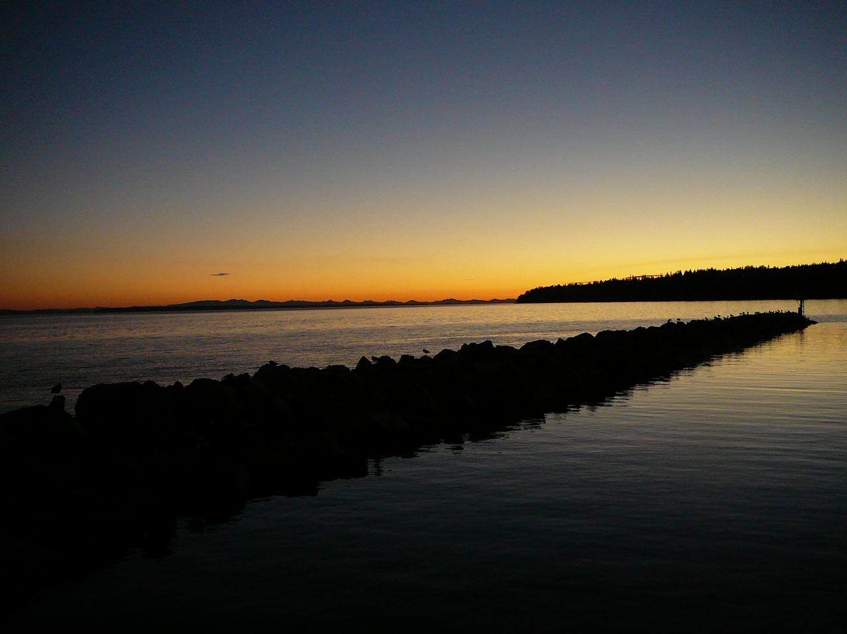
5. The notion of “crossing the bar” is a metaphor for (a) Praying to God (b) Dying (c) Becoming an attorney (d) Growing old
This Photo by Unknown Author is licensed under CC BY-NC-ND
This Photo by Unknown Author is licensed under CC BY-NC-ND

Slide 9
Elizabeth Barrett Browning
6. “The Cry of the Children” was written because?
(a) The Poverty Laws
(b) Children working in chimneys
(c) Children working in coal mines
(d) Her love for Robert Browning

Slide 10
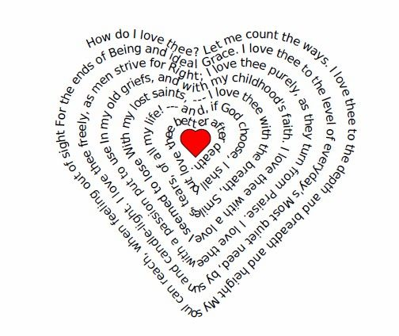
(7) Elizabeth Barrett Browning (1806-1861) wrote a series of 44 poems, in secret, about the intense love she felt for her husband-to-be, poet Robert Browning. She called this series ________________________________, a title based on the pet name Robert gave her.

Slide 11
(8)
How did her family get to their money?
(a) They were Pirates of the Seven Seas.
(b) They wrote poetry.
(c) They owned slave plantation in Jamaica.
(d) They owned shops to sell arsenic wallpaper.

Slide 12
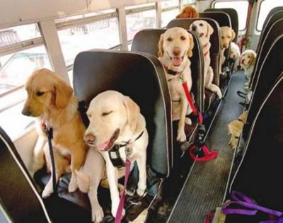
How did the bus driver see a dog in the road when there was a blackout?
It was daylight.

Slide 13
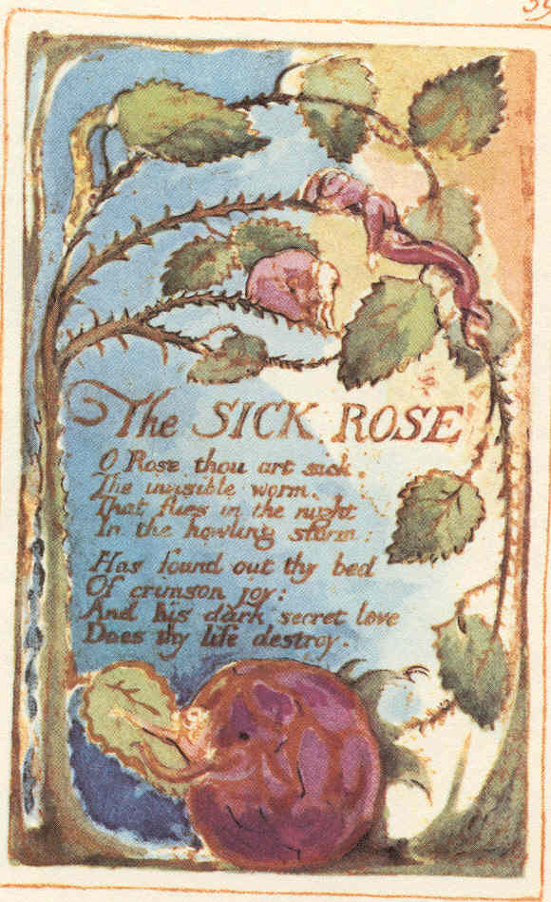
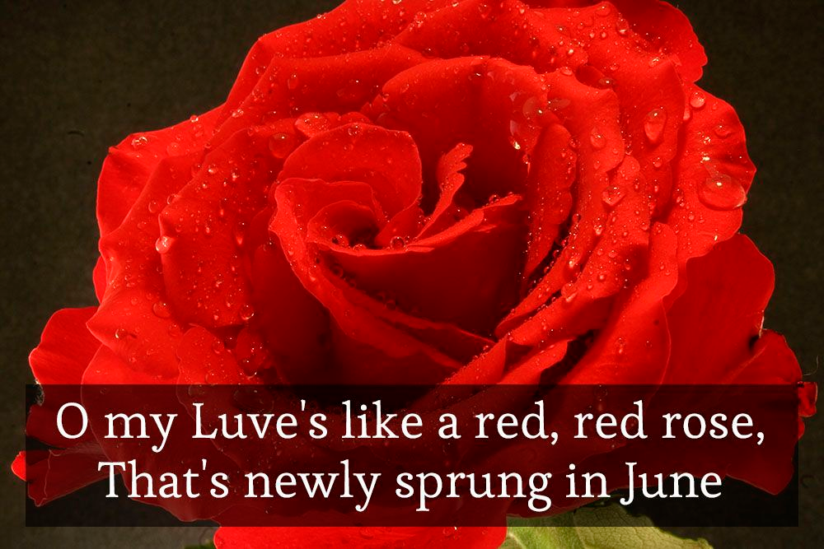
9. In the following poem by
Elizabeth Barrett Browning, explain how
the image of the rose for the Victorians
takes on a different meaning than for the Romantics (Burns’ “Red Red Rose”
& Blake’s “The Sick Rose”).

Slide 14
O Rose! who dares to name thee? No longer roseate now, nor soft, nor sweet; But pale, and hard, and dry, as stubble-wheat,--- Kept seven years in a drawer---thy titles shame thee. The breeze that used to blow thee Between the hedgerow thorns, and take away An odour up the lane to last all day,--- If breathing now,---unsweetened would forego thee. The sun that used to smite thee, And mix his glory in thy gorgeous urn, Till beam appeared to bloom, and flower to burn,

Slide 15
10. So why is Victorian England so obsessed with DEATH?

Slide 16
Victorian Novel vs Poetry
Novel = portraits of difficult lives, love & luck usually won in the end, central moral lesson, John Stuart Mills thought novels come from incidents & events
Poetry = John Stuart Mills thought poems paint human soul & reveal inner feelings, nature matches the mood, more narrative poems but still dramatic monologues, ponder their fate, feeling of smallness & helplessness

