Slide 1
Migration

Slide 2
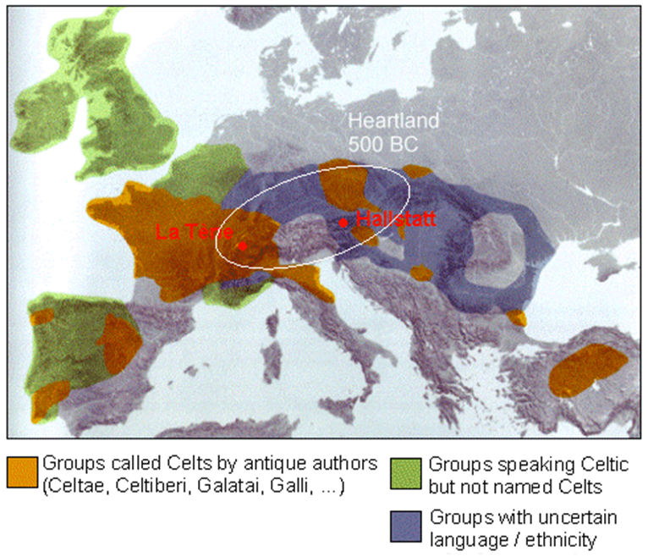
Before starting this class, you thought that the Celts lived in Ireland & Scotland, not in central Europe, right? And now you think that they must have migrated to the islands.
Unfortunately, it’s not that simple. And it’s not that fast. The Keltoi had a few adventures on the continent first.
We don’t know much about the migration of pre-historic Celts. (Pre-historic = before written records.) That’s unfortunate, because, if you recall, they occupied a great deal of Europe.

Slide 3
Something we do know about pre-historic Celts is that they somehow got to Spain. Originally it was believed that they had invaded the peninsula, but more & more it seems that they migrated there. As we’ll soon see, there are explanations for later migrations, but we don’t have enough information about the migration to Iberia to be able to determine reasons.
The people who occupied the peninsula when the Celts migrated there (presumably in waves between 1000 & 600 B.C.) are known as Iberians. By the time we get to the historic (as opposed to pre-historic) period, the people are known as Celtiberians, because of mingling & intermarriage.
The best known Celtiberian town was Numantia (Spanish Numancia). After 20 years of conflict, the Romans attacked it in earnest in 133 B.C. Numantia resisted valiantly, and the siege lasted 13 months, with the Roman leader erecting a wall around the town, along with watch towers. In the end, the people of Numantia burned the town down before surrendering. Cervantes (of Don Quixote fame) wrote a play about the tragedy.
An item to look for later in the course: the Irish, at different times, have thought that their predecessors came from Spain.

Slide 4
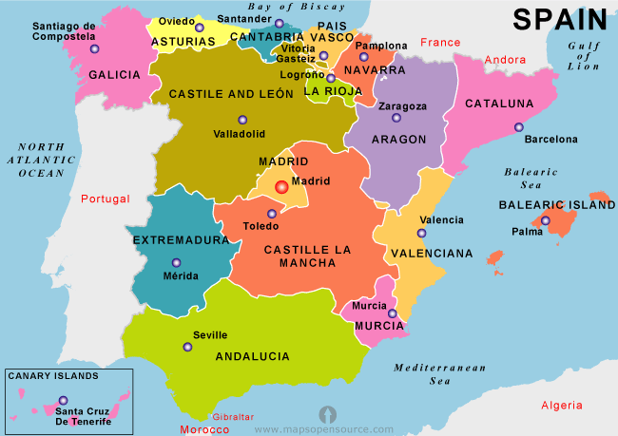
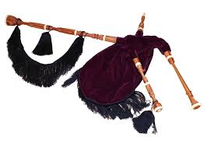
Galicia in the northwestern corner of Spain still has a Celtic flavor.
Interestingly, this instrument is native to Galicia and is called a gaita. Obviously, it’s related to the bagpipe.

Slide 5
First, you need to know that the Celts were not a nomadic people. They didn’t migrate just for the heck of it or because they wanted a warmer climate or better jobs.
Indications are that the mass migrations that began between the 5th & 3rd centuries B.C. were due to overpopulation. In fact, Livy, writing around 27 B.C., tells us that the Celtic king (there really wasn’t a single Celtic king, because, as we’ve seen, each clan lord was king of his own keep) Ambicatus ruled well & that “under his rule Gaul grew so wealthy & populous that it became a matter of great difficulty to control such a multitude. The king, who was an old man, wishing to rid his kingdom of the burden of its excess population” sent his two sons abroad to establish “kingdoms” of their own. While Livy was writing about something that had occurred 4 centuries earlier, it is at about that time that the migrations for which we have other records began.

Slide 6
The story of Ambicatus’s sons is a good illustration of one fact of Celtic migration: it wasn’t an organized affair where all Celts of the area got together and decided to move. When they migrated, they spread out over the continent--& beyond—but it wasn’t an empire, as was the Roman empire, for example. There was no central rule, no central plan.
Remember, by the time we get to the 5th-3rd century B.C. migrations, the Celts are already quite spread out. Everyone has heard of “Gauls,” but very few people realize, even if they know that Gaul was basically what is modern-day France, along with pieces of other modern-day countries surrounding France, that the Gauls were a tribe of Celts. There is an extinct language called Gaulish that’s related to modern-day Gaelic. In fact, there are a number of extinct Celtic languages, but we’ll get into that later.

Slide 7
The earliest migration of which we can be sure occurred around 390 B.C. A tribe of Gauls, the Senones, marched across the Alps and into Italy. (The parts of Italy that the Celts occupied came to be called Cisalpine Gaul.) The Senones sacked Rome, which isn’t the same thing as destroying it, so it might be helpful here to use Merriam-Webster’s definition of sack: “to plunder (a place, such as a town) especially after capture.” Plundering, of course, means grabbing by force possessions that aren’t yours. So the Senones fought their way into Rome, killing and stealing & destroying the city & its people. One place they tried to take was Capitoline Hill, one of the famous Seven Hills of Rome. (On it have been built several temples, so it wasn’t a small hill.) However, it had been fortified, & the Senones were unable to break through.
The Senones were able to wait out the people on Capitoline Hill, who finally, starving, sent out a negotiator to meet with Brennus, leader of the Senones. He agreed they would leave if they received a payment of 1000 pounds of gold. The Romans agreed, but the Senones cheated, using weights heavier than the agreed amount. When the Romans protested, Brennus’s response was “Woe to the vanquished!” as he tossed his sword onto the scale, adding to the unfair weight.
But at least the Senones did leave then.
For details of the battle & then sack of Rome, see https://en.wikipedia.org/wiki/Battle_of_the_Allia. Yes, it’s a Wikipedia article, but it has good references.

Slide 8
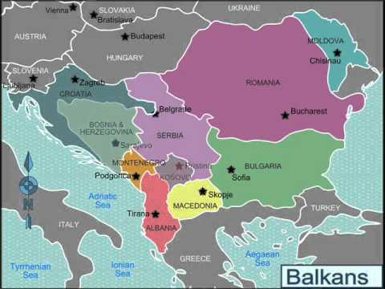
Celtic tribes began migrating east close to the same time period that the Senones were in Italy, but we have no records of their sacking any cities there. There is archeological evidence of their presence in modern-day Hungary, Slovakia, Serbia, & southern Poland. Coins from the reign of Leucon II, ruler of Bosporus (a Hellenistic—Greek—kingdom in modern-day Ukraine), depict Celtic weapons & shields.
In 323, Alexander the Great died. His empire included many lands to which the Celts had recently migrated east of their homeland, and they took advantage of the chaos that followed his death. Alexander had made great conquests and was undefeated (except by death), but he didn’t leave an heir, & his generals began fighting among themselves for land & power, &
not surprisingly, everything Alexander had built quickly began
to fall apart. The Celts took this as an opportunity to
continue moving southeast into the Balkans. In 281, the
Celts, led by a warrior named Bolgios, attacked the king of
Macedonia. (Macedonia was Alexander’s original kingdom.)
The Celts won & paraded around with the Macedonian king’s
head on the end of a spear. They then set their sights on
Greece.

Slide 9
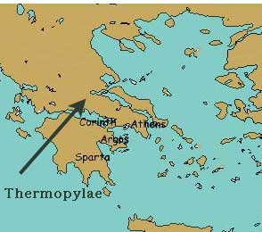
According to Greek sources, there were hundreds of thousands of Celts in this force, and although that estimate, as generic as it is, wouldn’t hold up in court, it was evidently an enormous force. With a group of alpha males that size, it’s no surprise that there was internal fighting before they even reached Greece. About a third of the force followed leaders Leonorios and Lutorios to Thrace (modern-day European Turkey), & the others followed Brennus (not the same one as in Rome, obviously) into Greece.
The Celts marched down the Aegean coast, tossing aside Greeks right & left. Around the year 287 B.C., the Greeks finally organized a defense at Thermopylae, a narrow passage about 150 miles from the southeastern tip of Greece.
According to Hay,
https://ebookcentral-proquest-com.proxygsu-gor1.galileo.usg.edu/lib/gordonstate/reader.action?docID=1733985&ppg=40
Greece
The Celts tried to force a way through the pass but were beaten back with heavy losses….Brennus, who seems to have been a resourceful commander, now discovered the same “secret” mountain path that the Persians had used to outflank the Spartans in 480. Now Brennus divided the Greek defense by sending Achicorios with a force west…[where he] fell unexpectedly upon the city of Callium, which was sacked with great savagery, including the mass rape of its women.
Aegean Sea

Slide 10
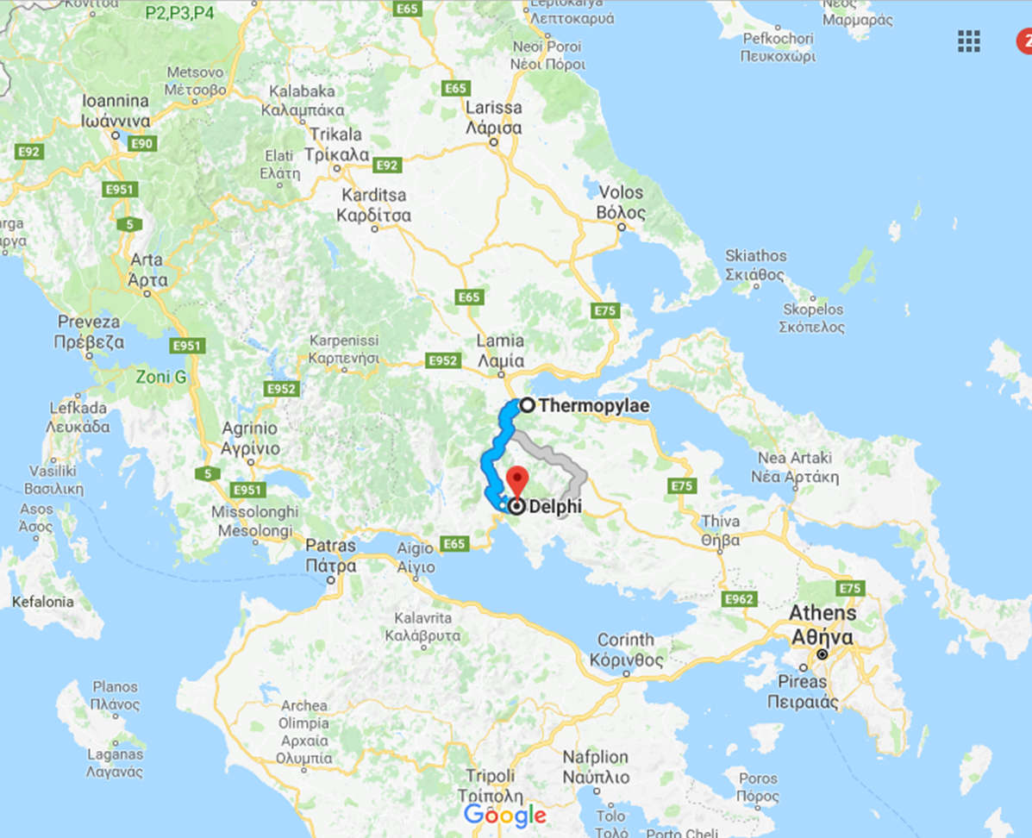
The pillaging of Callium sent the Greek troops on the west side running for the hills. The Celts overran the remaining Greeks, many of whom were saved by the Athenian navy, which didn’t send men ashore but evacuated the remaining Greek army.
Perhaps high on success, the Celts marched on Delphi in Central Greece. Delphi, of oracle fame, was a site that was sacred to Greeks, and it wasn’t well protected because no Greek army would dare touch it.
The Celts faced some disasters on the way to Delphi, not the least of which was a rock slide that killed a number of them. We don’t have a great deal of details about this march, but their bad luck apparently made the Celts somewhat nervous about attacking the Greek site, & they turned back. During the night, their nerves somehow made them think that Greeks had invaded their camp site, & they began fighting each other. Brennus committed suicide, an act that was considered honorable because of the disastrous attempt to attack Delphi.

Slide 11
The previous account is the more conservative of two. Some claim that the Celts actually sacked Delphi. Perhaps the history majors among us can tell us how true is the claim that “history is written by the victors.” Of course, since we have two versions, how do we know which were the victors?
Both sides agree that Brennus committed suicide, so there had to be a reason for that, at least.

Slide 12
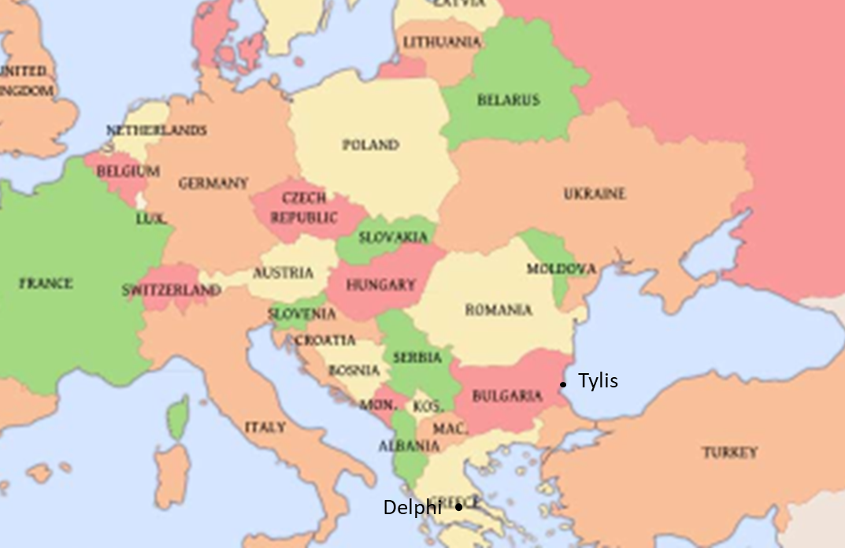
The survivors (victors?) left Delphi & headed north, where they founded a kingdom called Tylis. It rapidly became a robber kingdom, with its inhabitants blackmailing the other kingdoms around it. Not surprisingly, another kingdom, Thrace, destroyed it, and that was in 212 B.C. The march on Delphi was around 279 B.C., so you can see that the kingdom of Tylis didn’t last very long.
Thrace

Slide 13
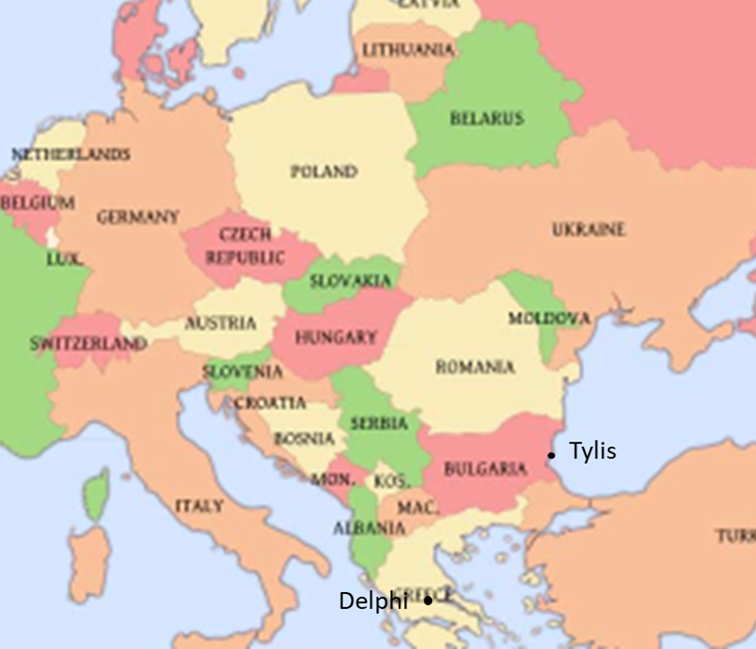
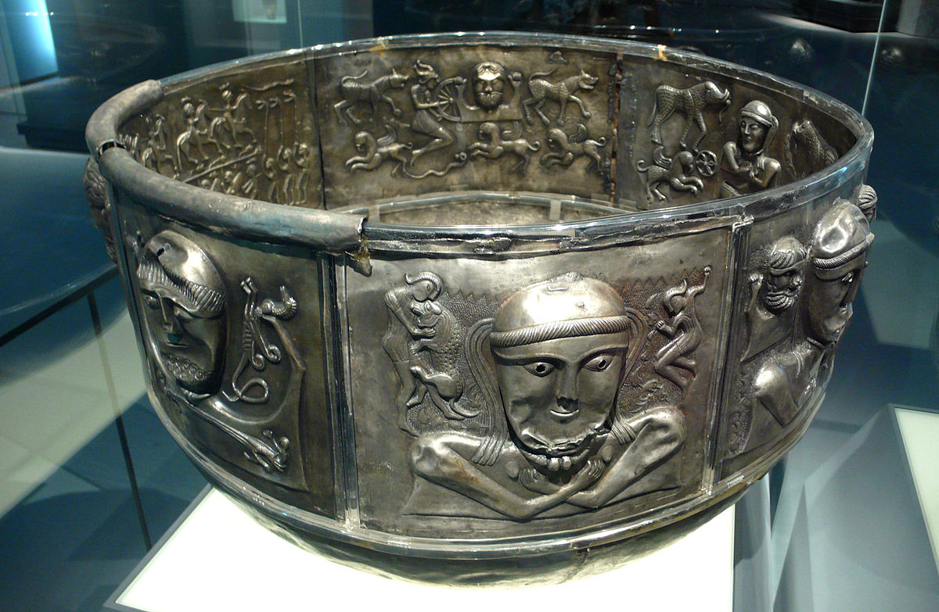
You can imagine that archeologists haven’t found much evidence of the Celtic presence in the area, since Tylis lasted such a
short time. One artifact of that brief period of time is famous among Celticists, however. A cauldron was found in Denmark,
which is, of course, quite far from ancient Thrace & Tylis. The Gundestrup (the town where it was found) Cauldron, as it is
known, is believed to be of Thracian construction, but its decoration is clearly Celtic. One theory is that a Celt put in an order
with a Thracian for the cauldron. It’s 97% pure silver. It’s dated between the 2nd & 1st century B.C., but if it truly is, as the
scholars believe, Celtic in design (and there’s actually no debate about that), it’s hard to imagine that it was made later than
212 B.C. But there are two schools of thought: that its workmanship is Thracian so that it therefore originated in Thrace, and
that it originated in Gaul. (That requires a longer explanation; please see http://www.unc.edu/celtic/catalogue/Gundestrup/kauldron.html if you’re interested.)
As you might imagine,
the question of how
the cauldron got to
Denmark is another
topic for debate.
There are several
theories discussed
in the article linked
above.
Denmark
Thrace

Slide 14
Let’s take a look at our map again:
There are very few modern-day countries on this map, which includes virtually the entire continent of Europe, that were not occupied by Celts at some point between 400 & 1 B.C. When we first become aware of them, they occupied Switzerland, Austria, Hungary, bit of Germany, and a large section of France, as well as edges of the countries east of Austria.

Slide 15
We’ve seen them march south & sack Rome; southeast to Greece; east to the Black Sea. Fortunately for Scandinavia, the Celts seemed to prefer warmer weather, because they aren’t done migrating & raiding yet.
.

Slide 16
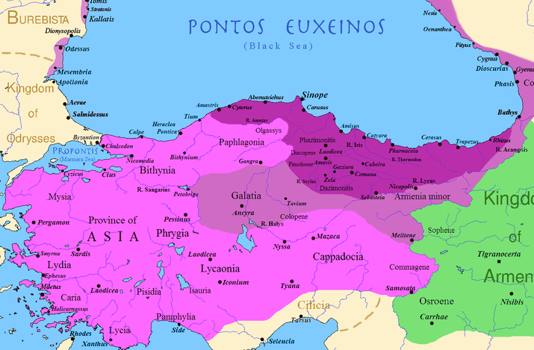
Remember the Celtic group that left Brennus in Macedonia to follow Leonorios and Lutorios? About half “were women, children and old folk, suggesting that they were migrants in search of land to settle and that the reason they had broken with Brennus was because he was more interested in plunder” (https://ebookcentral-proquest-com.proxygsu-gor1.galileo.usg.edu/lib/gordonstate/reader.action?docID=1733985&ppg=40). Around the time Brennus was fighting at Thermopylae, the L & L group was crossing from Thrace to Anatolia (the peninsula which is modern-day Asian Turkey), having received an invitation from King Nicomedes of Bithynia, who was willing to let them settle in his kingdom if the warriors would join his war against a King Antiochus.
Unfortunately, they never reached Bithynia, because Antiochus, who controlled most of the peninsula, fought & defeated the Celts before they could do so.
Picking themselves up, the Celts accepted an offer from King Mithridates I of Pontus (a region on the Black Sea coast) to settle in Phrygia in the west central part of Anatolia (i.e., Turkey). However, that region happened to belong not to him but to Antiochus, who’d already defeated these Celts once. But once the Celts had dug in their heels, Antiochus found it impossible to get rid of them. He was killed while fighting them, around 261 B.C.
Thrace
Pontus

Slide 17
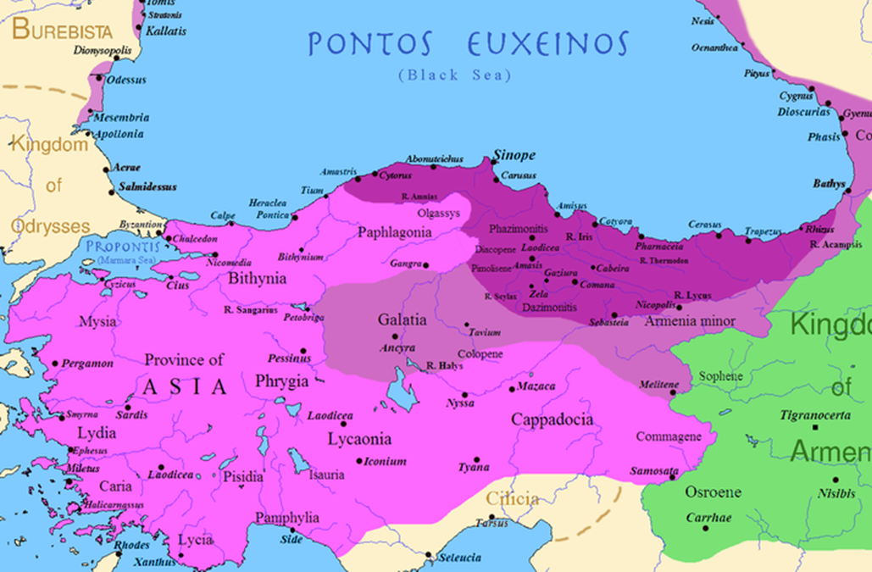
This Celtic settlement in modern-day Turkey is about to become more interesting to some of you. They named the city where the Celts settled after the Greek word for “Celts,” which was based on “Gaul,” which is, remember, part of the region where the Celts live when they show up in (pre-) history. That word is “Galatia.” Yes, the Galatians were Celts.
Some of you are thinking, “Wow!” A few of you are probably thinking, “So?” There’s a book in the Bible called “Galatians,” which is a collection of letters from Paul, a missionary, to the Galatians. Paul converted Celts to Christianity long before St. Patrick was even born (385 A.D.).
As far as we know, Galatia was the only Celtic
region in Asia. But apparently, they were
there for the long haul. They settled there,
remember, around 261 B.C. St. Jerome, in
the 4th century A.D., observed that the
Galatians & the Gauls spoke the same
language, so the Celts most likely still
occupied & ruled that region. Gordion is the
name of one site in Galatia that has been well
excavated, and evidence suggests that it
(Gordion, not necessarily all of Galatia) was
abandoned in the 2nd century A.D.

Slide 18
Back to the Celtic base in central Europe. Julius Caesar stated that the Helvetii, a tribe of Gauls, migrated in the first century B.C. because they occupied land between the Rhine River and the Alps (which means they were in modern-day Switzerland) and therefore had limited opportunities to make war with their neighbors. As we’ve seen, warriors were an elite class, so they weren’t the type that liked to stay home. War meant spoils but also prestige and honor. Haywood states that “if the opportunities for raiding were restricted for some reason, the competitive nature of warrior society might turn inwards” (https://ebookcentral-proquest-com.proxygsu-gor1.galileo.usg.edu/lib/gordonstate/reader.action?docID=1733985&ppg=1). In other words, if they didn’t have a common enemy, they might fight each other.
The Helvetii actually planned well for their migration. They spent two years storing up food, purchasing transportation needs, and negotiating with people through whose lands they would have to pass. The group purportedly included over 300,000 people, quite a high number for that time. As they packed up & headed for western Gaul, they burned their villages behind them, obviously having no intention of returning.
Unfortunately for them, Caesar, whose ambition was to conquer all of Gaul, met them with a large group of his forces to deny them entry into the area. The majority of Helvetii were killed. Those who survived limped back toward their homeland.

Slide 19
As was discussed in the first slide presentation, the Celtic societal structure was based on clans. There was never a central city, government, people…anything. As you might imagine, different Celtic clans & tribes would sometimes fight each other. And sometimes they would seek aid from non-Celtic neighbors. As Rome grew into an empire, a Celtic tribe would sometimes seek and/or accept help from Romans in their war with another Celtic tribe.
The jury is still out on whether this acceptance of Roman aid allowed for the eventual Roman defeat of the Celts. Rome was able to divide & conquer, since the Celts were not unified or centralized, but on the other hand, it was harder to conquer a people that was spread out & didn’t feel any allegiance to the tribes that were conquered. Rome actually spent two hundred years trying to subdue the Celtiberians, a fact that isn’t surprising if you remember the fierce resistance of Numancia, described in the first slide show.
Most of you had probably heard of Gaul before studying the Celts, even if you weren’t sure what it was & didn’t know the Gauls were Celts. That’s because Caesar’s conquer of Gaul shows up in literary as well as historical sources. Not to get bogged down in details, we’re simply going to acknowledge that Rome conquered Gaul. What we want to look at is what that conquest meant for the Gaulish Celts, as well as what the spread of the Roman empire meant for the Celts as a whole (although, admittedly, we’re no longer talking about migration, so consider the next slide parenthetical).

Slide 20
With constant contact & interaction with the growing Roman empire, parts of the Celtic world were becoming Romanized before any “official” conquest ever took place. In central Europe (which includes Gauls & other tribes), they “gradually adopted a Romanised material culture, while their role in local government encouraged them to learn Latin and worship the state gods. This last was made easier by the Roman custom of twinning their gods with local gods, for example, in the Celtic world, the thunder god Taranis with Jupiter” (https://ebookcentral-proquest-com.proxygsu-gor1.galileo.usg.edu/lib/gordonstate/reader.action?docID=1733985&ppg=40). Joining the Roman army was attractive to a people who had always considered the role of warrior to be an honorable one, and the military life of the army was Roman, its language Latin, so the army advanced the Romanization of the Celts.
There was a blending of DNA throughout the Roman Empire as Rome conquered & absorbed. (If you watch the “Star Trek” franchise, think about the Borg. They assimilated a great number of races, and all became Borg.) Romans who settled in any given location might never have actually been to Rome, & Latin might not have been their native language. But Latin was obviously the language of the empire, a prestige language, because today France (Gaul), Spain, & Italy speak what began as dialects of Latin & then became the languages spoken there today. The Celtic languages seem to have disappeared from the continent by the end of the first century A.D.
*Note: Prestige, when speaking of language, is of great significance. There were many more Celtic speakers than Latin speakers when Rome began its conquest, but, as its power & influence grew, Latin became important to the point that it replaced the local languages.

Slide 21
If now you are expecting to hear about the Celtic migration to Ireland, you’re going to be disappointed. Modern evidence suggests that they never migrated there.
What???? How did the Celts get to Ireland, Scotland, & Wales??
You’re going to have to wait a bit, because next on the agenda is the indigenous peoples of the islands.

