Slide 1
Imperfect and Preterit Illustrations

Slide 2
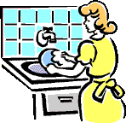
Las mujeres y la niña preparaban la comida y la madre lavaba los platos…
La chica se sentó.
…cuando una chica entró.
You see the girl appear. That’s preterit. You didn’t see the women start their actions; you just saw them ongoing, background actions to what you did see begin.
La chica se levantó.
La chica saltó por la ventana.

Slide 3
Now let’s do something a bit different. The ladies are still the background…
Las mujeres y la niña preparaban la comida y la madre lavaba los platos…
cuando una chica entró y se sentó.
So this is just like the last slide, right? And
if we want to talk about the TV, we’d just
add “La chica miró la tele” IF we ended
the story there. But what if something else
were to happen while the girl was watching television? In that case, the action of
watching television would be doing the same thing that the preparing food and
washing dishes were doing: serving as background information, setting the
scene, showing what’s going on when the new action begins.
La chica miraba la tele…
…cuando un chico entró y se cayó.

Slide 4
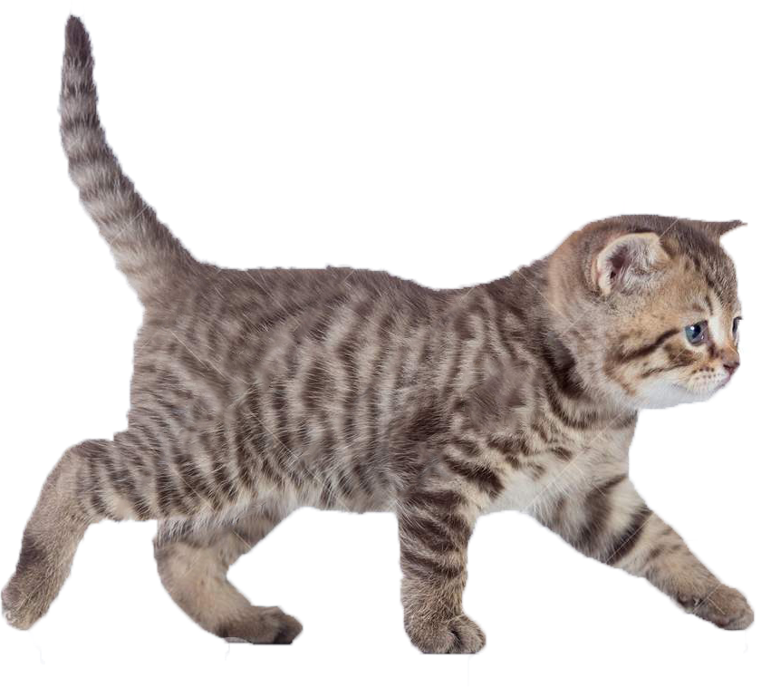
What was happening here? – El bebé lloraba y el gato comía…
…cuando un chico y una chica entraron. La chica pegó al chico.
El chico besó a la chica.
So against the backdrop of the crying
baby and the eating cat, we see a
boy and a girl enter, the girl slap the
boy, and the boy kiss the girl.
We could end the story there. But
maybe the girl decided she liked
the kiss. So it didn’t end but became
the background for another action.
Mientras el chico y la chica se besaban…
…el gato echó al bebé de la habitación.

