Slide 1

Pronouns

Slide 2
Pronouns stand in place of nouns. The pronouns we recognize the most easily are personal pronouns, because we use them in place of a person:
Rick doesn’t live here. HE lives next door.
Alexis likes to write. SHE has written 3 books.
Rick & Alexis are great people. I like THEM.
We don’t repeat nouns over & over. We wouldn’t say, “Rick doesn’t live here. Rick lives next door. I like Rick.” We say “Rick” the first time but use pronouns after that.
The same is true with things as well as people:
The book is interesting. It is set in Australia. I’m really enjoying it.
NOT
The book is interesting. The book is set in Australia. I’m really enjoying the book.

Slide 3
Personal Pronouns
I | we
you | you
he/she/it | they
me | us
you | you
him/her/it | them
There are 3 sets of personal pronouns. We won’t talk about how to use each set right now, but if you understand the concept of subject/object, you understand why there are two sets, anyway.
Let’s talk about the concept of “person.” We refer to pronouns (& verbs, but we’ll talk about that later) as 1st, 2nd, or 3rd person.
1st person is the person who’s speaking: I live here.
2nd is the person whom is being addressed: YOU are a student.
3rd person is the person about whom one is speaking: HE lives next door.
Besides person, we talk about NUMBER. There are 2 choices: SINGULAR & PLURAL.
If ONE person is speaking/addressed/spoken about, the pronoun is SINGULAR.
If TWO OR MORE persons are speaking, etc., the pronoun is PLURAL.
So I/me/myself are 1st person singular; they/them/themselves are 3rd person plural.
One more thing: “you” is both singular & plural, & for clarification, you will probably hear
me say “y’all.”

Slide 4
Identify the personal pronouns in the following selection from Jane Eyre.
There was no possibility of taking a walk that day. We had been wandering, indeed, in the leafless shrubbery an hour in the morning; but since dinner (Mrs. Reed, when there was no company, dined early) the cold winter wind had brought with it clouds so sombre, and a rain so penetrating, that further out-door exercise was now out of the question.
I was glad of it: I never liked long walks, especially on chilly afternoons: dreadful to me was the coming home in the raw twilight, with nipped fingers and toes, and a heart saddened by the chidings of Bessie, the nurse, and humbled by the consciousness of my physical inferiority to Eliza, John, and Georgiana Reed.
The said Eliza, John, and Georgiana were now clustered round their mama in the drawing-room: she lay reclined on a sofa by the fireside, and with her darlings about her (for the time neither quarrelling nor crying) looked perfectly happy. Me, she had dispensed from joining the group; saying, "She regretted to be under the necessity of keeping me at a distance; but that until she heard from Bessie, and could discover by her own observation, that I was endeavouring in good earnest to acquire a more sociable and childlike disposition, a more attractive and sprightly manner--something lighter, franker, more natural, as it were--she really must exclude me from privileges intended only for contented, happy, little children."

Slide 5
Be sure you’ve written your answers, because the answer key is next. If you did them just in your head, GO BACK AND DO THEM ON PAPER!!!!!
There was no possibility of taking a walk that day. We had been wandering, indeed, in the leafless shrubbery an hour in the morning; but since dinner (Mrs. Reed, when there was no company, dined early) the cold winter wind had brought with it clouds so sombre, and a rain so penetrating, that further out-door exercise was now out of the question.
I was glad of it: I never liked long walks, especially on chilly afternoons: dreadful to me was the coming home in the raw twilight, with nipped fingers and toes, and a heart saddened by the chidings of Bessie, the nurse, and humbled by the consciousness of my physical inferiority to Eliza, John, and Georgiana Reed.
The said Eliza, John, and Georgiana were now clustered round their mama in the drawing-room: she lay reclined on a sofa by the fireside, and with *her darlings about her (for the time neither quarrelling nor crying) looked perfectly happy. Me, she had dispensed from joining the group; saying, "She regretted to be under the necessity of keeping me at a distance; but that until she heard from Bessie, and could discover by *her own observation, that I was endeavouring in good earnest to acquire a more sociable and childlike disposition, a more attractive and sprightly manner--something lighter, franker, more natural, as it were--she really must exclude me from privileges intended only for contented, happy, little children.“
*These are not pronouns but possessive adjectives; see the slide on adjectives.

Slide 6
Possessive Pronouns
mine | ours
yours | yours
his/hers/its | theirs
Pronouns stand in place of nouns, remember. When we say, “John studies a lot. He is smart,” we use “he” instead of repeating “John.”
Consider the following sentences:
His car is broken, so we’re going to drive mine.
You’d better not spend all your money, because we won’t give you ours.
“Mine” stands in place of “my car”; “ours” stands in place of “our money.”
We call these “possessive pronouns” because they stand in place of a noun & show who is the possessor of some object (as in “car” & “money” above).
IMPORTANT: my, your, her, our, your, & their are NOT pronouns. They stand in front of a noun, not in place of it:
The car is mine (pronoun). – This is my car. (Not a pronoun, because it doesn’t replace a noun.)
“His” can go either way:
This car is his. – This is his car.

Slide 7
Identify all the possessive pronouns in the paragraph below.
Both my sister & I drive Hondas. Hers is a Fit; mine is a Civic. Her car is newer than mine, but mine is bigger than hers. My father says that hers looks like a roller skate. My father drives a Ford. My sister & I like our cars better than his. Ours get better gas mileage. My father thinks his car is more comfortable, but we think that paying less for gasoline is pretty comfortable.

Slide 8
Below are the answers. If you haven’t written them but just did them in your head, GO BACK & WRITE THEM!
Both my sister & I drive Hondas. Hers is a Fit; mine is a Civic. Her car is newer than mine, but mine is bigger than hers. My father says that hers looks like a roller skate. My father drives a Ford. My sister & I like our cars better than his. Ours get better gas mileage. My father thinks his car is more comfortable, but we think that paying less for gasoline is pretty comfortable.

Slide 9
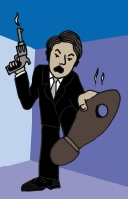
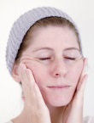
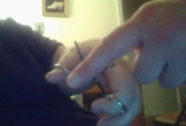
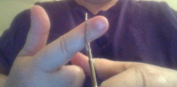
Reflexive/Intensive Pronouns
myself ourselves
yourself yourselves
himself/herself/itself themselves
*Note: there is no such word as “hisself” or “theirselves.”
These pronouns are used when the person has already been mentioned in the sentence:
I shot myself in the foot. – NOT I shot me in the foot.
You gave yourself a facial. – NOT You gave you a facial.
You can say either of these two sentences:
She cut herself with the scissors. ~ She cut her with the scissors.
But in the 2nd sentence, we’re talking about 2 different people. Using nouns, we’d rewrite the sentences like this:
Maddy cut herself with the scissors. ~ Maddy cut Emily with the scissors.
People seem to think that using “myself” in a compound subject “sounds better.” But it is incorrect:
*My brother, my sister, & myself are going to visit my parents.*
That is incorrect because 1st person (I/me/myself) hasn’t been mentioned yet. The sentence should be
My brother, my sister, & I are going to visit my parents.

Slide 10
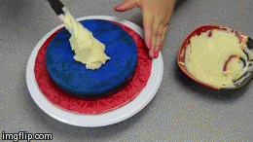
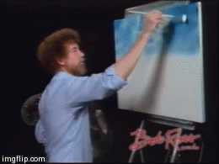
The pronouns with –self are usually called simply “reflexive pronouns.” But sometimes you hear them called “intensive pronouns” as well because they can also be used to intensify a previous noun or pronoun that refers to the same person:
I made the cake myself.
Tony himself did the painting.
In these cases, the sentence is perfectly correct even if you leave “myself” & “himself” out. What the pronouns do in this case is emphasize or intensify the first mention of the person.

Slide 11
Demonstrative Pronouns
Demonstrative pronouns are pronouns that show or point out. There are four:
this that
these those
“These” is the plural of “this”:
(Child touches toy/toys & says…) I want this. / I want these.
“Those” is the plural of “that”:
(Child points to toy/toys & says…) I want that./I want those.
Like some indefinites, demonstratives can stand in place of nouns (so that they’re pronouns) or in front of a noun (so that they’re adjectives):
These apples are sour. OR These are sour.
In the first sentence above, “these” is not a pronoun, because it comes in front of the noun; in the second, it replaces the noun & is therefore a pronoun.
*Note: In the singular, we tend to add “one” after the demonstrative:
I want this one, not that one.
In that case, “one” is the pronoun, & “this” & “that” are adjectives, not pronouns.

Slide 12
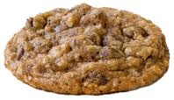
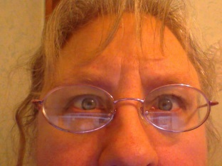
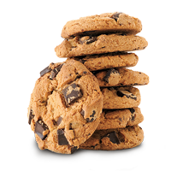
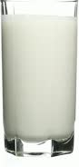
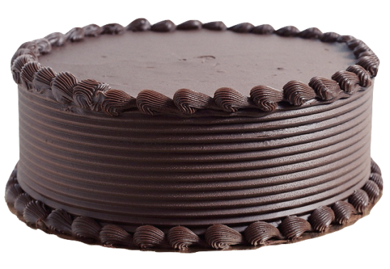

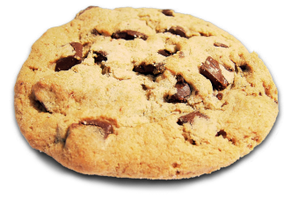
Identify all the demonstrative PRONOUNS (not adjectives).
If you want this cookie, you have to hand that cup
of coffee to me. On the other hand, if you want that one, I’ll be happy if you just don’t eat any of these in front
of me. I appreciate what you brought me, but I just don’t want to drink this right now. I’d rather save it for when I have that cake I bought yesterday. I want to have enough of that to share with my brother. Did you know that he’s coming to visit today?

Slide 13
Answers
If you want this cookie, you have to hand that cup of coffee to me. On the other hand, if you want that one, I’ll be happy if you just don’t eat any of these in front of me. I appreciate what you brought me, but I just don’t want to drink this right now. I’d rather save it for when I have that cake I bought yesterday. I want to have enough of that to share with my brother. Did you know that he’s coming to visit today?
All other occurrences of this/these/that/those stand in front of the noun (or the pronoun “one”), not in place of the noun, & are therefore NOT pronouns but rather adjectives. But there’s another exception. Look at the occurrence of “that” in the very last sentence above. It’s not a demonstrative pronoun OR adjective. It’s not standing in place of an object or describing an object; it’s not pointing to anything (as in “THAT cake”). We’ll discuss the way “that” is used in the last sentence when we get to the slide show on conjunctions.

Slide 14
Interrogative Pronouns
who whom whose what which
These seem pretty straightforward; they’re words we use to ask questions. But as always, you MUST remember that a pronoun stands in place of a noun. Like this/that/these/those, the interrogatives aren’t always pronouns.
What do you want?
Put it in statement form: You want what?
Now replace “what” with a noun: You want food.
But look at this sentence:
Which fruit do you want?
Statement: You want which fruit?
You can’t put a noun in place of “which” in the previous sentence:
You want apple fruit?
But you CAN do so In the sentence below:
Which do you want? – You want which? – You want the apple.
So in the first example, where “which” doesn’t have a noun after it, it’s a pronoun. In the second, when it’s followed by “fruit,” it’s NOT a pronoun. (It’s an adjective; adjectives are the next slide show in the series.)
For now, don’t worry about the difference between “who” & “whom.”

Slide 15
Identify the interrogative pronouns.
Have you ever spent much time with a 2 year old? They ask questions all the time: “Why is it raining?” “Who lives in that house?” “When are you getting married?” “Whose cat is that? And whose is that one?” No answer satisfies her, because it just makes her ask another question. I’m sure young people must frequently here, “What’s that thing in your nose?” I myself have questions about those things in my students’ noses. Which part of the body hurts most when it’s pierced?

Slide 16
Answers
Have you ever spent much time with a 2 year old? They ask questions all the time: “Why is it raining?” “Who lives in that house?” “When are you getting married?” “Whose cat is that? And whose is that one?” No answer satisfies her, because it just makes her ask another question. I’m sure young people must frequently here, “What’s that thing in your nose?” I myself have questions about those things in my students’ noses. Which part of the body hurts most when it’s pierced?
Note the use of the intensifier.
“Whose” & “which” in these cases are adjectives.
If you need a break, it may amuse you to click here & view a clip of Abbot & Costello’s “Who’s on First” sketch. It’s directly related to interrogative pronouns & a classic comedy sketch.

Slide 17
Indefinite Pronouns
I’ve saved the best for last. There are quite a few indefinite pronouns, & you need to learn to recognize them rather than memorize them.
Indefinite pronouns, unlike personal pronouns, don’t rename a definite person. Instead, they refer to an indefinite person or thing:
Anyone can blow a bubble. (as opposed to “Mary can … “ or “She can…”)
Nothing can make me cry. (as opposed to “Pain can…” or “It can…”
He needs help from someone. (as opposed to “…from Maddy” or “…from her.”)
In short, if it’s a word with “-one,” “-thing,” or “-body,” it’s an indefinite pronoun:
someone something somebody
anyone anything anybody
no one nothing nobody
everyone everything everybody
Other common indefinite pronouns are the following: all, another, any, each, few, many, one, several, some, more, most. Many of these can function as adjectives as well as pronouns. These are a bit different from those above; they replace a noun that was previously mentioned:
Many people like chocolate cake, but few (people) know how to make one (chocolate cake).
I’ve already eaten one slice of cake, but now I’d like another (slice).

Slide 18
Identify all the indefinite pronouns in the paragraph below.
My sister and I love going to Barcelona. We take a group of students every year, and there are usually some who have never flown before. My sister loves to take all of them hiking on a mountain called Montserrat. Most students enjoy going, & everyone always has a good time. Each student has to sign a statement saying that he agrees to follow the rules, which include being in class at 9:30 every morning. Several fail to realize that they need to take those rules seriously, but within a few days, every single one knows that I mean business.

Slide 19
The answers are below. If you didn’t write the answers to the previous exercise, go back & do so!
My sister and I love going to Barcelona. We take a group of students *every year, and there are usually some who have never flown before. My sister loves to take all of them hiking on a mountain called Montserrat. *Most students enjoy going, & everyone always has a good time. *Each student has to sign a statement saying that he agrees to follow the rules, which include being in class at 9:30 *every morning. Several fail to realize that they need to take those rules seriously, but within a few days, every single one knows that I mean business.
*These words are not standing in place of a noun; they are standing WITH (in front of) a noun. Since pronouns stand in place of nouns, these that stand with a noun are adjectives (see slide show on adjectives), not nouns.

Slide 20
Now here’s a tough one. It’s a poem called “anyone lived in a pretty how town.” If you aren’t familiar with e.e. cummings, it will seem strange. See if you can pick out all the indefinite pronouns.
anyone lived in a pretty how town
(with up so floating many bells down)
spring summer autumn winter
he sang his didn’t he danced his did.
Women and men(both little and small)
cared for anyone not at all
they sowed their isn’t they reaped their same
sun moon stars rain
children guessed(but only a few
and down they forgot as up they grew
autumn winter spring summer)
that noone loved him more by more
when by now and tree by leaf
she laughed his joy she cried his grief
bird by snow and stir by still
anyone’s any was all to her
someones married their everyones
laughed their cryings and did their dance
(sleep wake hope and then)they
said their nevers they slept their dream
stars rain sun moon
(and only the snow can begin to explain
how children are apt to forget to remember
with up so floating many bells down)
one day anyone died i guess
(and noone stooped to kiss his face)
busy folk buried them side by side
little by little and was by was
all by all and deep by deep
and more by more they dream their sleep
noone and anyone earth by april
wish by spirit and if by yes.
Women and men(both dong and ding)
summer autumn winter spring
reaped their sowing and went their came
sun moon stars rain

Slide 21
anyone lived in a pretty how town
(with up so floating many bells down)
spring summer autumn winter
he sang his didn’t he danced his did.
Women and men(both little and small)
cared for anyone not at all
they sowed their isn’t they reaped their same
sun moon stars rain
children guessed(but only a few
and down they forgot as up they grew
autumn winter spring summer)
that noone loved him more by more
when by now and tree by leaf
she laughed his joy she cried his grief
bird by snow and stir by still
*anyone’s any was all to her
someones married their everyones
laughed their cryings and did their dance
(sleep wake hope and then)they
said their nevers they slept their dream
stars rain sun moon
(and only the snow can begin to explain
how children are apt to forget to remember
with up so floating many bells down)
one day anyone died i guess
(and noone stooped to kiss his face)
busy folk buried them side by side
little by little and was by was
all by all and deep by deep
and more by more they dream their sleep
noone and anyone earth by april
wish by spirit and if by yes.
Women and men(both dong and ding)
summer autumn winter spring
reaped their sowing and went their came
sun moon stars rain
*This would be an indefinite pronoun if it weren’t for the apostrophe + s.

Slide 22
Pronoun or Adjective?
You need to remember that several words can be an adjective (which stands in front of a noun) or a pronoun (which stands in place of a noun) .
All demonstratives can be either:
I want these grapes; she wants those.
His:
I want his milkshake. ~ You have your own; you don’t need his.
Whose, which, what:
Whose car is this? ~ I don’t know. Whose is that car?
Which car do you want? ~ I don’t know; which do you want?
What kind of guy do you like? ~ None. What do you want to do now?
A number of indefinites:
Few people live here. ~ Few live here.
Some people live here. ~ Some live here.
Several people live here. ~ Several live here.
There are more indefinites like this. ~ There are more.

Slide 23
If you click HERE, you’ll go to an interactive exercise that will allow you to practice the difference between adjectives & pronouns.
You may think it’s not opening, but you have to get out of the Power Point to see it, usually. Be sure to come back to the slide show!!!!!

Slide 24
Relative Pronouns
who whom whose which that
I’m including a mention of these here because they’re pronouns, but they won’t make sense to you until we do clauses.

Slide 25
And that’s it! About time, right? As far as this unit on parts of speech is concerned, this presentation on pronouns is by far the longest & most involved.
But you need to PRACTICE. For that reason, I’m including a bunch of them. I hope you’ve taken this slide show a bit at a time, since it’s so long, & you definitely can’t do the exercises with a fatigued brain. Take a break if necessary, & don’t do all the exercises at once if it’s too tiring for you. But please do them all.

Slide 26
A couple of things to note on the next set of exercises:
Relative pronouns are included, but you should know by now when who/whom/whose/which/that/ are pronouns & when they’re not.
Two mistakes:
1. “his & her own shoes”—for some reason, it marks “his” & “her” as pronouns when they’re standing in front of “shoes,” not in place of “shoes.”
At one point, it fails to mark “I” as a pronoun, which, of course, it is.
After a while, some of the sentences are repeated in each new set of sentences. When you start seeing so much of that that it drives you crazy, stop & go on to the NEXT set of questions, which I made.

Slide 27
http://www.esldesk.com/grammar/practice/identify-pronoun
Exercise I wrote

